Slide 1
Flexible framework for P2P applications
Martin Evans,
Supervisor Rachid Anane

Slide 2
Motivation
Client/server architectures are easier to program than P2P
  Many frameworks
  Conceptually simpler
Drawbacks
  Scale
  Robustness

Slide 3
P2P
Structured
  Nodes are organised into a specific structure
  Any peer can infer what another peer knows based on its position within the structure
Unstructured
  Nodes are arranged more “chaotically”
  The existence of a peer is obscured to any peer other than its direct neighbours
My system is a structured network
  More universally applicable

Slide 4
Distributed Hash Table
A DHT provides normal hashtable semantics (Key -> Value) in a distributed environment
A value may be put onto any peer
Any peer may retrieve a value if it knows the key
This is bad software engineering
  “Do one thing and do it well”

Slide 5
Distributed Service Provider
DSP provides the first function of a DHT
  Key -> Peer
The second function is left undefined
  Peer -> Value
The system is far more flexible
  Any kind of imaginable Peer -> Value mapping can be implemented
    Data Storage
    Video Casting
    Distributed Data Processing
    Anonymous Communications
DSP functionality is a superset of DHT functionality

Slide 6
Kademlia

Slide 7
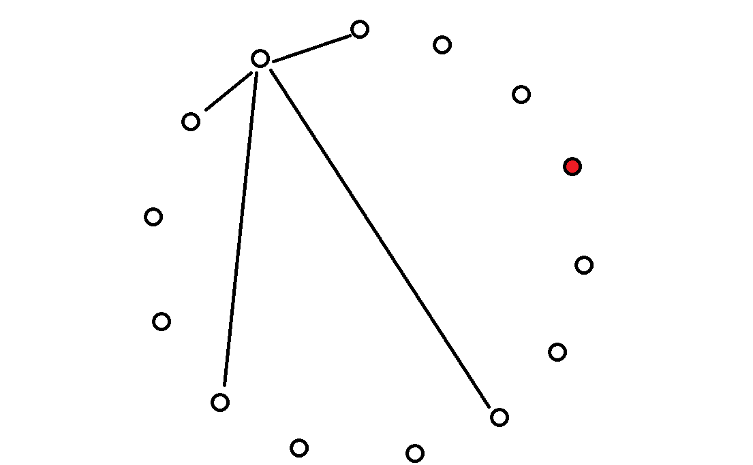

Slide 8
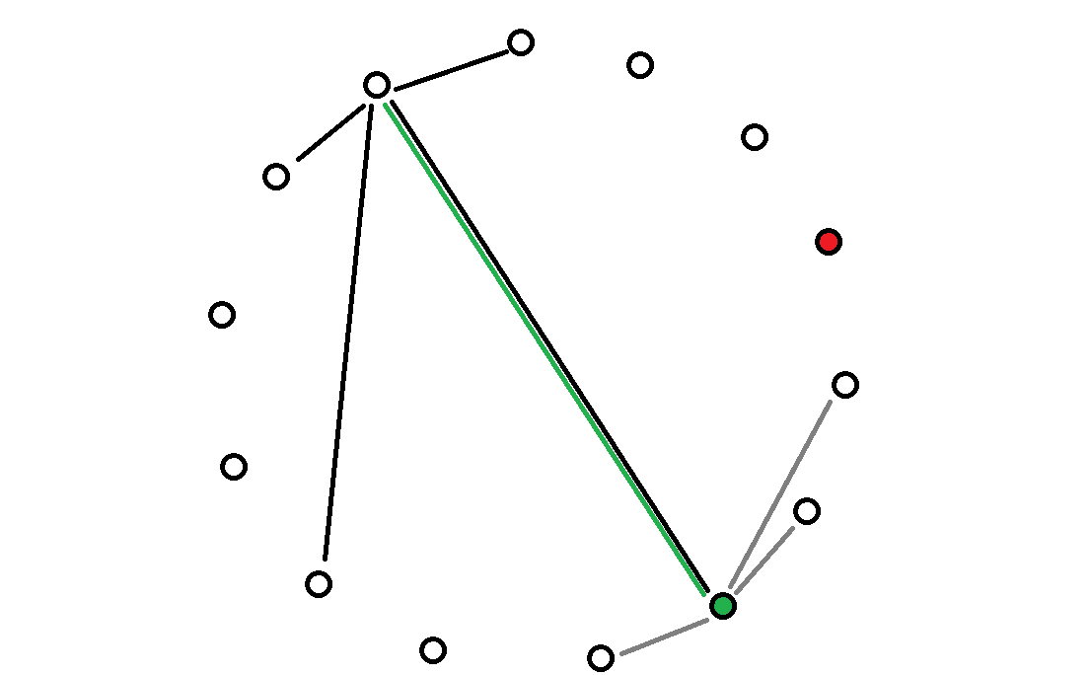

Slide 9
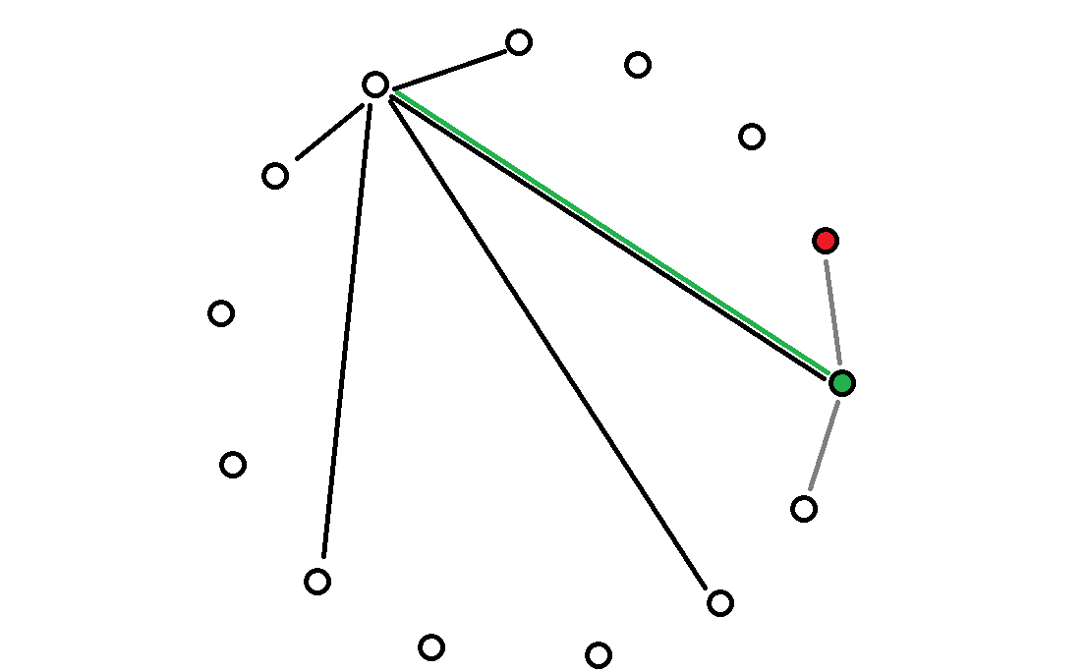

Slide 10
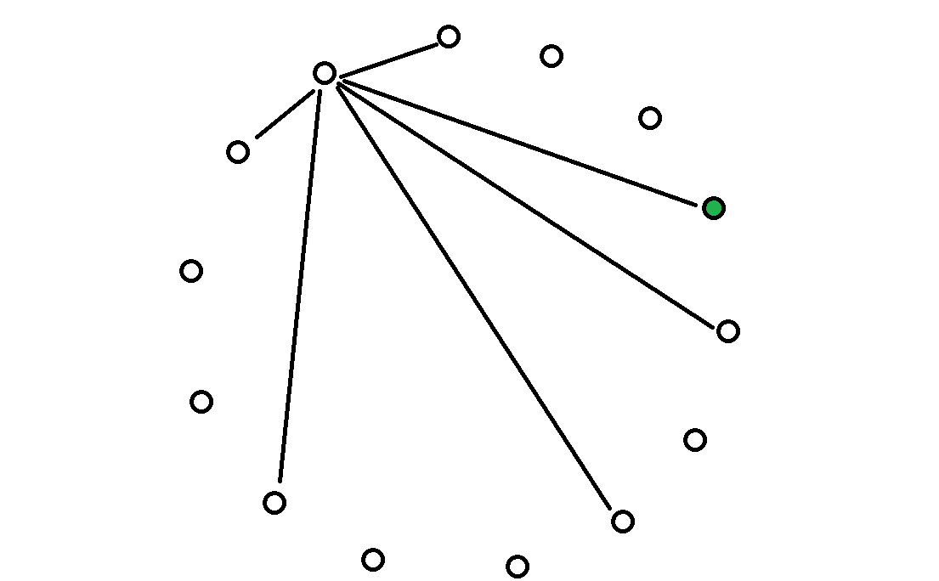

Slide 11
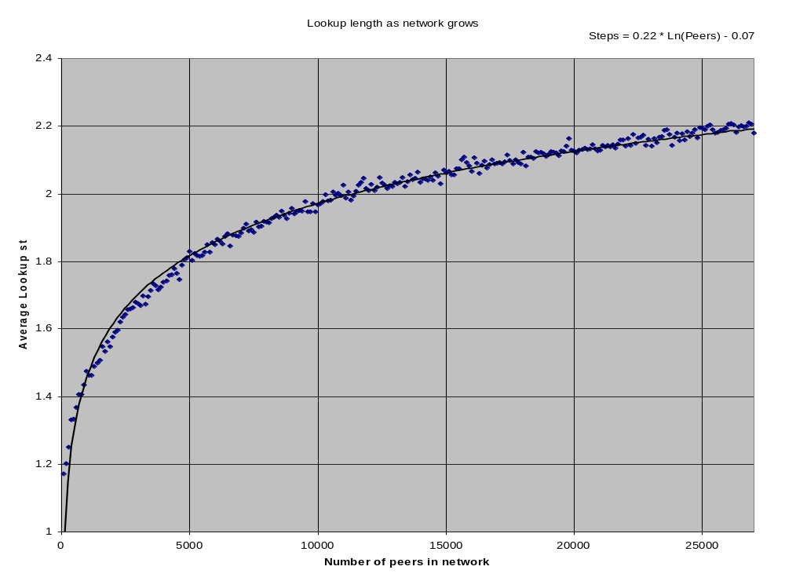

Slide 12
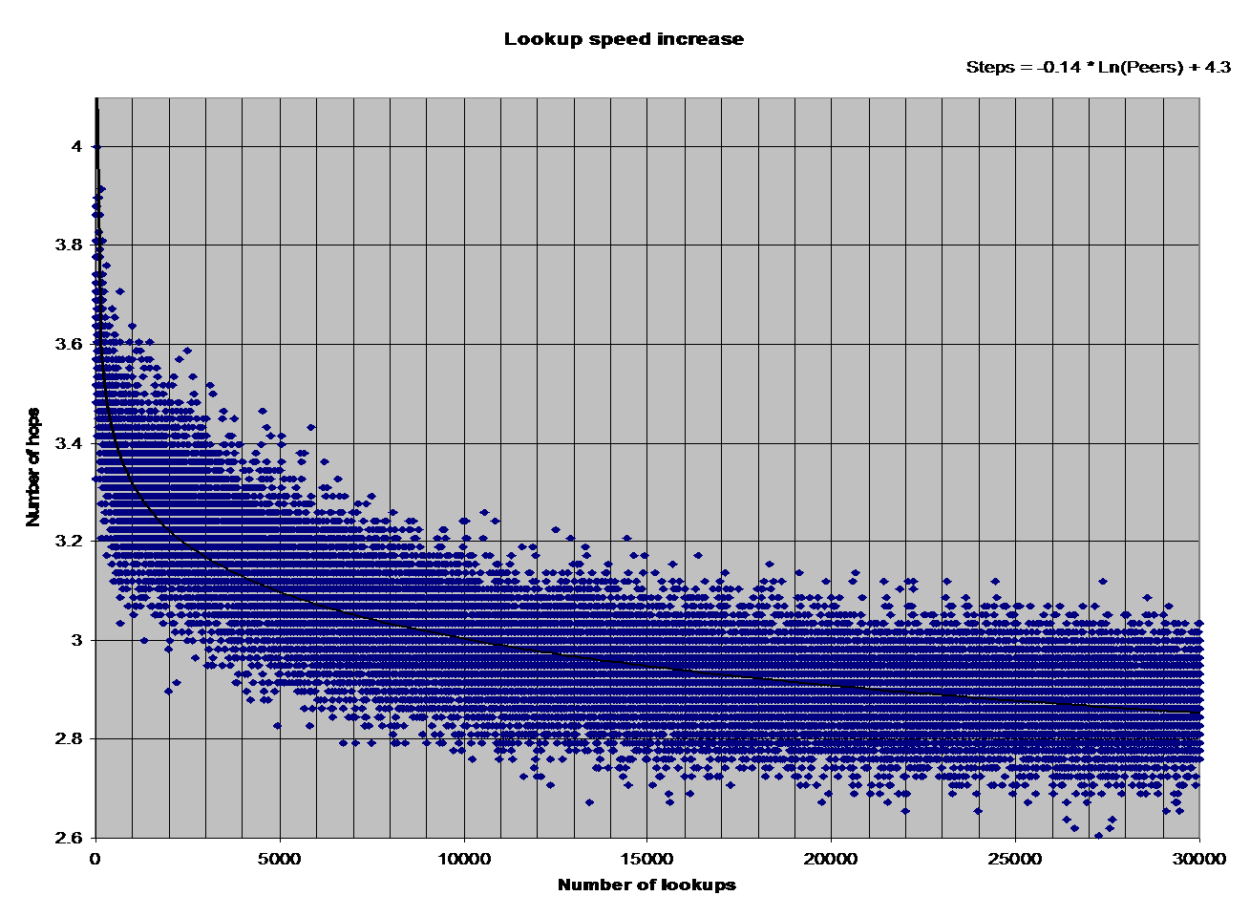

Slide 13
DSP: Extensible Architecture
Functionality within DSP is provided through an extensible “plug-in” architecture
All services are registered to the core routing table
Packets are automatically routed to the correct service
Services can build upon other services to provide very powerful services with simple and modular code

Slide 14
Proof of concept
Extensible Storage
  Normal DHT style storage
  (Secure)
  Reliable
Map/Reduce
  Scalable, p2p, “google style” data processing
  Manage a global data processing system
  Distributed Quicksort
peerTube
  Infinitely scalable live video casting
  Empower a single person to reach an unlimited number of people

Slide 15
Extensible Storage
Erasure Coding Service
Reliable
Digital Signing Service
Secure
Key/Value Store
Unreliable & Insecure

Slide 16
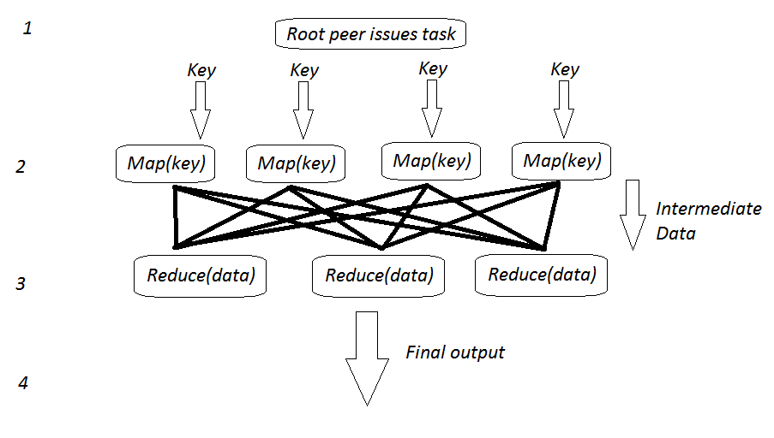
Map/Reduce

Slide 17
peerTube
Broadcaster
Consumer
Consumer
Consumer
Consumer
Consumer
Consumer
Consumer

