Slide 1

Encoding GeoJSON Geometries in TEI
Martin Holmes
Martin Holmes
University of Victoria Humanities Computing and Media Centre

Slide 2
Outline
What are GeoJSON geometries?
GeoJSON geometries in <geo>
Maps versus facsimiles
Proposals for <zone>

Slide 3
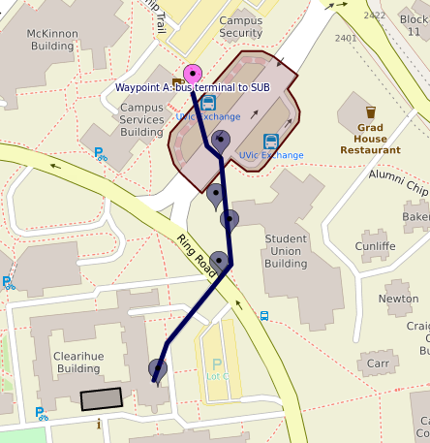


Geometries
Point
LineString
Polygon

Slide 4
Geometries in GeoJSON:
Point
{"type": "Feature", "geometry":{"type":"Point","coordinates":[-123.308834,48.463699]}}

Slide 5
Geometries in GeoJSON:
LineString
{"type": "Feature", "geometry":{"type":"LineString","coordinates":[[-123.308824,48.463705],[-123.308929,48.463696],[-123.308917,48.463631],[-123.30959,48.463585],[-123.309719,48.463626]]}}

Slide 6
Geometries in GeoJSON:
Polygon
{"type": "Feature", "geometry":{"type":"Polygon","coordinates":[[[-123.308914,48.463685],[-123.308899,48.463614],[-123.30873,48.463625],[-123.30874,48.463698],[-123.308914,48.463685]]]}}

Slide 7



More complex geometries
MultiPoint
MultiLineString
MultiPolygon
MultiGeometry

Slide 8
TEI <geo>
<geoDecl xml:id="WGS" datum="WGS84">World
Geodetic System</geoDecl>
<!-- ... -->
<location>
<desc>A tombstone plus six lines of Anglo-Saxon
text, built into the west tower (on the south
side of the archway, at 8 ft. above the
ground) of the Church of St. Mary-le-
Wigford in Lincoln.</desc>
<geo decls="#WGS">53.226658 -0.541254</geo>
</location>

Slide 9
TEI <geo> with GeoJSON
<geoDecl xml:id="GJ">GeoJSON</geoDecl>
<!-- ... -->
<location>
<desc>A tombstone plus six lines of Anglo-Saxon
text, built into the west tower (on the south side of the archway, at 8 ft. above the
ground) of the Church of St. Mary-le-Wigford
in Lincoln.</desc>
<geo decls="#GJ">
"geometry":
{"type":"Point",
"coordinates": [-0.541254,53.226658]}
</geo>
</location>

Slide 10
<quote>
For geographic information, suitable non-TEI vocabularies include:
the OpenGIS Geography Markup Language (GML) being defined by the OGC51
the Keyhole Markup Language (KML) used by Google Maps52
</quote>
So why not GeoJSON?

Slide 11
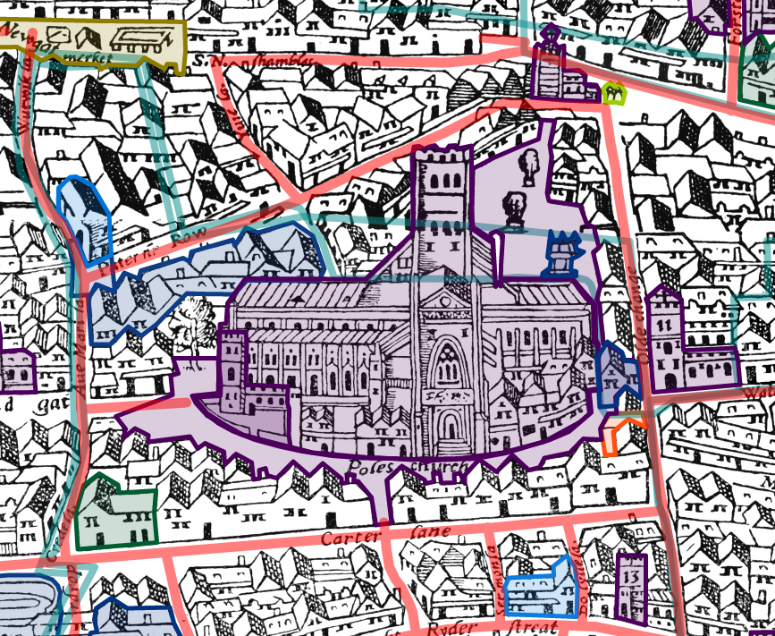
Maps versus facsimiles
https://mapoflondon.uvic.ca/agas.htm

Slide 12
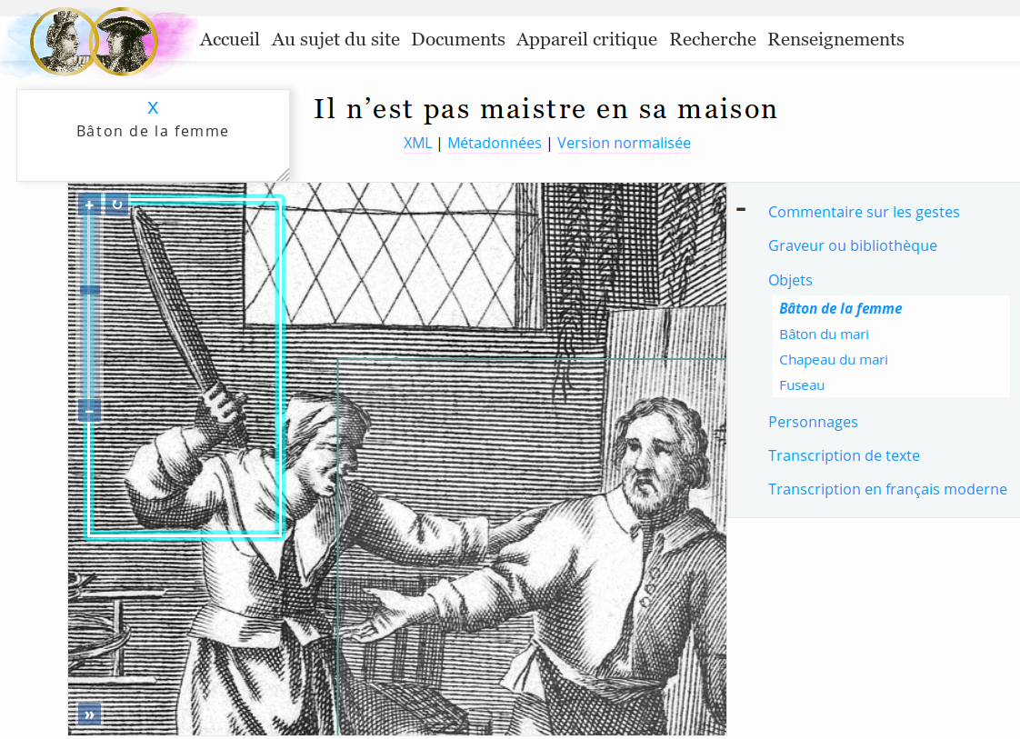
Maps versus facsimiles
https://mariage.uvic.ca/il_nest_pas_maistre.html

Slide 13
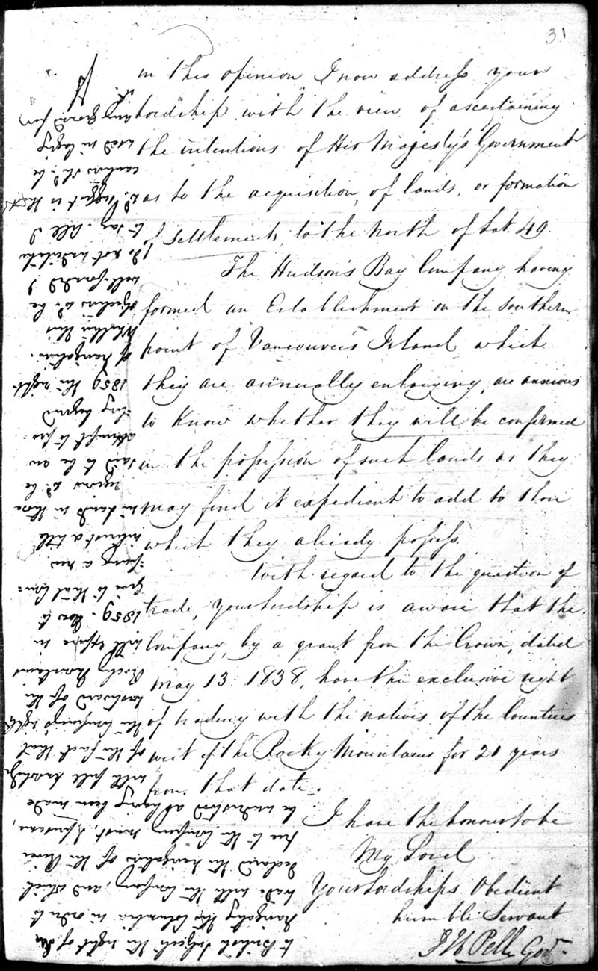
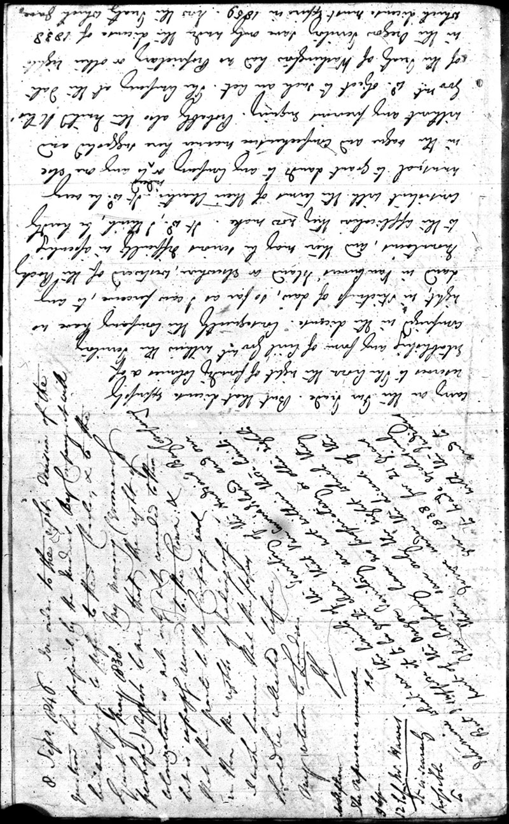

Slide 14
The evolution of <zone>

Slide 15
The evolution of <zone>
Originally <zone>s were rectangles. It wasn’t enough.

Slide 16
The evolution of <zone>
Originally <zone>s were rectangles. It wasn’t enough.
Then with @points, <zone>s were polygons. It wasn’t enough.

Slide 17
The evolution of <zone>
Originally <zone>s were rectangles. It wasn’t enough.
Then with @points, <zone>s were polygons. It wasn’t enough.
Soon, with <path>, we will have LineStrings. It isn’t enough.

Slide 18
The evolution of <zone>
Originally <zone>s were rectangles. It wasn’t enough.
Then with @points, <zone>s were polygons. It wasn’t enough.
Soon, with <path>, we will have LineStrings. It isn’t enough.
We must haz all the geometries!

Slide 19
But this is not GEO!
Correct. WGS84 geo coordinates are not the same thing as pixel offsets on a 2D surface.
BUT the requirement to be able to define complex geometries is the same.
AND the same mechanisms and tools work for parsing and drawing these shapes.

