Slide 1
CodeSharing
CodeSharing:
a simple API for disseminating
our TEI encoding
Martin Holmes
University of Victoria
Notes:
Abstract:
Although the TEI Guidelines are full of helpful examples, and other inititatives such as TEI By Example have made great progress in providing more access to samples of text-encoding to help beginners get started, there is no doubt that one of the biggest obstacles to encoders at many levels is finding out how other scholars and projects have chosen to encode a particular feature or use a specific tag or attribute. Many projects now share their XML code, but that in itself is only marginally helpful; it can take substantial time to sift through the XML code in a large project to find what you're looking for. At the same time, many other projects do not provide any access to their XML encoding.
This talk presents a simple specification for an Application Programming Interface, along with a sample implementation written in XQuery and designed for the eXist XML database, providing straightforward access both for applications and end-users to sample code from any TEI project. The API is modelled on the Open Archives Inititative Protocol for Metadata Harvesting (OAI-PMH), a mechanism designed to allow archival search tools to ingest metadata from repositories.

Slide 2
The need
We have TEI By Example, we have the TEI Guidelines, we have the TEI Wiki, we have Cheatsheets...and yet...
...you can never find enough good examples of how to encode what it is you actually want to encode.
Two audiences:
  Novice encoders
  Researchers into encoding practices

Slide 3
Novice encoders...
...most often need to search the documents in their own project
...are not keen on this sort of thing:
//div[@type='chapter']
...and especially not on this:
<div\s+[^>]+type="\s*chapter\s*"[^>]+>

Slide 4
Novice encoders
May not have read access to the full repository
Need easy access to example encoding
Have no XPath or XQuery skills
Find regular expressions overwhelmingly difficult
Find the Guidelines intimidating and Guidelines examples often not directly relevant.

Slide 5
Researchers into encoding practices
TEI Council: "Before we make a decision on this, we should find out what people actually do when they use <thing>."
We ask on TEI-L.
We look at projects we know (although most do not share their XML).
We end up with unrepresentative samples.

Slide 6
Lou Burnard to TEI-L:
I've been asked by the TEI Council to CONSULT THE COMMUNITY about how the @corresp attribute is used, if indeed it is. The Guidelines are, to be fair, a bit vague on this particular topic ("indicates correspondence of any kind") so it is possible that divergent practices have developed, but my view is that the intention was to use this attribute for correspondence in the strict mathematical sense; others think it can be used to indicate any kind of association. So, for me (for example) if a corresponds to b, then b corresponds to a; this is consistent with the example in the Guidelines showing @corresp being used to indicate translation equivalence, but not with the practice (of which earlier versions of P5 were -- I shamefacedly confess -- guilty) of using it to associate a quotation with a bibliographic reference providing its source. However the point of this enquiry is not to beat the argument to death (this has already been done on the TEI Council list) but rather to ask
DO YOU USE @CORRESP?
IF SO, FOR WHAT? (please supply an example or two!)
Notes:
Lou received 12 responses on-list; some gave one or two examples, others gave some usage statistics from their projects, and a few responses were discussions of the issue and examples submitted.

Slide 7
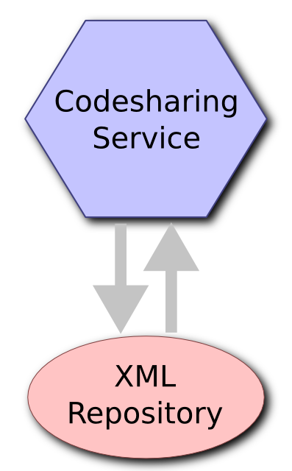
The basic idea

Slide 8
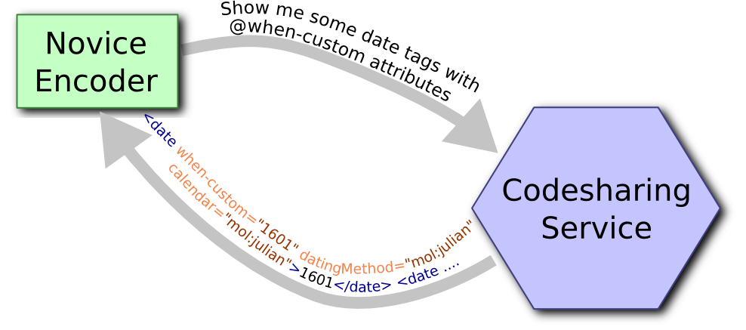
The basic idea

Slide 9
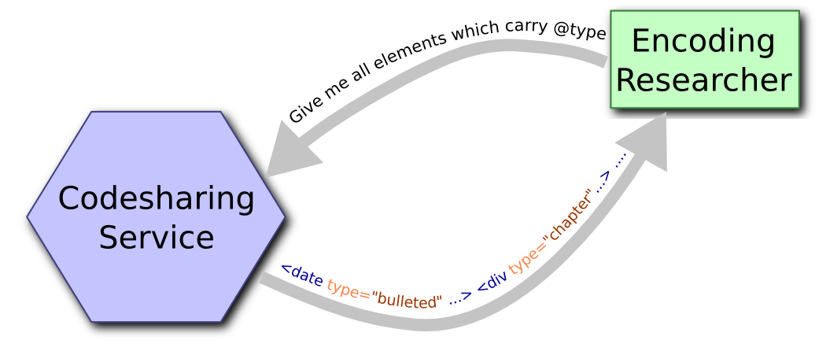
The basic idea

Slide 10
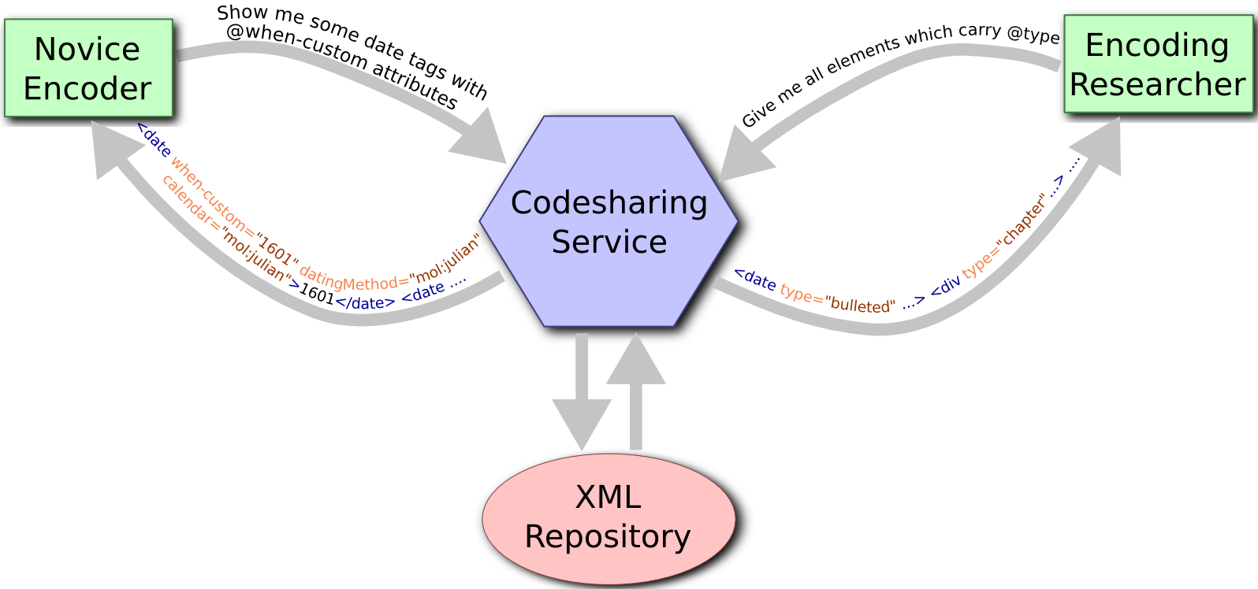
The basic idea

Slide 11
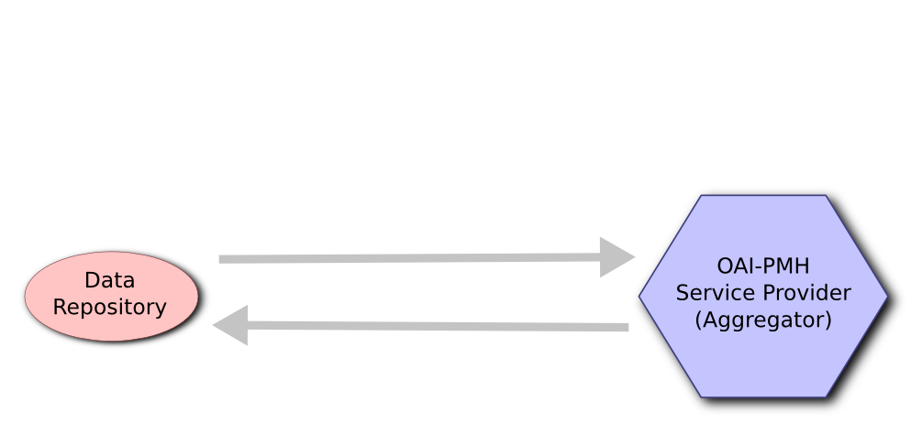
The model: OAI-PMH
The Open Archives Initiative
Protocol for Metadata Harvesting

Slide 12
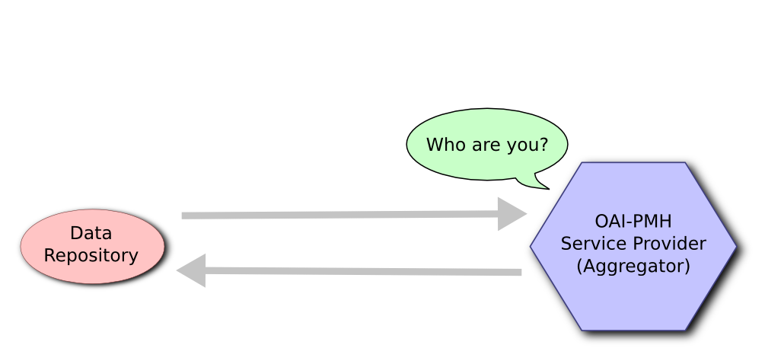
The model: OAI-PMH

Slide 13
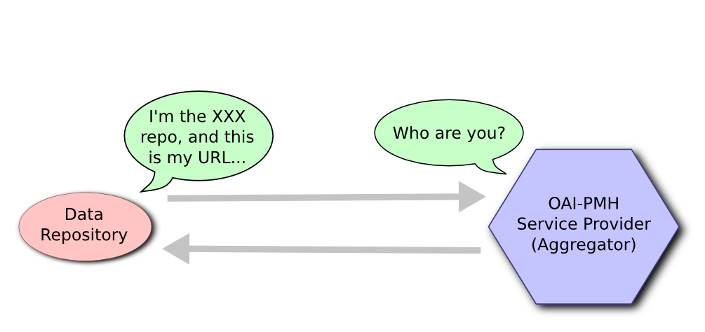
The model: OAI-PMH

Slide 14
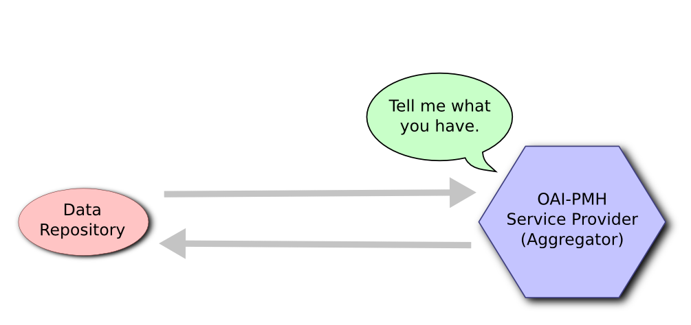
The model: OAI-PMH

Slide 15
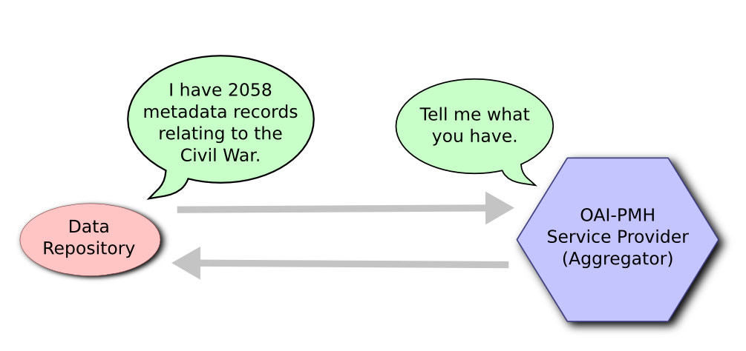
The model: OAI-PMH

Slide 16

The model: OAI-PMH

Slide 17
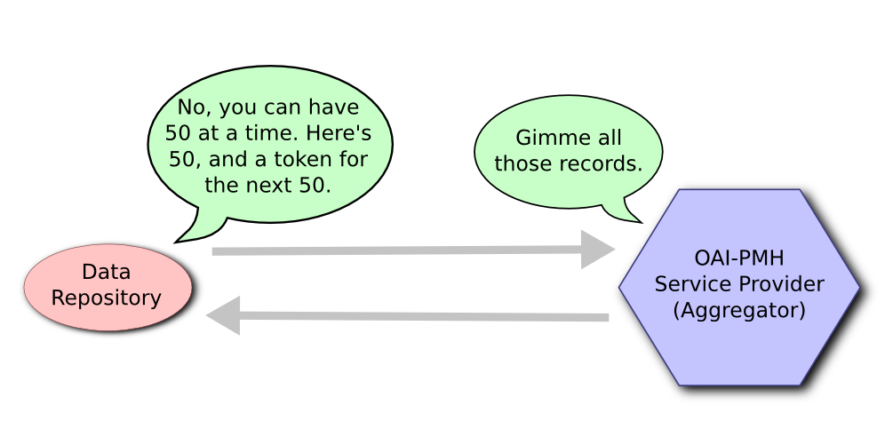
The model: OAI-PMH

Slide 18
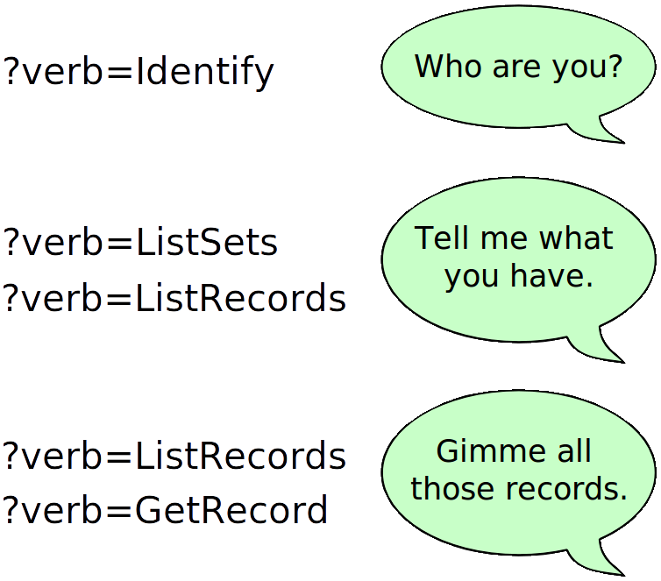
The model: OAI-PMH

Slide 19
The model: OAI-PMH
?verb=
Identify
ListMetadataFormats
ListIdentifiers
ListSets
ListRecords
GetRecord
http://bcgenesis.uvic.ca/oai.xq?verb=Identify

Slide 20
The model: OAI-PMH
http://bcgenesis.uvic.ca/oai.xq?verb=ListRecords&metadataPrefix=oai_dc
Resumption token:
<resumptionToken completeListSize="7154">
from:2010-01-01;until:2020-01-01;set:;next:21
</resumptionToken>

Slide 21
The nitty-gritty of CodeSharing
codesharing?verb=
identify
listElements
listAttributes
listNamespaces
getExamples

Slide 22
The nitty-gritty of CodeSharing
codesharing?verb=getExamples
&elementName=
&attributeName=
&attributeValue=
&namespace=
&wrapped=
&maxItemsPerPage=

Slide 23
The nitty-gritty of CodeSharing
codesharing?verb=getExamples
&elementName=title
&attributeName=level
&attributeValue=m
&wrapped=true
&maxItemsPerPage=100

Slide 24
The nitty-gritty of CodeSharing
Response:
  a TEI XML file
  results in the <body>
  settings and resumption URIs in the <front>
http://mapoflondon.uvic.ca/codesharing?verb=listElements
http://mapoflondon.uvic.ca/codesharing?verb=listAttributes
http:...?verb=getExamples&elementName=date

Slide 25
A sample implementation
The sample implementation is running here:
http://mapoflondon.uvic.ca/codesharing
There is a human-friendly interface here:
http://mapoflondon.uvic.ca/codesharing.htm

Slide 26

Imagining a harvester

Slide 27
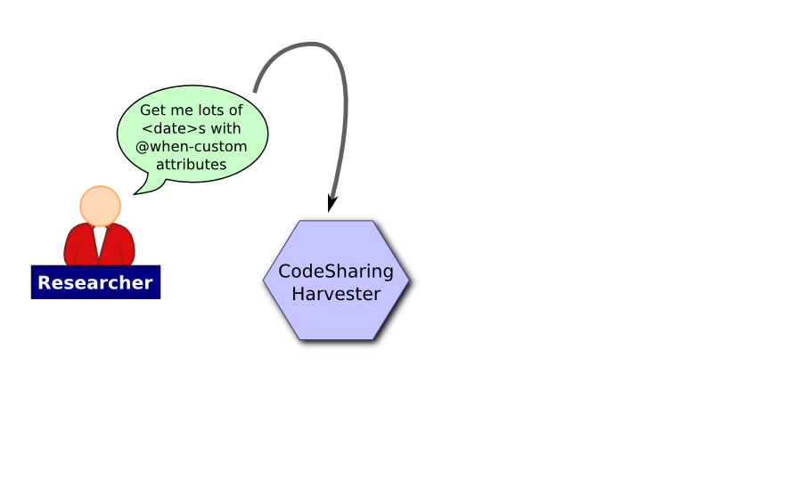
Imagining a harvester

Slide 28
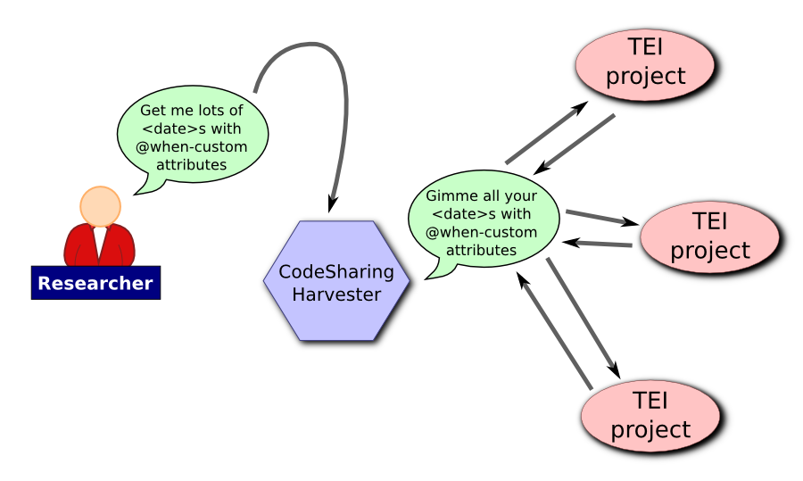
Imagining a harvester

Slide 29
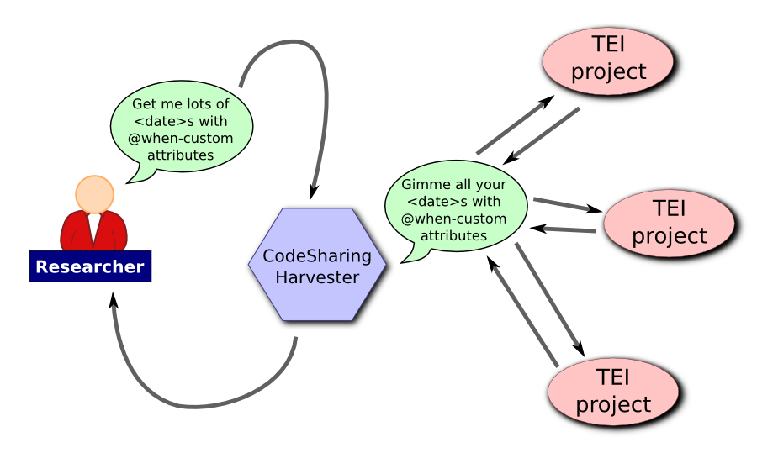
Imagining a harvester

Slide 30
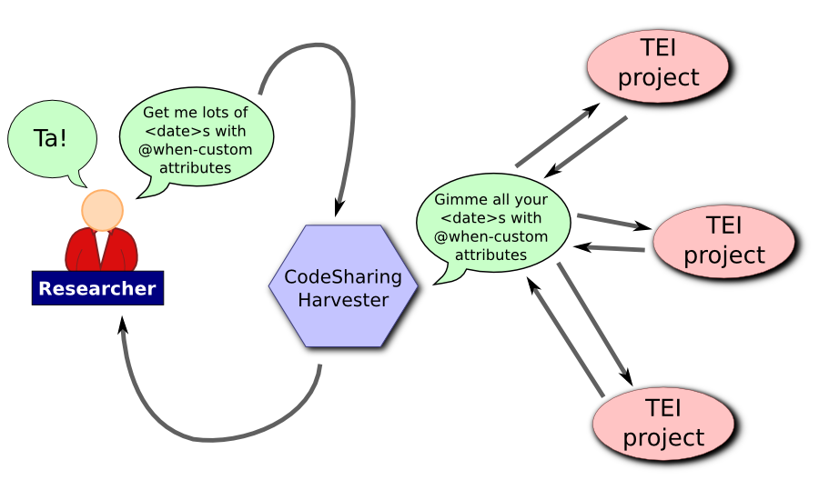
Imagining a harvester

Slide 31
The state of play
Working implementation of the repository side in XQuery 3.0 for eXist
Port of that for XQuery 1.0 for older versions of eXist
Working XSLT for the human-friendly interface
Complete semi-formal specification for the protocol
BUT no work on a harvester yet.

Slide 32
The future: implementation
Implementations in more projects using eXist.
Listing of projects providing CodeSharing on the TEI wiki.
Ports to other frameworks (BaseX; pure Saxon XSLT; PHP with Zorba...).
Creation of a harvester application.
Response compression?
XPath support?

Slide 33
Where to find it
Current specification:
http://mapoflondon.uvic.ca/codesharing_protocol.xhtml
Calling potential collaborators!
ALL YOUR TEI ARE BELONG TO US!

