Slide 1
XSLT Step-by-step
Remember, the input XML file is a tree. (So is the XSLT stylesheet and probably the output, too.)
When stripped down to basics, an XSLT stylesheet is a root <xsl:styleheet> element with a series of templates (each encoded as an <xsl:template>).
Each <xsl:template> is a child of <xsl:stylesheet>; templates do not nest!
With few exceptions, nothing else is a child of <xsl:stylesheet>.

Slide 2
Birds-eye-view

Slide 3
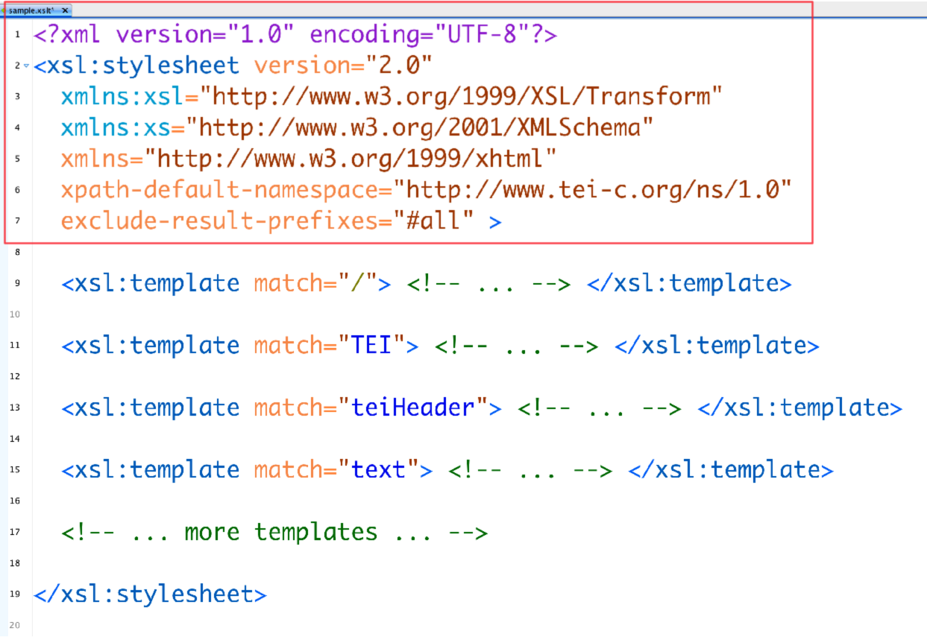
Housekeeping

Slide 4
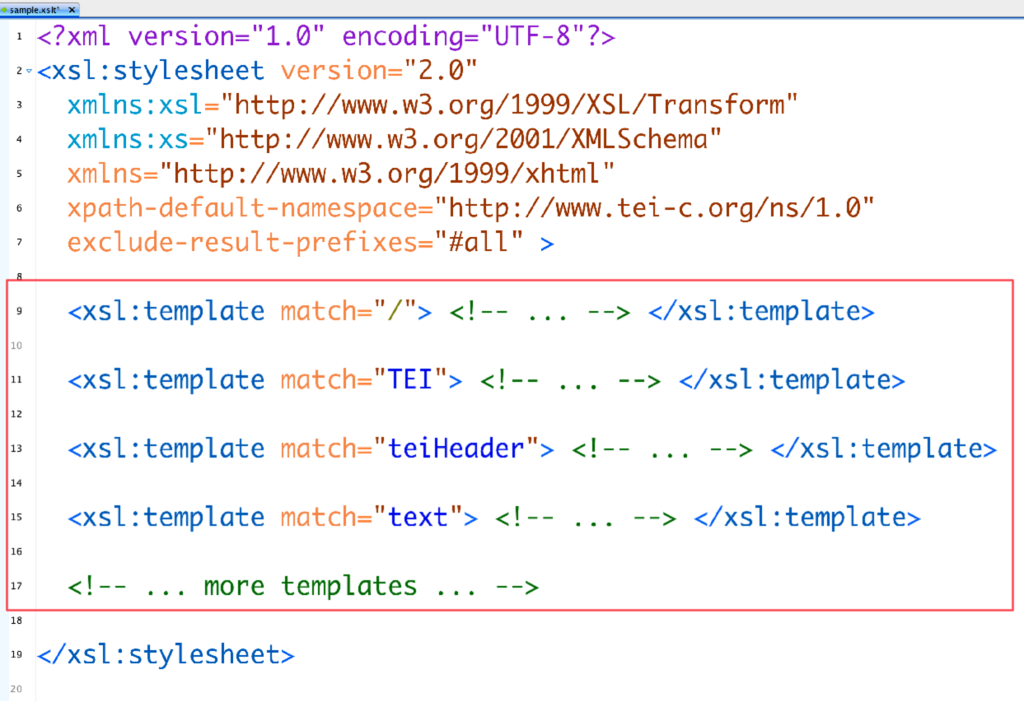
Templates

Slide 5
a template …
an xsl:template …
is “A generic model or pattern from which other objects are based or derived.”
— Wiktionary, 2015-10-25
is a generic model or pattern of XML from which the output is derived.

Slide 6
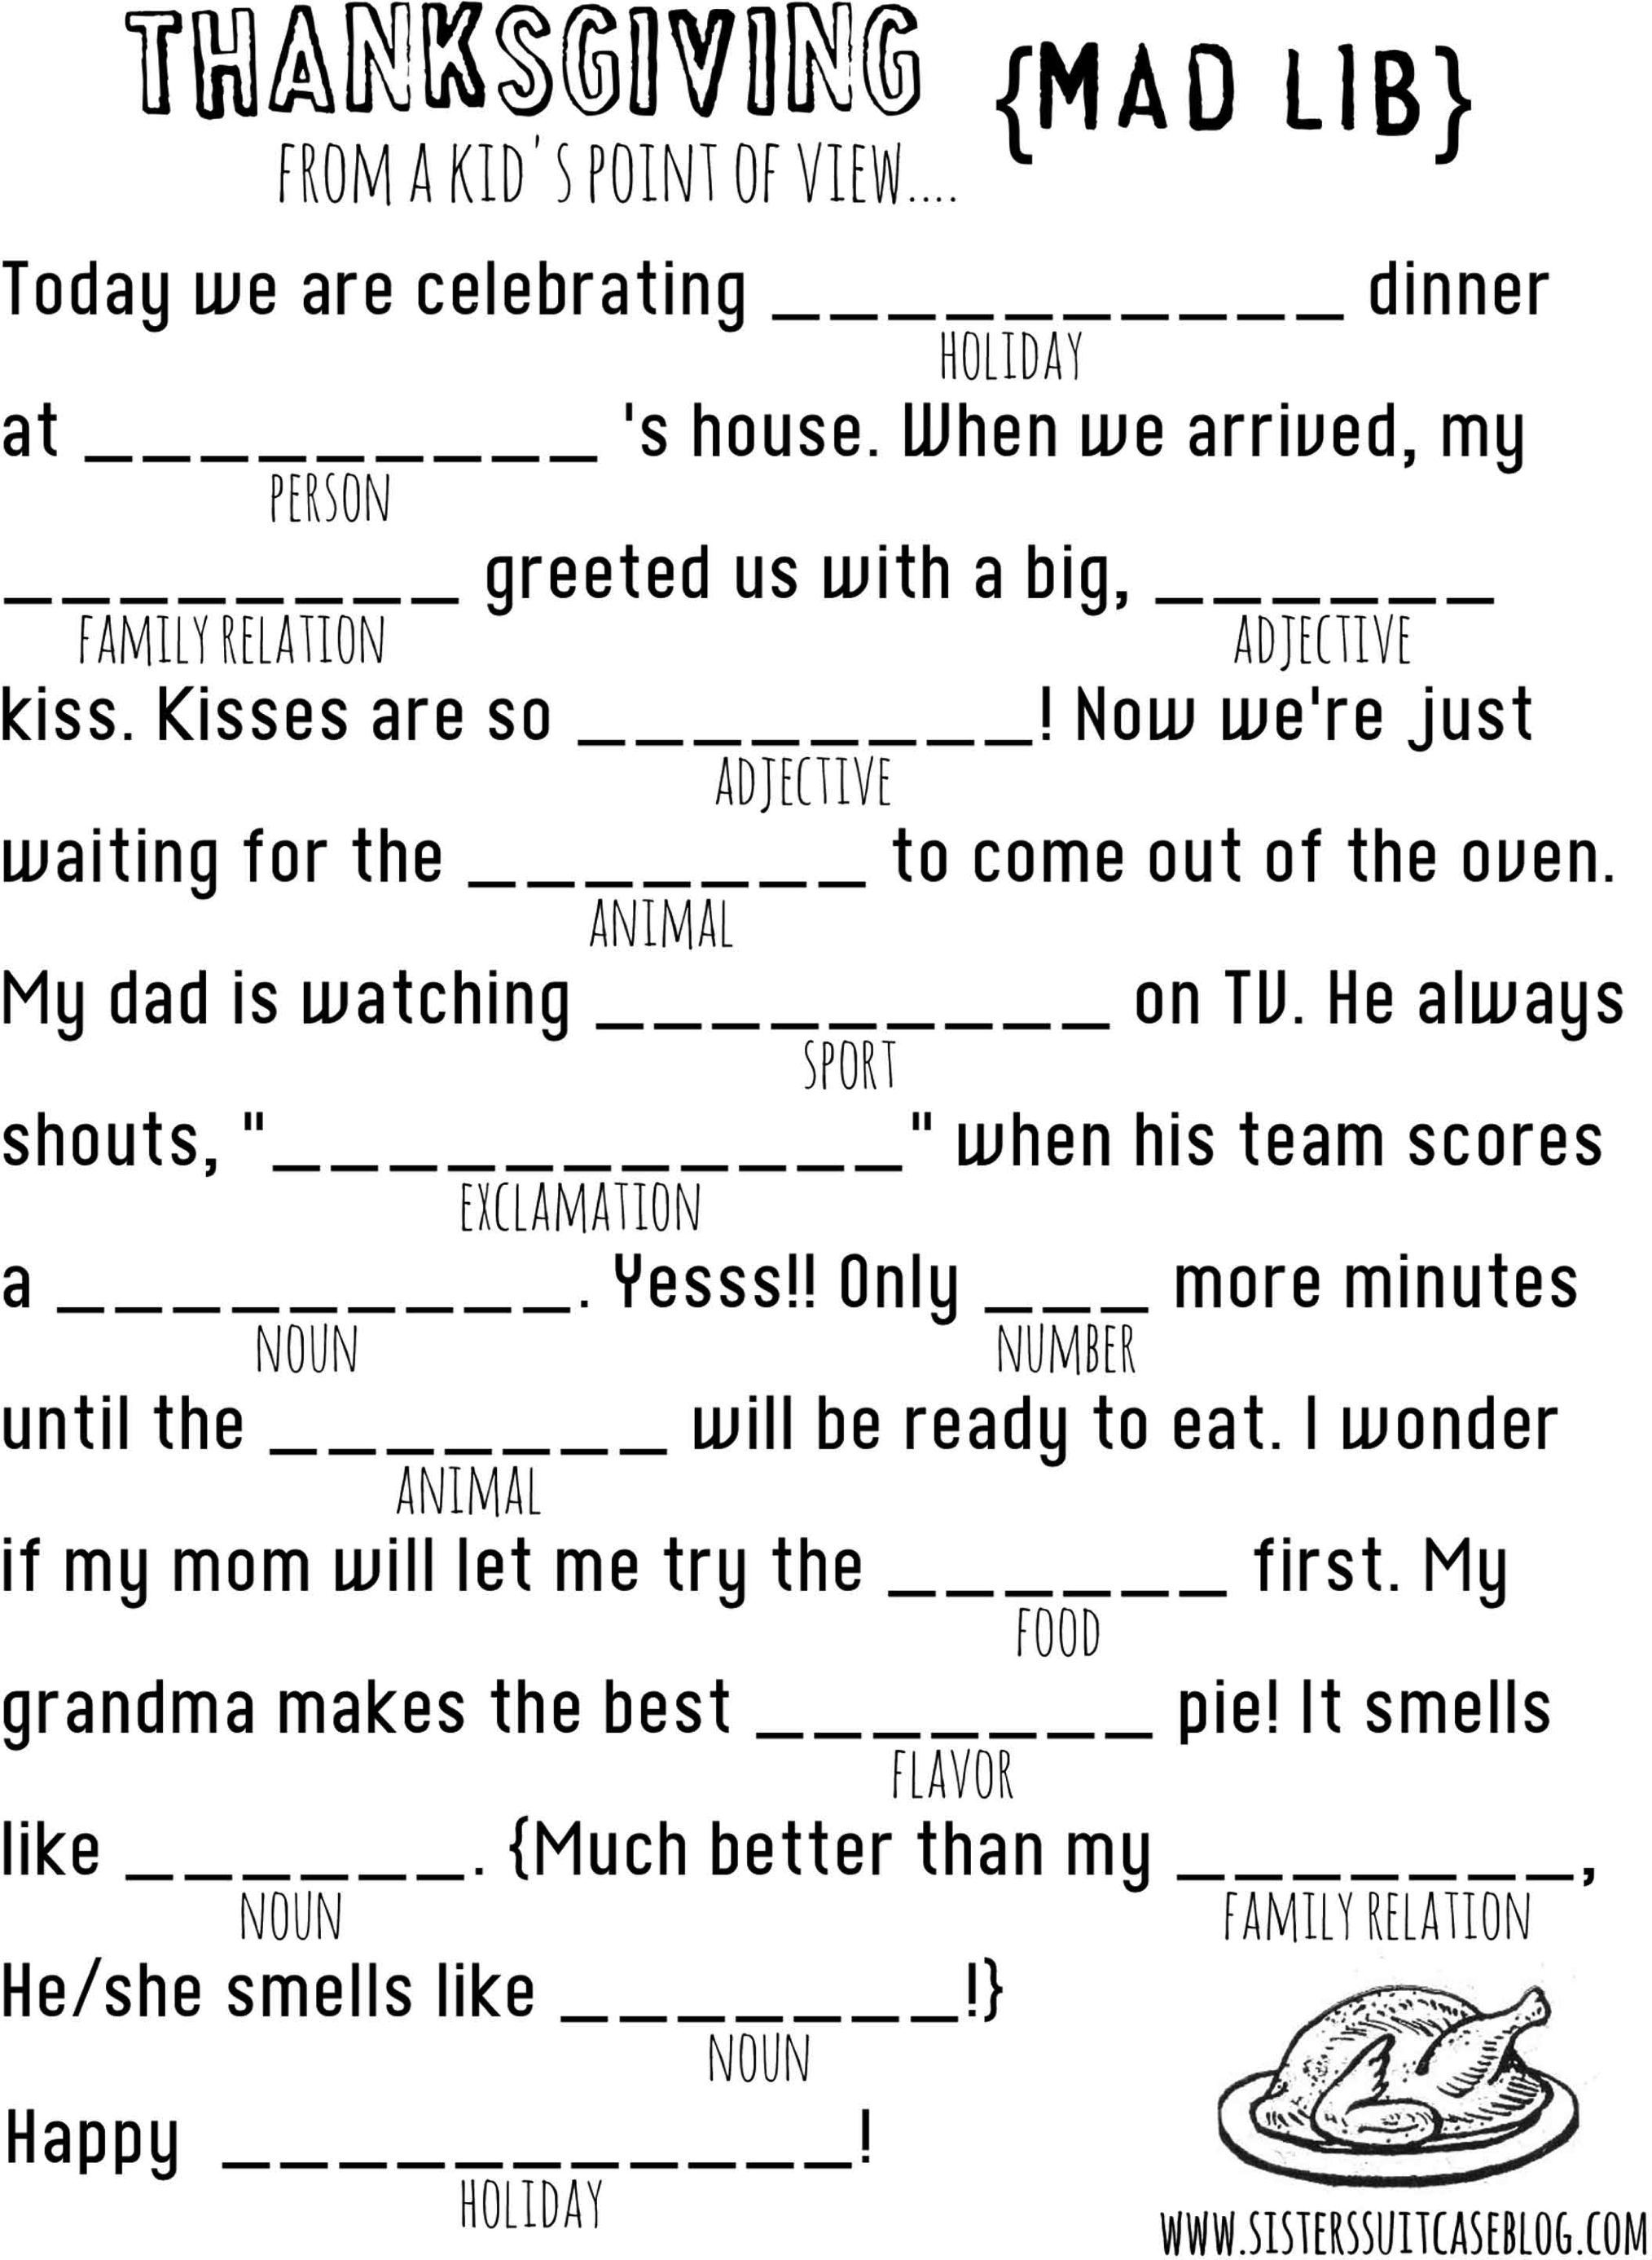
A simple story template …

Slide 7
A simple XSL template …
Notes:
The XSLT template follows the same principle. The content of the template is copied to the output except that XSL instructions are processed first. Here the only instruction is the xsl:value-of in light blue. The rest of the elements in the template (that is, inside the <xsl:template>), are in dark blue, and are the majority of a tiny little HTML file.

Slide 8
Templates in XSLT
Each template “matches” some bit of the input XML tree
The template is executed when the XSLT engine comes across that bit of the input XML tree
What a template “matches” is expressed using the @match attribute of the <xsl:template> element, using XPath

Slide 9
XML documents involved
Thus we have 3 XML documents involved in this process:
  the input (TEI)
  the program (XSLT)
  the output (XHTML)
We separate them:
  element names on @match and @select attributes are always from the input
  elements that have the “xsl:” prefix are the program
  elements that do not have a prefix are output elements

Slide 10
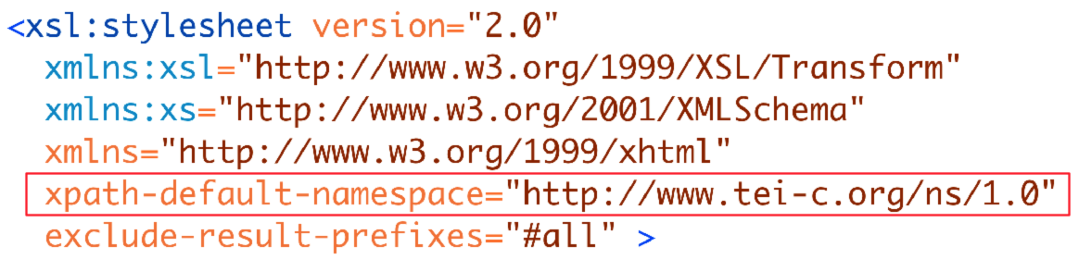
Housekeeping, detail — input

Slide 11
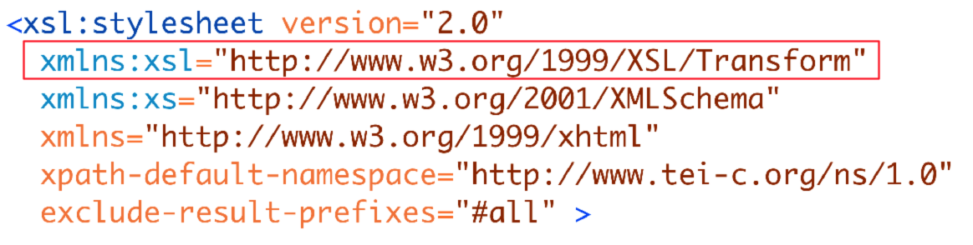
Housekeeping, detail — program

Slide 12
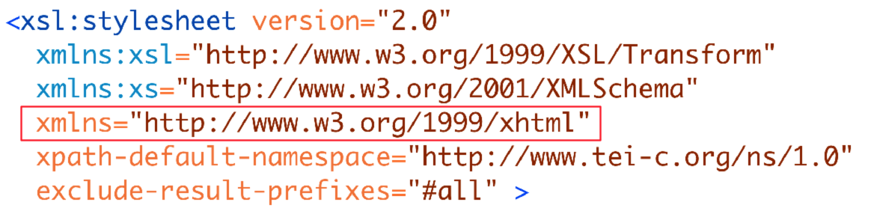
Housekeeping, detail — output

