Slide 1
XSLT Walkthrough
How the simplest XSLT in the world actually works.

Slide 2
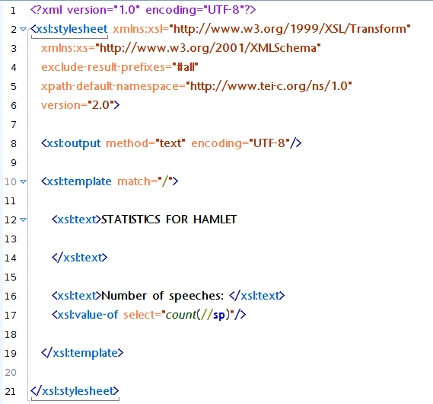

Slide 3
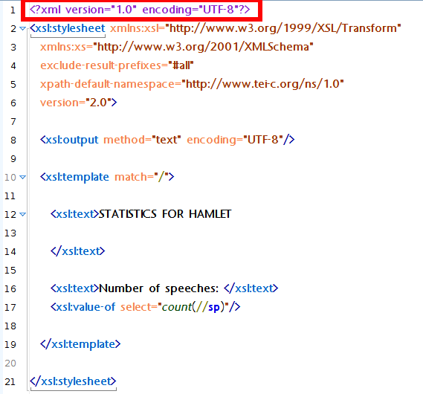

Slide 4
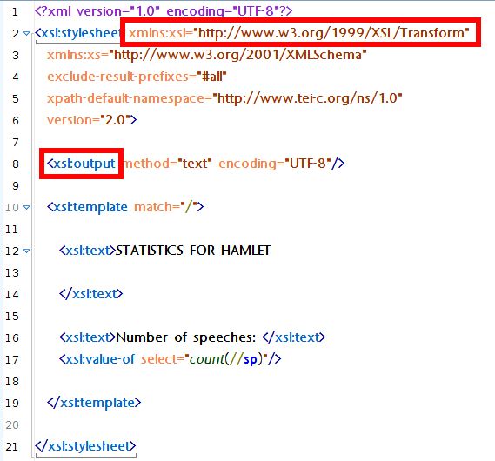

Slide 5
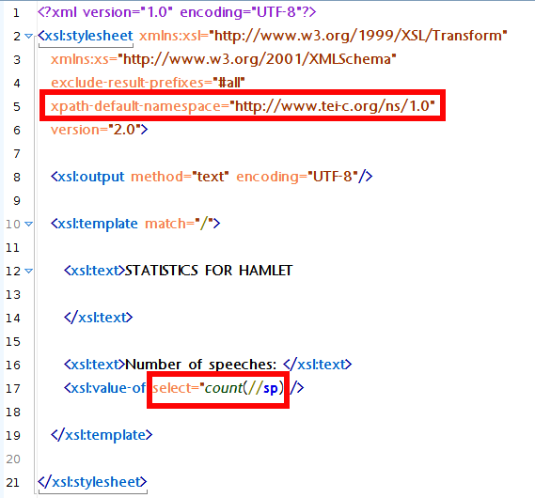

Slide 6
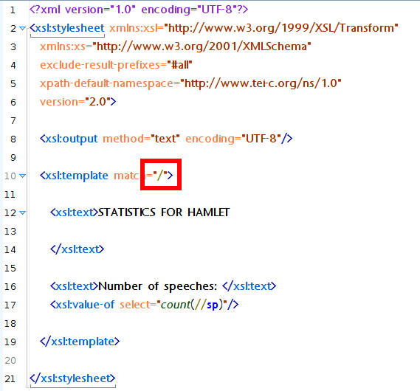

Slide 7
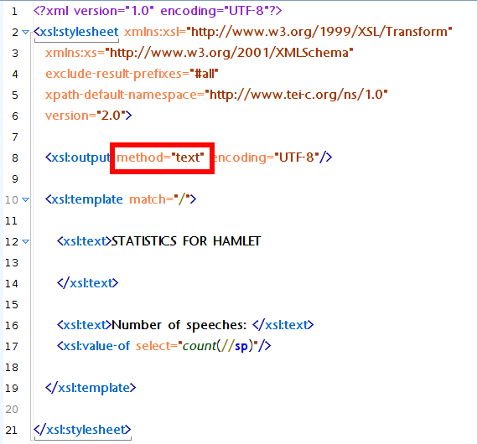

Slide 8
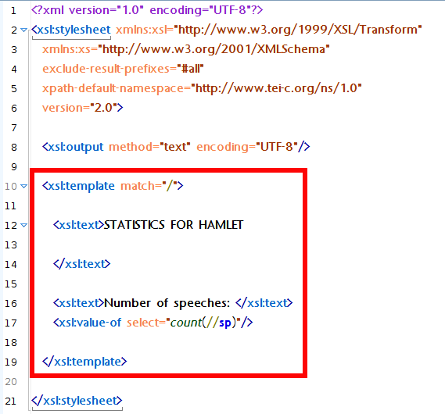

Slide 9
Summary
XSLT processes an XML document.
It consists of one or more templates.
It identifies parts of the document using Xpath.
It outputs another document (text, XML, HTML).

