Slide 1
A Transformation Scenario

Slide 2
The XSLT debugger is useful, but limited.
We would like to run the transformation and save the results to a file automatically.
We can do this using an Oxygen Transformation Scenario.

Slide 3
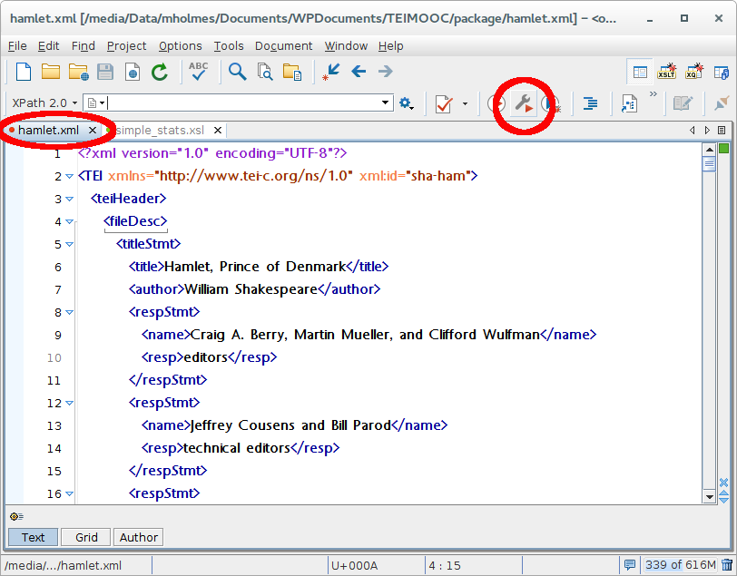

Slide 4
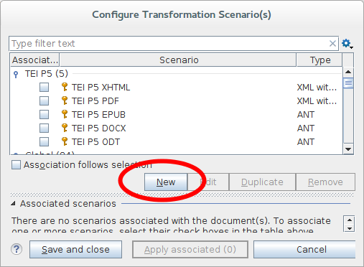

Slide 5
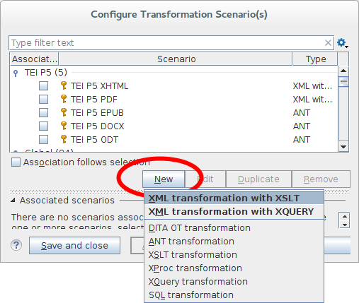

Slide 6
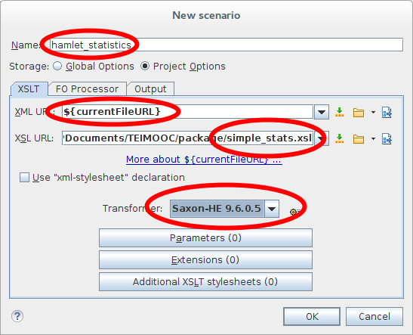

Slide 7
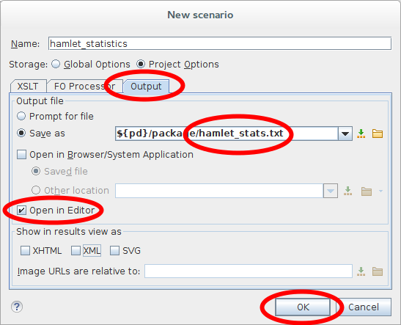

Slide 8
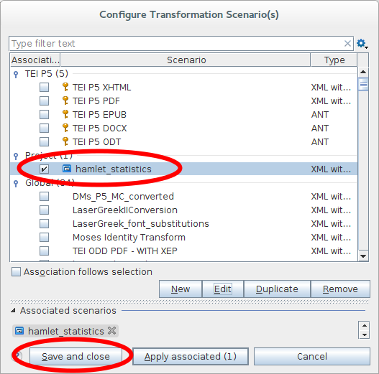

Slide 9
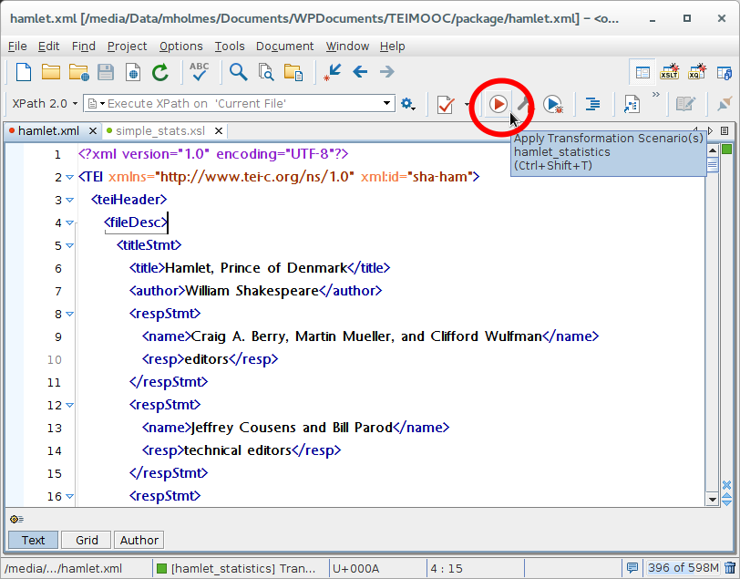

Slide 10
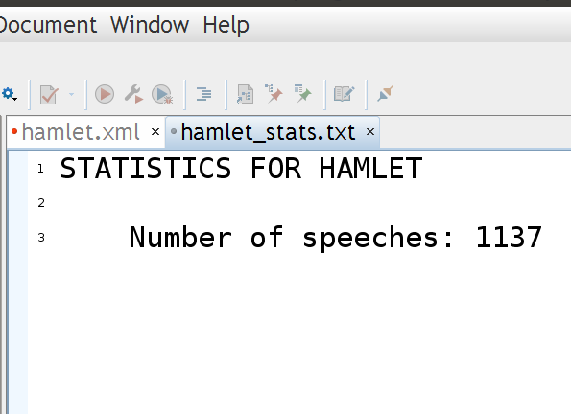
Results as a .txt file

Slide 11
Adding more stats
We have a count of speeches:
<xsl:text>Number of speeches: </xsl:text>
<xsl:value-of select="count(//sp)"/>
What next?
<xsl:text>
Number of acts: </xsl:text>
<xsl:value-of select="...."/>

Slide 12
Acts
<xsl:text>
Number of acts: </xsl:text>
<xsl:value-of select="count(//body/div)"/>

Slide 13
Scenes
<xsl:text>
Number of scenes: </xsl:text>
<xsl:value-of select="..."/>

Slide 14
Scenes
<xsl:text>
Number of scenes: </xsl:text>
<xsl:value-of select="count(//body/div/div)"/>

Slide 15
Task and demonstration
Add a new transformation scenario that processes hamlet.xml using simple_stats_complete.xsl.
Warning: it can take a long time!
Be impressed by the useful things that XPath can do.
Notice how complicated it can be.

