Slide 1
Introduction to XPath
Or: investigating Hamlet

Slide 2
hamlet.xml
Open the hamlet.xml file in Oxygen
You'll see a TEI-encoded version of the Shakespeare play.
<div xml:id="sha-ham1">
<head>Act 1</head>
<div xml:id="sha-ham101">
<head>Act 1, Scene 1</head>
<stage>Elsinore. A platform before the castle. FRANCISCO at his post.</stage>
<stage>Enter to him BERNARDO.</stage>
<sp who="#Barnardo">
<speaker>Bernardo</speaker>
<l xml:id="sha-ham101001" n="1">
Who's there?
</l>
</sp>
[...]
</div>
</div>

Slide 3
Acts are <div>s:
<div xml:id="sha-ham1">
<head>Act 1</head>
Scenes are <div>s:
<div xml:id="sha-ham101">
<head>Act 1, Scene 1</head>
Stage directions:
<stage>Enter to him BERNARDO.</stage>
Speeches:
<sp who="#Barnardo">

Slide 4
Investigating the text with XPath
XPath: a path language for interrogating and navigating an XML document.
XSLT depends on it.
Oxygen supports it.

Slide 5
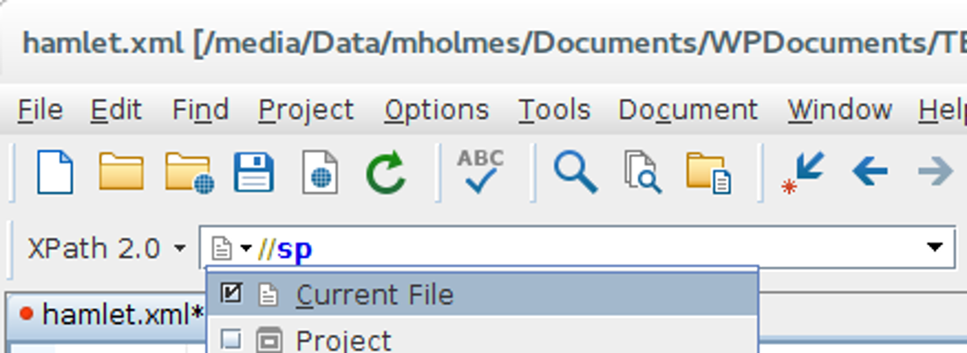
Oxygen's XPath window

Slide 6
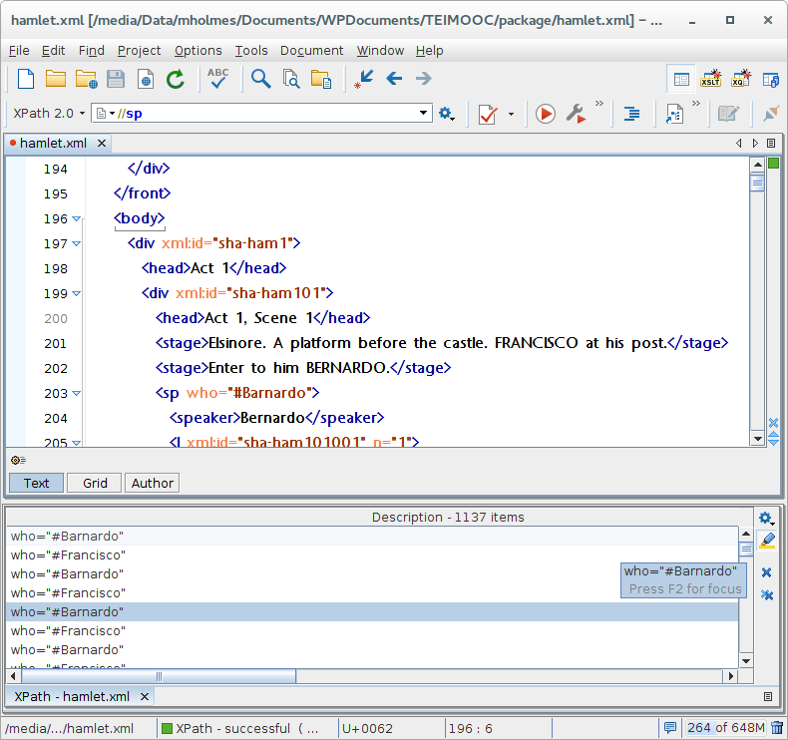

Slide 7
We learn that there are 1137 speeches in the play.
How many stage directions are there?
//stage →264 results.
How many lines are there?
//l →2949 results.

Slide 8
XPath is a path language
//sp is a crude path: "all of the <sp> elements in the document."
Actual path:
/TEI/text/body/div/div/sp
What does this search for?
/TEI/text/body/div/div
What about this?
//sp[@who='#Barnardo']

Slide 9
XPath has functions
count(//sp[@who='#Horatio'])
//div/div[string-length(.) > 20000]
avg(//div/div/string-length(.))

Slide 10
With XPath, we can:
navigate an XML document and select elements and attributes (scenes, lines, speeches by Hamlet...)
answer questions about the text (how long are scenes, who has the most lines, who shares the stage with who...)
To do lots of these things simultaneously and save the results in a file, we can use:
XSLT!

