Slide 1
The simplest XSLT in the world

Slide 2
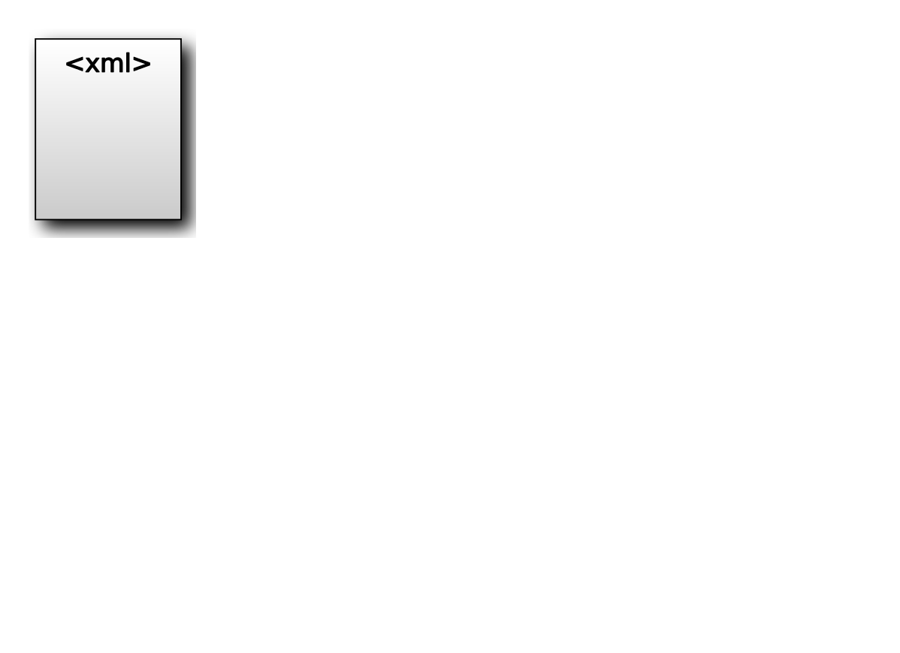

Slide 3
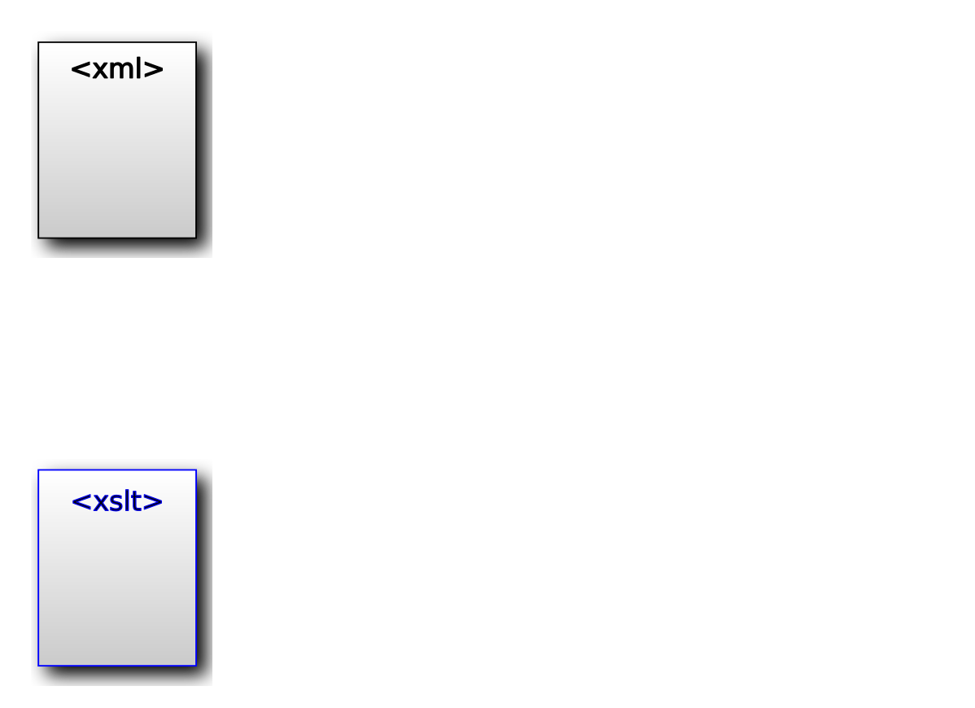

Slide 4
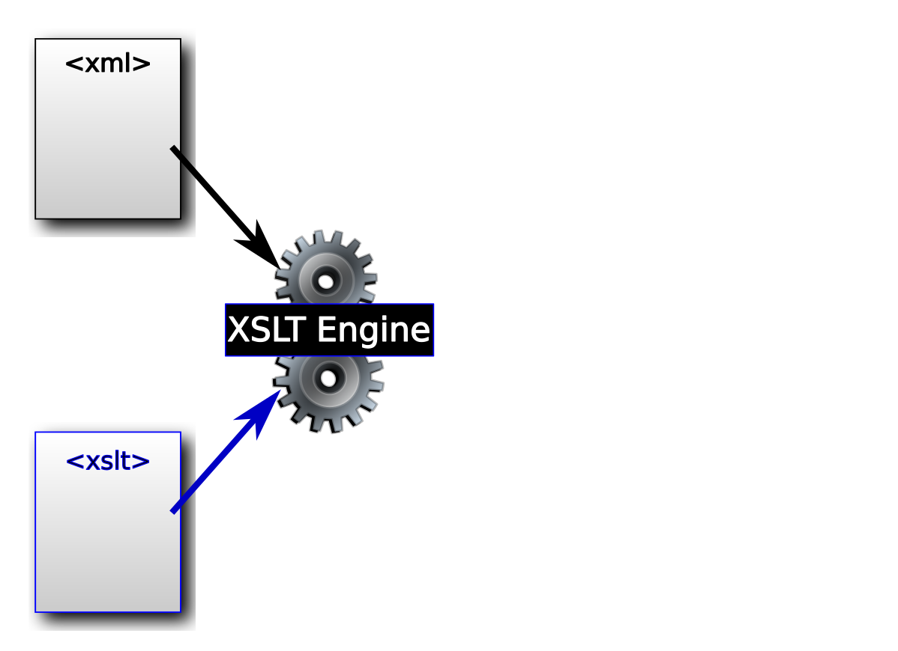

Slide 5
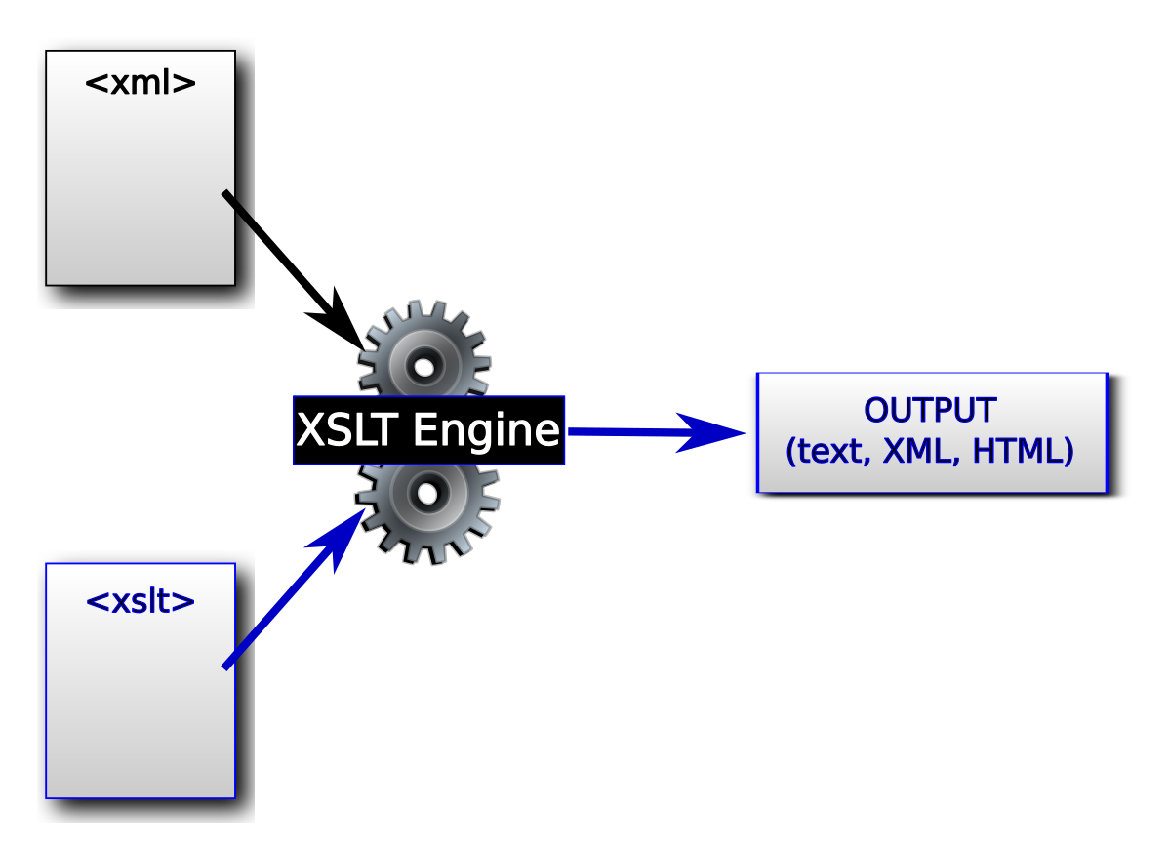

Slide 6
Transforming in Oxygen
Open hamlet.xml in Oxygen
Open the simple_stats.xsl file

Slide 7
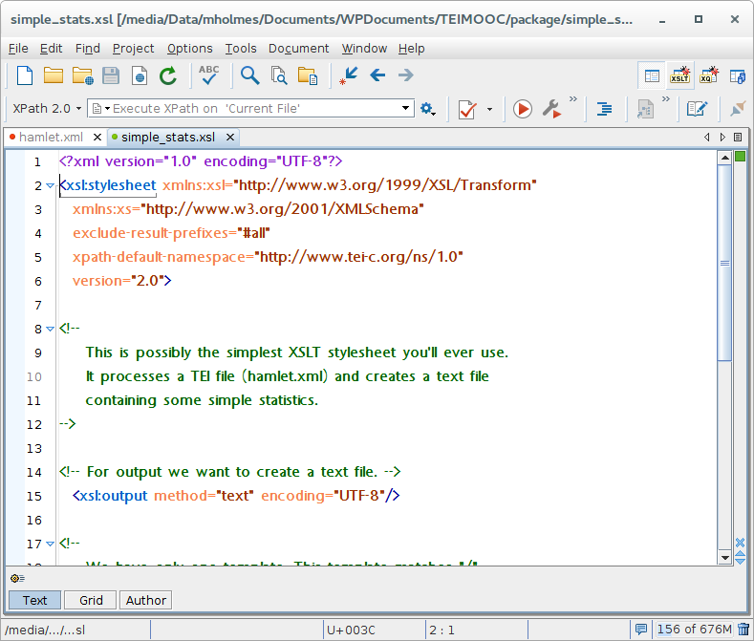

Slide 8
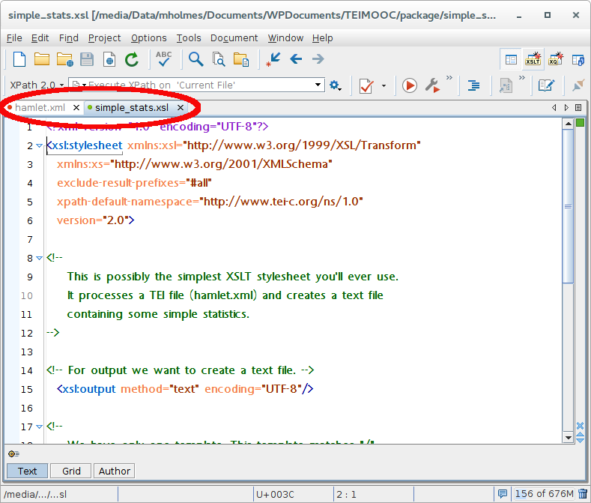

Slide 9
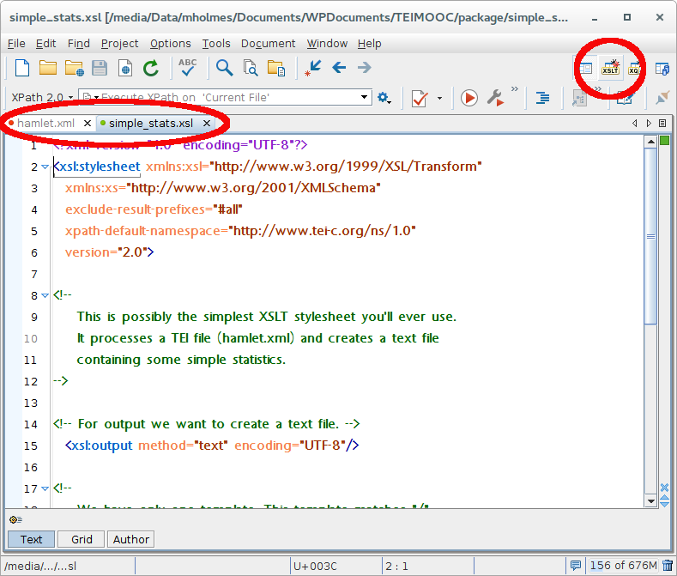

Slide 10
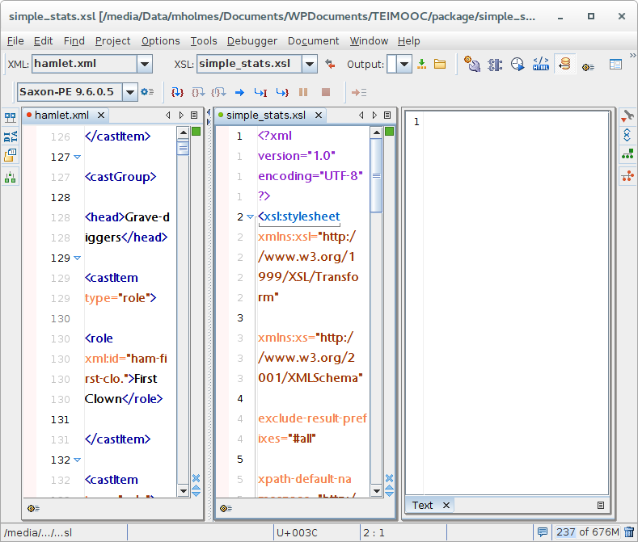

Slide 11
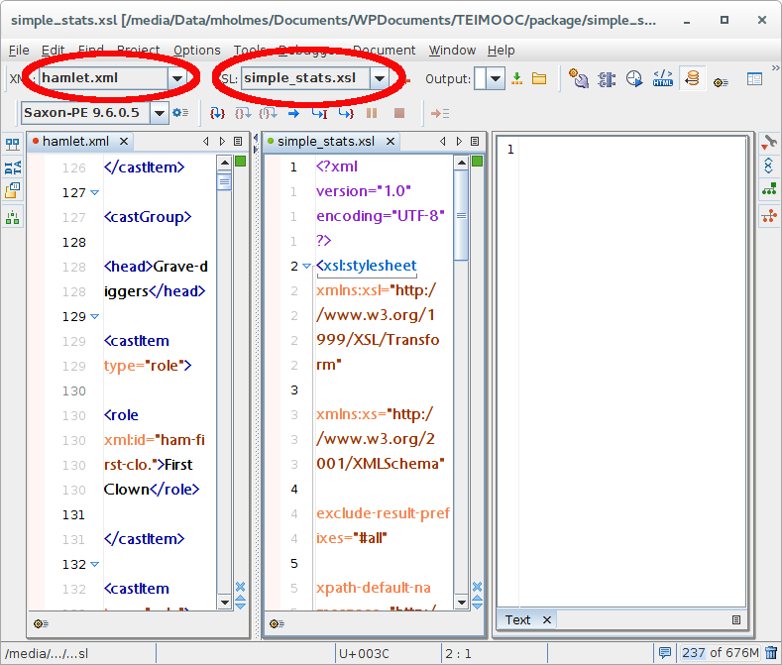

Slide 12
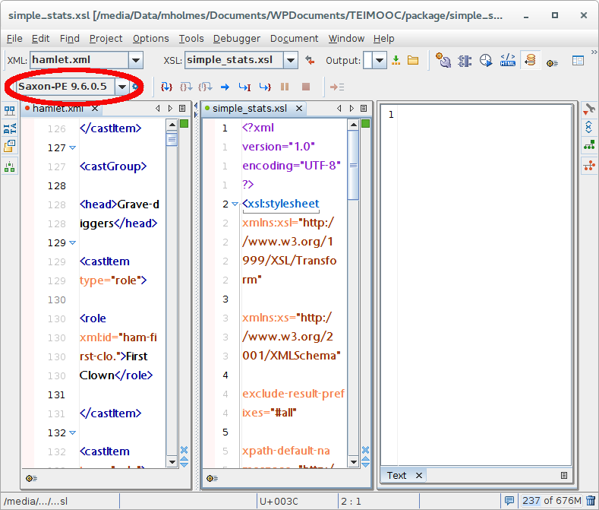

Slide 13
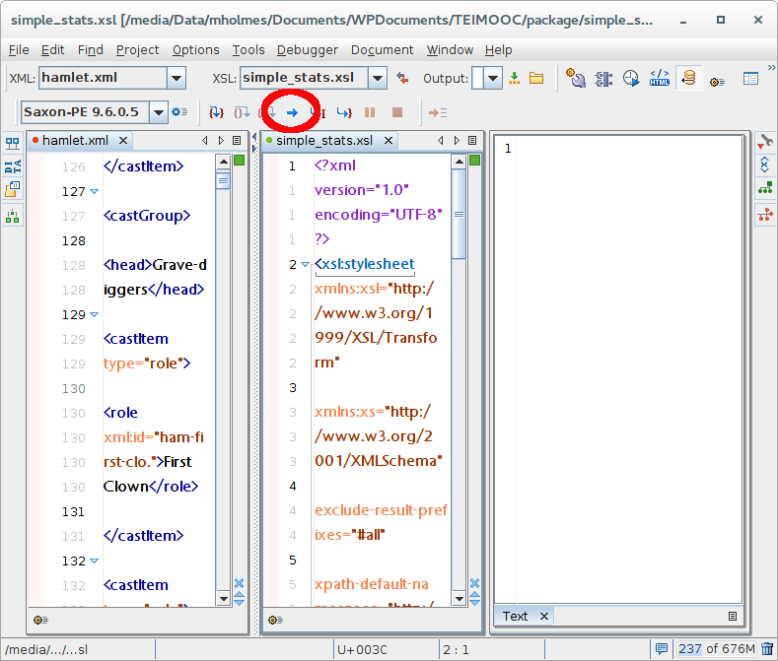

Slide 14
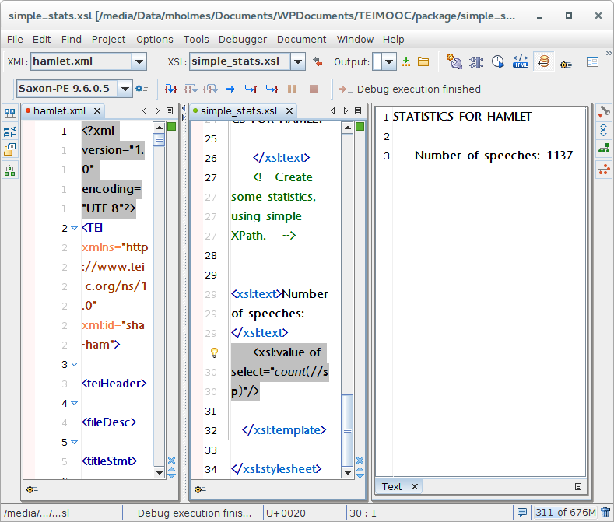

Slide 15
Summary
XML + XSLT -> XSLT processor -> output.
Saxon is an XSLT processor.
Oxygen has Saxon built into it.
Oxygen has an XSLT debugger.
You can use the debugger to run your XSLT transformations “live” and see the results.

