Slide 1
XSLT processing
Or: how to do more than just count things

Slide 2
An XML snippet
<lg>
<head>XSLT</head>
<l>X-S-L-T can manipulate your X-M-L,</l>
<l>But the input tree,</l>
<l>Well-formed must be,</l>
<l>Or the process won’t go very well.</l>
<note>To the tune of <title>Oklahoma</title>
by Rodgers &amp; Hammerstein</note>
</lg>

Slide 3
Snippet as an element tree
Document or “root”
node. XSLT starts
processing here.
lg
head
l
l
l
l
note
All these others are element nodes.
We will be dealing with mostly these,
but also text nodes and attribute
nodes shortly.
title

Slide 4
Basic handling of a single node
XSLT engine selects a node from the input tree
Asks “Is there a template that knows how to process this node?”.
If the answer is yes, apply that template to the input node
If the answer is no, apply the built-in template for that kind of node (i.e., root, element, text, or attribute)

Slide 5
Node selection
XSLT engine starts with the root or document node
The XSLT instruction <xsl:apply-templates> tells the processor to select some nodes from the input tree, and for each one, to look for a template with which to process it
If a template is found, it is applied to the node
If no template is found, the built-in template for that node type is applied to the node

Slide 6
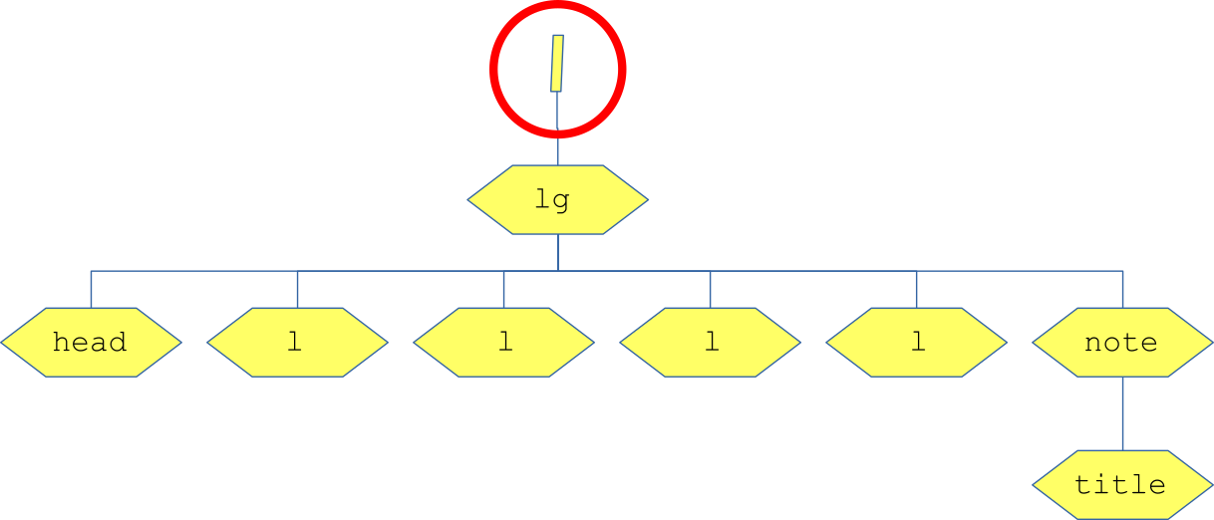
Snippet root template (1)
<xsl:template match="/">
<html>
<head>
<title>A Snippet</title>
</head>
<body>
<xsl:apply-templates select="child::node()"/>
</body>
</html>
</xsl:template>

Slide 7
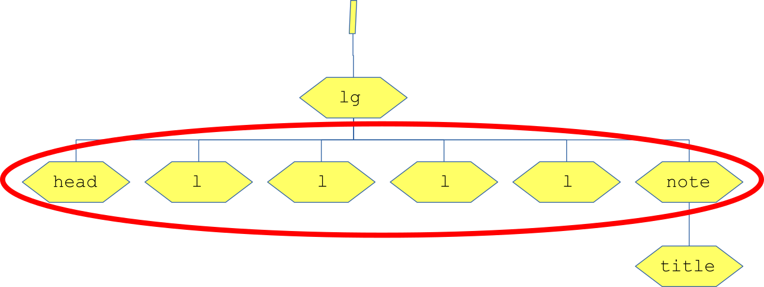
Snippet root template (2)
<xsl:template match="l">
<html>
<head>
<title>A Snippet</title>
</head>
<body>
<xsl:apply-templates select="child::node()"/>
</body>
</html>
</xsl:template>

Slide 8
@select
Can be thought of as “select these nodes from the input tree”
But in fact it’s really “evaluate this XPath and give me the result”
Easier to think of it the 1st way for
<xsl:apply-templates>
Makes more sense the 2nd way for
<xsl:value-of>

Slide 9
XPaths for input nodes
If a path starts with a solidus (“/”), then it starts from the root of the document
If not, then it starts from “here”, i.e., wherever we are now
In oXygen, “here” is wherever the cursor is
In XSLT, “here” is whatever node we are currently processing
  In template for "head", “here” is the <head>
  In template for "l", “here” is the 1st <l> the 1st time the template runs, the 2nd <l> the 2nd time the template runs, the 3rd …

Slide 10
@match
Indicates which nodes a template knows how to process
Uses a subset of XPath, essentially matching just the right side of the input node’s path
Thus we say match="sp", not match="//sp"
E.g.:
  "title" = matches all <title> elements
  "teiHeader//title" = matches all the titles inside the <teiHeader> (i.e., not in the <text>)

Slide 11
Snippet output (after "/")
<?xml version="1.0" encoding="UTF-8"?>
<html xmlns="http://www.w3.org/1999/xhtml">
<head>
<title>A Snippet</title>
</head>
<body>
</body>
</html>

Slide 12
Snippet output (after "lg")
<?xml version="1.0" encoding="UTF-8"?>
<html xmlns="http://www.w3.org/1999/xhtml">
<head>
<title>A Snippet</title>
</head>
<body>
<div class="poem">
</div>
</body>
</html>

Slide 13
Snippet output (after "head")
<?xml version="1.0" encoding="UTF-8"?>
<html xmlns="http://www.w3.org/1999/xhtml">
<head>
<title>A Snippet</title>
</head>
<body>
<div class="poem">
<h1>XSLT</h1>
</div>
</body>
</html>

Slide 14
Snippet output (after "l" #1)
<?xml version="1.0" encoding="UTF-8"?>
<html xmlns="http://www.w3.org/1999/xhtml">
<head>
<title>A Snippet</title>
</head>
<body>
<div class="poem">
<h1>XSLT</h1>
<p class="metrical_line">X-S-L-T can manipulate your X-M-L,</p>
</div>
</body>
</html>

Slide 15
Snippet output (after "l" #2)
<?xml version="1.0" encoding="UTF-8"?>
<html xmlns="http://www.w3.org/1999/xhtml">
<head>
<title>A Snippet</title>
</head>
<body>
<div class="poem">
<h1>XSLT</h1>
<p class="metrical_line">X-S-L-T can manipulate your X-M-L,</p>
<p class="metrical_line">But the input tree,</p>
</div>
</body>
</html>

Slide 16
Snippet output (after "l" #3)
<?xml version="1.0" encoding="UTF-8"?>
<html xmlns="http://www.w3.org/1999/xhtml">
<head>
<title>A Snippet</title>
</head>
<body>
<div class="poem">
<h1>XSLT</h1>
<p class="metrical_line">X-S-L-T can manipulate your X-M-L,</p>
<p class="metrical_line">But the input tree,</p>
<p class="metrical_line">Well-formed must be,</p>
</div>
</body>
</html>

Slide 17
Snippet output (after "l" #4)
<?xml version="1.0" encoding="UTF-8"?>
<html xmlns="http://www.w3.org/1999/xhtml">
<head>
<title>A Snippet</title>
</head>
<body>
<div class="poem">
<h1>XSLT</h1>
<p class="metrical_line">X-S-L-T can manipulate your X-M-L,</p>
<p class="metrical_line">But the input tree,</p>
<p class="metrical_line">Well-formed must be,</p>
<p class="metrical_line">Or the process won’t go very well.</p>
</div>
</body>
</html>

Slide 18
Snippet output (after "note")
<?xml version="1.0" encoding="UTF-8"?>
<html xmlns="http://www.w3.org/1999/xhtml">
<head>
<title>A Snippet</title>
</head>
<body>
<div class="poem">
<h1>XSLT</h1>
<p class="metrical_line">X-S-L-T can manipulate your X-M-L,</p>
<p class="metrical_line">But the input tree,</p>
<p class="metrical_line">Well-formed must be,</p>
<p class="metrical_line">Or the process won’t go very well.</p>
<p style="font-size:small; text-align: right;">
To the tune of
by Rodgers &amp; Hammerstein</p>
</div>
</body>
</html>

Slide 19
Snippet output (after "title")!
<?xml version="1.0" encoding="UTF-8"?>
<html xmlns="http://www.w3.org/1999/xhtml">
<head>
<title>A Snippet</title>
</head>
<body>
<div class="poem">
<h1>XSLT</h1>
<p class="metrical_line">X-S-L-T can manipulate your X-M-L,</p>
<p class="metrical_line">But the input tree,</p>
<p class="metrical_line">Well-formed must be,</p>
<p class="metrical_line">Or the process won’t go very well.</p>
<p style="font-size:small; text-align: right;">
To the tune of “Oklahoma”
by Rodgers &amp; Hammerstein</p>
</div>
</body>
</html>

Slide 20
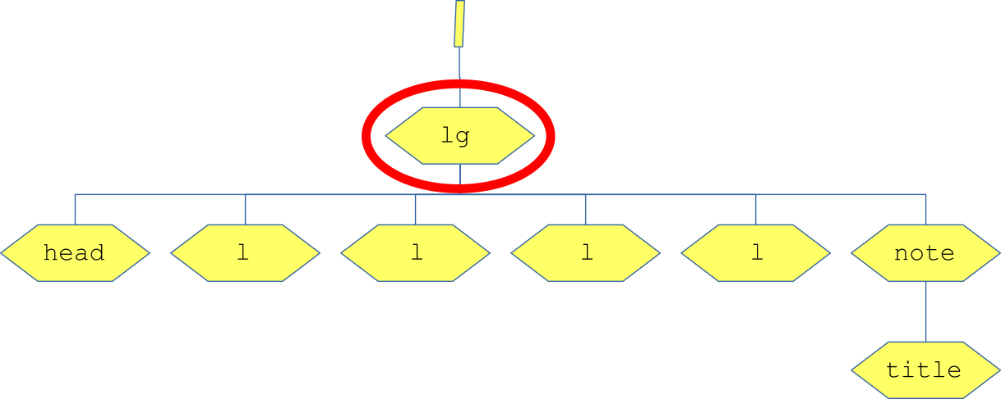
Snippet <lg> template
<xsl:template match="lg">
<div class="poem">
<xsl:apply-templates select="child::node()"/>
</div>
</xsl:template>

Slide 21
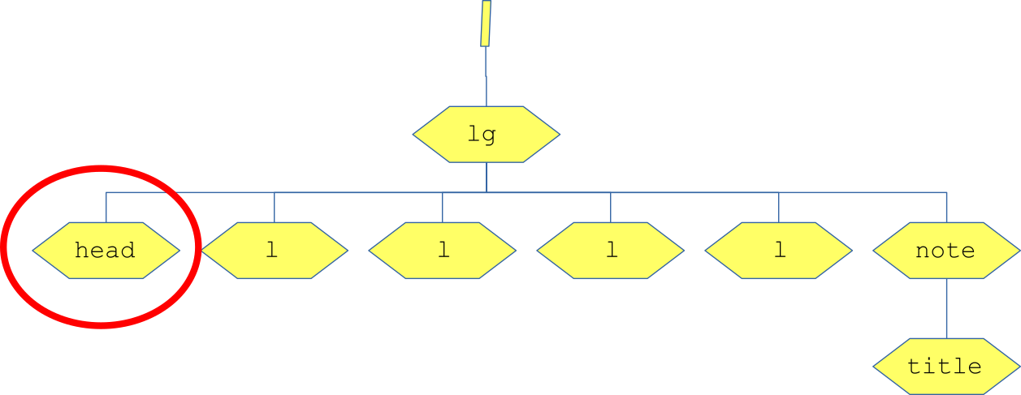
Snippet <head> template
<xsl:template match="head">
<h1><xsl:apply-templates/></h1>
</xsl:template>

Slide 22
Snippet <l> template
<xsl:template match="l">
<p class="metrical_line">
<xsl:apply-templates select="child::node()"/>
</p>
</xsl:template>

Slide 23
Snippet <title> template
<xsl:template match="title">
<xsl:text>“</xsl:text>
<xsl:apply-templates/>
<xsl:text>”</xsl:text>
</xsl:template>

