Slide 1

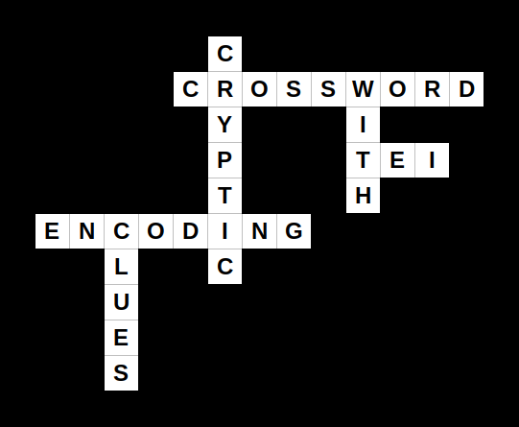
Encoding Cryptic Crossword Clues with TEI
Martin Holmes
University of Victoria Humanities Computing and Media Centre

Slide 2
Outline
How do cryptic crossword clues work?
A brief history of cryptic crosswords
Why they’re worth studying
How TEI encoding can help

Slide 3
Anatomy of a typical cryptic clue
A clue is a phrase or sentence which has an apparent meaning as a whole.

Slide 4
Anatomy of a typical cryptic clue
A clue is a phrase or sentence which has an apparent meaning as a whole.
One part of it constitutes a definition of the answer.

Slide 5
Anatomy of a typical cryptic clue
A clue is a phrase or sentence which has an apparent meaning as a whole.
One part of it constitutes a definition of the answer.
The other part of it consists of instructions for constructing the answer.

Slide 6
Four card players wrapping party gifts (6)
“Nutmeg”. Guardian Cryptic Crossword No. 27,183. https://www.theguardian.com/crosswords/cryptic/27183

Slide 7
Four card players wrapping party gifts (6)
Constructor

Slide 8
Four card players wrapping party gifts (6)
Constructor
Definition

Slide 9
Four card players wrapping party gifts (6)
“Four card players” = E N W S (East, North, West, South)

Slide 10
Four card players wrapping party gifts (6)
“Four card players” = E N W S (East, North, West, South)
“party” = DO (UK informal word)

Slide 11
Four card players wrapping party gifts (6)
“Four card players” = E N W S (East, North, West, South)
“party” = DO (UK informal word)
“wrapping” = instruction to put one thing around the other

Slide 12
Four card players wrapping party gifts (6)
Answer:
ENDOWS

Slide 13
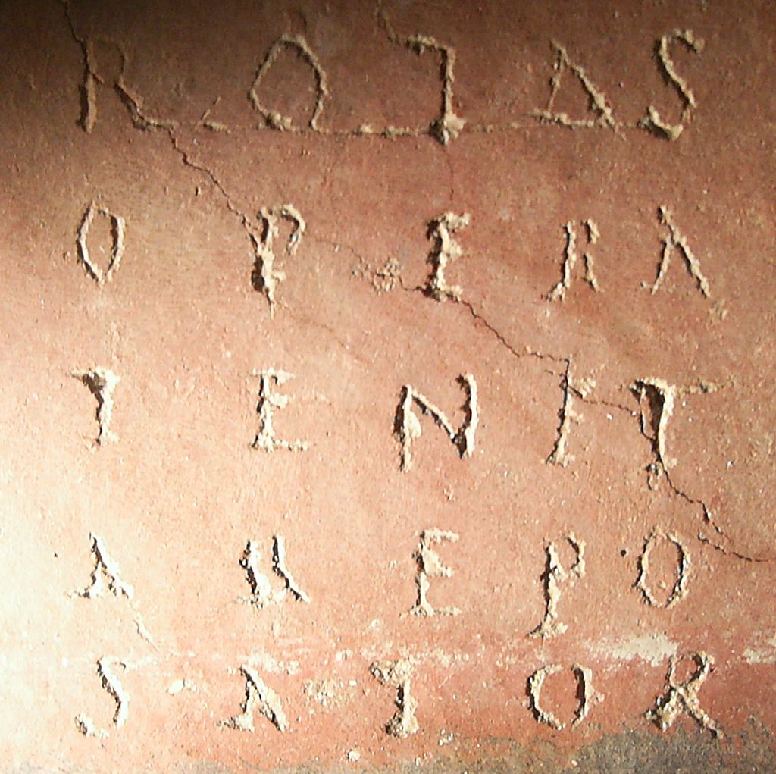
Brief history
Word-grids go back to ancient times.
Image: Throwawayhack at English Wikipedia.
Notes:
SATOR square from Cirencester.

Slide 14
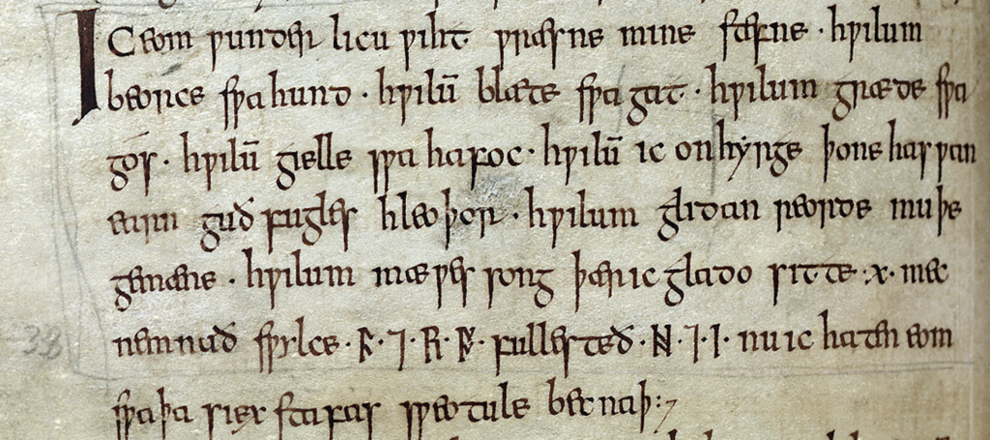
Riddles are among the oldest English language texts we have.
Image: https://sites.nd.edu/manuscript-studies/2017/02/17/reading-runes-in-the-exeter-book-riddles/.
Notes:
Exeter Book Riddle 24, higoræ 'jay, magpie’.
Riddle 24 on folio 106v, Exeter Cathedral Library MS 3501.

Slide 15
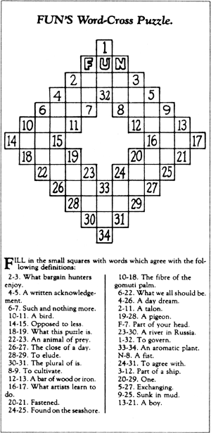
1913: first recognizable crossword
Author: Arthur Wynne
Published in New York Sunday World

Slide 16
1925: crosswords are appearing in daily newspapers in US and UK.
1926: Torquemada (Edward Powys Mathers) begins using cryptic clues regularly in the Observer.
1949: Afrit (A. F. Ritchie) publishes Armchair Crosswords.
1966: Ximenes (Derek MacNutt) publishes Ximenes on the Art of the Crossword.

Slide 17
Ximenes on the Art of the Crossword
Ontology of clue types
Rules and principles for fairness (“cluemanship”)
Guidance on constructing grids and clues

Slide 18
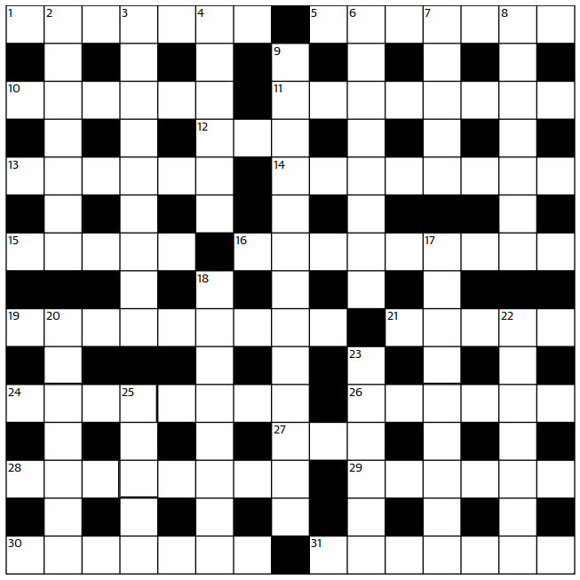
Grids
15 squares by 15 squares
Symmetrical
About half the “lights” should be “checked” (part of at least two words)

Slide 19
Why are cryptic crosswords worth studying?
The tradition stretches back nearly a century.
It has been very stable for over 50 years.
These are literary artefacts.

Slide 20
Features of good cryptic clues
Elegance
Concision
Clarity
Precision
Allusiveness
Multiple layers of meaning

Slide 21
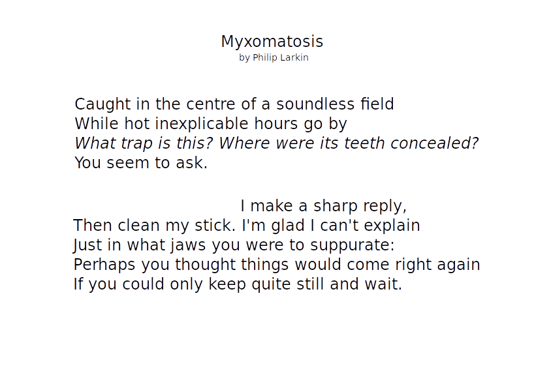

Slide 22
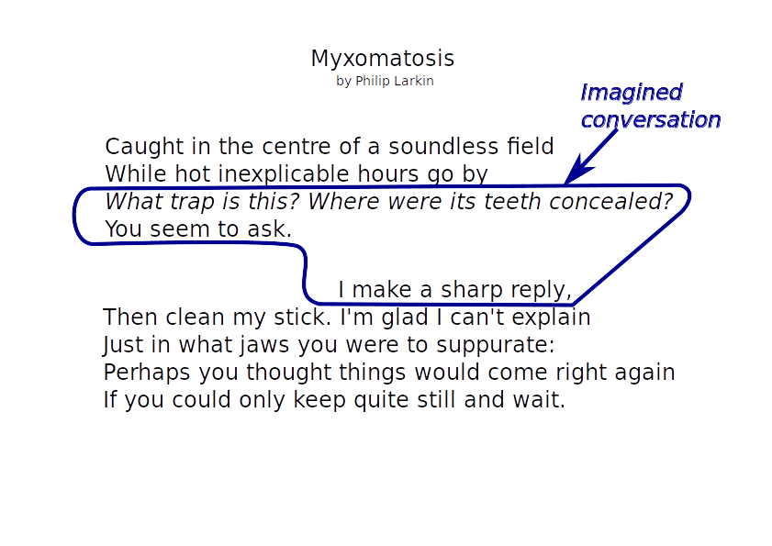

Slide 23
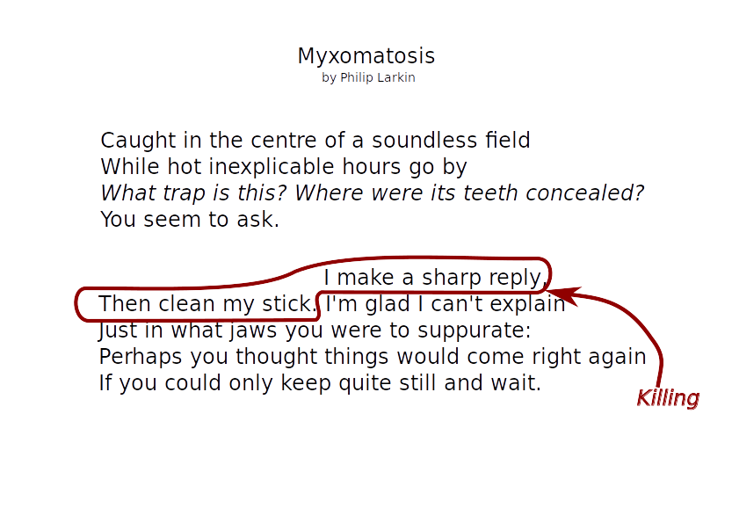

Slide 24
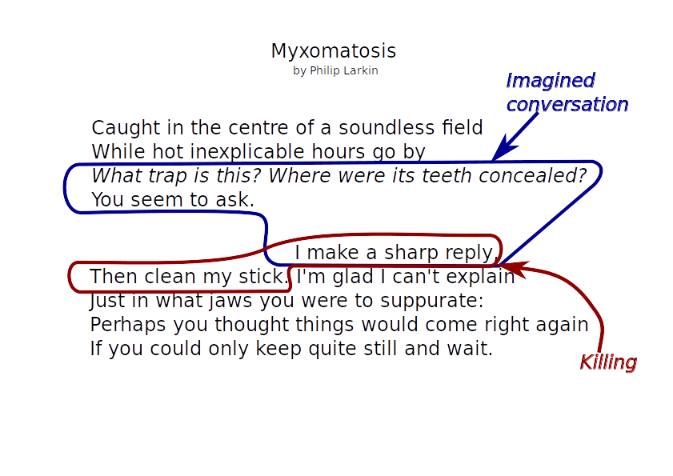

Slide 25
Guard dog kept within sight (6)
Daily Telegraph. 2002. The Daily Telegraph big book of cryptic crosswords. 9. London: Pan.

Slide 26
Guard dog kept within sight (6)
Definition

Slide 27
Guard dog kept within sight (6)
Definition
Constructor

Slide 28
Guard dog kept within sight (6)
“dog” = CUR

Slide 29
Guard dog kept within sight (6)
“dog” = CUR
“sight” = SEE

Slide 30
Guard dog kept within sight (6)
“dog” = CUR
“sight” = SEE
“kept within” = instruction to put one thing inside the other

Slide 31
Guard dog kept within sight (6)
Answer:
SECURE

Slide 32
Guard dog kept within sight (6)
Overlapping hierarchy

Slide 33
Four card players wrapping party gifts (6)
Overlapping hierarchy

Slide 34
TEI encoding can be used to:
Identify clue components
Categorize clue and component types
Delimit overlapping segments
Categorize topics and themes

Slide 35
Taxonomies
Clue components:
  Definition
  Form (constructor)
  Signal (word or phrase signaling e.g. anagram or insertion of one thing inside another)
  Misdirection (such as exploitation of overlapping hierarchy)
  Convention (well-used or fossilized instances of word-play such as “worker” = “ant” or “bee”)
  Length

Slide 36
Taxonomies
Clue types:
  Enumerates the range of types of clue
  A single clue may have multiple values
  Most types are initially derived from Ximenes Chapters VI and VII.

Slide 37
Unknown
Synonyms (Xim type 6.1: one or more meanings)
Reversals (Xim type 6.2: reversal)
Charade (Xim type 6.3: charade)
Container and contents (Xim type 6.4: container and contents)
Pun (Xim type 6.5: pun)
Anagram (Xim type 6.6: anagram)
Heads and tails (Xim type 7.1 Heads and tails)
Speech peculiarities (Xim type 7.2 Peculiarities of speech)
Words in words (Xim type 7.3 Words treated as parts of other words)
Initial or final letters (Xim type 7.4 Initial or final letters)
Foreign languages (Xim type 7.5 Foreign languages)
Literary references (Xim type 7.6 Literary references etc.)
Outsides (Xim type 7.7 Outsides
Embodiment (non-Ximenean)
Cross-reference to another clue/answer (non-Ximenean)
& Lit. (Xim type 8 & Lit.)
Unclassified (Xim type 7.8 Various)

Slide 38
Example encoding
<item ana="crs:ctpWordsInWords" source="bibl:xwDt_2002">
<anchor xml:id="item_001_1"/>
<seg ana="crs:ccpDef">Guard</seg>
<seg ana="crs:ccpForm">dog<anchor xml:id="item_001_2"/>
<seg ana="crs:ccpSignal">kept within</seg> sight</seg>
<seg ana="crs:ccpLength">(6)</seg>
<span ana="crs:ccpMisdirection" from="#item_001_1"
to="#item_001_2">The phrase <mentioned>guard
dog</mentioned> crosses the definition/form
boundary.</span>
</item>

Slide 39
Possible research approach
Select two or three British broadsheet newspapers covering 1930 to 2017
Randomly select one crossword from each year from each newspaper (= 88 crosswords per paper)
Encode and analyze

Slide 40
Possible research questions
How do the various clue types emerge over time?
When do the fossilized conventions emerge?
How similar are well-known setters to each other?
How closely are Ximenes’s principles adhered to over time?

Slide 41
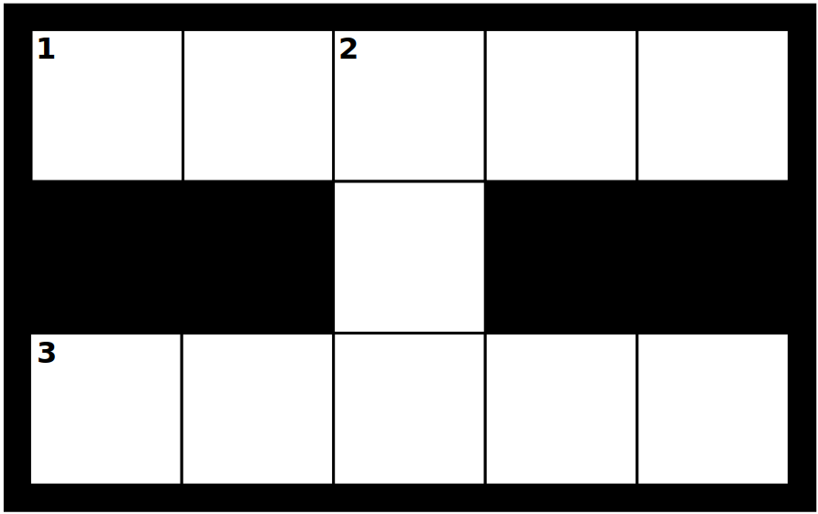
1, 2, 3: I.e. everyone, as Porky Pig said (5,3,5)

Slide 42
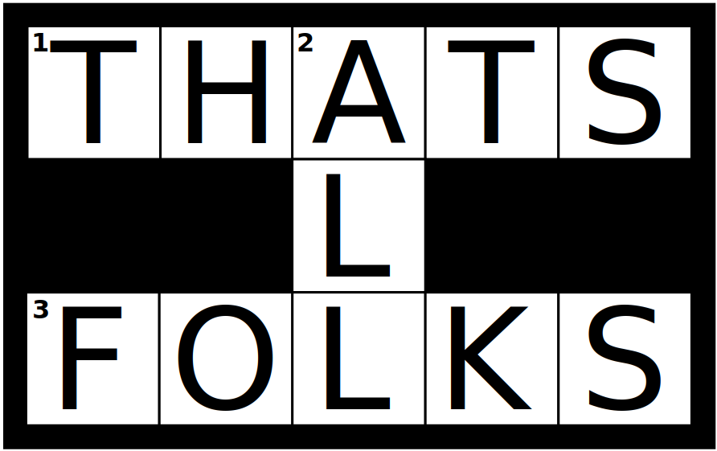
1, 2, 3: I.e. everyone, as Bosko said (5,3,5)

Slide 43
Favourite clues
Of of of of of of of of of of (10)

Slide 44
Favourite clues
Of of of of of of of of of of (10)
OFTENTIMES

Slide 45
Favourite clues
Of of of of of of of of of of (10)
OFTENTIMES
(3,3,3,1,4)

Slide 46
Favourite clues
Of of of of of of of of of of (10)
OFTENTIMES
(3,3,3,1,4)
HAS NOT GOT A CLUE

Slide 47
Favourite clues
Of of of of of of of of of of (10)
OFTENTIMES
(3,3,3,1,4)
HAS NOT GOT A CLUE
Honestly? No, otherwise (2,3,3)

Slide 48
Favourite clues
Of of of of of of of of of of (10)
OFTENTIMES
(3,3,3,1,4)
HAS NOT GOT A CLUE
Honestly? No, otherwise (2,3,3)
ON THE SLY

