Slide 1

The ISE, TEI and XML Encoding

Slide 2
The ISE is contemplating moving to TEI
Why?
What are the implications for editors?
How will it help them?
How hard will it be?
What tools are available and how do they work?
What are the drawbacks?
What more can we do?

Slide 3
What makes a good encoding system?
intelligible
precise
nice (fine distinctions)
concise
comprehensive
unambiguous
well-supported with tools for editors
open, standardized, documented, maintained...

Slide 4
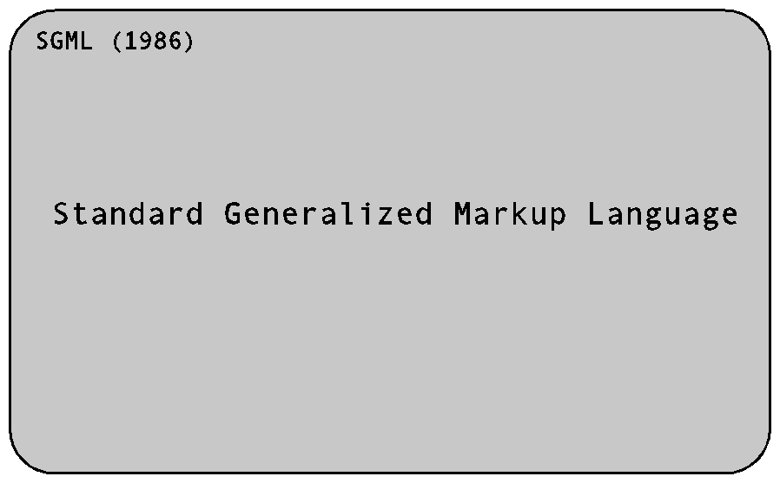
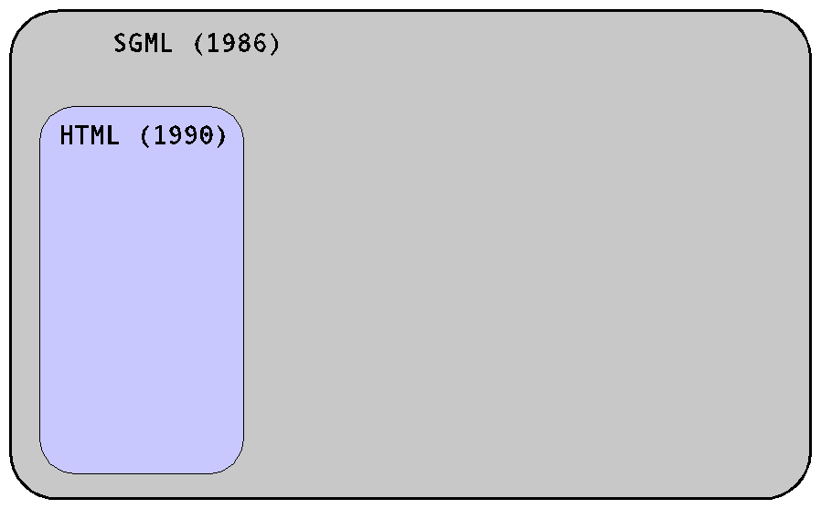
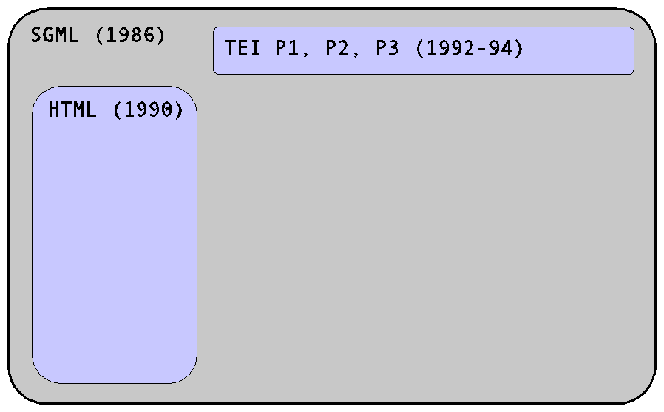
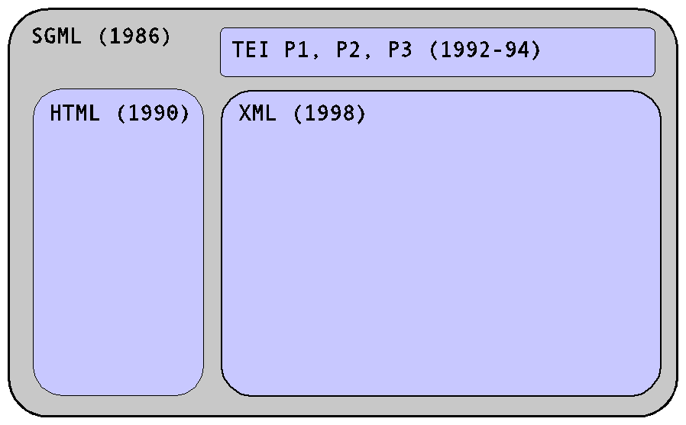
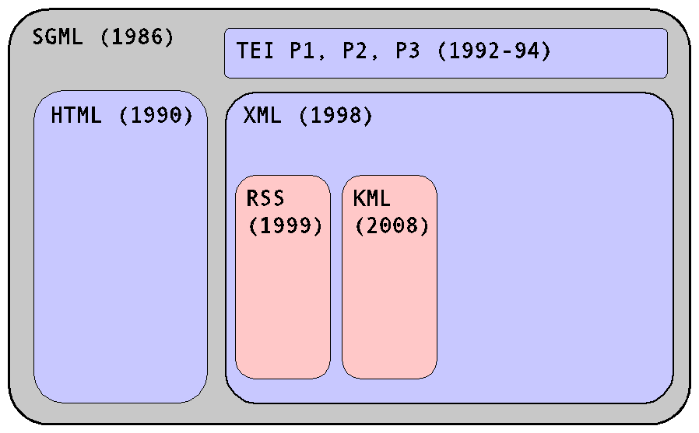
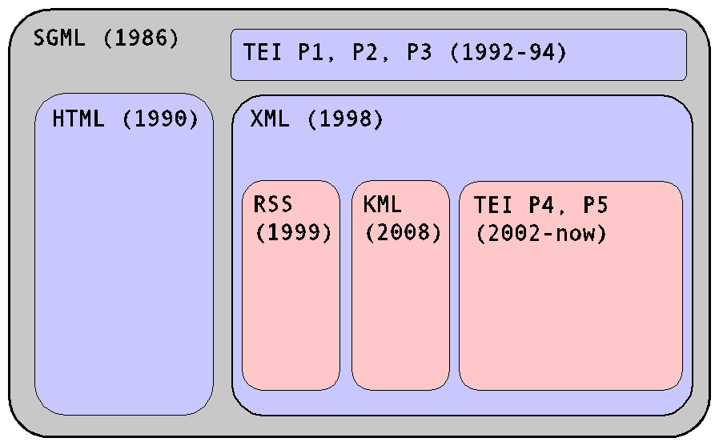
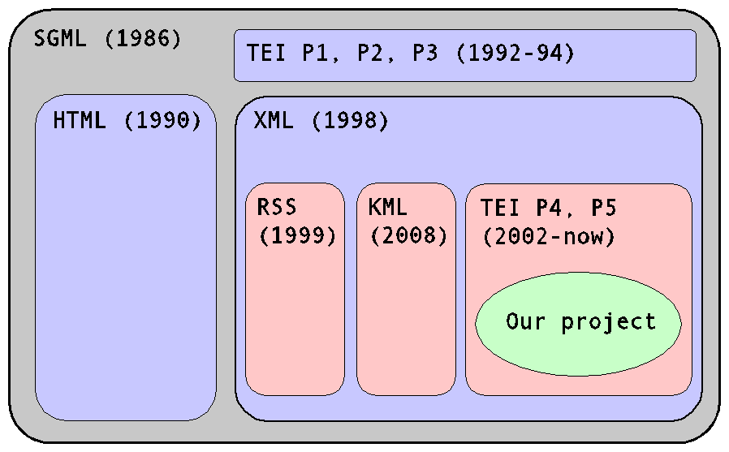
Encoding texts: where TEI fits

Slide 5
A quick intro to/refresher on XML

Slide 6
XML elements
<p>His name is <name>Fred</name>.</p>
Opening tag: <p>
Closing tag: </p>

Slide 7
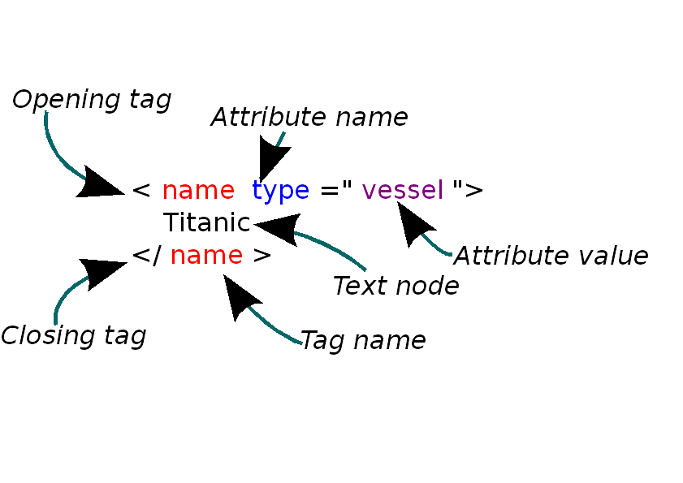
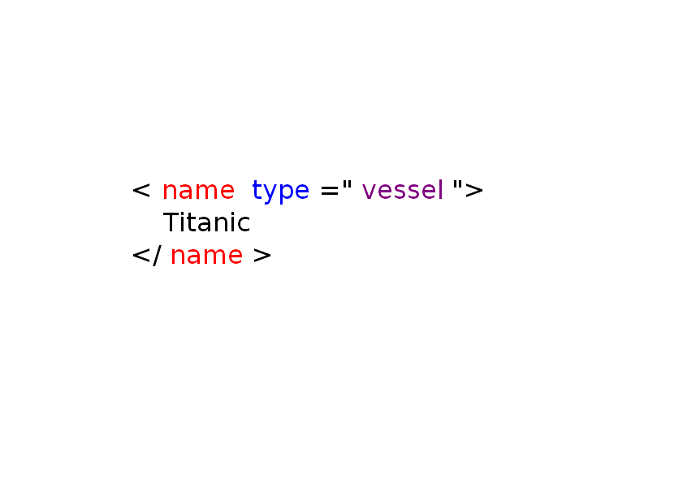
Elements, attributes, values and text nodes

Slide 8
Creating an XML file in Oxygen
File / New / XML Document / Create.
This gives a file consisting of:
<?xml version="1.0" encoding="UTF-8"?>
Now add this:
<human period="stone-age">
<name>Fred Flintstone</name>
</human>

Slide 9
Check well-formedness
Document / Validate / Check Well-Formedness
What do you see at the bottom?
Now add a second human, after Fred:
<human period="stone-age">
<name>Barney Rubble</name>
</human>
Check well-formedness again. What happens? Why?
How can we fix it?

Slide 10
Required: a single root element
Select both your humans, and press Control+e.
Type “humans” and press return.
Check for well-formedness.

Slide 11
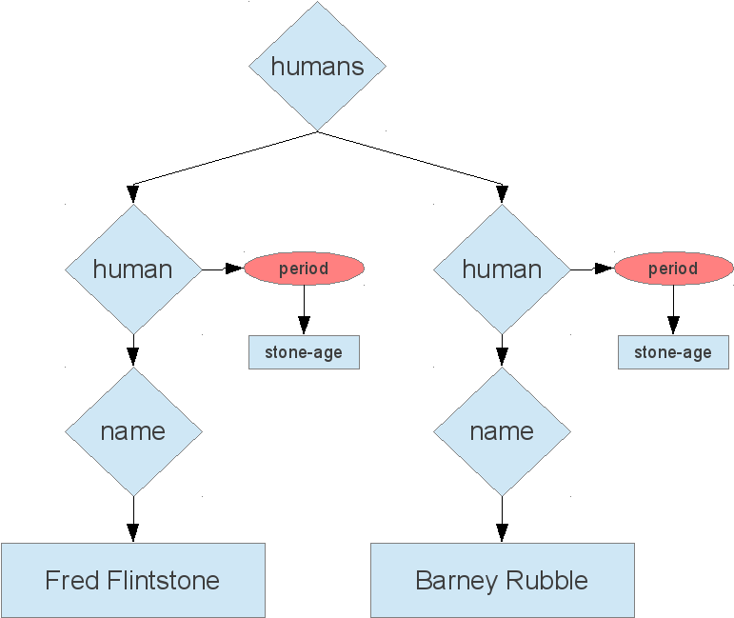
XML documents are trees

Slide 12
Anybody can make up XML tags
In our document, we made up three XML elements and one attribute.
We have the power.
Everybody has the power.
What might be the drawbacks of this?
Notes:
Among other things, all this silliness shows clearly something which is, on the face of it, surprising: you can make up your own XML tags. If you want a <human> tag, you can make one and use it, and your XML will be perfectly well-formed.
You can easily imagine the problems that arise out of this. How do I know what XML tags I should use? Should I make up my own, to suit my own project? What will happen if I do that?
This raises two distinct issues, which we'll deal with in turn. The first is the obvious need for people to agree on what tags and attributes we should all be using for what purpose. This is the reason for the existence of the TEI, and one of the major reasons for the existence of lots of other industry bodies such as the W3C itself. Somebody has to set out a detailed list of the elements and attributes you can use in a particular kind of document. Without that, no-one could use anyone else's documents, web browsers wouldn't be able to display web pages, and nowadays even word-processors wouldn't work at all.
There are of course many kinds of document, each with its own set of requirements. What goes into a web page is not the same as what goes into a set of instructions for a print-rendering program, or a spreadsheet. Each document type needs its own set of elements, attributes, and rules for using them. This is why schemas were invented.

Slide 13
XML Schemas to the rescue
We need standardization.
We need a way to enforce compliance and consistency.
XML schemas allow us to do that.
There are several different types of schema. Hahahaha.
But we'll be using RelaxNG schemas.

Slide 14
How to use a schema
http://hcmc.uvic.ca/workshops/ise/humans.rng
In Oxygen:
Document / Schema / Associate Schema.
Type or paste in the URL above, and press OK.
<?xml-model
href="http://hcmc.uvic.ca/workshops/ise/humans.rng"
type="application/xml"
schematypens="http://relaxng.org/ns/structure/1.0”
?>

Slide 15
An ISE project for Oxygen
Download the package of materials here:
http://hcmc.uvic.ca/workshops/ise/ise_tei.zip
Unzip it somewhere convenient.
In Oxygen, Project / Open Project, then navigate to the ise_tei.xpr file.

Slide 16
What will this do for you?
Allow you to create a new ISE TEI file based on a template.
Validate that file continuously while you work on it.
Allow you to work in both a code view and a reader-friendly view.
Create an HTML page from your document automatically.

