Slide 1
Introduction to TEI and XML Encoding:
A Simple TEI file

Slide 2
TEI is for all sorts of purposes
Medieval manuscripts
Renaissance plays
Modern scholarly articles
Critical editions
Dictionaries
Linguistic corpora
Gravestones
....

Slide 3
So TEI is HUGE!
539 elements.
253 attributes.
Organized into 20 different modules.
60 attribute classes.
Virtually nobody “knows” all of TEI.
We just know (something about) the bits we use.
So don't panic.

Slide 4
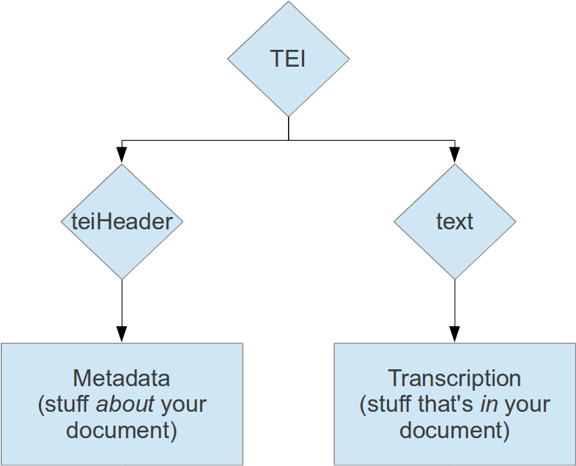
Basic TEI file structure
Notes:
Go to http://hcmc.uvic.ca/workshops/tei_intro/tree.htm
Then step through the hitch.xml file in Oxygen.

Slide 5
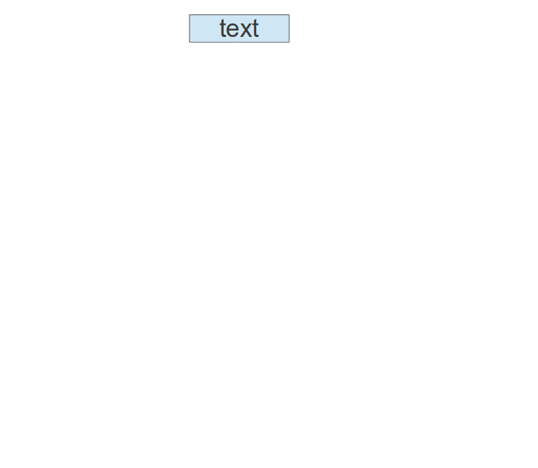
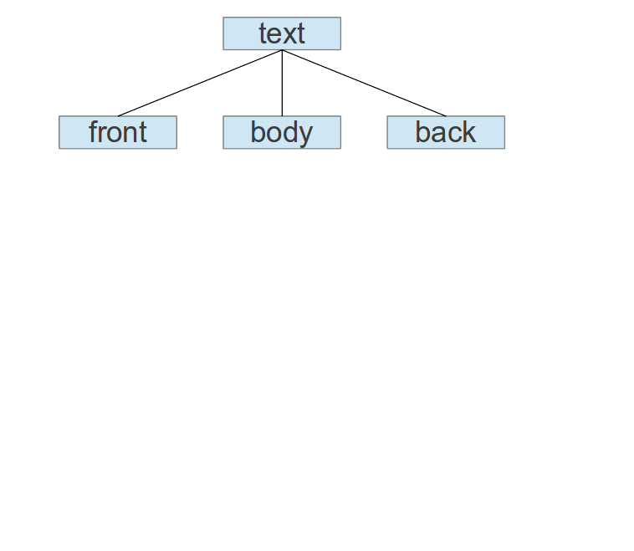
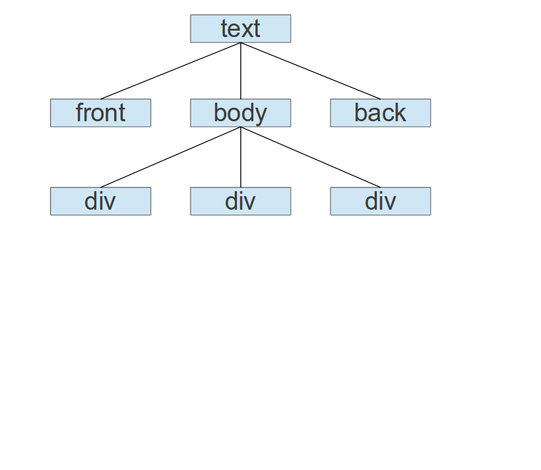
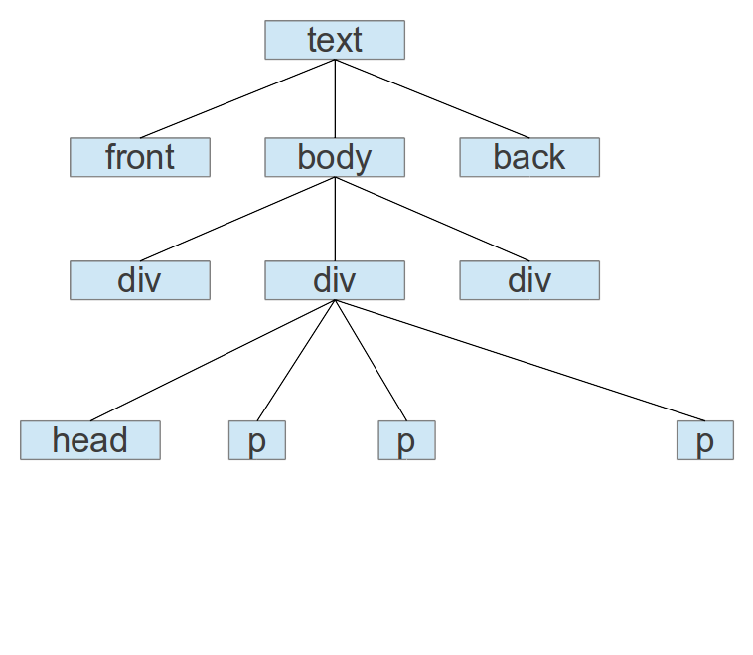
Basic text structure

Slide 6
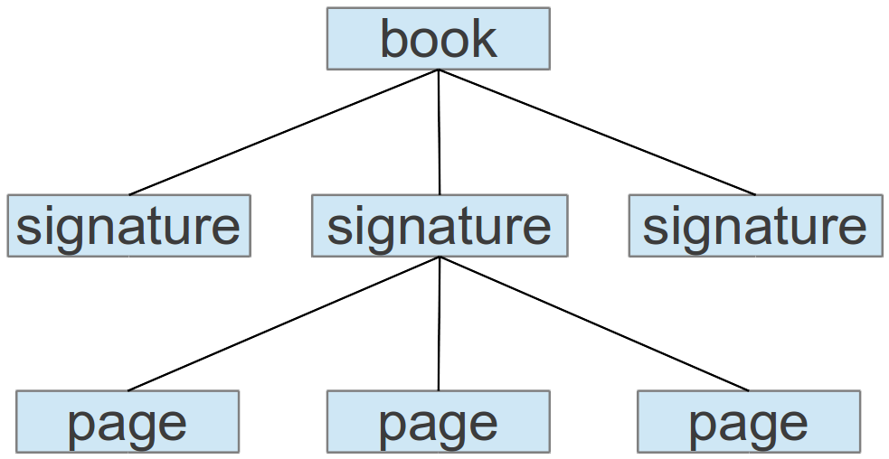
Another hierarchy

Slide 7
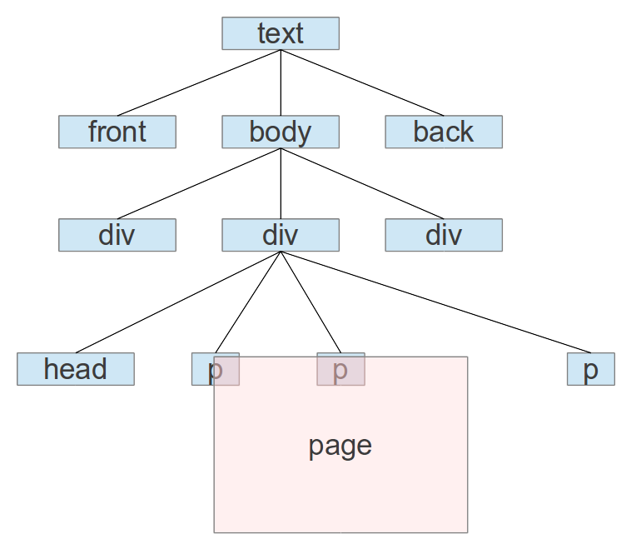
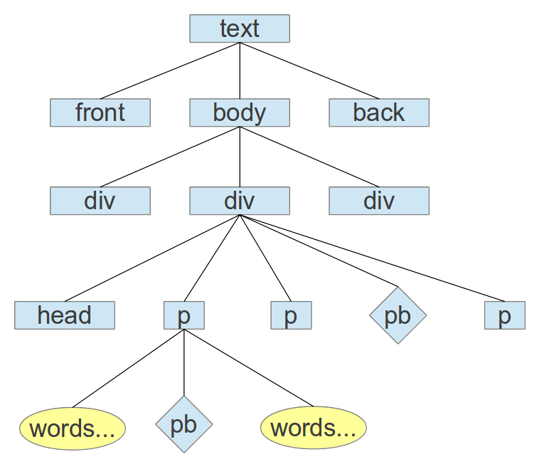
Limitations of a well-formed tree

Slide 8
Block elements
Structural chunks: the sort of thing that has a return before and after it.
<div>, <head>, <p>, <lg>, <l>, <list>, <item>
We normally tag structural chunks first.

Slide 9
Inline elements
Phrase-level: the kind of thing that shows up inside a phrase, sentence or line.
<emph>, <term>, <title>, <date>, <foreign>
<persName>, <placeName>, <orgName>, <name>, <rs>

Slide 10
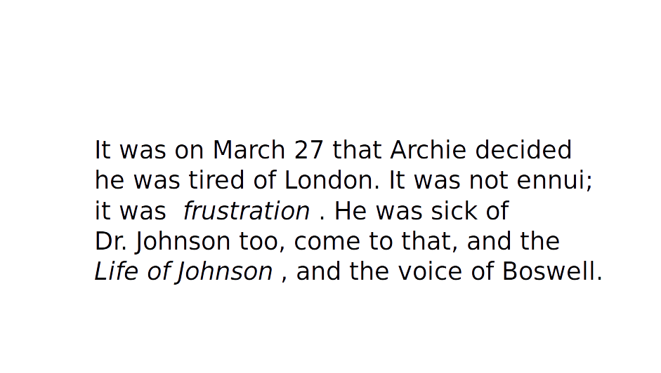

Slide 11
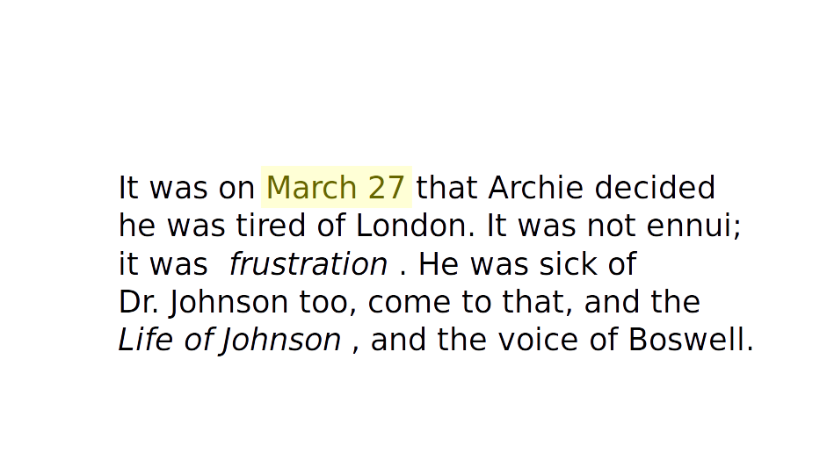

Slide 12
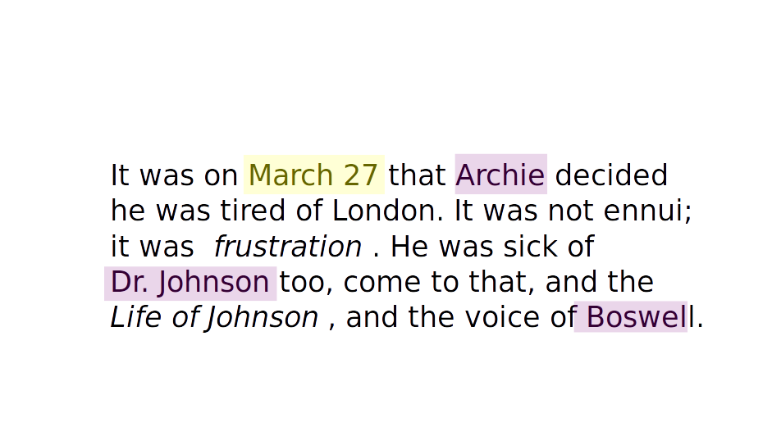

Slide 13
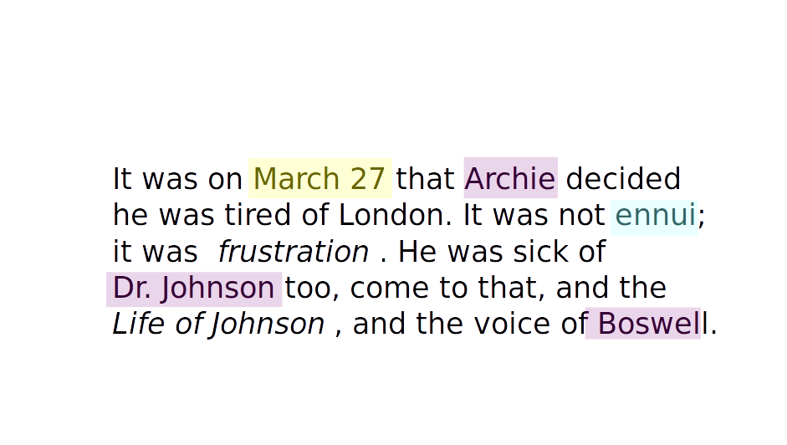

Slide 14
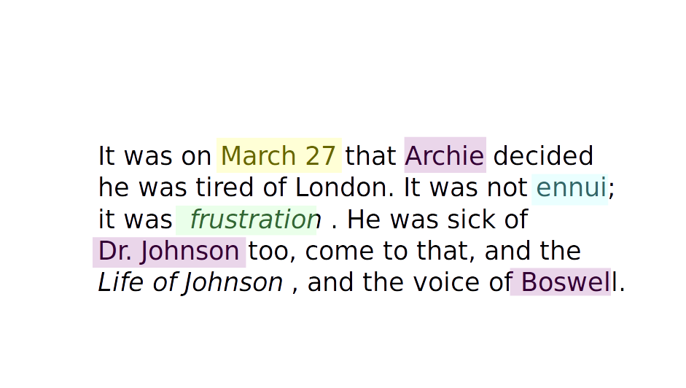

Slide 15
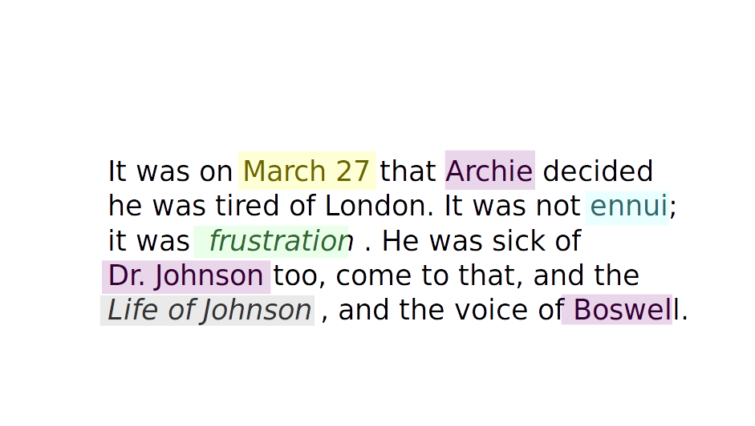

Slide 16
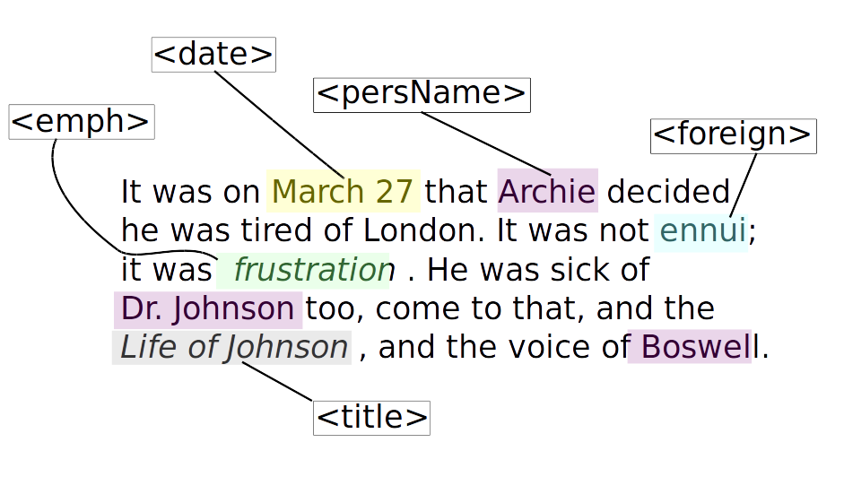

Slide 17
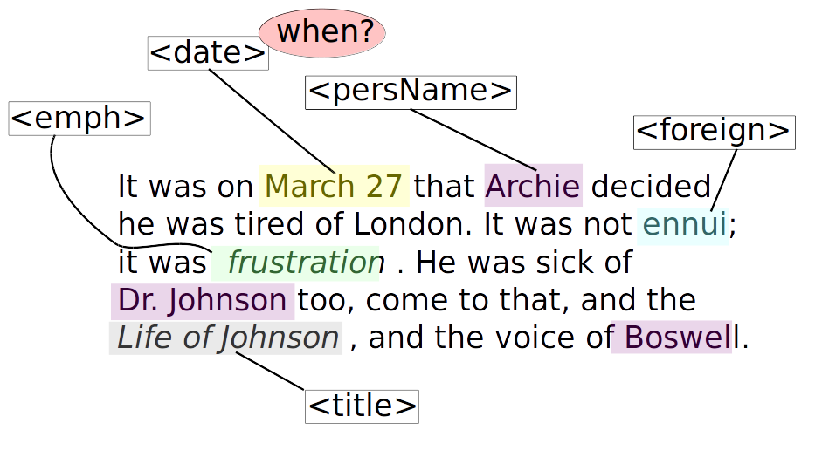

Slide 18
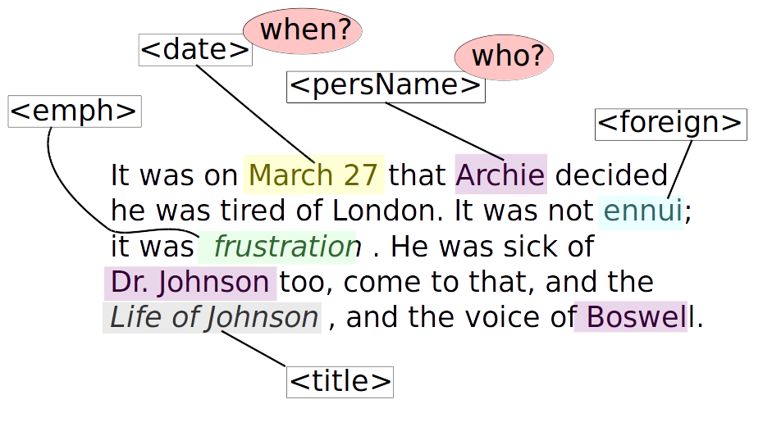

Slide 19
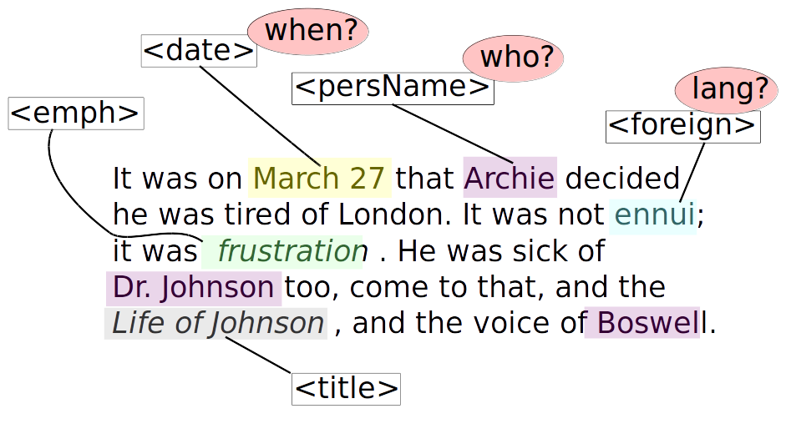

Slide 20
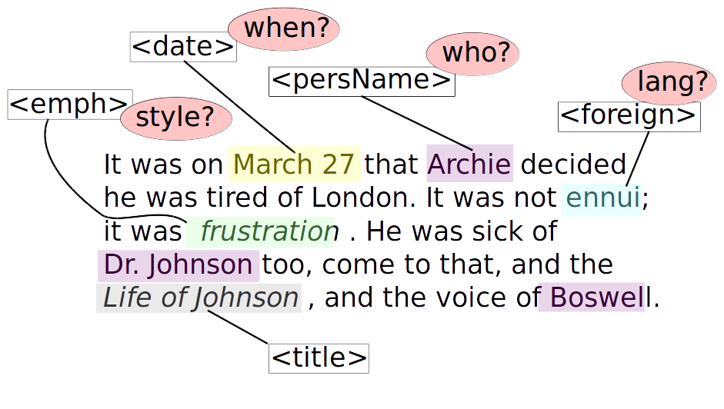

Slide 21
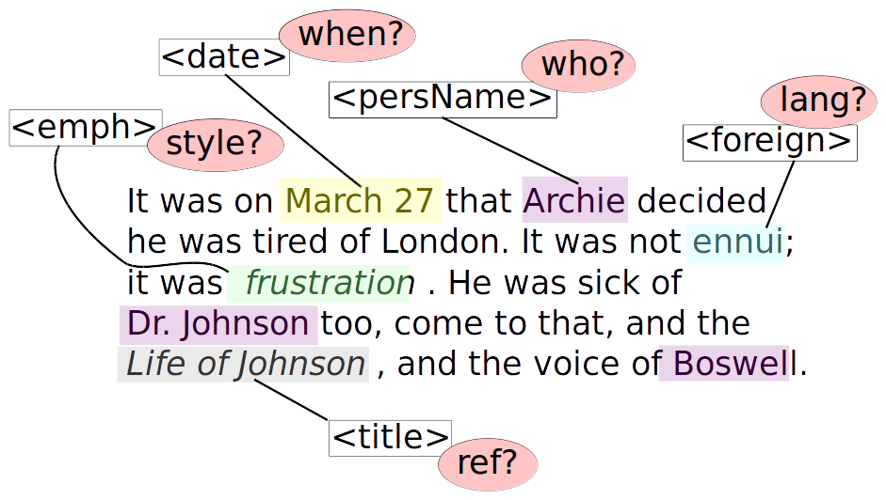

Slide 22
Milestone elements
Typically these are represent transitions between units from a different hierarchy.
<lb/>, <cb/>, <pb/>, <gb/>, <anchor/>
<fw> (= forme work)
Notes:
Now do the basic markup task (“Chapter 27”).

