Slide 1
Introduction to TEI and XML Encoding:
Basic Components of XML

Slide 2
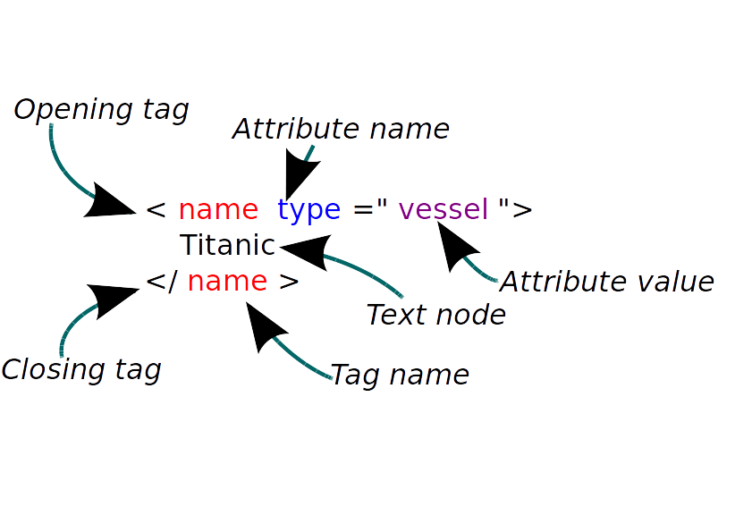
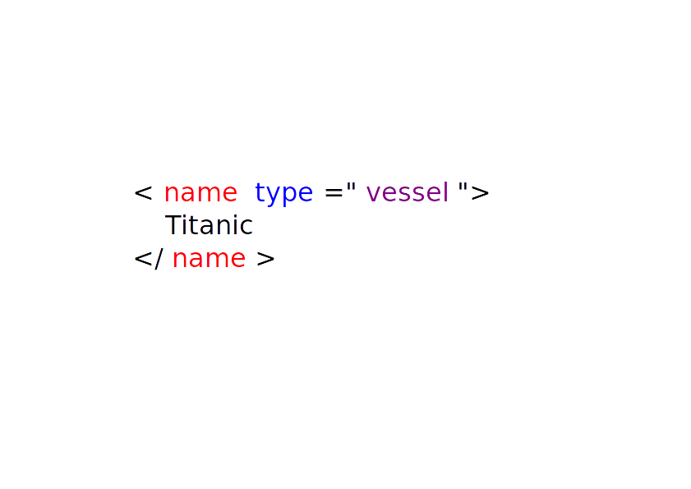
Elements, attributes and text nodes

Slide 3
Elements vs attributes
Is there a difference between these?
  <person name=”Fred Bloggs” />
  <person>
  <name>Fred Bloggs</name>
  </person>

Slide 4
Elements vs attributes
Attributes can consist only of text; they can't include any other markup.
<person>
<name>
<forename>Fred</forename>
<surname>Bloggs</surname>
</name>
</person>
*<person name=”<forename>Fred</forename>
<surname>Bloggs</surname>” />

Slide 5
Elements vs attributes
The same attribute can only occur once in the same context.
<person>
<name>Fred Bloggs</name>
<name>Bloggsie</name>
</person>
*<person name=”Fred Bloggs” name=”Bloggsie”/>

Slide 6
Elements vs attributes
Elements are components of their parent.
Attributes describe their parent element, by ascribing properties to it.
  <s>Elephants are contagious!</s>
  *<s text=”Elephants are contagious!”/>
  <s type=”exclamatory”>Elephants are contagious!</s>

Slide 7
Elements vs attributes
Attributes cannot have attributes.
<person>
<name type=”nickname”>Bloggsie</name>
</person>
*<person name=”Bloggsie
type='nickname'”/>

Slide 8
Elements vs attributes
Elements may have meaningful order, but attributes cannot.
<parent>
<firstchild>A</firstchild>
<secondchild>B</secondchild>
</parent>
<parent firstchild=”A” secondchild=”B”/>

Slide 9
Elements or attributes?
a chapter of a book
the number of a chapter
the colour of a circle
the text on a label
the position of a label
the name of a place
the geographic location of a place
the gender of a noun
the nationality of a person
the catalogue number of a book
the language from which a word comes
the language a person speaks

Slide 10
Other XML components
XML declaration:
  <?xml version="1.0" encoding="UTF-8"?>
Entities:
  &lt; &gt; &amp; &#x2024;
Comments:
  <!-- Check this reference asap. -->
Processing instructions (more later)

Slide 11
Anybody can make up XML tags
In our document, we made up three XML elements and one attribute.
We have the power.
Everybody has the power.
What might be the drawbacks of this?
Notes:
Among other things, all this silliness shows clearly something which is, on the face of it, surprising: you can make up your own XML tags. If you want a <human> tag, you can make one and use it, and your XML will be perfectly well-formed.
You can easily imagine the problems that arise out of this. How do I know what XML tags I should use? Should I make up my own, to suit my own project? What will happen if I do that?
This raises two distinct issues, which we'll deal with in turn. The first is the obvious need for people to agree on what tags and attributes we should all be using for what purpose. This is the reason for the existence of the TEI, and one of the major reasons for the existence of lots of other industry bodies such as the W3C itself. Somebody has to set out a detailed list of the elements and attributes you can use in a particular kind of document. Without that, no-one could use anyone else's documents, web browsers wouldn't be able to display web pages, and nowadays even word-processors wouldn't work at all.
There are of course many kinds of document, each with its own set of requirements. What goes into a web page is not the same as what goes into a set of instructions for a print-rendering program, or a spreadsheet. Each document type needs its own set of elements, attributes, and rules for using them. This is why schemas were invented.

Slide 12
XML Schemas to the rescue
We need standardization.
We need a way to enforce compliance and consistency.
XML schemas allow us to do that.
There are several different types of schema. Hahahaha.
But we'll be using RelaxNG schemas.

Slide 13
How to use a schema
http://hcmc.uvic.ca/workshops/ise/humans.rng
In Oxygen: Document / Schema / Associate Schema.
Type or paste in the URL above, and press OK.
<?xml-model
href="http://hcmc.uvic.ca/workshops/ise/humans.rng"
type="application/xml"
schematypens="http://relaxng.org/ns/structure/1.0”
?>

Slide 14
Well-formedness and Validation
Previously you checked the well-formedness of your file.
Now you can also validate your file against the schema.
What happens when you do that?
RULE 1 when encoding: validate your XML all the time.

Slide 15
An ISE project for Oxygen
Download the package of materials here:
http://hcmc.uvic.ca/workshops/ise/ise_tei.zip
Unzip it somewhere convenient.
In Oxygen, Project / Open Project, then navigate to the ise_tei.xpr file.

Slide 16
What will this do for you?
Allow you to create a new ISE TEI file based on a template.
Validate that file continuously while you work on it.
Allow you to work in both a code view and a reader-friendly view.
Create an HTML page from your document automatically.

