Slide 1
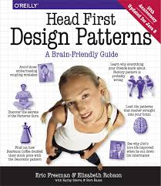

Slide 2
Design Principle
Identify the aspects of your application that vary and separate them from what stays the same.
The result of this will be fewer unintended consequences from code changes and more flexibility.
This concept forms the basis for almost every design pattern. All patterns provide a way to let some part of a system vary independently of all other parts.
In Duck simulator of Chapter 1, this concept encourages us to separate fly() and quack() methods from the Duck class, as they are parts that vary across ducks.

Slide 3
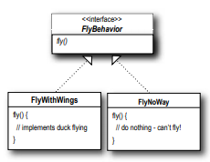
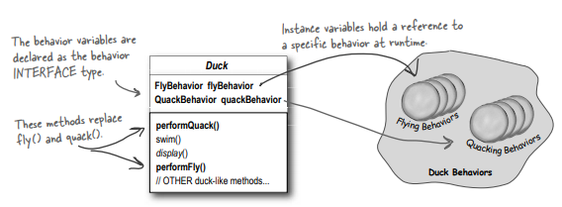
Design Principle
Program to an interface, not an implementation.
In Duck simulator of Chapter 1, this concept encourages us to use an interface to represent each behavior – for instance, FlyBehavior and QuackBehavior – and each implementation of a behavior will implement one of those interfaces. The Duck subclasses will use a behavior represented by an interface (FlyBehavior and QuackBehavior), so that the actual implementation of the behavior won’t be locked into the Duck subclass.

Slide 4
Design Principle
Favor composition over inheritance
Creating systems using composition gives you more flexibility. Not only does it let you to encapsulate a family of algorithms into their own set of classes, but it also lets you change behavior at runtime as long as the object you’re composing with implements the correct behavior interface.

Slide 5
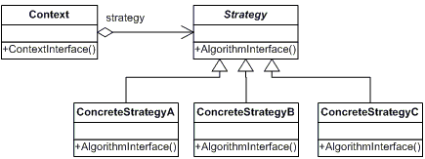
Strategy Pattern
The Strategy Pattern defines a family of algorithms, encapsulates each one, and makes them interchangeable. Strategy lets the algorithm vary independently from clients that use it

Slide 6
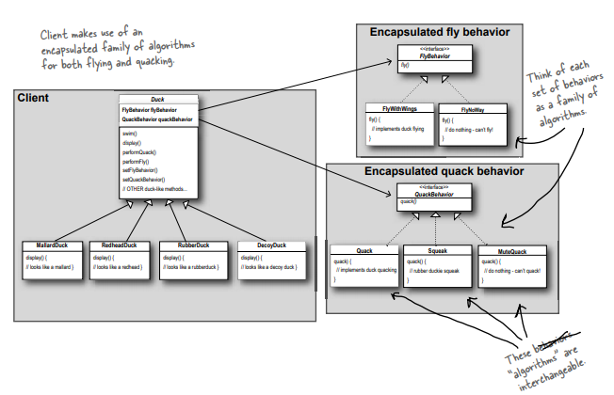
Strategy Pattern

