Slide 1
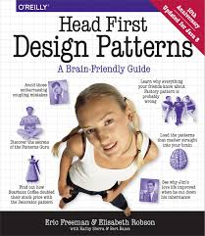

Slide 2
Design Principle
Identify the aspects of your application that vary and separate them from what stays the same.
The result of this will be fewer unintended consequences from code changes and more flexibility.
This concept forms the basis for almost every design pattern. All patterns provide a way to let some part of a system vary independently of all other parts.
In Duck simulator of Chapter 1, this concept encourages us to separate fly() and quack() methods from the Duck class, as they are parts that vary across ducks.

Slide 3
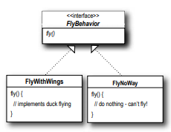
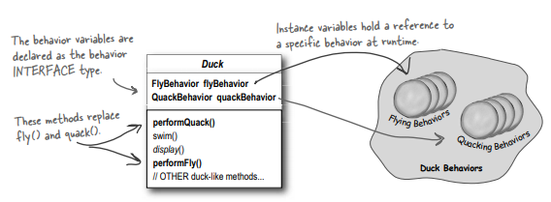
Design Principle
Program to an interface, not an implementation.
In Duck simulator of Chapter 1, this concept encourages us to use an interface to represent each behavior – for instance, FlyBehavior and QuackBehavior – and each implementation of a behavior will implement one of those interfaces. The Duck subclasses will use a behavior represented by an interface (FlyBehavior and QuackBehavior), so that the actual implementation of the behavior won’t be locked into the Duck subclass.

Slide 4
Design Principle
HAS-A is better than IS-A
Each Duck has a FlyBehavior and a QuackBehavior. Instead of using inheritance, we’re using composition.
Favor composition over inheritance
Creating systems using composition gives you more flexibility. Not only does it let you to encapsulate a family of algorithms into their own set of classes, but it also lets you change behavior at runtime as long as the object you’re composing with implements the correct behavior interface.

Slide 5
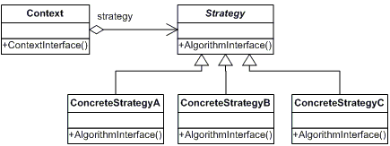
Strategy Pattern
The Strategy Pattern defines a family of algorithms, encapsulates each one, and makes them interchangeable. Strategy lets the algorithm vary independently from clients that use it

Slide 6
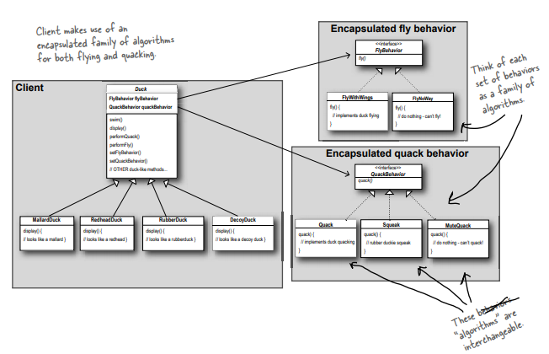
Strategy Pattern

Slide 7
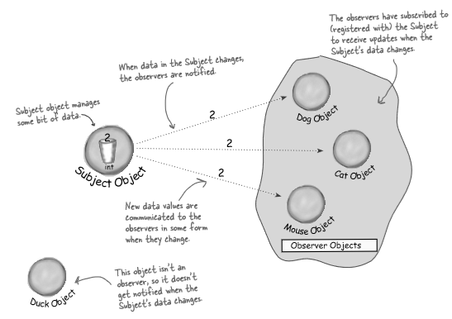
Observer Pattern
Publishers + Subscribers
Object Pattern is comparable to newspaper subscriptions. We call the publisher the SUBJECT, and the subscribers the OBSERVERS.

Slide 8
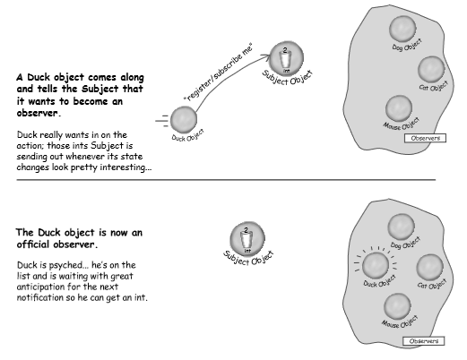
Observer Pattern

Slide 9
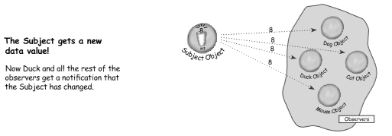
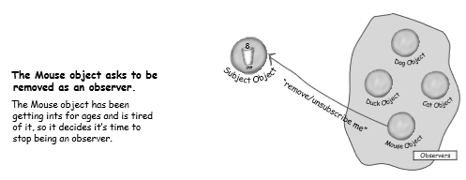
Observer Pattern

Slide 10
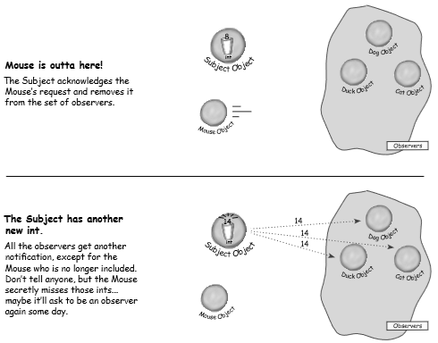
Observer Pattern

Slide 11
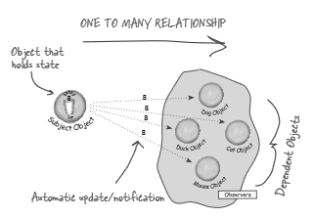
Observer Pattern
The Observer Pattern deﬁnes a one-to-many dependency between objects so that when one object changes state, all of its dependents are notiﬁed and updated automatically.
The subject and observers define the one-to-many relationship. The observers are dependent on the subject such that when the subject’s state changes, the observers get notified. Depending on the style of notification, the observer may also be updated with new values.

Slide 12
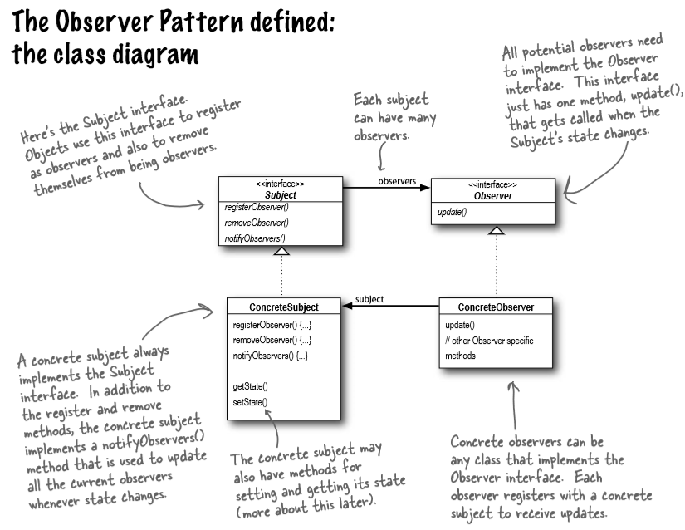

Slide 13
The power of Loose Coupling
The only thing the subject knows about an observer is that it implements a certain interface.
We can add new observers at any time.
When two objects are loosely coupled, they can interact, but have very little knowledge of each other. The Observer Pattern provides an object design where subjects and observers are loosely coupled.
We never need to modify the subject to add new types of observers.
Changes to either the subject or an observer will not affect the other.

Slide 14
Design Principle
Strive for loosely coupled designs between objects that interact.
Loosely coupled designs allow us to build ﬂexible Object-Oriented systems that can handle change because they minimize the interdependency between objects.

Slide 15
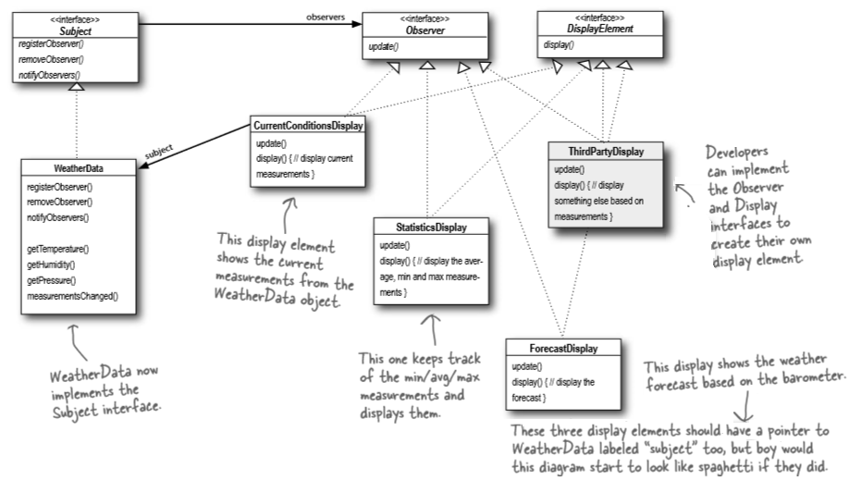
Observer Pattern

