Slide 1
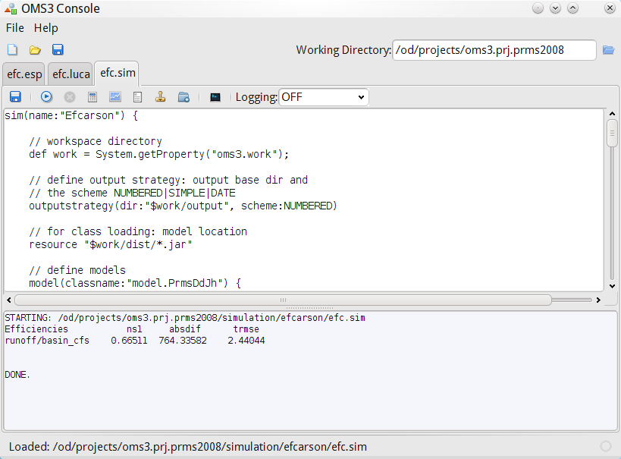

Slide 2
New Concept
Prototype
Legacy
Java
(Wrapping) POJO
Refactored
Java
OMS Component
Legacy
FORTRAN
(Wrapping)
FORTRAN
Module
Simple
JNA
Interface
Refactored
FORTRAN
(Wrapping)
C/C++
File
Legacy
C/C++
Refactored
C/C++
Identify
Refactor
Modularize
Annotate

Slide 3
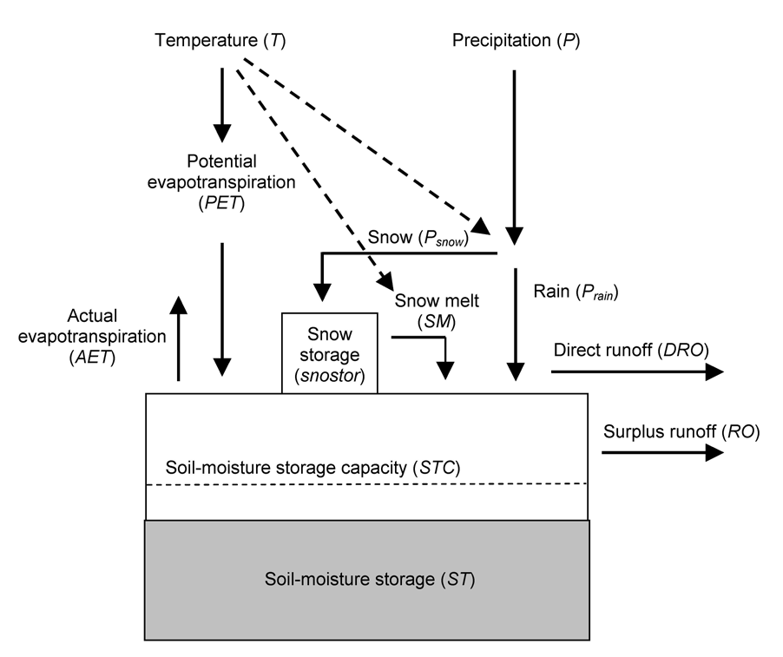

Slide 4
HamonET
daylen [hours]
@In
@Out
pet [mm/month]
time [month]
temp [deg C]
POJO & Annotation Component

Slide 5
Input
- Parameter
- Variables
Output
- Variables
Component
[ Internal State ]

Slide 6
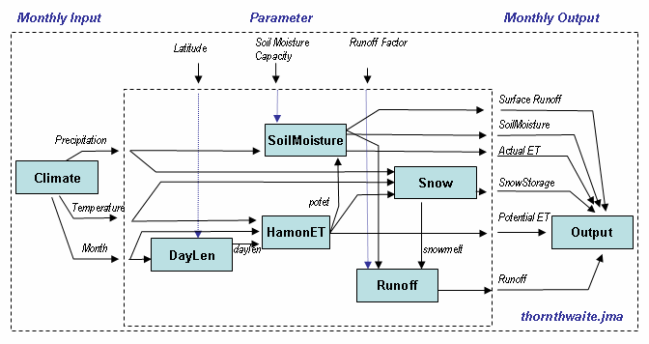

Slide 7
Version Control System
Model
Model
Model
Output ^{SD}
Comp
Run
1)
Simulation
SD (SHA, Resources)
SD - DB
2)
Data
Data
Data
Simulation reconstruction
Data
Document
Data
Doc
3)

Slide 8
HamonETCompInfo
daylen [hours]
@In
@Out
pet [mm/month]
time [month]
temp [deg C]
Annotation Component
HamonET
POJO

Slide 9
HamonETCompInfo
daylen [hours]
@In
@Out
pet [mm/month]
time [month]
temp [deg C]
Annotation Component
HamonET
POJO
ETLib
DLL

Slide 10
@In
@Out
daylen [hours]
HamonET
pet [mm/month]
time [month]
temp [deg C]

Slide 11
Calibration,
Sensitivity
Analysis
Model
Application
Audit Trails
Visual
Analysis
Docu-mentation
Products
Development
Tools
Models
Simulations
OMS3
Ontologies
Components
Meta data
Knowledge
Base
Databases
Web
Services
Source
Repositories
Resources

Slide 12

A)
Comp A
Comp C
Comp B
B)
Comp A
Comp B
Comp C

Slide 13
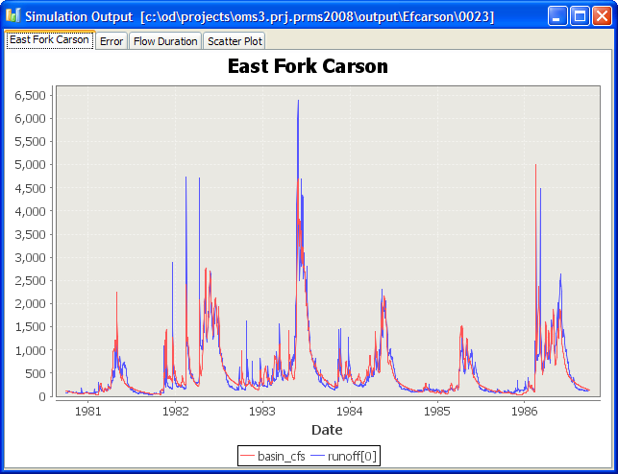
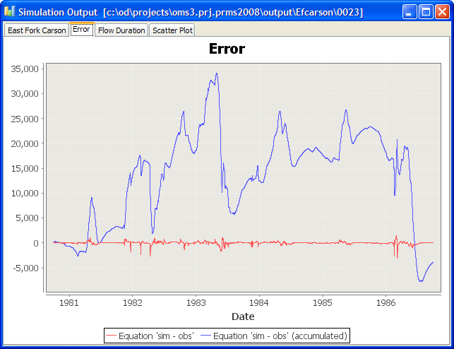
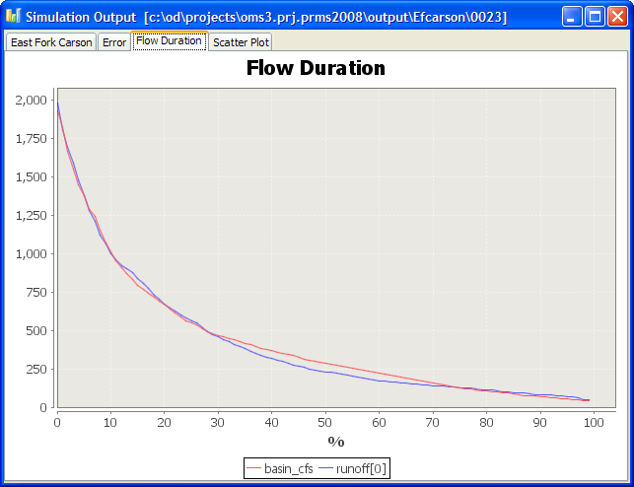
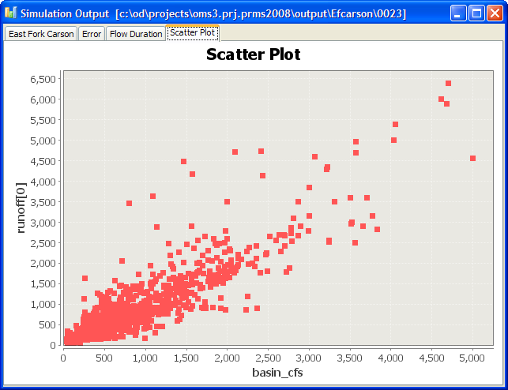

Slide 14
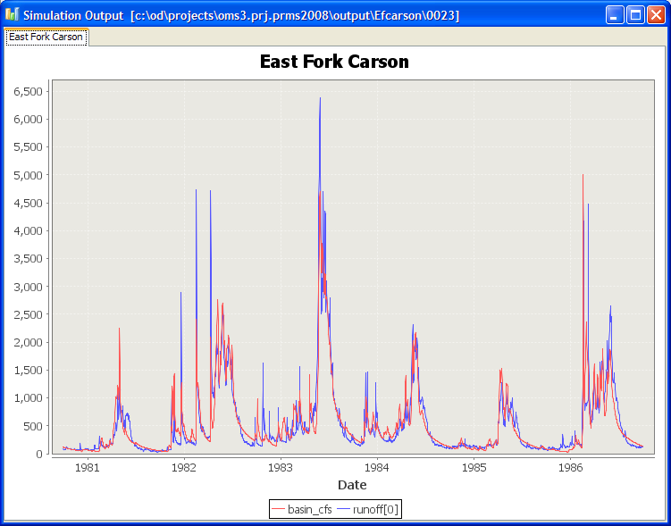

Slide 15
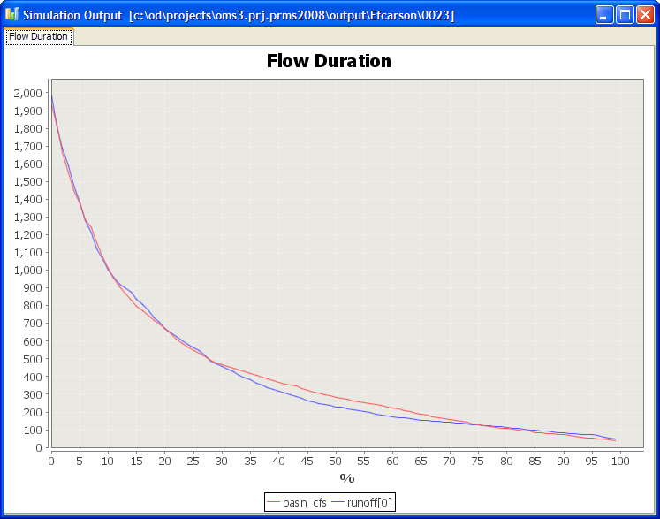

Slide 16
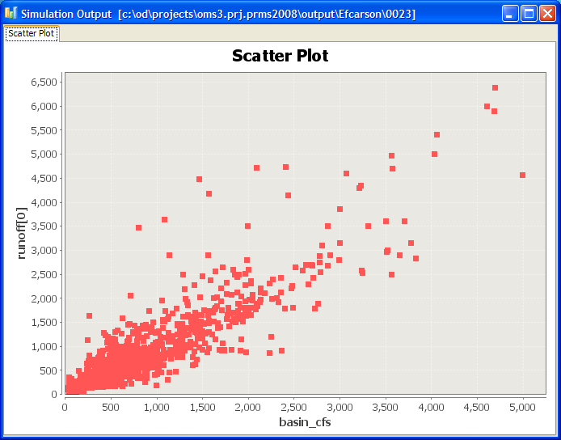

Slide 17
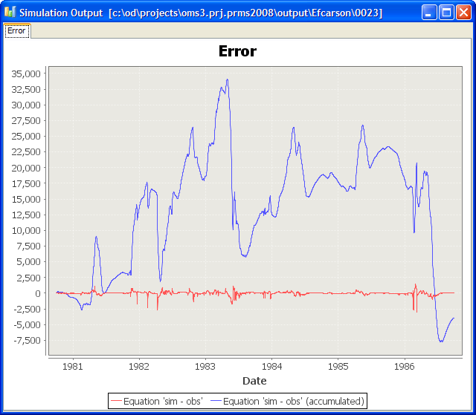

Slide 19
Execution phases
(Initialize Run Finalize)
Component A
Component
C
Input data
Output data
Component
B

Slide 20


Comp A
Comp C
Data
Comp B
Data Provisioning
Model Execution (Type)
Data output Analysis

Slide 21
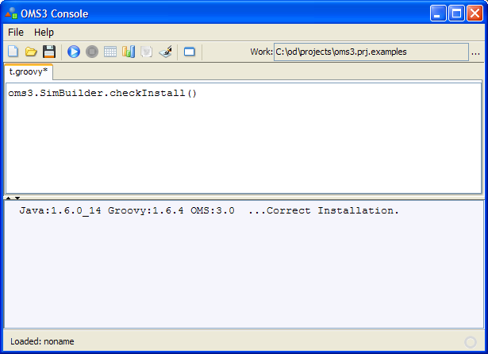

Slide 22
Rounds
Steps
Start
Step 1
Step 1
Step 1
Step 2
Step 2
Step 2
Step n
Step n
Step n
End
Round 1
Round 2 …
Round n

Slide 23
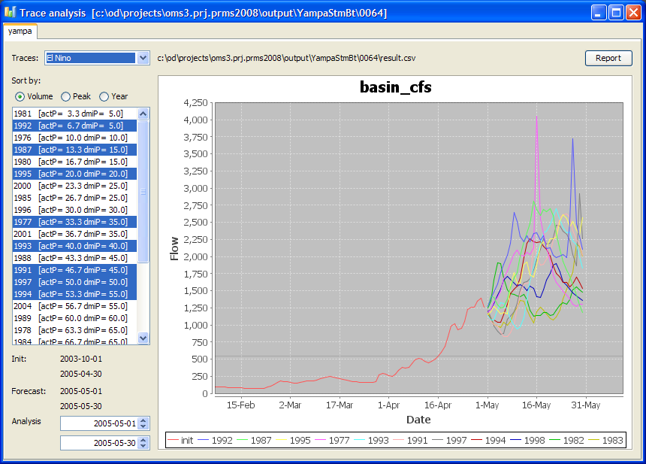

Slide 24
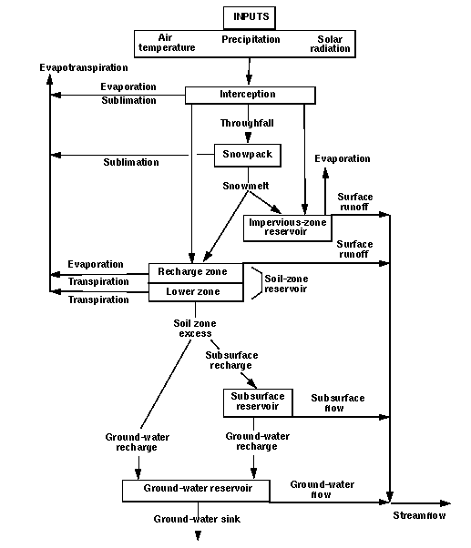
Inputs
Evapotranspiration
Air temperature
Precipitation Solar radiation
Evaporation
Sublimation
Interception
Evaporation
Throughfall
Sublimation
Snowpack
Snowmelt
Evaporation
Impervious-zone
Reservoir
Surface runoff
Transpiration
Recharge Zone
Lower Zone
Transpiration
Surface runoff
Soil zone
excess
Subsurface
Reservoir
Subsurface flow
Groundwater
recharge
Groundwater recharge
Groundwater flow
Groundwater Reservoir
Streamflow
Groundwater sink

Slide 25
class A {
@Out
public double out_val;
...
}
class B {
@In
public double in_val;
...
}
a : A
b : B
out_val
in_val
out2in(a, “out_val”, b, “in_val”);

Slide 26
class A {
@Out
public double out_val;
...
}
class Obj {
public double field;
...
}
a : A
o : Obj
out_val
field
out2field(a, “out_val”, obj, “field”);

Slide 27
class Obj {
public double field;
...
}
class B {
@In
public double in_val;
...
}
o : Obj
b : B
field
in_val
field2in(o, “field”, b, “in_val”);

Slide 28
class Obj {
public double field;
...
}
class B {
@In @Out
public double inout_val;
...
}
o : Obj
b : B
field
in_val
field2inout(o, “field”, b, “inout_val”);

Slide 29
class Obj {
public double field;
...
}
class B {
@In @Out
public double inout_val;
...
}
o : Obj
b : B
field
in_val
field2inout(o, “field”, b, “inout_val”);

Slide 30
class B {
@In
public double in_val;
...
}
b : B
in_val
3.145
val2in(3.145, b, “in_val”);

Slide 31
class A {
@Out
public double out_val;
@In
public double in_fb;
...
}
class B {
@In
public double in_val;
@Out
public double out_fb;
...
}
t_{n +} ..
a : A
b : B
out_val
in_val
t_{n + 1}
a : A
b : B
out_val
in_val
t_{n}
t_{n -1}
out2in(a, “out_val”, b, “in_val”);
feedback(b, “out_fb”, a, “in_fb”);

Slide 32
class A {
@In
public double in_val;
...
}
class B {
@In
public double in_val;
...
}
a : A
in_val
b : B
in_val
in2in(a, “in_val”, b, “in_val”);

Slide 33
class A {
@Out
public double out_val;
...
}
class B {
@Out
public double out_val;
...
}
a : A
out_val
b : B
out_val
out2out(b, “out_val”, a, “out_val”);

Slide 40
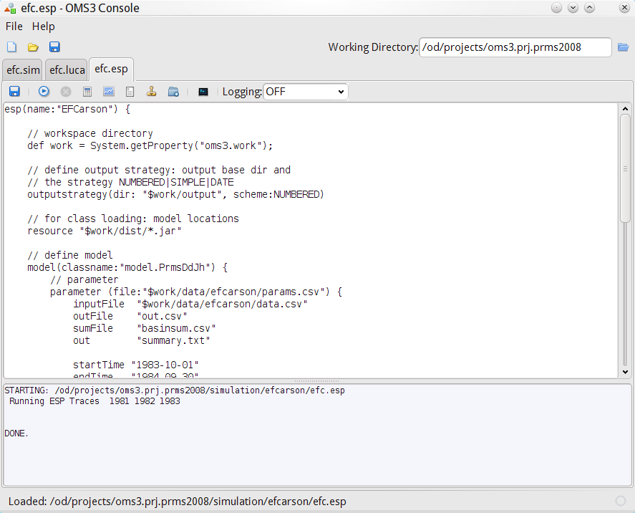
Toolbar
Simulation Tabs
Working Directory
Toolbar
Editor
Console Output
Status Line

Slide 41
1 2 3
4 5 6 7 8 9 10 11 12 13

Slide 42
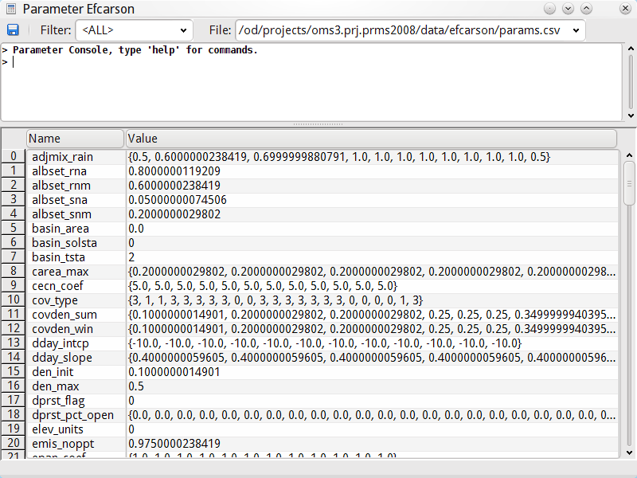
Type Filter
Parameter File
Command Console
Parameter Editor

Slide 43
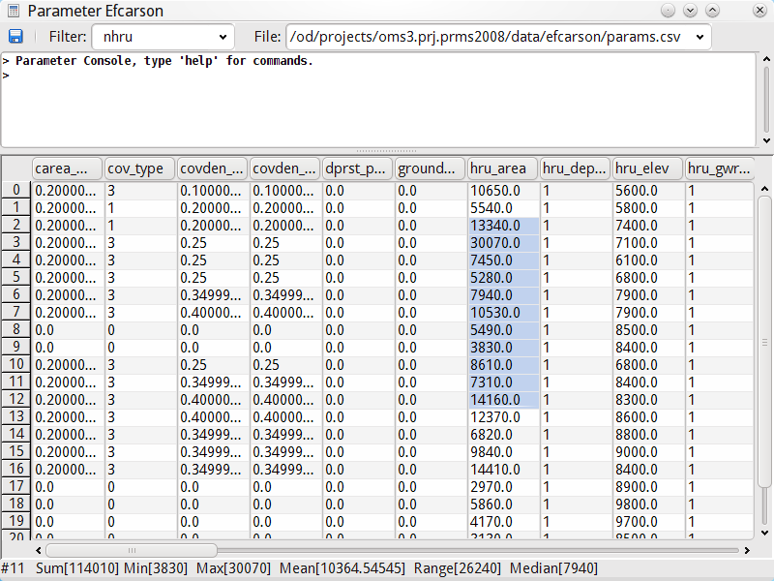
Table View (Filter for ‘nhru’ dimensioned parameter)
Statistics on Selection

Slide 47
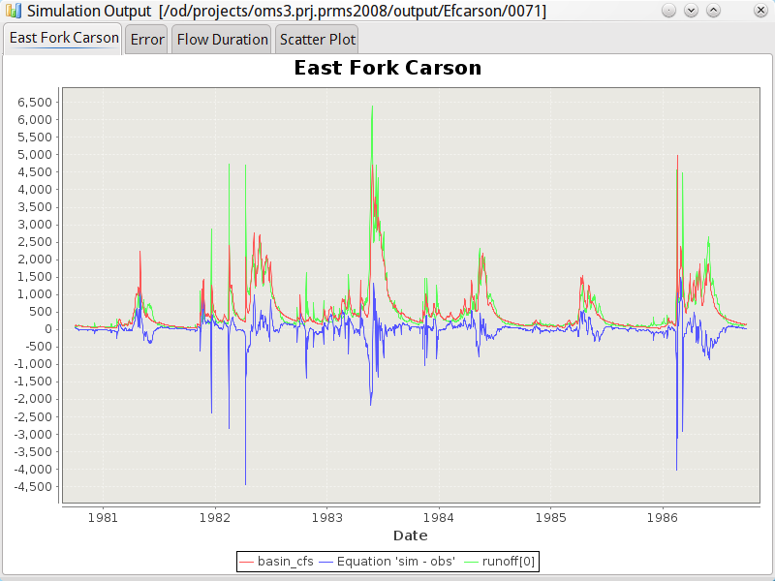
Output folder
Analysis tabs

