Slide 1
OMS 3
Modeling Workshop
JRC, Ispra, July 2012
Olaf David, Jim Ascough, Jack Carlson
Colorado State University
US Department of Agriculture, ARS

Slide 2
Overview

Slide 3
Object Modeling System
Reduce redundancy in model development
Improve model code quality
Simplify model technology transfer
Allow simulation traceability, support auditing
Improve model maintainability
Flexible use and rigorous testing of models
Allow flexible change in science
Software Framework for Environmental Modeling
“Science building blocks”

Slide 4
System Components
Principal Architecture
Science Components
Component Based Model
Data IO
Temporal
Erosion
Spatial
Time
ETP
Plant Growth
Plant growth
Irrigation
Space
Inter- ception
Groundwater
Erosion
Water Quality
Control
Snow
Surface RO
Stream RO
Statistics
Surface water use
ET
Soil- water
SS RO
Ground water use
....
Ground-
water
GW Flow
Optimization
Uncertainty
Sensitivity
Calibration
Visualization
Reporting

Slide 5
History of the OMS development
2001/02 2003/04 2005/06 2007/09 2010/11
Initial Prototype
Swing based
Netbeans Platform
Refactoring
Central Version Control
Standardize Component API
PRMS - Prototype
Modeling Projects
USDA CoLab Use
Project Plan/Process
PRMS WSF
CEAP
Calibration Tools
Sensitivity Analysis
Uncertainty Analysis
Data Provisioning
Agency Governance
J2000(S), PRMS WSF, WWEM, Range,
OMS3
COSU
CSIP
Cloud Computing
Parallelization
CEAP-AgEs, AgesUI, PRMS WSF, WWEM, Range, McCabe MWB
Hymod, (GeoTop)
IAEA Rusle2

Slide 6
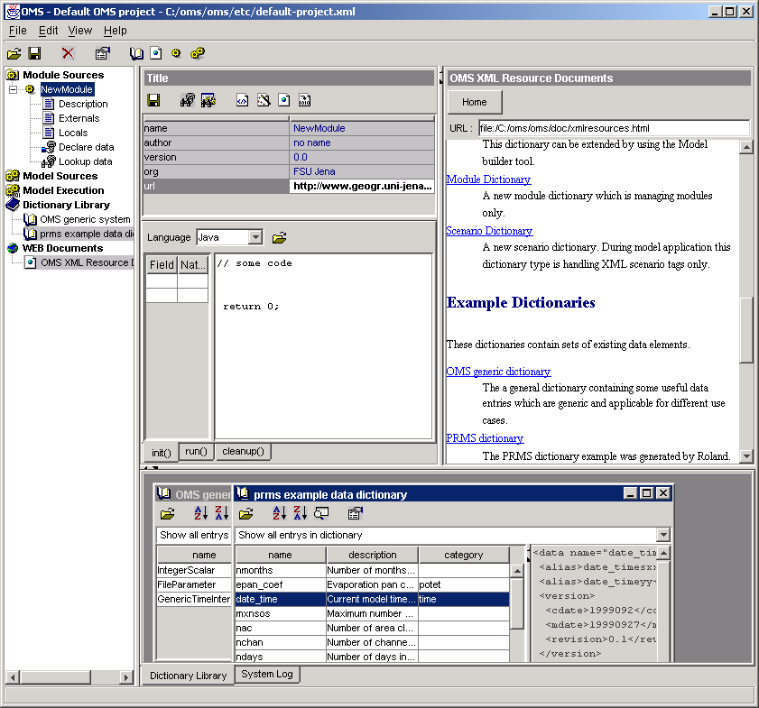
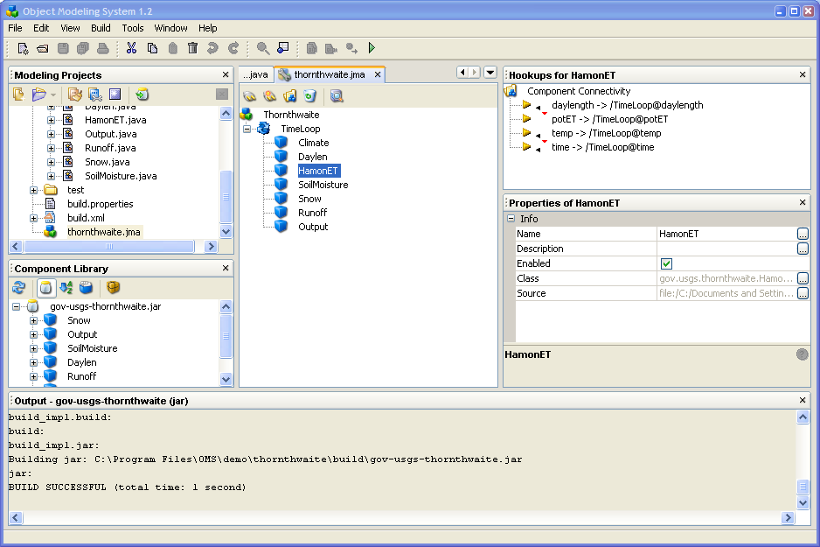
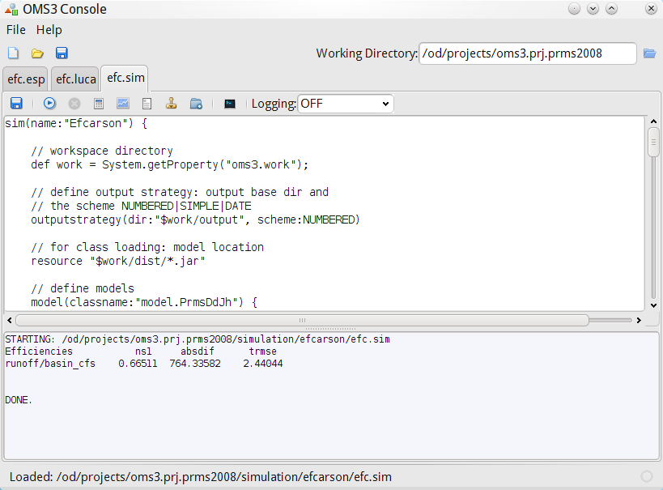
Versions
1.0
2.2
3.0

Slide 7
OMS3 Features
Lightweight, non-invasive, component-based modeling framework
Dataflow driven, Multithreaded execution
Multi-language support
Conversions / Transformation SPI
Ontologies
DSLs for Simulations, Calibration, Uncertainty, and Sensitivity analysis
Auditing, Traceability, Doc generation
EMF interoperability

Slide 8
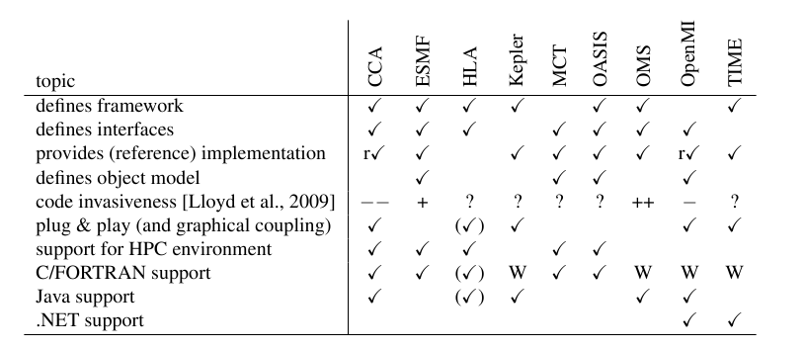
OMS3 and other IMFs
Jaegers B. et al., 2010 Proc IEMSS, Ottawa, Canada

Slide 9
Example Measures MCabe WBM
Language/ Framework | Total LOC | Average CC/method | Total CC
FORTRAN only | 244 | 3.33 | 40
OMS 3.0 Java | 295 | 2.38 | 31
Java only | 319 | 2.85 | 37
C++ only | 405 | 2.41 | 41
OMS 2.2 Java | 450 | 1.18 | 103
ESMF 3.1.1 C | 583 | 1.97 | 65
ESMF 3.1.1 FORTRAN | 683 | 1.44 | 56
OpenMI 1.4 Java | 880 | 1.61 | 116
CCA 0.6.6 Java | 1635 | 2.25 | 276

Slide 10
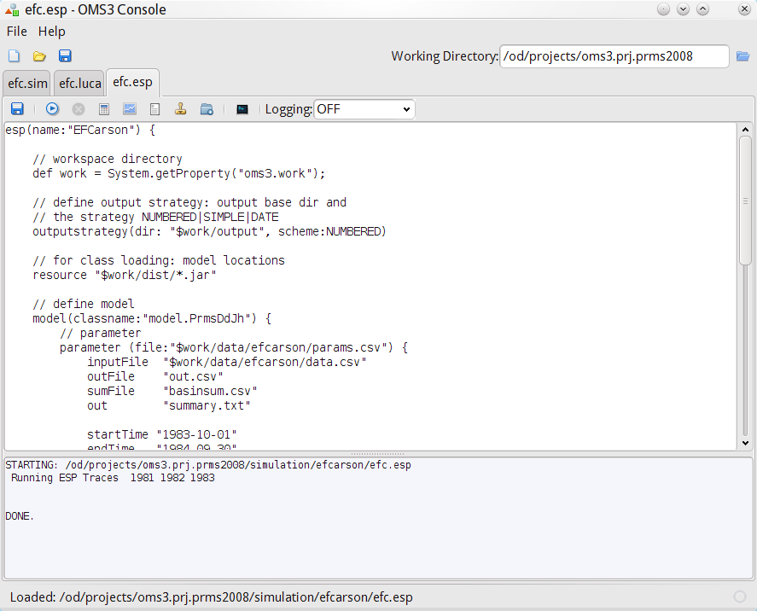
Toolbar
Simulation Tabs
Working Directory
Toolbar
Simulation Editor
Console Output
Status Line

Slide 11
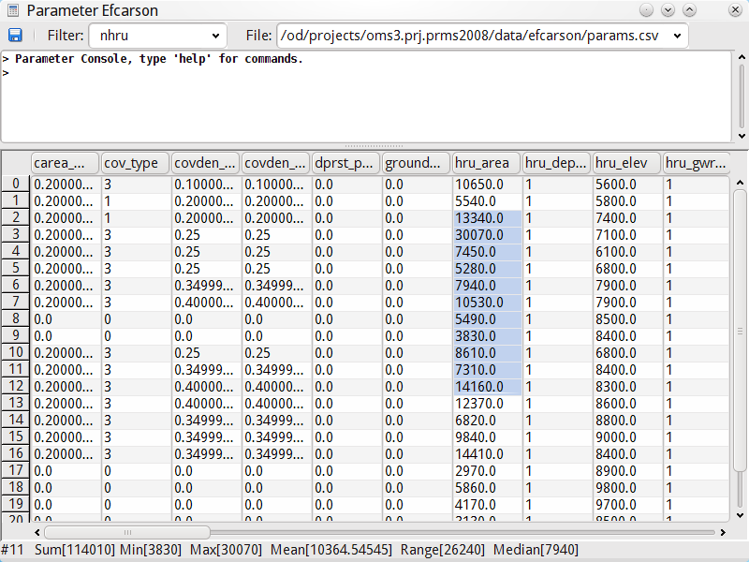
Table View (Filter for ‘nhru’ dimensioned parameter)
Statistics on Selection

Slide 12
NGMF – a Noninvasive modeling Framework

Slide 13
Environmental Modeling Frameworks
Support the development & application of environmental models
Coupling, Execution management
Analysis, Statistics, Visualization
Spatial / Temporal relationships and management
Calibration/Parameter Estimation/Uncertainty Analysis/Solver/…
Data I/O
…

Slide 14
Environmental Modeling Frameworks
They are optional!
Driven by research organizations
Reflecting a domain views
Goals
Eliminate redundancy
Improve efficiency
Simplify complicated tasks

Slide 15
Major Efforts
Earth System Modeling Framework
Common Component Architecture
Object Modeling System
OpenMI
Frames
and probably 20 more …

Slide 16
Framework Invasiveness
A study of how differences between scientific modeling frameworks impacts the quality of the model implementation
Wes Lloyd, Olaf David
Colorado State University, Civil Engineering, Computer Science
US Department of Agriculture ARS,NRCS

Slide 17
Framework Invasiveness
How does the use of a particular framework impact an application's quality?
Quality with respect to
Maintainability
Portability
Reusability
Understandability (of code)

Slide 18
Framework Invasiveness - 2
Coupling between application and framework code
Use of Framework APIs
Use of Framework Interfaces
Use of Framework Custom Data Types
Mass of boilerplate code
Mass should account for both Lines of Code (LOC) and source code size in bytes
External framework dependencies
Required non-framework APIs

Slide 19
Framework Invasiveness – 3
Other framework couplings
Language dependencies
Platform dependencies
For example CCA required Redhat 8
Organizational dependency
Training cost/investment
Hardware cost/investment
Support cost/investment

Slide 20
Research Questions
How does framework invasiveness impact software quality?
In order to answer the question we must first quantify invasiveness
How do we measure framework to application invasiveness?
Perform an analysis of models implemented in various frameworks, languages

Slide 21
Invasiveness Properties
Number of Framework specific data types used/uses
Number of framework specific functions used/uses (API calls)
LOC of model implementation
Boilerplate LOC of model implementation
Application LOC of model implementation
Boilerplate to Application LOC ratio
Size of Framework
Number of classes/modules/functions
Size (LOC)

Slide 22
Model Implementation Investigation
Thornthwaite Water balance model
Models allocation/distribution of water among components of hydrological system
Model
FORTRAN Implementation = 244 LOC
8 Modeling Components
Climate, Daylen, HamonET, Snow, Soil moisture, Runoff, Output, Controller

Slide 23
ThornthwaiteMC Simulation Model
1..1000000
OF
Random number generation in @Range
Parameter
Latitude
Soil Moisture
Capacity
Runoff Factor
Monthly Output
Surface Runoff
SoilMoisture
SoilMoisture
Precipitation
Actual ET
Climate
Snow
SnowStorage
Temperature
potet
HamonET
Potential ET
Output
Month
DayLen
daylen
snowmelt
Runoff
Runoff
Monthly Input
Thornthwaite
Monte Carlo Simulation

Slide 24
Invasiveness Measures
Source code size (bytes)
Lines of Code (LOC)
Framework dependent datatypes used/uses
Framework specific functions used/uses
Framework dependent code lines of code (FDLOC)
Does not compile if framework removed
Must be refactored if framework removed or changed

Slide 25
Model Implementation Investigation - 2
Model implementation in 4 Languages, 5 Frameworks
Produce identical output
Same functional decomposition
Time step driven by input datafile
How do the implementations differ?
Preliminary Measurements

Slide 26
Source Code Size
Thornthwaite
* ESMF C implementation uses global data
Implementation | Size (bytes)
Plain C++ | 12437
OMS Java | 21846
NGMF Java | 11843
ESMF C* | 24002
ESMF Fortran | 44473
Plain Fortran | 10678
CCA Java (java source only, no infrastructure) | 581901
OpenMI Java | 40408

Slide 27
Lines of Code
Thornthwaite
* ESMF C implementation uses global data
Implementation | Size
Plain C++ (.cpp and .h files) | 364
OMS Java (java source only, no infrastructure) | 444
NGMF Java (java source only, no infrastructure) | 240
ESMF C* (.cpp and .h files) | 496
CCA Java (java source only, no infrastructure) | 9926
Plain Fortran | 244
ESMF Fortran | 700
OpenMI Java | 532

Slide 28
Framework Datatype Usage
Thornthwaite
* ESMF C implementation uses global data
Implementation | Framework datatypes used | Framework datatype uses
Plain C++ (.cpp and .h files) | 0 | 0
Plain Fortran (.F90 files) | 0 | 0
OMS Java (java source only, no infrastructure) | 4 | 36
NGMF Java (java source only, no infrastructure) | 1 | 1
ESMF C* (.cpp and .h files) | 8 | 30
ESMF Fortran (.F90 files) | 4 | 113
CCA Java (java source only, no infrastructure) | 12 | 91
OpenMI Java | 10 | 137

Slide 29
Framework Specific Functions
Thornthwaite
* ESMF C implementation uses global data
Implementation | Framework functions used | Framework function uses
Plain C++ (.cpp and .h files) | 0 | 0
Plain Fortran (.F90 files) | 0 | 0
OMS Java (java source only, no infrastructure) | 3 | 4
NGMF Java (java source only, no infrastructure) | 4 | 18
ESMF C* (.cpp and .h files) | 9 | 55
ESMF Fortran (.F90 files) | 8 | 138
CCA Java (java source only, no infrastructure) | ? | 1480*
OpenMI Java | 20 | 231

Slide 30
Framework Dependent Lines of Code (FDLOC)
Thornthwaite
* ESMF C implementation uses global data
Implementation | LOC | FDC LOC | % FDC
Plain C++ (.cpp and .h files) | 364 | 0 | 0.00%
Plain Fortran (.F90 files) | 244 | 0 | 0.00%
OMS Java (java source only, no infrastructure) | 444 | 324 | 72.90%
NGMF Java (java source only, no infrastructure) | 244 | 87 | 35.60%
ESMF C* (.cpp and .h files) | 496 | 229 | 46.16%
ESMF Fortran (.F90 files) | 700 | 270 | 39.00%
CCA Java (java source only, no infrastructure) | 9926 | 9716 | 97.88%
OpenMI Java | 532 | 305 | 57.00%

Slide 31
Issues
Infrastructure complexity
Commitment level
Learning curve
App and Framework lifelines
Legacy user code
API/Type overlap
Invasive vs. non-invasive

Slide 32
Methods
Use Annotations/metadata over API
Minimize the API or eliminate it entirely.
Implementation Techniques
Annotations / Attributes
Runtime introspection / Reflection
Dynamic class loading

Slide 33
NGMF Component basics

Slide 34
NGMF
OMS 3
Component-based
lightweight (non-invasive)
Dataflow driven execution
Defaults to multithreaded execution of components.
Notes:
Emphasize the real costs of transitioning between different kinds of processing (GIS & ESMs).
Consistent structure for modeling and all of its related activities.

Slide 35
NGMF & OMS
What is common?
Conceptually similar, Init/Run/Cleanup
What is different?
No Framework data types in NGMF
No interfaces provided by NGMF
Default Multithreading in NGMF
NGMF Annotated POJOS vs. OMS2 API Interface implementations

Slide 36
A Component
input(s)
output(s)
processing

Slide 37
Example Component
CircleArea
radius
area
Input ouput

Slide 38
Example Component (cont.)
import ngmf.ann.*;
@Description(“Circle computation”)
@Author(“me”)
public class CircleArea {
@Description(“Radius”)
@Range(min=0)
@In public double r;
@Out public double area;
@Execute public void runme(){ area = Math.PI * r * r;
}
}

Slide 39
Component
Simple Example component. Any Plain Old java Object (POJO) is a component in NGMF.
public class Component { ...
}
Public component class
Default public , non argument constructor. It can be omitted if there is no other constructor given.
No need to subclass or implement interfaces.
Component
=
POJO + Meta data

Slide 40
Meta data purpose
Execution control and connectivity
Execution support
Documentation/Repository support
Testing support
Runtime consistency support

Slide 41
Meta Data
C
F
M
Component
Field
Method
@Description
@Author
@Bibliography
@Status
@VersionInfo
@SourceInfo
@Keywords
@Label
@Description
@Unit
@In
@Out
@Range
@Role
@Bound
@Label
@Execute
@Initialize
@Finalize

Slide 42
Description
C,F
A component with more descriptive information.
@Description(“Circle Area Calculation.”)
public class CircleArea {
@Description (“Radius”)
@In public double r; ...
}
Tag the Component and the fields being used for input and output with the @Description annotation.
This is optional metadata.

Slide 43
Author
C
Simple Example component with author information.
@Author(
name="Joe Scientist",
org=“Joe’s Research Org",
contact="joe.scientist@research-org.edu")
public class ET {
}
@Author provides some contact information.
Attribute name is mandatory, org and contact are optional

Slide 44
Bibliography
C
Example component with Bibliography information.
@Description(“Circle Area Calculation.”)
@Bibliography(“Journal of Geometry, Vol.1, p..”)
public class CircleArea { ...
}
Attach a @Bibliography annotation to a component to refer to Literature background, Web sites that contain detailed documentation, etc.
This annotation does have the same purpose like a Bibliography list in a scientific paper.
Each reference is a separate string, multiple references are comma separated.
This is optional metadata and can be used to document components.

Slide 45
Status
C
Component with status information. A status is a component quality indicator.
@Description(“Circle Area Calculation.”)
@Status(Status.TESTED)
public class CircleArea { ...
}
Component have an optional status.
A developer can specify the level of completeness or maturity of a component with this tag.
Predefined values
DRAFT, SHARED, TESTED, VALIDATED, CERTIFIED
This is optional metadata and can be used to classify, verify stored components in a repository

Slide 46
VersionInfo
C
Simple Example component with version information. Can (Should) be used in conjunction with a VCS.
@VersionInfo(“$Id: ET.java 20 2008-07-25 22:31:07Z od $”)
public class ET {
}
@VersionInfo might contain more than just a number.
Version control systems such as CVS, Subversion, or Mercurial provide keyword substitution that present revision number, last modification time, or developer id.
@VersionInfo is optional but is good practice.
Component repositories can use and present this information
http://svnbook.red-bean.com/en/1.5/svn.advanced.props.special.keywords.html
http://www.selenic.com/mercurial/wiki/index.cgi/KeywordPlan

Slide 47
SourceInfo
C
Simple Example component with source information. Can (Should) be used in conjunction with a VCS.
@SourceInfo(“$HeadURL: http://www.test.org/repo/ET.java $”)
public class ET {
}
@SourceInfo provides some link to the source.
Version control systems such as CVS, Subversion, or Mercurial provide keyword substitution that fills in the Repository URL.
@SourceInfo is optional.
Component repositories can use and present this information
http://svnbook.red-bean.com/en/1.5/svn.advanced.props.special.keywords.html
http://www.selenic.com/mercurial/wiki/index.cgi/KeywordPlan

Slide 48
Keywords
C
Example component with descriptive information.
@Description(“Circle Area Calculation.”)
@Keywords(“Geometry, 2D”)
public class CircleArea { ...
}
Tag the Component with the @Keywords annotation to characterize it.
This annotation does have the same purpose like a Keyword list in a scientific paper.
This is optional metadata and can be used to index, search, and retrieve archived and stored components. It is optional meta data.

Slide 49
Label
C,F
Simple Example component with label information. Labels relate to ontologies (label is an OWL annotation)
public class Calc {
@Label(“latitude”) @In public double lat;
...
}
Labeling a field or component offers alternative names.
Labels might be used to relate components or fields to ontologies.
Labels are optional.
http://www.w3.org/TR/owl-ref/

Slide 50
Execute
M
Simple Example component with execution method. This method provides the implementation logic of the component where the input is being transformed to output.
public class Component { @Execute public void executemethod() { // execute code here }
}
Name the execution method any name you want, but annotate it with @Execute
The execute methods has to be non-static, public, void, no arguments.
This is required meta data

Slide 51
Initialize
M
Simple Example component with init method. In this method the internal state of a component should be initialized. (e.g. opening a file for reading)
import ngmf.ann.*;
public class Component { @Initialize public void start() { // initialization code }
}
Name the execution method any name you want, but annotate it with @Initialize
The init methods has to be non-static, public, void, and has no arguments.
This method gets called once after Component instantiation and before the first execution.
This is optional meta data

Slide 52
Finalize
M
Simple Example component with finalize method. This method provides the notion of a final cleanup after model execution (e.g. closing a DB connection)
public class Component { @Finalize public void cleanup() { // execute code here }
}
Name the finalization method any name you want, but annotate it with @Finalize
The method has to be non-static, public, void, and has no arguments.
Finalize overlaps with Java’s finalize() method that gets called from the garbage collector.
This is optional meta data

Slide 53
In & Out
F
Simple Example component with annotated I/O fields .
public class CircleArea { @In public double radius; @Out public double area; @Execute public void runme() { area = Math.PI * radius * radius; }
}
Tag the fields being used for input and output with @In and @Out
Fields can have any data type (primitive or objects) and should be public.
No arguments for @In and @Out
Required Meta data

Slide 54
Unit
F
Simple Example component with unit information.
public class Calc {
@Unit(“degree”) @In public double latitude;
...
}
Unit information for IO fields
Usually used for scalars and arrays.
Allows frameworks to support unit checking/validation and conversion
Optional Meta data.
http://jscience.org
http://www.jcp.org/en/jsr/detail?id=275

Slide 55
Ranges
F
Simple Example component with range information.
public class Calc {
@Unit(“degree”)
@Range(min = -90, max = 90) @In public double latitude;
...
}
Range information for valid input and output values.
Min and max inclusive.
Default value for min if omitted: Double.MinValue
Default value for max if omitted : Double.MaxValue

Slide 56
Ranges (cont.)
F
Uses cases for Range
@Range(min=0) // value has to be >=0
@Range(min=32, max=50)
Use cases
Runtime value exchange check
Component testing based on statistical data

Slide 57
Role
F
Field with role information. A role is a modeling concept such as a ‘parameter’ or ‘state variable’ that applies for a field.
public class ET {
@Description(“Jensen-Haise Coefficient”)
@Role(Role.Parameter)
@In public double jh_coeff; ...
}
Tag the Field with the @Role annotation to characterize its role in this component.
Choose from a predefined set: Role.Parameter, Role.Variable, Role.Simulated, Role.Observed) or create your own Role
A Role annotation takes a string argument.
This is optional meta data.

Slide 58
Bound
F
A field might have bound information. A bound defines a binding to another field. This could be a dimension for an array.
public class ET {
@Bound(“nsim”)
@In public double[] jh_coeff;
@In public int nsim; ...
}
A Bound annotation takes a string argument.
It allows a GUI to present dependencies between fields.
This is optional meta data.
Jh_coeff has the named dimension nsim.

Slide 59
Component Metadata Variants
3 different syntaxes to provide for the same Component meta data semantics using (i) Annotations or (ii) XML
Embedded Metadata using Annotations
Attached Metadata using Annotations
Attached Metadata using XML

Slide 60
1) Embedded Metadata Annotations
import ngmf.ann.*; // (1)
public class CircleArea { @In public double radius; // (2) @Out public double area; // (2)
@Execute public void runme() { area = Math.PI * radius * radius; // (3) }
}
CircleArea.java
The meta data is part of the component via Annotations
Must have access to source code

Slide 61
2) Attached Metadata Annotations
Two Separate files!
import ngmf.ann.*; // (1)
public abstract class CircleAreaCompInfo {
@In public double radius; // (2)
@Out public double area; // (2)
@Execute
public abstract void exec();
}
CircleAreaCompInfo.java
public class CircleArea {
public double radius;
public double area;
public void exec() {
area = Math.PI *
radius * radius;
}
}
CircleArea.java
POJO, no NGMF dependency
class/jar sufficient, no source required
Abstract Class (cannot run), abstract methods
Required ‘CompInfo’ Extension
Names for Component, fields and methods must match

Slide 62
3) Attached Metadata XML
public class CircleArea {
public double radius;
public double area;
public void exec() {
area = Math.PI *
radius * radius;
}
}
CircleArea.java
<CircleArea:Component>
<radius:In/>
<area:Out/>
<exec:Execute/>
</CircleArea:Component>
CircleAreaCompInfo.xml
POJO, no NGMF dependency
class/jar sufficient, no source required
XML namespaces for component and field name
Annotations → XML

Slide 63
3) Attached Metadata XML (cont)
@Description(“Groundwater Reservoirs”)
@Range(min=10, max=20)
@In public int ngwres;
...
<gwres:Description>
Groundwater Reservoirs
</gwres:Description>
<gwres:Range min=’10’ max=’20’/>
<gwres:In/>
Java Annotation – XML equivalence
Annotation Type name ↔ QName Local part
Field name ↔ QName Prefix
Annotation attribute ↔ Element Attribute
Annotation attribute value ↔ Element Attribute value
Annotation content ↔ Element PCDATA content
http://www.w3.org/TR/REC-xml/

Slide 64
Native code Access

Slide 65
What does it do?
Use FORTRAN code in OMS directly
No C/C++ bridge required!
Define OMS components in FORTRAN
Integrated with build system
Allow automatic documentation generation from source

Slide 66
Requirements
FORTRAN 90+ syntax
(MODULES notation)
ISO_C_BINDING
GCC 4.4+ / gfortran
OMS3.1+

Slide 67
Example
! @Execute
SUBROUTINE we(eroout, eroout_len,runoff,peakro,effdrn)
! @In
CHARACTER(kind = C_CHAR, len = eroout_len) :: eroout
INTEGER(C_INT), intent(in), VALUE :: eroout_len
! @In
REAL(C_FLOAT) :: runoff,peakro,effdrn
..
Annotations
(F2003+)
F90+ISO_C_BINDING constructs
Declaration part, no API

Slide 68
Annotations
! @Execute("we")
SUBROUTINE we(eroout, eroout_len, runoff,peakro,effdrn)
! @In
CHARACTER(kind = C_CHAR, len = eroout_len) :: eroout
INTEGER(C_INT), intent(in), VALUE :: eroout_len
! @In
REAL(C_FLOAT) :: runoff,peakro,effdrn
!
‘Hidden’ in language comments
optional arguments
Preceding the language construct
subroutine, function, argument, module

Slide 69
Annotations
Annotations = meta data for source elements
No arguments
@In
Single Value Argument
@Execute(“Erosion”)
Named argument(s)
@Description(en=“Erosion module”, de=“Erosionsmodul”)

Slide 70
ISO_C_BINDING
C Interoperability for FORTRAN
Data type mapping
C_DOUBLE
C_FLOAT
C_CHAR
C_BOOL

Slide 71
@Execute
! @Execute
SUBROUTINE we(eroout, eroout_len, runoff,peakro,effdrn)
@Execute defines entry point

Slide 72
Input
! @Description("Erosion output name")
! @In
CHARACTER(kind = C_CHAR, len = eroout_len) :: eroout
INTEGER(C_INT), VALUE :: eroout_len
@In input to the subroutine
Multiple annotations possible, one per line

Slide 73
CHARACTER
! @Execute("we")
SUBROUTINE we(eroout, eroout_len, ...
! @In
CHARACTER(kind = C_CHAR, len = eroout_len) :: eroout
INTEGER(C_INT), VALUE :: eroout_len
…
Character length passed in
Length follows the character array as Int

Slide 74
INTEGER
! @Execute
SUBROUTINE we(..., npart, ...
! @In
INTEGER(C_INT) :: npart
…
Call By Reference
ISO_C_BINDING: C_INT

Slide 75
REAL
! @Execute("we")
SUBROUTINE we(..., runoff, peakro, effdrn, ...
...
! @In
REAL(C_FLOAT) :: runoff, peakro, effdrn
...
Call By value
ISO_C_BINDING: C_FLOAT (4byte) or C_DOUBLE

Slide 76
Arrays (e.g. REAL)
! @Execute("we")
SUBROUTINE we(..., npart, ..., spg, ...
...
! @In
REAL(C_FLOAT), DIMENSION(npart) :: spg
...
ISO_C_BINDING: C_FLOAT, C_DOUBLE, C_INT, …
DIMENSION by some other @In (C_INT)

Slide 77
DSSAT dynamic states
! @DSSAT(control=“DYN”, states=“RATE, INTEG”)
! @Execute("we")
SUBROUTINE we(..., DYN, DYN_LEN, …, ...
...
...
Proposal (experimental)
State indicator
Proxy/Singleton for component
Every State becomes a ‘ProxyComponent’

Slide 78
Shared Libraries
Native code goes into DLL
Erosion.dll (windows)
libErosion.so (linux)
DLL loads at model execution time.
@Execute annotated method gets called

Slide 79
Resources in Simulations
model(classname:"hillslope.MainOMS") {
resource "$oms_prj/dist/*.jar“
resource "$oms_prj/dist"
parameter() {
// output files
eroout "/tmp/erosion.out"
// values
runoff "0.127631"
peakro "1.88969E-05"
effdrn "6754.0983"
}
}
resource (search path for windows DLLs and shared libraries)
resource for jar file(s)

Slide 80

Automated Build system
compile/link
*.f90
Parse
Annotations
in *.f90
Auto generate
Java bindings
Compile/
package all
Bindings
xyz.dll
xyz.jar
(DYN
Proxy)

Slide 81
Conclusions
Annotations can be used to extend FORTRAN sources.
Enable existing native sources to seamlessly integrate into OMS3, following the OMS3 annotation conventions.

Slide 82
Resources
http://gcc.gnu.org/onlinedocs/gfortran/ISO_005fC_005fBINDING.html
http://gcc.gnu.org

Slide 83
Java Native Architecture
Open source project
Simplify native code integration
Generic dynamic dispatch
No bridging code (JNI) required
Direct call from Java -> DLL (Shared Object)
Direct data type mapping
32 and 64 bit, all major OS

Slide 84
A F95 Subroutine
! File: ftest.f90
! Author: od
!
FUNCTION potET(daylen, temp, days) BIND(C, name='hamon') ! 1)
REAL*8,VALUE :: daylen,temp ! 2}
INTEGER*4,VALUE :: days
REAL*8 :: potET
REAL*8 :: Wt,D2
Wt = 4.95 * exp(0.062 * temp) / 100.0
D2 = (daylen / 12.0) * (daylen / 12.0)
potET = 0.55 * days * D2 * Wt
print *, Wt
if (potET <= 0.0) then
potET = 0.0
endif
if (temp <= -1.0) then
potET = 0.0
endif
potET = potET * 25.4
END
F03 C name binding as ‘hamon’ (no underscoring)
Argument passing as value

Slide 85
Example in NGMF
// Interface binding
interface ETLib extends Library { // 1)
double hamon(double daylen, double temp, int days);
}
// Binds the native library ‘F90Lib.dll’ to ‘ETLib’ // 2)
ETLib etlib = (ETLib) Native.loadLibrary(“F90Lib", ETLib.class);
@Execute
public void execute() {
int month = currentTime.get(Calendar.MONTH);
potET = etlib.hamon(daylen, temp, DAYS[month]); // 3)
}
Define a Java interface for all DLL functions that should be accessible. Can be a subset of available DLL functions.
Bind the external DLL to the Java interface.
Call the dll using the binding object, pass in java data

Slide 86
NGMF Component Integration

Slide 87
Compound
Is a more complex component (but still POJO)
Contains other, internal components
Responsible for internal connectivity, In/Out mapping
Contains an internal NGMF Controller

Slide 88
Cylinder Compound
CylinderCompound
height
mapIn
CylinderSurface
CircleArea
height
rad
radius
mapIn
connect
surface
surface
mapIn
area
area
mapOut
CirclePerimeter
perimeter
radius
connect
perimeter

Slide 89
Cylinder Compound
public class CylinderCompound extends Compound { @In public double rad; @In public double height; @Out public double surface; Object p = new CirclePerimeter(); Object s = new CylSurface(); Object a = new CircleArea();
public CylinderCompound () {
mapIn(“height”, s, “height”); mapIn(“rad”, a, “radius”); mapIn(“rad”, p, “radius”); connect(a, “area”, s, “area”); connect(p, “perimeter”, s, “perimeter”); mapOut(“surface”, s, “surface”); }
}

Slide 90
connect(..)
Connects an @Out with an @In field of two components
Syntax
connect(Object out, String outfield, Object in, String infield);
connect (Object out, String field, Object…in);
(if the same field name is being used in out and in objects)

Slide 91
mapIn()
Maps an Compound @In with an @In field of an inner component
Syntax
mapIn(String infield, Object in, String infield1);
mapIn(String field, Object…in);
(if the same field name is being used in all ‘in’ objects)

Slide 92
mapOut()
Maps an Compound @Out with an @Out field of an inner component
Syntax
mapOut(String outfield, Object out, String outfield1);
mapOut(String field, Object…out);
(if the same field name is being used in all ‘out’ objects)

Slide 93
Example: Geoprocessing
DEM
Fill
FlowDir
FlowAcc
User
Output
Cond
Condition
StrmSeg
Consequence
ContribAreas
Hillslope

Slide 94
NGMF + EC2 + Terracotta (Preparation)

Slide 95
Objective
Develop a scalable architecture for simulation models based on OMS (NGMF),
Exercise model deployment into a cloud computing environment such Amazon Web Services
Prototype an on-demand Service Oriented Architecture using AWS/EC2 for computational intensive models

Slide 96
Terminology
AWS – Amazon Web Service
S3 – Simple Storage Service (part of AWS)
EC2 – Elastic Compute Cloud (part of AWS)
EBS – Elastic Block Storage (part of AWS)
AMI – Amazon Machine Image (Part of EC2)
TC – Terracotta
NGMF – Next Generation Modeling Framework (OMS3 core)

Slide 97
Modeling Stack
Model
NGMF
Terracotta
EC2

Slide 98
Scalability Concept
3
1
2
CPU
CPU
CPU
CPU
CPU
CPU
CPU
CPU
CPU
RAM
RAM
RAM
RAM
NAM
Single CPU
Multi Core/CPU
Cluster (physical/virtual)

Slide 99
Amazon Web Services
Cloud computing platform provided by Amazon
Collection of “on-demand” infrastructure services
Elastic Compute Cloud (EC2)
Simple Storage Service (S3)
Simple DB
…
“Pay as you go”

Slide 100
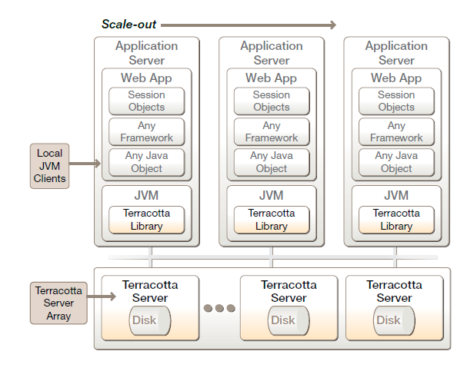
Terracotta
“Terracotta is open source infrastructure software that makes it inexpensive and easy to scale a Java application to as many computers as needed, without the usual custom application code and databases used to share data in a cluster.
Terracotta manages mission critical data using Network-Attached Memory (NAM) technology.
NAM enables Terracotta to cluster Java Virtual Machines (JVMs) directly underneath applications, and is a proven runtime approach to providing Java applications both high availability and scalability”
Network
Attached Memory

Slide 101
General AWS Preparation
Amazon account
Sign up for S3 and EC2
Configured client tools
AWS credentials (access key + secret access key)
SSH keys
Regions (US, EU)
Security groups (open ssh and jmx ports)
EBS (for installation package)
Good Clients: AWS (timkay.com), elasticfox, s3fox

Slide 102
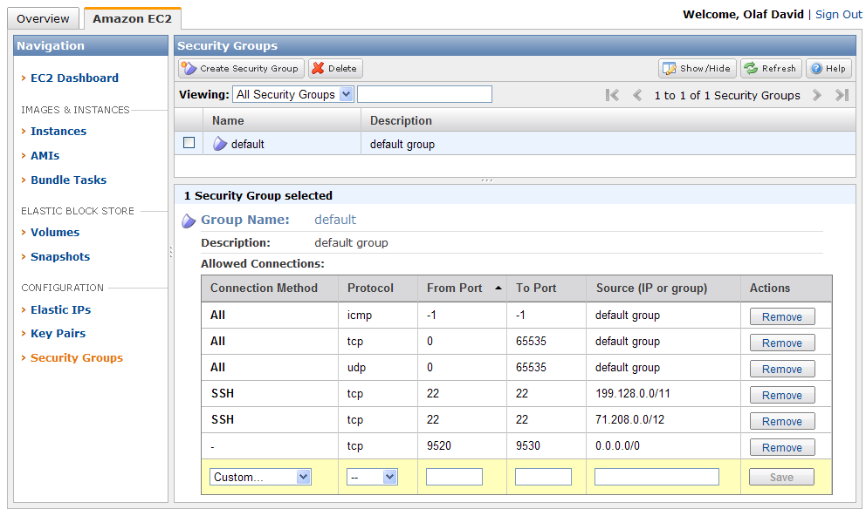
Security Groups (instance FW)

Slide 103
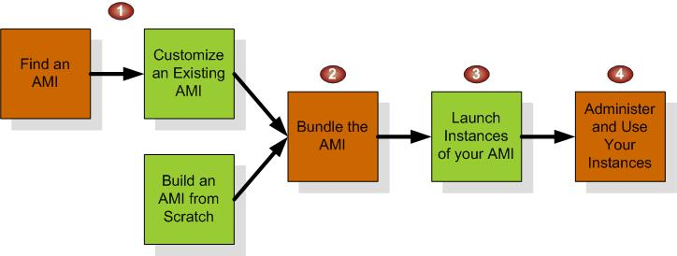
Amazon Machine Image Bundling
RH FC8
TC 2.7
JDK 1.6
ngmfimage
ami-21a74048
Selected existing AMI (FC8), started
Installed Terracotta 2.7, JDK 1.6, NGMF
Created EBS install disk (4GB)
Bundled/Uploaded/Registered as new AMI
‘ngmfimage’
“ami-21a74048”
private

Slide 104
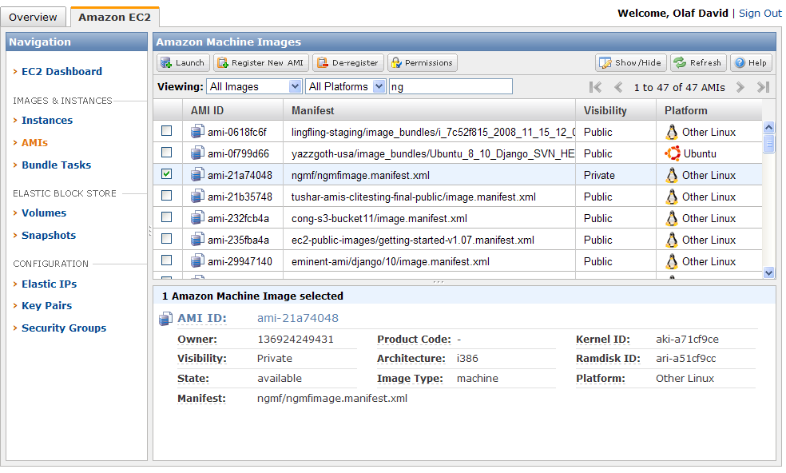
Published NGMF AMI

Slide 105
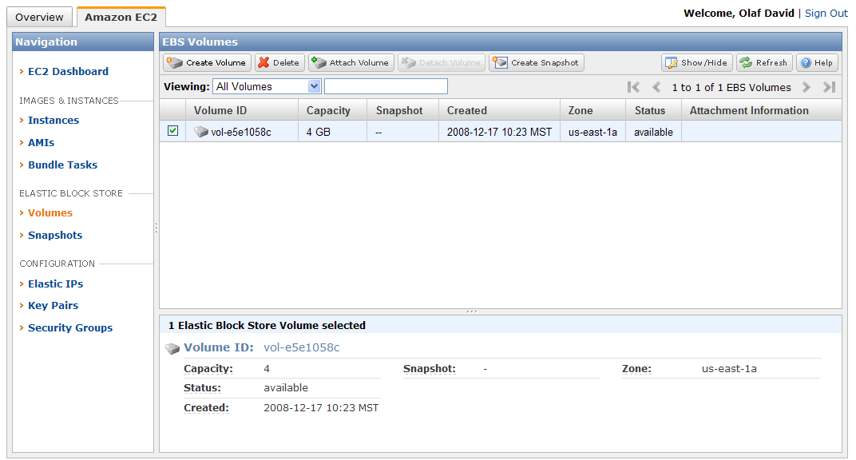
Elastic Block Store
4 GB volume, Installation packages (Terracotta, java, …)

Slide 106
NGMF Cluster control (NC2)

Slide 107
NGMF Cluster Control (nc2)
Purpose: manage a set of machines
Copy files
Execute commands
Physical and Virtual machine cluster
Part of NGMF library
Other tools such as C3 (Globus) insufficient
No output serialization/merging
Insufficient Configuration for EC2, ssh vs. rsync vs. rsh

Slide 108
nc2 Options
-s
serialize output with node, default is merged output
-v
verbose output
-c<cluster name>:<node 0>[-<node n>]
select a cluster and node set (default is ‘default’)
-c ec2:0-* all nodes in cluster ‘ec2’
-c ec2:0 first node in ‘ec2’
-c def:0,1-3,5,7-* node 0,1,2,3,5,7,rest in ‘def’
-put <local file> <remote file>
copy <local file> in to <remote file> on nodes in selected cluster
-exec <command>
executes <command> on nodes in cluster in parallel

Slide 109
Configuration: $HOME/nc2.conf
# location of the ssh executable
ssh = /usr/bin/ssh
# location of the scp executable
scp = /usr/bin/scp
# ssh key file
key = /home/od/ec2-keys/id_odkey
# remote user
user = root
# cluster definition
# cluster.<name> = <node0> <node1> ...
cluster.ec2 = \
ec2-174-129-169-130.compute-1.amazonaws.com \
ec2-75-101-218-88.compute-1.amazonaws.com \
ec2-75-101-218-146.compute-1.amazonaws.com \

Slide 110
nc2 Examples
$nc2 -v -c ec2:0-4 -exec ls –l
$nc2 -v -c ec2:0 -exec tc-start-server.sh
$nc2 -c ec2:1-* -put /model.jar /tmp/model.jar
$nc2 -c ec2:1-5 -exec java -jar model.jar

Slide 111
TW EC2 example

Slide 112
ThornthwaiteMC Simulation Model
1..1000000
OF
Random number generation in @Range
Parameter
Latitude
Soil Moisture
Capacity
Runoff Factor
Monthly Output
Surface Runoff
SoilMoisture
SoilMoisture
Precipitation
Actual ET
Climate
Snow
SnowStorage
Temperature
potet
HamonET
Potential ET
Output
Month
DayLen
daylen
snowmelt
Runoff
Runoff
Monthly Input
Thornthwaite
Monte Carlo Simulation
Thornthwaite Water Balance Model (Thornthwaite, 1948; Mather, 1978; 1979)

Slide 113


Modeling Workflow
Node n
.
1) Instantiate ngmf cluster on EC2
.
NGMF AMI
.
Node 0
2) Fetching cluster information, configure nc2
3) Copy model files to all nodes
4) Start the TC server on node 0
5) Execute model on all nodes
6) Get results
EC2 Controller
- Desktop
- Web Service

Slide 114
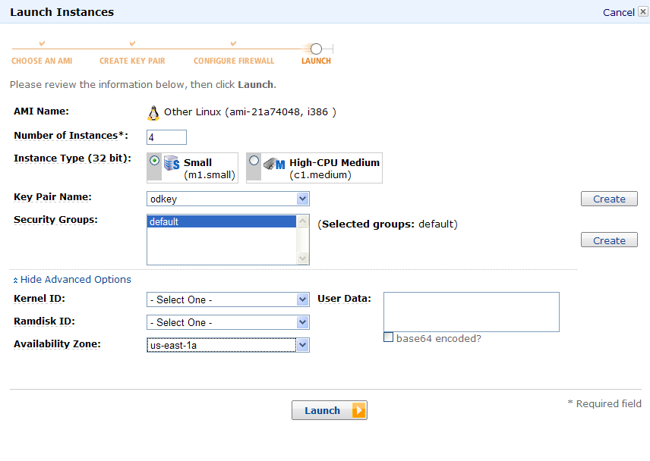
Start NGMF AMI

Slide 115
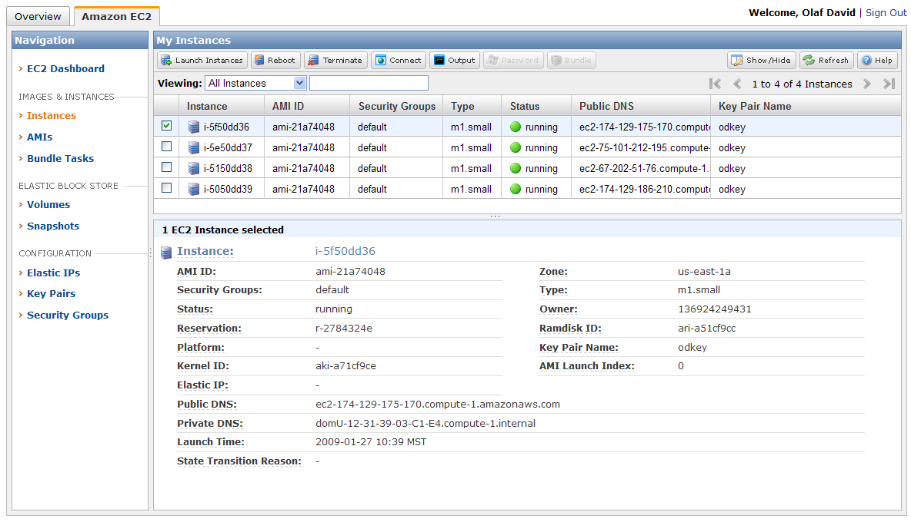
Running instances

Slide 116
Fetching Cluster IPs
(aws_to_c3.sh)
#!/bin/bash
echo "cluster.default = \\"
aws din | grep running | awk -F "|" '{ print $6 "\\" }'
echo " "
$ ./aws_to_c3.sh
cluster.default = \
ec2-174-129-169-130.compute-1.amazonaws.com \
ec2-75-101-218-88.compute-1.amazonaws.com \
ec2-75-101-218-146.compute-1.amazonaws.com \
$ ./aws_to_c3.sh >> ~/nc2.conf

Slide 117
TC Server Configuration
NGMF TC configuration file (tc.xml)
Server host attribute customization
public DNS name
needed for JMX
<servers>
<!-- Tell DSO where the Terracotta server can be found. -->
<server host="ec2-174-129-169-130.compute-1.amazonaws.com">
<data>%(user.home)/terracotta/server-data</data>
<logs>%(user.home)/terracotta/server-logs</logs>
</server>
</servers>

Slide 118
Copy model files
Put these on all nodes in cluster ‘ec2’
$nc2 –c ec2:0-* -put ngmf.jar ngmf.jar
$nc2 –c ec2:0-* -put ngmf.models.jar ngmf.models.jar
$nc2 –c ec2:0-* -put climate.cst climate.cst
$nc2 –c ec2:0-* -put tc.xml tc.xml
NGMF jar
Model jar
Climate input file
TC configuration

Slide 119
Staring the TC Server
Run on the first node in cluster ‘ec2’
$nc2 –c ec2:0 –exec /opt/tc/bin/start-tc-server.sh -f /root/tc.xml
TC server
TC server configuration

Slide 120
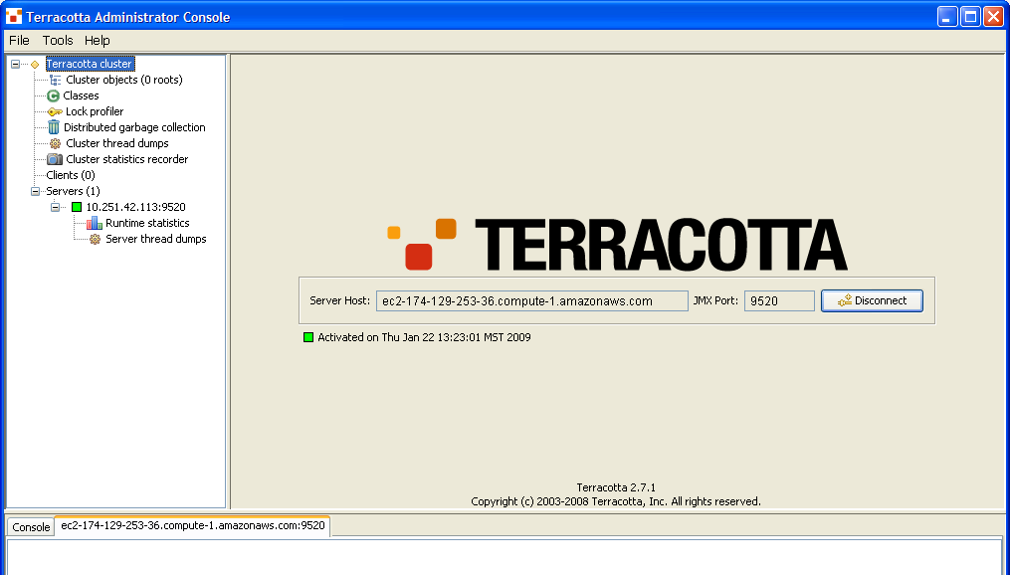
TC Server Admin console
private EC2 IP
public EC2 IP
Connect to running TC server(s)
Throughput analysis
Shared Data object content
…

Slide 121
Running the model on all nodes
Time the overall cluster execution
Run on nodes 1..max in cluster ‘ec2’
Instrumented DSO Java (TC)
$ time nc2 –c ec2:1-* \\
-exec /opt/tc/bin/dso-java.sh \\
-cp 'ngmf.jar:ngmf.models.jar' \\
-Dtc.config=/root/tc.xml \\
tw.ThornthwaiteMC
classpath (ngmf + model)
TC configuration
Model class

Slide 122
Instrumentation for NAM & synchronization (tc.xml)
...
<dso>
<roots>
<root>
<field-name>tw.ThornthwaiteMC.app</field-name>
</root>
</roots>
<instrumented-classes>
<include>
<class-expression>tw.ThornthwaiteMC</class-expression>
</include>
<include>
<class-expression>models.CompoundExecutor*</class-expression>
</include>
</instrumented-classes>
<locks>
<autolock>
<lock-level>write</lock-level>
<method-expression>* *..*.*(..)</method-expression>
</autolock>
</locks>
</dso>
...

Slide 123
Model Output
[ec2-75-101-225-141.compute-1.amazonaws.com] Starting BootJarTool...
[ec2-174-129-167-37.compute-1.amazonaws.com] Starting BootJarTool...
[ec2-174-129-175-95.compute-1.amazonaws.com] Starting BootJarTool...
[ec2-174-129-175-95.compute-1.amazonaws.com]
[ec2-174-129-175-95.compute-1.amazonaws.com]
Starting Terracotta client...
[ec2-75-101-225-141.compute-1.amazonaws.com]
[ec2-174-129-167-37.compute-1.amazonaws.com]
[ec2-174-129-167-37.compute-1.amazonaws.com]
Starting Terracotta client...
[ec2-75-101-225-141.compute-1.amazonaws.com]
Starting Terracotta client...
[ec2-75-101-225-141.compute-1.amazonaws.com]
Submit 19
[ec2-174-129-167-37.compute-1.amazonaws.com]
Submit 18
[ec2-174-129-175-95.compute-1.amazonaws.com]
Submit 17
[ec2-75-101-225-141.compute-1.amazonaws.com]
Submit 16
[ec2-174-129-167-37.compute-1.amazonaws.com]
Submit 15
[ec2-174-129-175-95.compute-1.amazonaws.com]
Submit 14
[ec2-174-129-167-37.compute-1.amazonaws.com]
…

Slide 124
Stopping the server
Run on the first node in cluster ‘ec2’
$nc2 –c ec2:0 –exec ./stop-tc-server.sh -f /root/tc.xml
TC server
TC server configuration

