Slide 1
Building an APEX app for Mobile
github.com/martindsouza/pres-apex-mobile
Martin D’Souza
Oracle APEX Developer @martindsouza
martin.dsouza@oracle.com

Slide 3
15 Years
4 Books
APEX Experience

Slide 4
0
“Mobile First” apps

Slide 5
Intro
About
Goal
Background
Demo
Wrap Up

Slide 6
About
~15 years Oracle & APEX experience
Author of several books (TODO LINK)
Recently joined Oracle on APEX development team

Slide 7

Goal
Build a better experience

Slide 8
Background

Slide 9
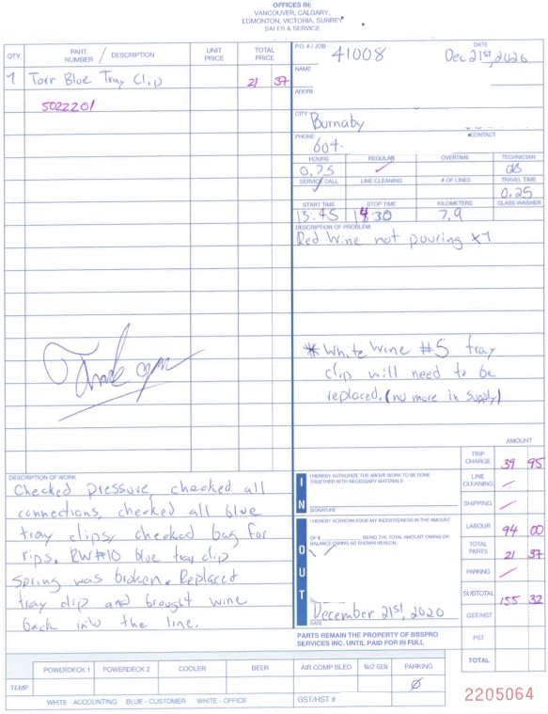

Slide 10



People First

Slide 11



Slide 12
Demo

Slide 13


Slide 14
Conclusion
Live with your app
Keep it simple (use the built-in APEX classes/tools)
Support as few devices (to start) as possible

Slide 15
Building an APEX app for Mobile
github.com/martindsouza/pres-apex-mobile
Martin D’Souza
@martindsouza
martin.dsouza@oracle.com

