Slide 1
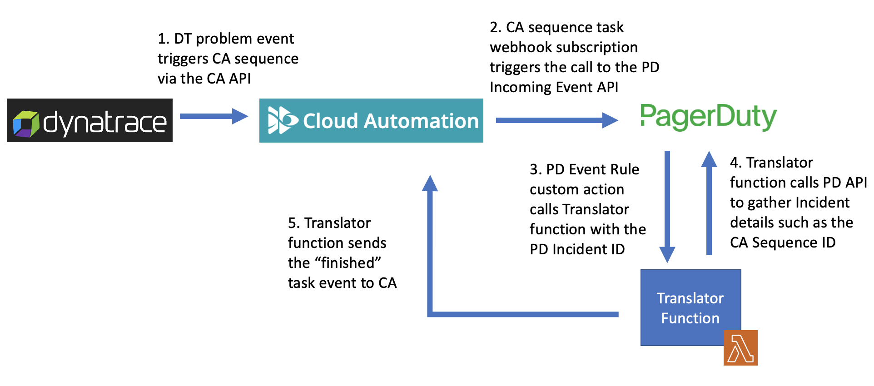




2. CA sequence task webhook subscription triggers the call to the PD Incoming Event API
1. DT problem event triggers CA sequence via the CA API
3. PD Event Rule custom action calls Translator function with the PD Incident ID
4. Translator function calls PD API to gather Incident details such as the CA Sequence ID
5. Translator function sends the “finished” task event to CA
Translator Function

