Slide 1
HS - February 2015
How to secure a web server like a boss “comme un patron”
par Martin Dubé

Slide 2
Tonight’s plan
Security 5 Ws
Scenario
Strategy
Approach
Choosing an Operating System
Choosing a web server
Choosing a network topology
Choosing an architecture
Implementation
Test security of the solution (penetration test)

Slide 3
About me
Daddy
Hackfest admin since 2011
Worked hard on Hacking Games
All other kind of tasks
Security Analyst at GoSecure
Penetration Testing
Systems Hardening
Firewall Management (Checkpoint & Fortinet)

Slide 4
[Security] What?
From OSSTMM
“a form of protection where a separation is created between the assets and the threat.”
Assets
The web application
The infrastructure around
Threat
Outsiders (Those who access the web site)
Insiders (Those who manage the web site)

Slide 5
[Security] Who?
Everyone.
Example:
Should the developer put time on security?
Should the sysadmin put time on security?

Slide 6
[Security] Where?
On all available layers
Example:
Operating System (OS)?
Network?
Application vs Infrastructure
Client side?

Slide 7
[Security] When?
Until it is considered enough
Depend on risk acceptance
Depend on budgets
Depends on the criticality of the assets and interest for the threat
An extranet
A public web site
An internal web site
A VPN web portal

Slide 8
[Security] Why?
Protect assets against Threats

Slide 9
[Security] How?
The following shall give some ideas.

Slide 10
Scenario
We are a system admin
We need to integrate a web app in the infrastructure
It is extremely insecure (let’s say we know it)
It is extremely critical for the company
Do a shit load of things
Must work flawless

Slide 11
Scenario
The need is clear. We know that:
The app is coded in PHP
The app must run shell commands (dafuq?)
The app must access several servers outside the network

Slide 12
Scenario
We won’t waste time on:
Performance
Hardcore security sometimes means performance cost. Here we don’t care.

Slide 13
Strategy
Securing by component
OS
Web server
PHP
Database
Application arch.
Application source

Slide 14
Strategy
For each component
Ask about their communications (in / out)
Ask about DIC
Authenticity
Integrity
Disponibility
Implement relevant security mechanism
Fuck Security by Obscurity.
Understand what the hell you do.

Slide 15
[Strategy] Choosing a secure OS
We want an OS that
Offer multiple relevant security mechanism
Is supported by an active community
Quick security fix
Is well documented

Slide 16
[Strategy] Choice: OpenBSD
Why?
Is secure by default
“Four years without a remote hole in the default install!”
Full of security mechanisms
Memory Protection (W^X, ProPolice, strlcpy/strlcat)
chroots (by default on some packages)
Privilege separation, by default (51 user, 39 for low priv.)
Powerful randomness (arc4random, libressl)
Regular source code audits (6 to 12 members security team)
Quick security updates
No damn /proc :)

Slide 17
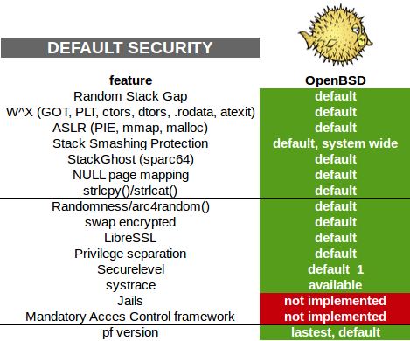
[Strategy] Choice: OpenBSD
Thanks to: http://networkfilter.blogspot.ca/2014/12/security-openbsd-vs-freebsd.html

Slide 18
[Strategy] Choice: OpenBSD
Securelevel: 1 (default)
- /dev/mem and /dev/kmem may not be written to raw disk devices of mounted file systems are read-only
- system immutable and append-only file flags may not be removed
- kernel modules may not be loaded or unloaded
- a panic or trap cannot be forced

Slide 19
[Strategy] Choice: OpenBSD
Securelevel 2: "Highly secure mode"
all effects of securelevel 1
raw disk devices are always read-only whether mounted or not
settimeofday(2) and clock_settime(2) may not set the time backwards or close to overflow
firewall and NAT rules may not be altered

Slide 20
[Strategy] Choosing a web server
Nginx vs Apache
Both are mature and well documented
Nginx pros
Chrooted by default
Less vulnerabilities documented (8 on nginx vs 284 on apache @ cvedetails)
Apache pros
mod_security
.htaccess
Understanding how to use it is what matter!

Slide 21
[Strategy] Choice: nginx
Why?
For previously enumerated reasons.

Slide 22
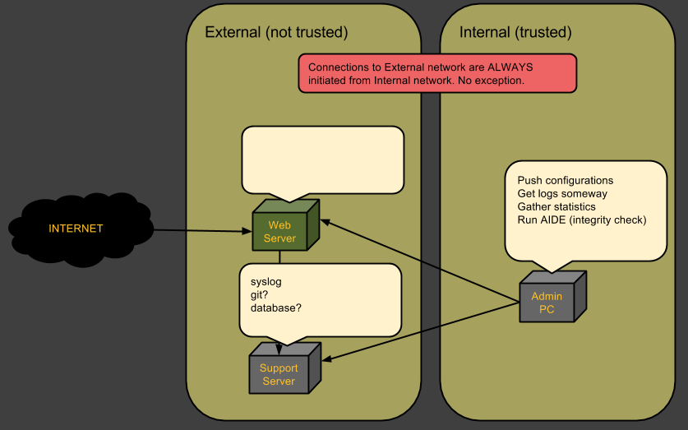
[Strategy] Choosing a topology

Slide 23
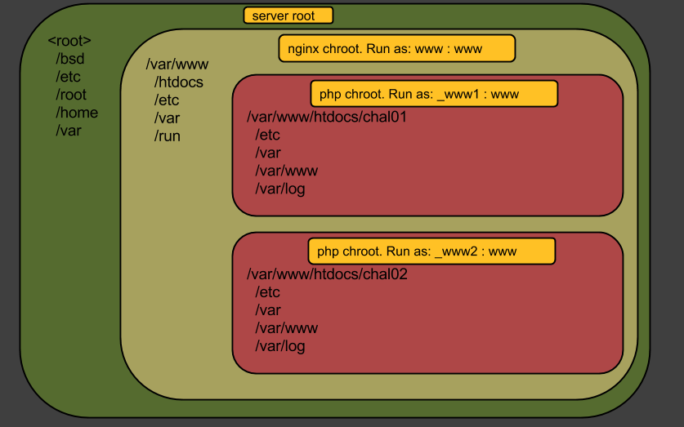
[Strategy] Choosing an architecture

Slide 24

[Impl.] OS Installation
Minimal Install. Enable only what’s needed.
During install
An admin user can be created
OpenSSH server can be installed
root login can be restricted on OpenSSH
A ntp server can be configured
After install
Install your favourite tools

Slide 25
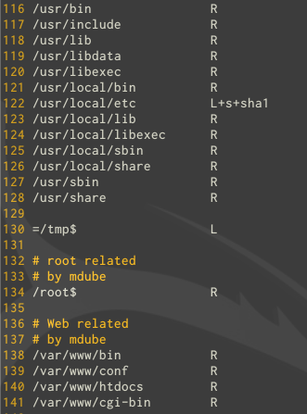
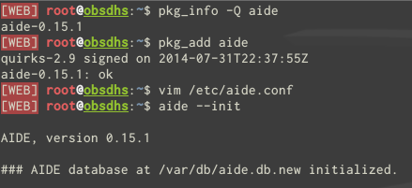
[Impl.] OS Hardening
Filesystem integrity
Install, configure and run AIDE (Advanced Intrusion Detection Environment)

Slide 26
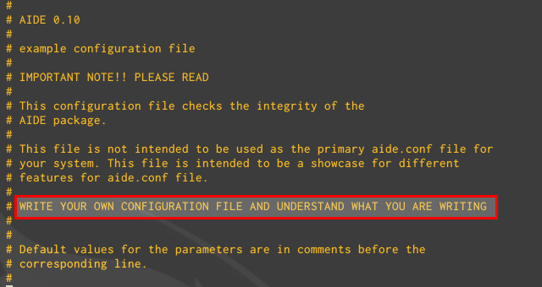
[Impl.] OS Hardening
Filesystem integrity
Don’t forget to download the file at a safe place!
Keep understanding what you are doing :)

Slide 27
[Impl.] OS Hardening
Filesystem integrity
To check for changes on the file system:
Upload latest baseline at /var/db/aide.db
aide --check
To update database with new files
aide --update

Slide 28
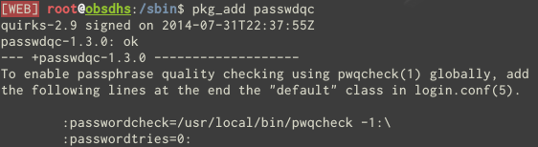
[Impl.] OS Hardening
Password Policy

Slide 29
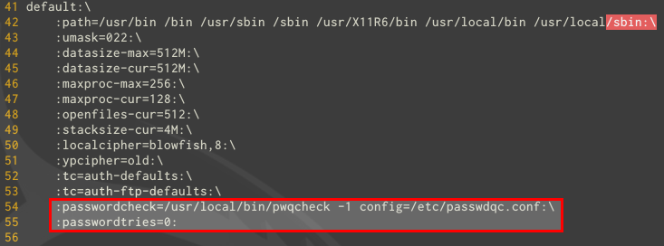
[Impl.] OS Hardening
Password Policy
Add these lines in /etc/login.conf

Slide 30
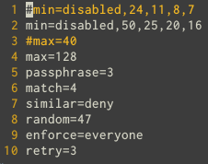
[Impl.] OS Hardening
Password Policy
Configure policy in /etc/passwdqc.conf

Slide 31
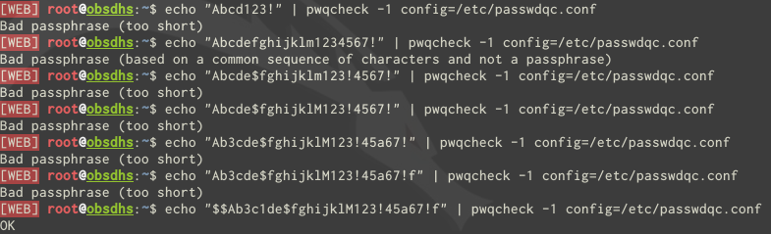
[Impl.] OS Hardening
Password Policy
Test the policy

Slide 32
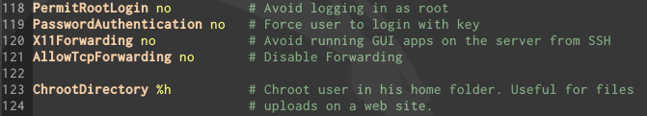
[Impl.] OS Hardening
Server Management: OpenSSH
Server side consideration
Client side consideration
Create a strong key (-t rsa -b 4096)
Encrypt it with PKCS#8

Slide 33
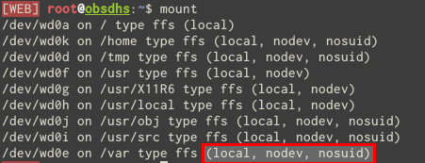
[Impl.] OS Hardening
Partitions security
Default partitions scheme
Other interesting options: noexec, rdonly

Slide 34
[Impl.] OS Hardening
Logs export
Distributed setup
Authenticate and Encrypt communication with log server
http://cromwell-intl.com/cybersecurity/syslog-tls-cloud.html
Local setup
Just send logs on a remote server
Use a dedicated network

Slide 35

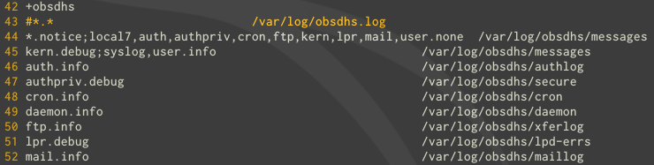



[Impl.] OS Hardening
Logs export
Config on client
/etc/syslog.conf
/etc/hosts
Config on server
/etc/syslog.conf
/etc/hosts
/etc/rc.conf.local (Note: -u flag is considered insecure.)

Slide 36
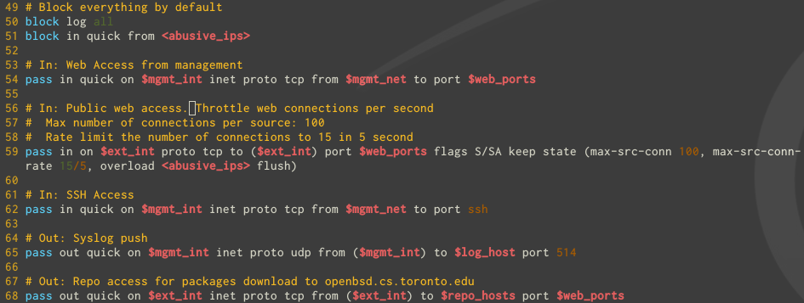
[Impl.] OS Hardening
Firewall rules

Slide 37
[Impl.] OS Hardening
If SSH must be publicly accessible
Implement fail2ban with PF
http://www.bsdguides.org/2012/fail2ban-with-pf-on-openbsd-5-2/

Slide 38
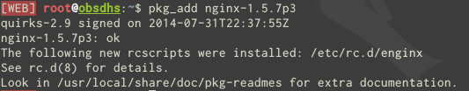

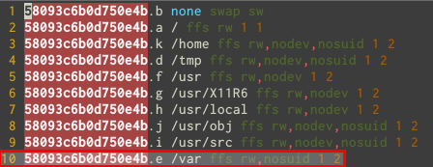
[Impl.] Web server Installation
Installation
Remove “nodev” flag from /var

Slide 39
[Impl.] Web server Hardening
Remove default web site
/etc/nginx/nginx.conf
Delete: section http -> server
Add: include conf.d/*.conf;
Configure logging
Remove nginx version in errors

Slide 40


[Impl.] Web server Hardening
Set limits
Set more limits

Slide 41
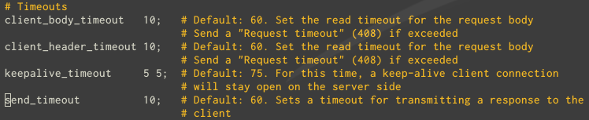
[Impl.] Web server Hardening
Set timeouts

Slide 42


[Impl.] Web server Hardening
Set max simultaneous connections
Set max concurrent connections

Slide 43


[Impl.] Web server Hardening
Limit access to our domain(s)
Limit Request Methods

Slide 44

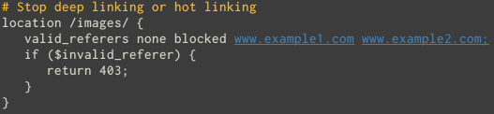
[Impl.] Web server Hardening
Block Referrer (Spam)
Block Image Hotlinking

Slide 45
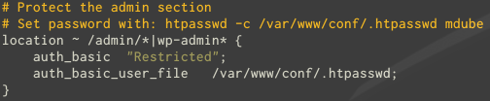
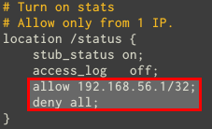
[Impl.] Web server Hardening
Limit access to some folder/files by password
Limit access to some folder/files by IP

Slide 46
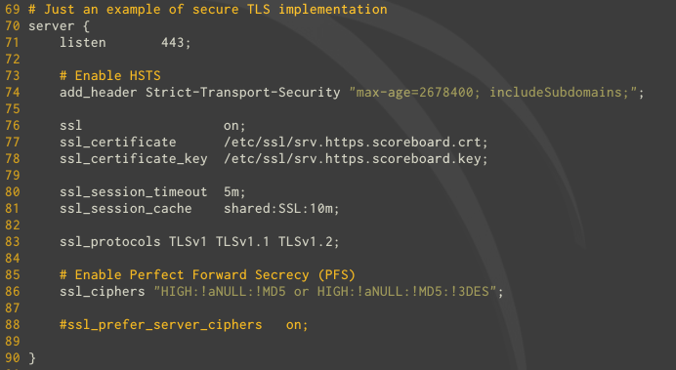
[Impl.] Web server Hardening
TLS

Slide 47
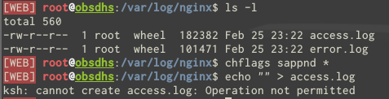

[Impl.] Web server Hardening
Secure logs
Remember what does Securelevel=1 ?

Slide 48
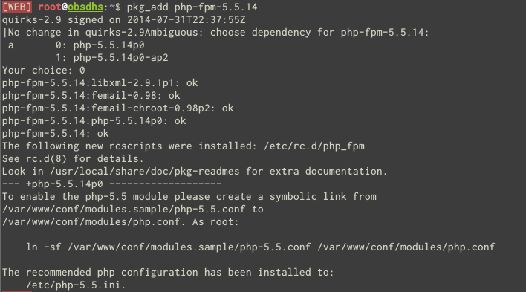
[Impl.] PHP Installation

Slide 49
[Impl.] PHP Hardening
Remove default pool
/etc/php-fpm.conf
Comment section [www]
Add: include=/etc/fpm.d/*.conf
Create and harden one php file per apps
php_value vs php_admin_value
The application cannot change its php.ini parameters with php_admin_value with ini_set()

Slide 50
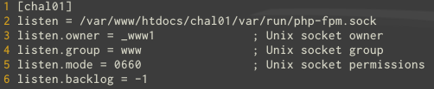
[Impl.] PHP Hardening
Harden unix socket security

Slide 51
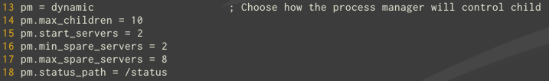
[Impl.] PHP Hardening
Harden process security
Harden memory management

Slide 52
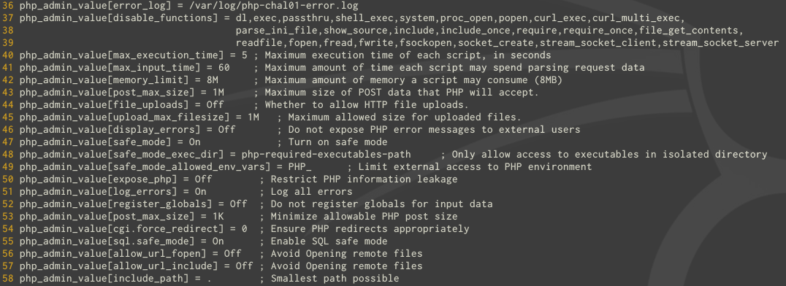
[Impl.] PHP Hardening
PHP ini file

Slide 53
[Impl.] Application Integration

Slide 54



[Impl.] File/Folder Security?
Whereas php run as _www1:www and nginx run as www:www
Is this acceptable?
nop
Is this enough?
nop
Is this secure?
yes

Slide 55

[Impl.] More Hardening
User / Groups / Files security
Make /tmp be writable but not readable
chmod 730 tmp
Verify that php user (_www1) run as gid 67 (www)

Slide 56
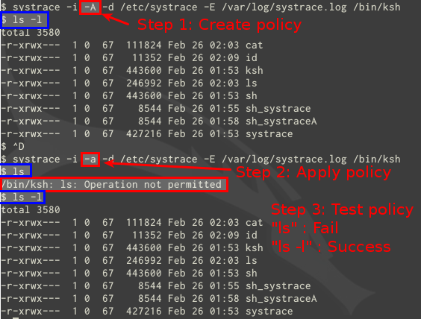
[Impl.] Still need more?
systrace demo

Slide 57
[Impl.] Still need more?
systrace logs!

Slide 58
Pentest Time!
Challenge #1
Find the flag file and read its content
Challenge #2
Exploit an eval()
URL: http://192.168.1.x/

Slide 59
Thanks!

Slide 60
References
http://www.tldp.org/HOWTO/Chroot-BIND-HOWTO-2.html
http://www.cyberciti.biz/tips/linux-unix-bsd-nginx-webserver-security.html
http://cromwell-intl.com/cybersecurity/syslog-tls-cloud.html
http://networkfilter.blogspot.ca/2014/12/security-openbsd-vs-freebsd.html
http://www.cyberciti.biz/tips/php-security-best-practices-tutorial.html
http://martin.kleppmann.com/2013/05/24/improving-security-of-ssh-private-keys.html
http://www.openbsd.org/faq/pf/config.html

