Slide 1
Yet another epsilon meteor echo simulator
An interactive, phenomenological model of overdense forward-scatter echoes
International Meteor Conference 2026
International Meteor Conference 2026 | 1

Slide 2
The question
• Can a compact trail model generate the characteristic curved / evolving Doppler signatures seen in overdense forward-scatter meteor echoes?
• Which ingredients matter most: geometry, trail skew, atmospheric shear, or the changing specular contribution?
• echoSim.py is intended as an experiment: change a parameter → observe the morphology → formulate a hypothesis.
International Meteor Conference 2026 | 2

Slide 3
The model in one picture
• Extended trail represented by a relative-altitude coordinate z.
• Initial trail: x₀(z) = tan(α) z.
• Each trail element has its own bistatic geometry and Doppler shift.
• Wind shear deforms the trail and changes its local slope.
• Only the evolving, locally favoured parts of the trail contribute strongly.
• The contributions are phase-coherent before they are summed.
International Meteor Conference 2026 | 3

Slide 4
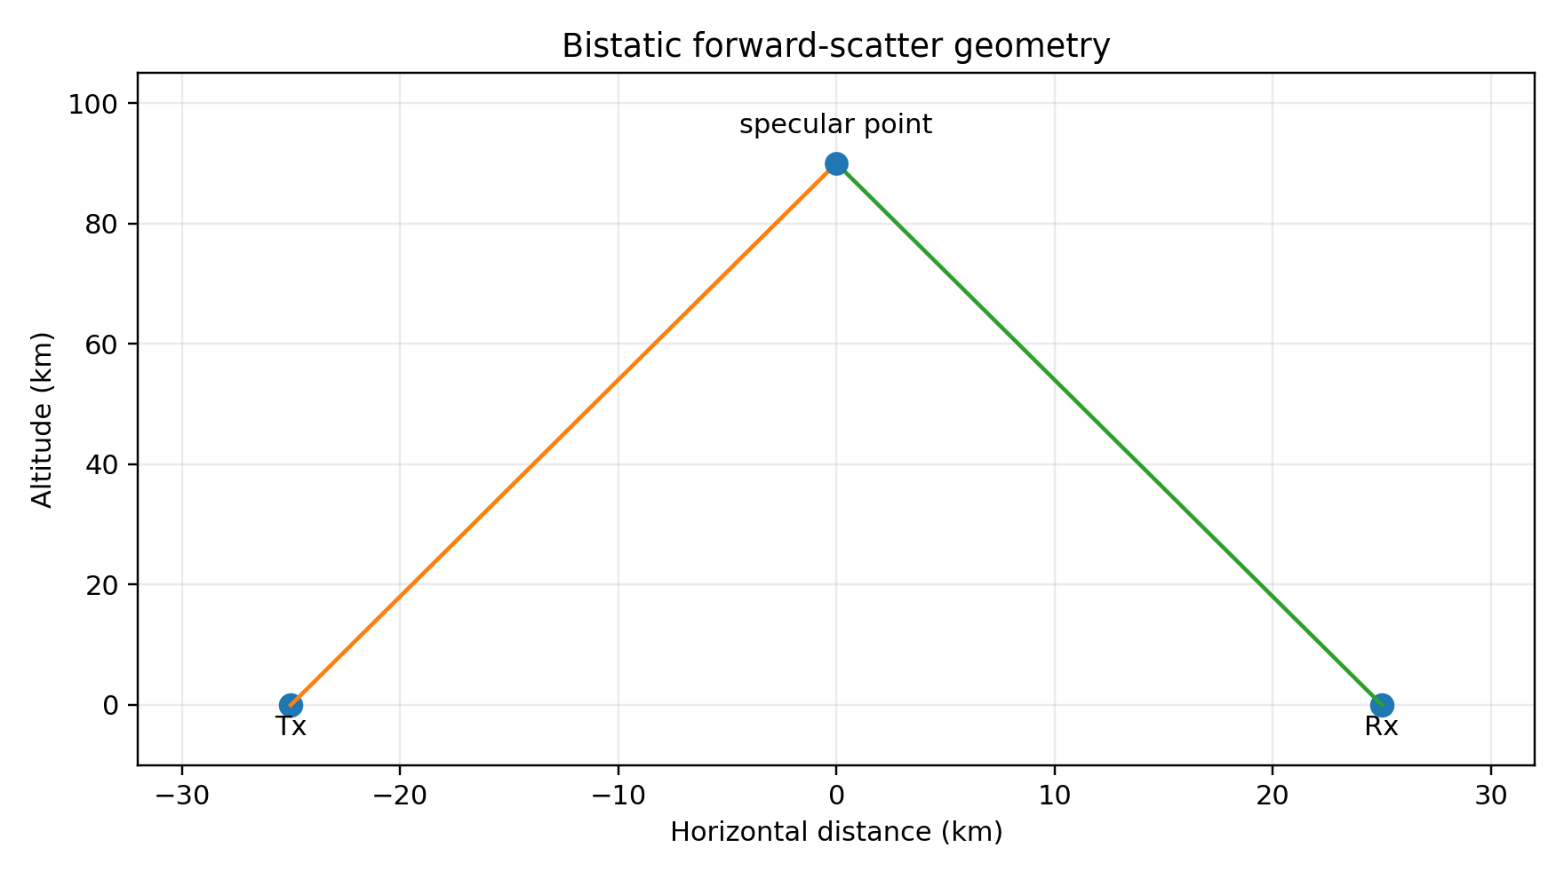
Step 1 — explicit bistatic geometry
• Default: Tx–Rx distance = 50 km
• Reference/specular altitude = 90 km
• RF frequency = 50.0 MHz → λ = 6.00 m
• Specular index = minimum of rₜ + rᵣ
• Local bisector b = normalize(uₜ + uᵣ)
International Meteor Conference 2026 | 4

Slide 5
Step 2 — prescribe an initially skewed trail
• Default trail skew α = 12.0°
• The model does not begin with a curved trail: the initial condition is a straight line in the local x–z plane.
• Skew changes dx₀/dz, which immediately changes the specularity weighting.
• The meteor azimuth and elevation define the 3-D trajectory direction used for the velocity projection.
International Meteor Conference 2026 | 5

Slide 6
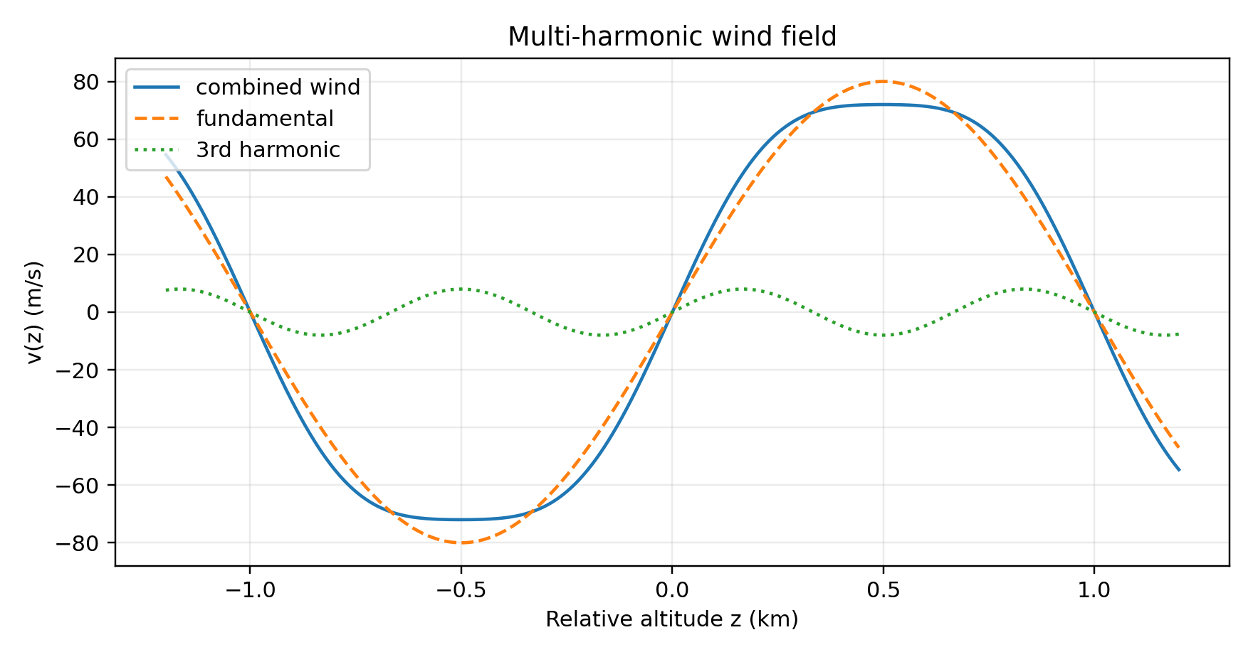
Step 3 — add multi-harmonic wind shear
• v(z) = V [R₁ sin(πz) + R₂ sin(2πz) + R₃ sin(3πz)]
• Default: V = 80 m/s; R₁ = 1.00; R₂ = 0.00; R₃ = 0.10
• The derivative dv/dz is used to deform the trail.
• The harmonic terms are a compact test field, not a measured atmospheric profile.
International Meteor Conference 2026 | 6

Slide 7
Step 4 — turn motion into Doppler
• Build a 3-D velocity vector from the evolving horizontal field and the selected meteor elevation.
• Project onto the local bistatic bisector:
• f_D(z,t) = v(z,t) · b(z) / λ
• Each trail element therefore has a different instantaneous frequency.
• Frequency is accumulated as phase, not simply sampled independently: coherence is retained during the trail integration.
International Meteor Conference 2026 | 7

Slide 8
Step 5 — select the scattering parts of the trail
• The model uses a slope-dependent specularity weight:
• W(z,t) = exp[−(∂x/∂z)² / A(t)]
• Small local slope → larger contribution.
• A(t) increases as the echo evolves and includes an additional post-diffusion term after t = 3 s.
• Thus the Doppler spectrum is not simply the wind spectrum: geometry and evolving specularity shape what is observed.
International Meteor Conference 2026 | 8

Slide 9
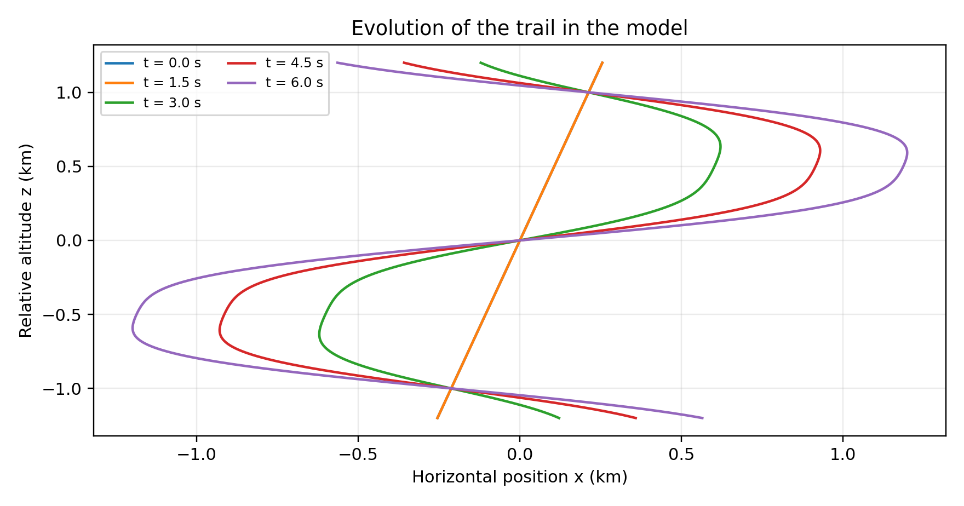
Step 6 — deform, interfere, decay
• Ping-like component decays with τ = 0.12 s.
• Wind-shear contribution grows with τ = 0.40 s.
• Trail deformation uses τ·w_s·0.0025.
• Echo starts at t = 2 s; diffusion/decay starts at t = 3 s.
• Finally: coherent sum → normalisation → optional Gaussian noise.
International Meteor Conference 2026 | 9

Slide 10
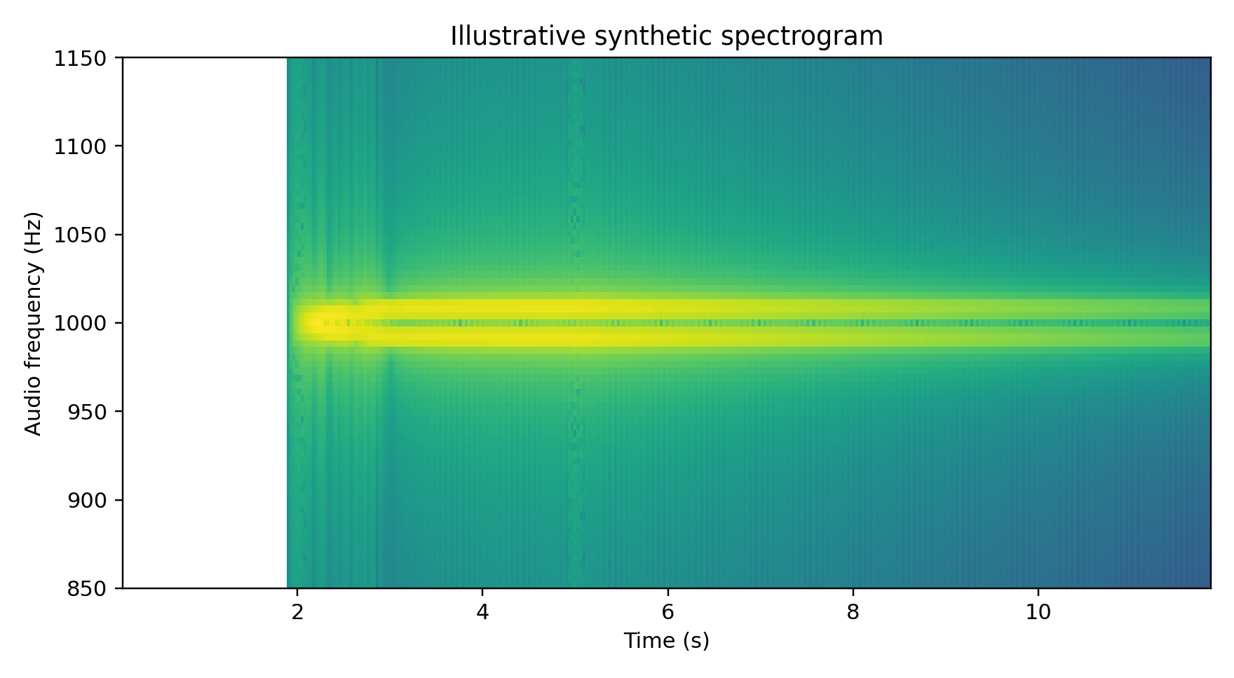
What comes out?
• Audio carrier = 1 kHz.
• RF Doppler is added to the audio carrier.
• Default GUI values shown here.
• The spectrogram is the main diagnostic: it exposes the evolving distribution of coherent trail contributions.
• Audio playback provides a second, intuitive representation.
International Meteor Conference 2026 | 10

Slide 11
What I would *not* claim
• This is not yet a physical inversion model.
• The wind field is phenomenological.
• The event envelope is prescribed.
• The deformation coefficient and specularity aperture are model parameters in the code.
• The present result is useful for controlled experiments and morphology, but validation against measured overdense echoes is still required.
International Meteor Conference 2026 | 11

Slide 12
Next experiments
• Replace the harmonic wind field with measured or atmospheric-model wind profiles.
• Compare synthetic and observed spectrograms quantitatively.
• Explore the sensitivity to Tx–Rx geometry, trail skew, altitude, frequency and harmonic content.
• Introduce a more explicit treatment of trail density, diffusion and scattering efficiency.
• Use the simulator to test whether particular Doppler morphologies can constrain trail / atmosphere parameters.
International Meteor Conference 2026 | 12

Slide 13
Questions?
Yet another epsilon meteor echo simulator
International Meteor Conference 2026 | 13

