Slide 1
Squad UP!™ ®
By: Jaron Martinez and Albert Fung

Slide 2
What is Squad Up!™ ®?
This app is for those who:
Are new to an area and need to meet new people
Make and meet up with friends in your local area
Need to find a lifting partner to help motivate one another
Mentor/ Mentee program to get those who are trying to get into fitness on the right track with a positive outlook and to help the Mentee achieve their Mental/Physical goals.
Mission:
To allow individuals to achieve a sense of community and to combat loneliness by interacting with others in physical activities together. Stop being alone, get off your phone and Squad Up!

Slide 3
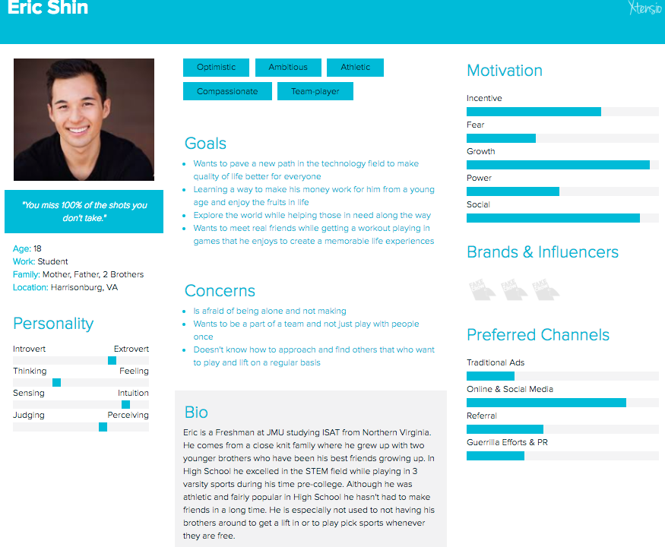

Slide 4
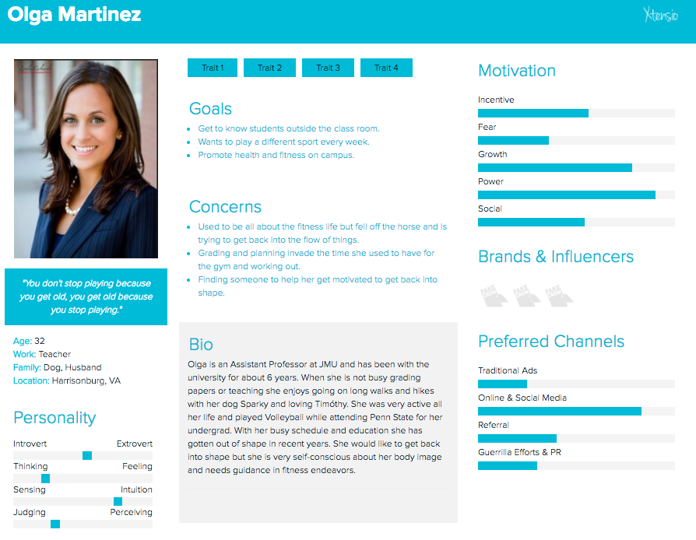

Slide 5
