Slide 1
FM50 Induction 2026

Slide 2
Outline
This induction will introduce you to the MSc project and the available topics

Slide 3
Changes
This is based on current information.
Modifications may still occur (aim to have them all in by end of May).
When we receive any specific information we will communicate this via KEATS.
This should not delay the timeline of the project.
In this presentation we highlighted specific requirements that may be subject to change. Additional measures may be decided as needed.

Slide 4
Documentation
There is a draft guide to the FM50 project on Keats.
The guide includes a Timeline.
The guide includes a “template” dissertation which describes in detail what is expected from each section of the dissertation.
The template dissertation is written in LaTeX which you should also you use to write up your project. The source code for the template dissertation is in KEATS, so you can copy all the formatting.
There are 3 project topics available on Keats, and they describe each of the topics you can choose between.
There are some example dissertations from previous years so you can get an idea of what a good dissertation might look like.

Slide 5
OVERVIEW

Slide 6
FM50 Key Points
FM50 is your MSc project dissertation.
You should work on your dissertation full time in June, July and August to avoid failing
You must choose a topic from a list of 3 (available on Keats and discussed today).
Each project has 3 parts. A literature review (Part 1); Mandatory Tasks (Part 2), and an extended personal contribution (Part 3)
You must attend the oral exam in person (unless resitting and no misconduct), and it is at the supervisor’s discretion whether you can attend project meetings online

Slide 7
Progression to project, suspension from project (Part-Time students)
All students are assumed to have progressed to the project.
Once provisional May results become available, if criteria are not met students are suspended from the project until these criteria will be met (i.e. passing or getting condoned fails in resits)

Slide 8
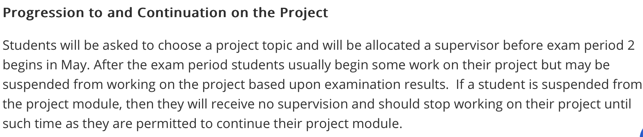
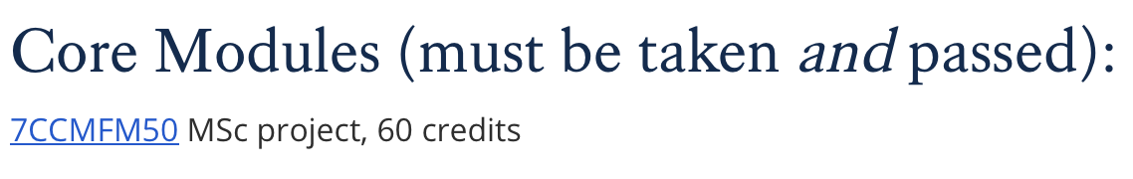
Progression to project, suspension from project (description of process)

Slide 9
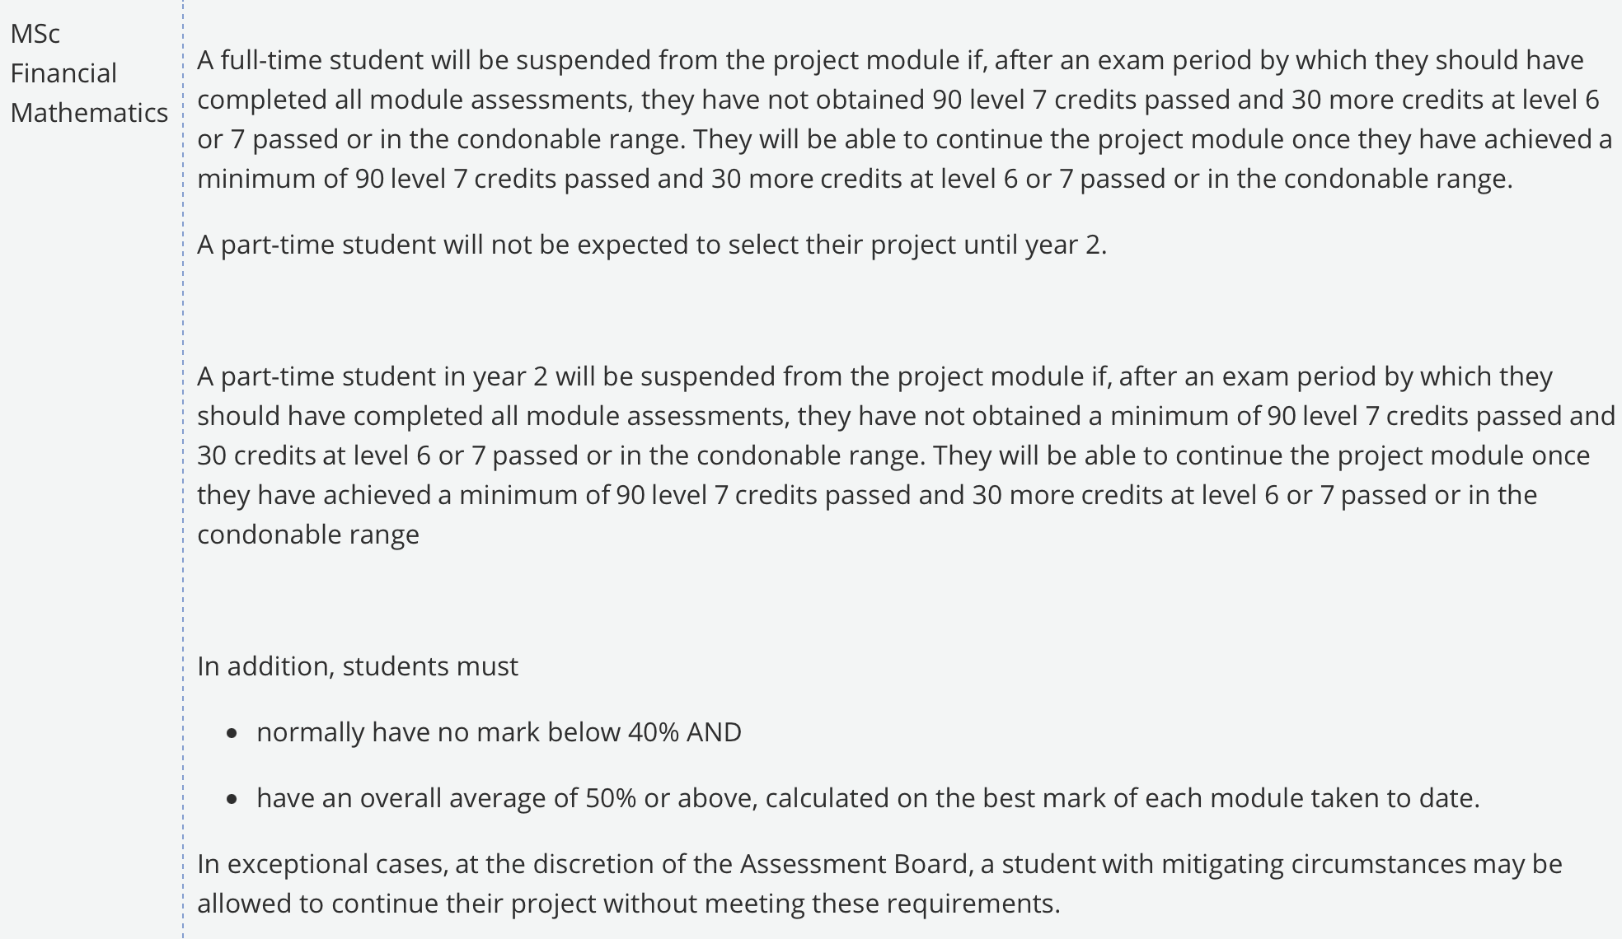
Progression to project, suspension from project (Full-Time students)

Slide 10
The structure of the project
Part 1. A literature review. You should review the literature yourself and write your own account of the material. You should use your own words and highlight the areas you think are important. Can leave for the end
Part 2. A clearly specified calculation. This is what the project topic specifies in detail. As well as performing the required calculation, you are expected to clearly describe how you have performed the calculation, how you have verified your answer and how you analysed your results. Start this
Part 3. Your own extended personal contribution. Although a few ideas for what you might do in part 3 are given in the project description, it is very much up to you to decide what to do in part 3. You should check with you supervisor beforehand that your proposed Part 3 topic is feasible but also sufficiently interesting/substantial to obtain a good mark. Your Part 3 should also include code.Continue with this

Slide 11
Mark Scheme
See KEATS (the mark scheme is included in the FM50 guide)
90% is the mark for the submitted project
10% is the mark for the oral exam
You should prepare/revise properly for the oral exam like any other exam
You need to pass the oral exam (i.e. get 5 or more out of 10) and get a combined overall mark of 50% or more to pass the project.
This gives you an idea of what a marker looks for in a project.

Slide 12
What are we looking for?
Your dissertation should be interesting to read. Try to write something that you would have enjoyed reading in order to learn about the subjects covered in your dissertation.
Your dissertation should be personal. We want to see your personal choices shining through. Which parts of the literature do you decide to review? How do you present the literature? How do you analyse the results of your calculation? What do you study in Part 3? These are all areas where your personality can come out.

Slide 13
What we are NOT looking for
Ground-breaking originality. OK, it’s great if we get it, but you can easily get a distinction without breaking new ground. If you make a significant personal contribution, that is enough.
Words for the sake of filling space. Parts 1-3 cannot be more than 40 pages (this excludes the title page, abstract, content, bibliography and code in the appendix). You should not adjust the standard latex template to widen the margins or make font smaller.
Other people’s words. Although in some maths exams you are given credit for repeating the lecturer word-for-word, we do not want you to do this, in fact doing so is PLAGIARISM.

Slide 14
Oral Exam
The oral exam helps us decide if the dissertation is your own work.
We can also clarify points we did not understand in your dissertation.
Be ready to answer questions about what you wrote and why.
Do not include material in the project that you cannot explain in the oral
It will last approximately 15-20 minutes.
You must pass the oral exam to pass the project.
Potential dates for the oral exam are listed in the timeline on p2 in FM50 guidance on KEATS.

Slide 15

PLAGIARISM

Slide 16
PLAGIARISM (quick writing)
Exercise 1:
Write a paragraph of your own about plagiarism. Try to cover the following points:
What is plagiarism?
How can you tell the difference between a plagiarism and the legitimate use of the literature and lecture notes?
How can you avoid plagiarism?

Slide 17
Plagiarism (def.)
Plagiarism is a form of cheating where you attempt to pass off someone/something else’s work as your own.
If you use someone else’s ideas you should clearly credit them and reference them in your bibliography. If you use someone words you should put them in quotes and clearly reference them.
The guide to FM50 contains links to the college policy on plagiarism and some resources you can follow to find out more about plagiarism.
Because Plagiarism is a form of cheating, it is taken very seriously. You may potentially get a mark of 0 or be expelled from the college for plagiarism. So don’t do it.

Slide 18
Plagiarism (def.)
According to the College policy plagiarism can be
Plagiarism e.g. copying, incorrect referencing, copy-paste, paraphrasing
Self-plagiarism e.g. work undertaken at a previous institution
Collusion e.g. submitting another student’s work, in part or as a whole, as their own
Cheating e.g. contract cheating – submitting part written by third party.

Slide 19
Plagiarism
Exercise 2: Which of the following are examples of plagiarism?
Copying a proof from a lecture without giving a reference.
Including code that you downloaded from a website in your project.
Using someone else’s code to perform a calculation without clearly crediting them.
Taking code not written by you and changing it so that it performs a new calculation without clearly crediting the original author.
Including a picture you downloaded from the internet in your dissertation without clearly crediting the original author.

Slide 20
Avoiding plagiarism
If you copy a picture from the internet (or from a lecture) and credit it correctly you will get little to no credit for that picture as it is not your work.
If you use Python to create your own charts you will be given credit and not accused of plagiarism. So illustrate your dissertation with your own charts.
If you download some software from the internet (or from a course website) and use it to perform a calculation you will get little or no credit as it is not your work.
If you write your own software to perform a task, you will be given credit and not be accused of plagiarism. So write your own code, and if your code is based on someone else’s ideas, credit them clearly in your bibliography.
Writing code and drawing pictures are two of the easiest ways to make a “personal contribution” to the project.

Slide 21
Turnitin
Turnitin is a tool we can use to HELP check if your work is plagiarised.
It gives a score which says how similar your dissertation is to existing literature.
There is no score above or below which your dissertation is acceptable. Turnitin is simply used as a guide.
Students who struggle with the idea of writing their own personal ideas in their own words may find it helpful to run Turnitin on their own project.
Some students may be tempted to run their dissertation through Turnitin repeatedly changing bits as they go until they get a sufficiently low score. Doing this is a stupid waste of time and might potentially be seen as deliberate cheating to avoid plagiarism going unnoticed. Instead of trying to game Turnitin, WRITE YOUR DISSERTATION IN YOUR OWN WORDS with a SIGNIFICANT PERSONAL CONTRIBUTION.

Slide 22
What you must submit
You must submit your dissertation pdf via the 2026 FM50 Keats page. This will automatically run Turnitin.
You must fill out the plagiarism declaration form at the beginning of the project file.
You must include the source code for any software you have written for your project as an appendix to the dissertation.
You write your Python code in CoCalc (you will receive an invitation to the CoCalc project). Having quick access to this can help clarify points in the oral exam.

Slide 23
Project preparation

Slide 24
Project preparation
The project requires communicating mathematical ideas in English
Mathematical writing support (diagnostic test, support sessions)
English language support (resources on Keats)
Dissertation writing support
Bloomberg tutorials (working with data)
Typesetting mathematics using LaTeX (we provide the template)
Resources: https://libguides.kcl.ac.uk/studyskills

Slide 25
The Project Template

Slide 26
The LaTeX Project Template
Your project must be written in LaTeX. The LaTeX project template is available on KEATS as a starting point.
Online environment: Overleaf (https://www.overleaf.com/edu/kcl)
This is a typical outline of the structure expected for your project:
Abstract
Introduction
1. Mathematical and Financial Background
2. Numerical Computation
3. Personal contribution
Conclusions
Appendix (codes)

Slide 27
Personal Contribution
Chapter 3 contains your EXTENDED personal contribution, but personal contributions are expected throughout.
Literature Review: Your selection of material and choice of presentation should be highly personal. For example, the charts you use to illustrate general ideas could be derived from the numerical computations you perform later.
Numerical Computation: your personal use of Python (in CoCalc)
As well as performing the computation you must say how the computation was performed, how you have interpreted the results, how you have tested your answer. There is a great deal of scope for personal input. We ask a specific, rigid question but there may be better questions we could have asked so your write up should try to answer those questions in addition to the concrete question posed.

Slide 28
SUPERVISION

Slide 29
Supervision outline
Everyone receives 3 supervisions in-person. One in June, one in July and one in August.
The first supervision is typically a group supervision so you cannot negociate the date for this
Individual supervisions typically last one hour.
FM50 is an assessment. To ensure fairness, you cannot have additional supervision.
Go to your supervision prepared. You should go with questions, ideas and with the work you have done so far written up.
If you do not pass enough credits you will be suspended from the project until you do. We get the results by the second supervision.

Slide 30
Industrial Placements
Some of you may be selected for an industrial collaboration.
Parts 1 and 2 of your project are unaffected.
Part 3 of your project can be determined by your industrial partner. The additional industry supervision you have received will be taken into account when deciding your mark. Please inform your supervisor in the first meeting if you are selected for this.

Slide 31
The Project Topics

Slide 32
Project 3: A joint density for FX rates from observed cross-smiles
In FX market we have three currencies: USD, GBP, EUR, USD. The pairwise cross-rates X=EUR/USD, Y=GBP/USD (cable), and Z=X/Y=EUR/GBP.
Given three target marginal densities µ_{X}, µ_{Y}, µ_{Z}, we want to find a joint density µ* that is consistent with all three
Target densities can be inferred from market European option prices using the Gatheral SVI parametrization to interpolate between market implied volatilities.
With these we can obtain a joint density for FX rates.

Slide 33
Project 1: A joint density for FX rates from observed cross-smiles (cont’d)
The joint density for FX rates can then be used to price options (basket, quanto or best-of options) whose terminal payoff depends on X and Y.
The problem requires parameter estimation using least squares minimization, and then iteratetively solving for the required joint density using Sinkhorn algorithm, and an application of resulting joint density to price various contracts (just compute numerical values).
For this topic you may find useful the material from the deprecated FM14 moduel (Advanced Volatility models), FM05 (least squares param. estimation), FM06 (Python numerical schemes) and FM04 and FM07 (change of measure).

Slide 38
Deadlines
You must choose a project topic by 17th April, see Topic choice link on FM50 KEATS page.
After that date the allocation of supervisors will be made, and then communicated on KEATS.
Once you finish your exams you will be invited to the first supervisory meeting (make sure you have read over the topic and prepared any questions).

Slide 39

Questions and discussion

