Slide 1

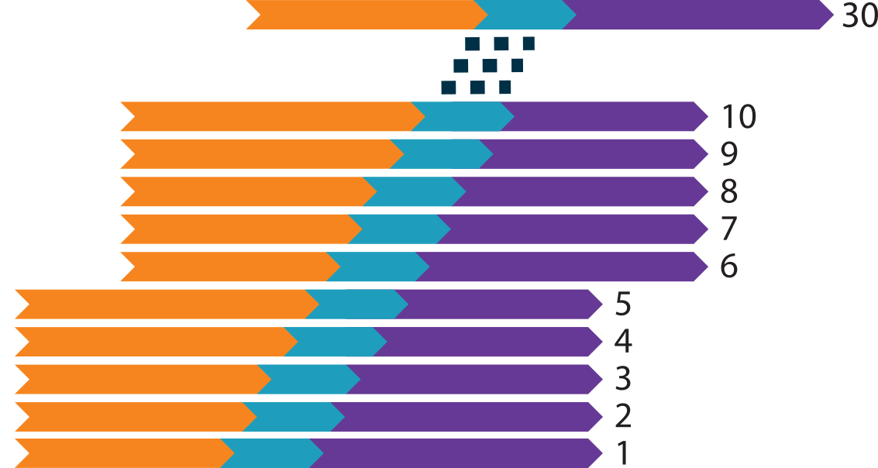
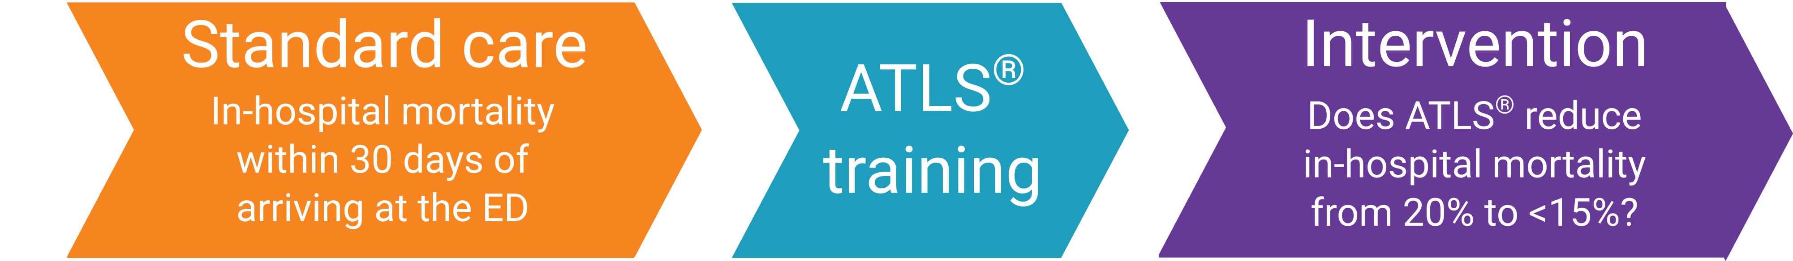




Rationale and design of ADVANCE TRAUMA
Gerdin Wärnberg M, Ranjan S, Fälth S, Kharat P, Bassi A, Basak D, Berg J, Chatterjee S, Felländer-Tsai L, Hemming K, Jha V, Kasza J, Khajanchi M, Martin J, Mishra A, Olofsson A, Roy N, Singh R, Soni KD.
How does ATLS® training impact patient outcomes in comparison to standard care in adult trauma patients? (ClinicalTrials.gov NCT06321419)
Study design
Batched stepped-wedge cluster randomised trial comparing ATS®
vs standard care
Population
Adult trauma patients in 30 hospitals across India. Target > 4320 patients
Uni-directional crossover trial:
30 clusters
6 batches
Primary outcome comparison
If ATLS® improves patient outcomes it should be further promoted
If ATLS® does not improve patient outcomes, trauma life support training needs to change
OR
Rationale
ATLS® is the most widely adopted trauma life support training worldwide, but there is no high-quality evidence that it improves patient outcomes.
Aim
To compare the effects of ATLS® training with standard care on outcomes in adult trauma patients.
Status
This trial is ongoing since February 2025 and expect to end in 2029. Over 1,400 patients from ten hospitals have been included so far.
For more information about the trial, visit www.advancetrauma.info
This will be the first large-scale trial to provide evidence of the effectiveness of ATLS since the programme started in 1978!
No Accidents research lab www.noacs.io
Karolinska Institutet Martin Gerdin Wärnberg Principal Researcher / Department of Global Public Health E-mail: martin.gerdin@ki.se Phone: +46 708 53 95 98 Web: ki.se
Karolinska University Hospital Martin Gerdin Wärnberg Specialist Physician / Perioperative Medicine and Intensive Care E-mail: martin.gerdin@regionstockholm.se Phone: +46 708 53 95 98 Web: karolinska.se

