Slide 1
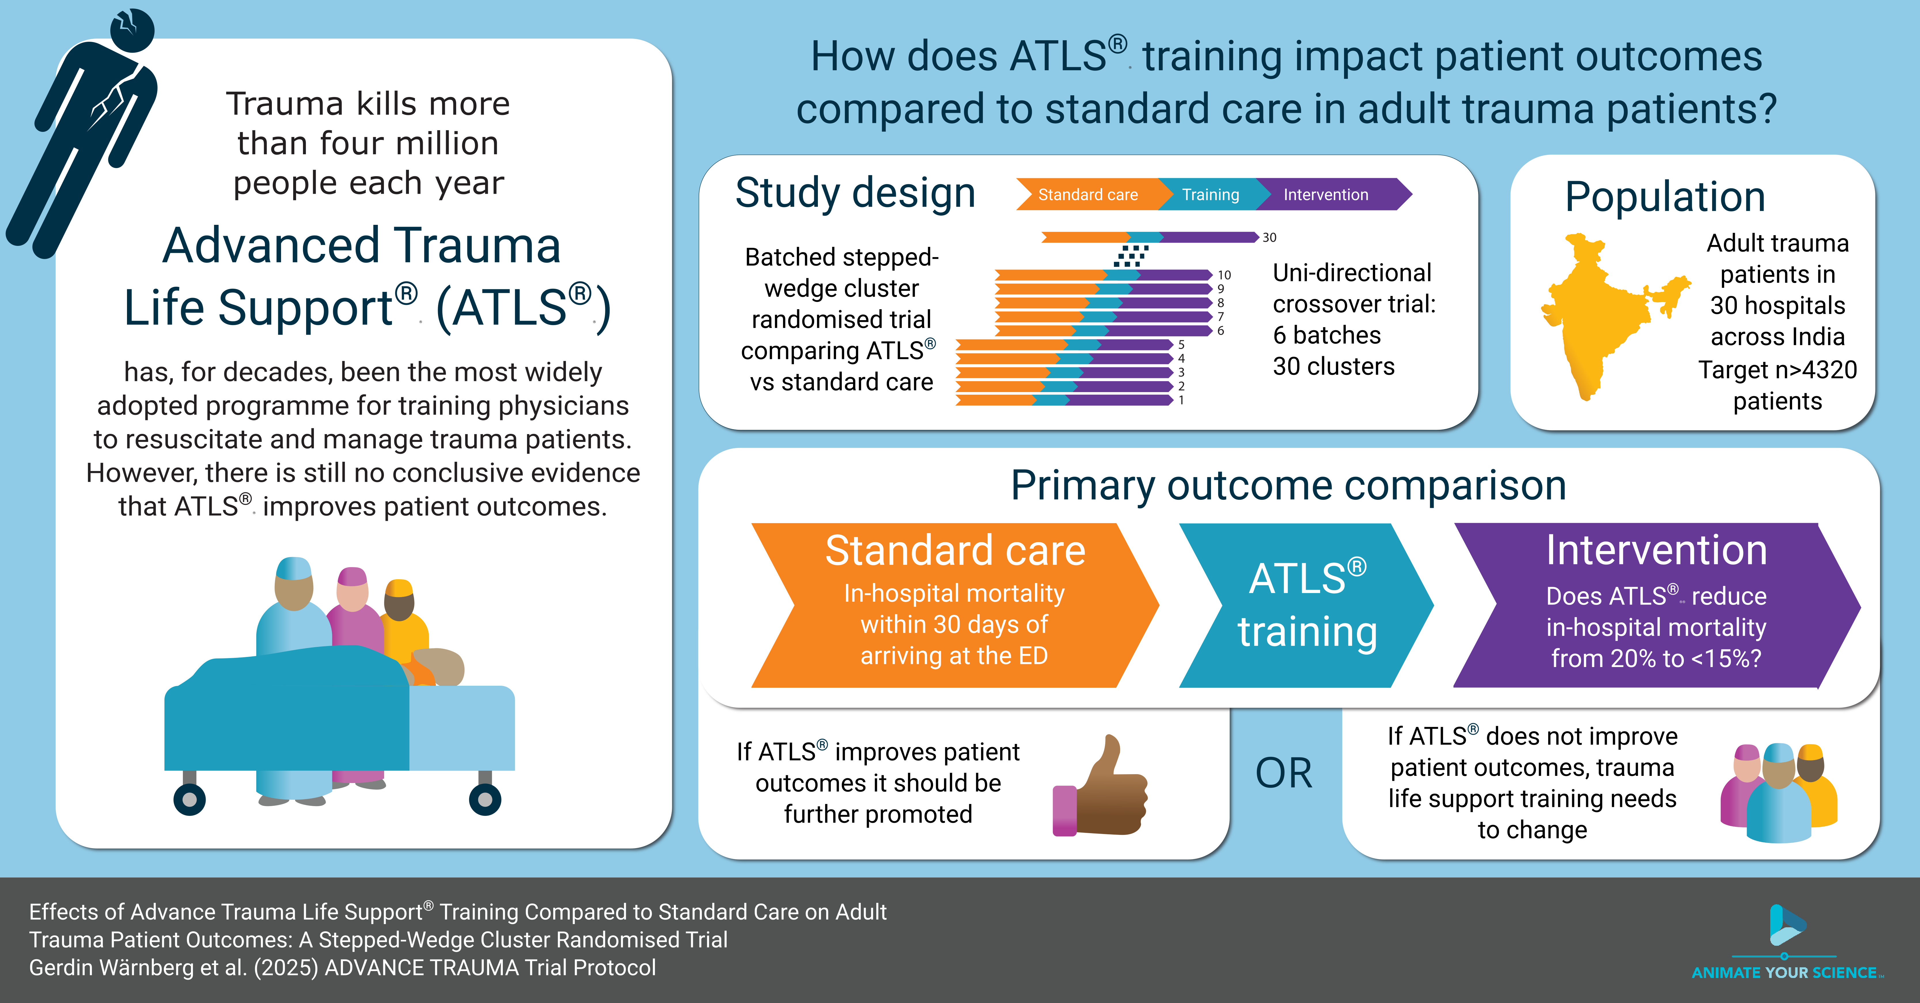

Slide 2

Effects of Advanced Trauma Life Support® Training Compared to Standard Care on Adult Trauma Patient Outcomes: A Stepped-Wedge Cluster Randomised Trial
Trial Meeting 2026・www.advancetrauma.info

Slide 3


Slide 4

Trauma
Scope of the problem
>4
million deaths globally¹
~2
million quality-related deaths³
#1
cause of disease burden in people aged 10-49 years⁴
$4.2
trillions in the US alone²

Slide 5
ATLS®
Purpose and content
“emphasizes the rapid initial assessment and primary treatment of injured patients, starting at the time of injury and continuing through initial assessment, lifesaving intervention, reevaluation, stabilization, and, when needed, transfer to a trauma center”
> ATLS® Student Course Manual. 10th ed. 2018.

Slide 6
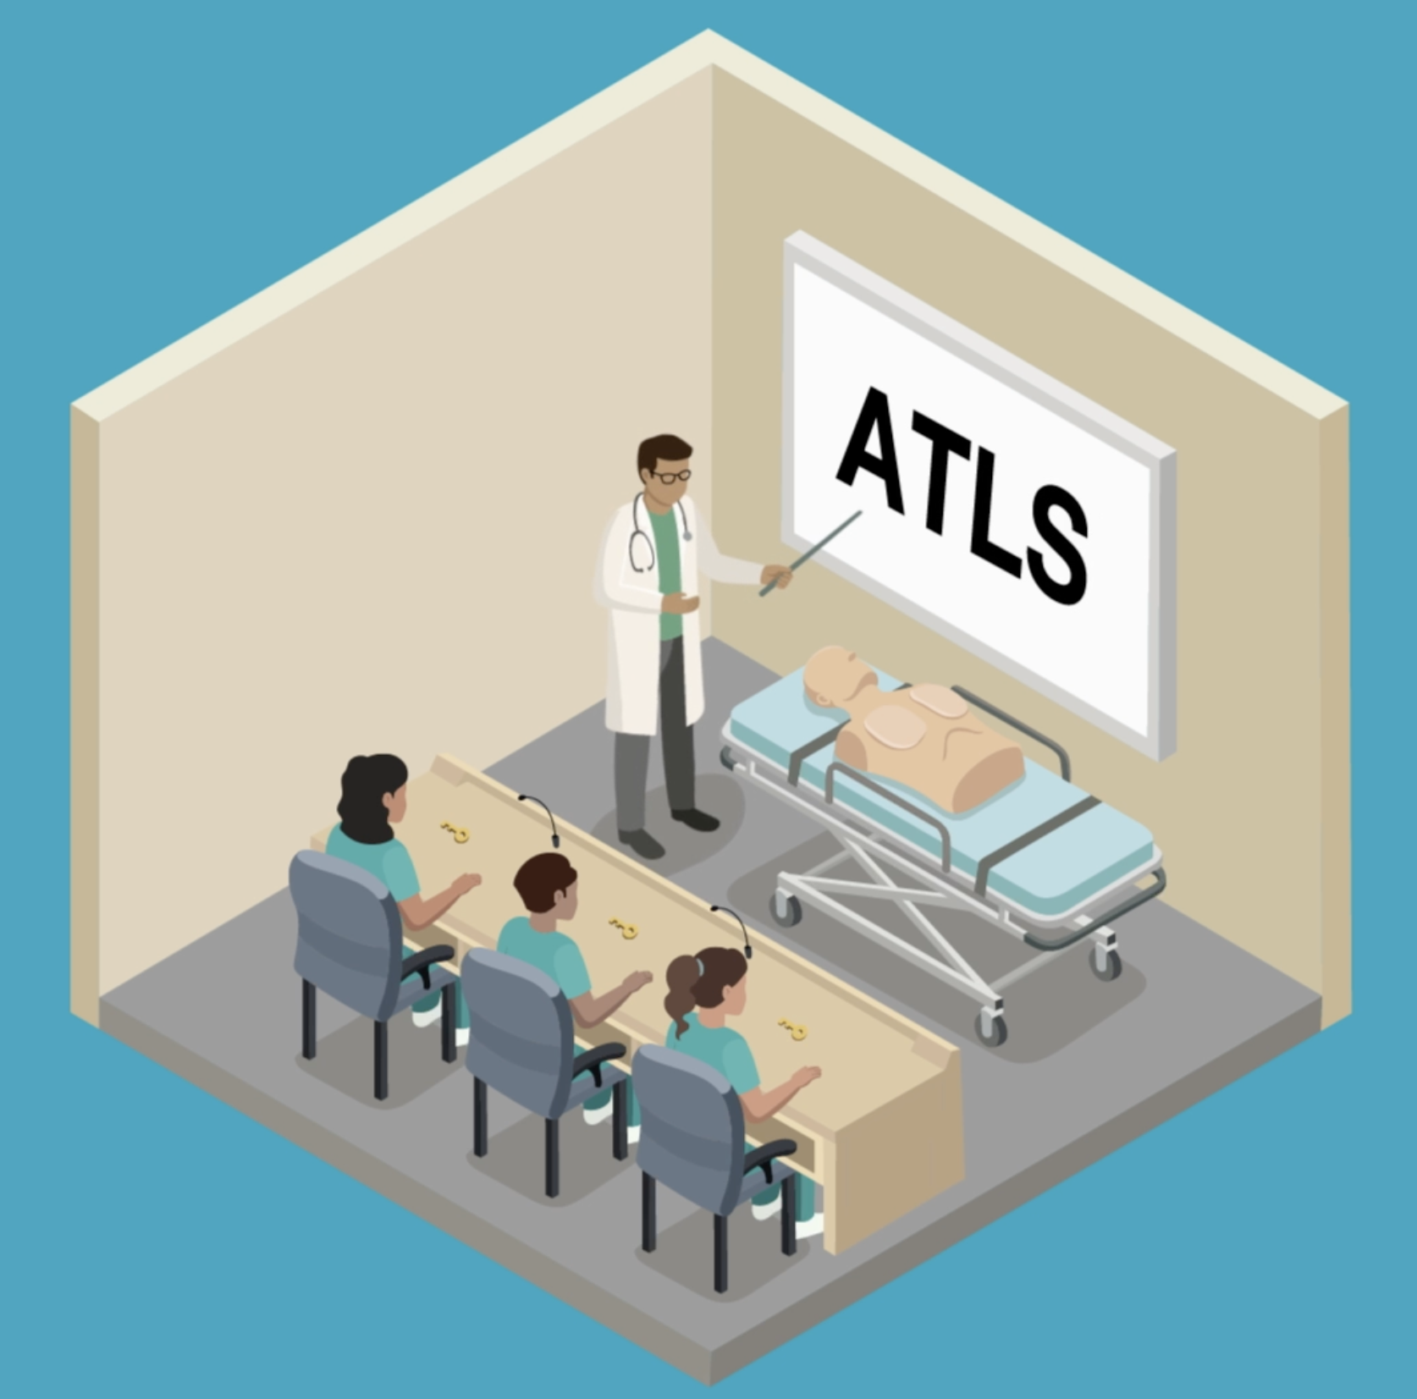
ATLS®
Spread and dissemination⁵
1978
first course
>80
countries worldwide
>1
million physicians trained

Slide 7
ATLS®
Impact on providers’ knowledge and skills
“There is abundant evidence that ATLS training improves the knowledge base, the psychomotor skills and their use in resuscitation, and the confidence and performance of doctors who have taken part in the program. The organization and procedural skills taught in the course are retained by course participants for at least 6 years, which may be the most significant impact of all”
> ATLS® Student Course Manual. 10th ed. 2018.
ADVANCE TRAUMA trial (NCT06321419)
7

Slide 8
ATLS®
Evidence of impact on providers’ knowledge and skills
Three randomised controlled studies:
Ali J et al. 1995⁶: “Using highly reliable trauma OSCE stations we have demonstrated trauma management skills acquisition by senior medical students after the ATLS course.”
Ali J et al. 1996⁷: “… improvement in OSCE scores, adherence to trauma priorities, maintenance of an organized approach to trauma care, and cognitive performance in MCQ examinations.”
Ali J et al. 1999⁸: “Using standard ATLS pass criteria, performance after the new and old ATLS courses was similar.”
ADVANCE TRAUMA trial (NCT06321419)
8

Slide 9
ATLS®
Impact on patient outcomes
“ATLS training in a developing country has resulted in a decrease in injury mortality. Lower per capita rates of deaths from injuries are observed in areas where providers have ATLS training. In one study, a small trauma team led by a doctor with ATLS experience had equivalent patient survival when compared with a larger team with more doctors in an urban setting. In addition, there were more unexpected survivors than fatalities”
> ATLS® Student Course Manual. 10th ed. 2018.
ADVANCE TRAUMA trial (NCT06321419)
9

Slide 10
ATLS®
Evidence of impact on patient outcomes
Five systematic reviews:
Mohammad A et al. 2013: “Future studies are required to properly evaluate the impact of ATLS training on trauma death rates and disability.”
Jayaraman S et al. 2014: “There is no evidence from controlled trials that ATLS or similar programs impact the outcome for victims of injury.”
Jin J et al. 2021: “In-hospital trauma training with certified courses resulted in a reduction of mortality (RR 0.71, 95% CI 0.62 to 0.78).”
Putra AB et al. 2023: “ATLS had no significant effect in reducing the risk of mortality (OR: 0.68; 95% CI 0.39 – 1.20; p = 0.18).”
Nakhid et al. 2026
ADVANCE TRAUMA trial (NCT06321419)
10

Slide 11
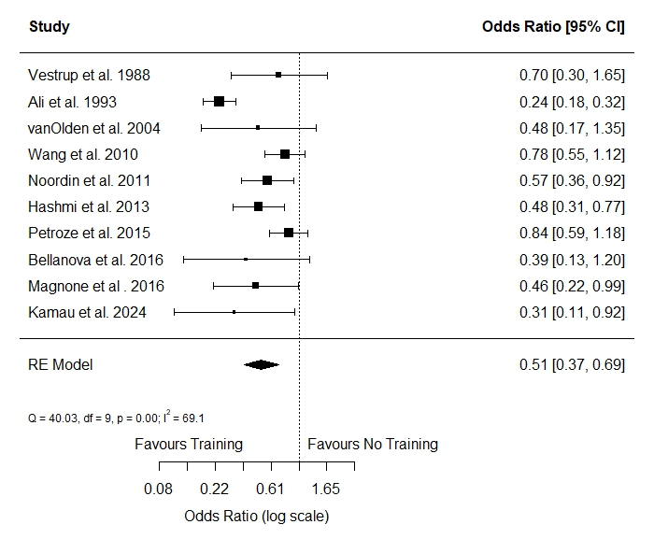
ATLS®
Evidence of impact on patient outcomes
Nakhid et al (2026)⁹:
search in August 2025;
screened 9,626 records;
included 10 observational studies; and
estimated a pooled odds ratio of 0.51.
ADVANCE TRAUMA trial (NCT06321419)
11

Slide 12
ATLS®
Critique^{10,11}
Costly
Perpetuates theories despite evidence of the contrary
Not adapted to modern trauma care
Not adaptable to local circumstances
Fixed didactic nature
ADVANCE TRAUMA trial (NCT06321419)
12

Slide 13
Aim
To compare the effects of ATLS® training with standard care on outcomes in adult trauma patients
ADVANCE TRAUMA trial (NCT06321419)
13

Slide 14


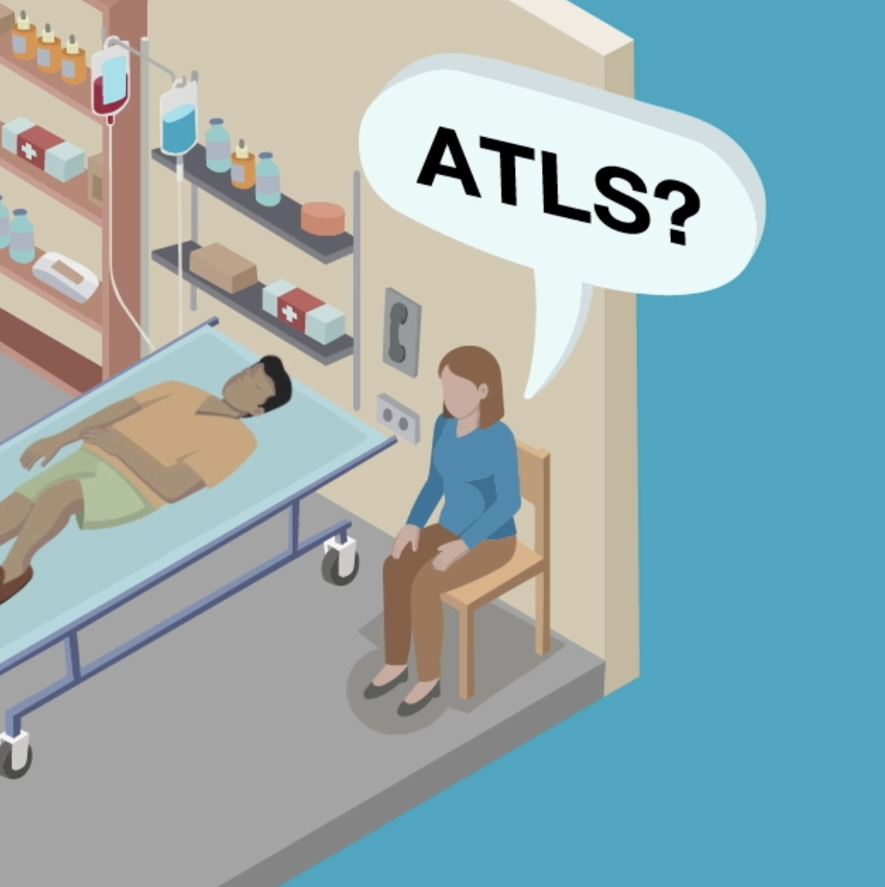
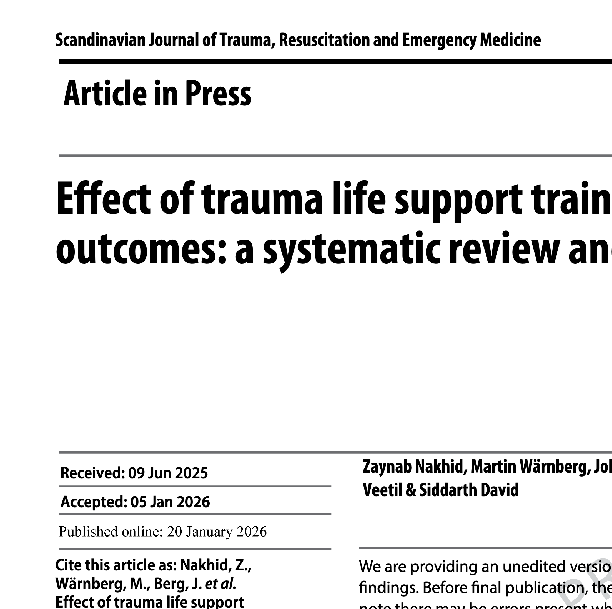
Previous work
Key references
2013 -
Multicentre research¹²
2022-2023
Pilot and feasibility study¹⁴
2022-2023
Community consultations¹³
2022-2026
Systematic review⁵
ADVANCE TRAUMA trial (NCT06321419)
14

Slide 15
Design
Key aspects and justification
Study design
Batched stepped-wedge cluster randomised trial:
30 hospitals
6 batches
5 sequences
13 months in trial
Justification
Is conducted in India because:
Ongoing collaborations > 10 years
ATLS® training not yet standard
ADVANCE TRAUMA trial (NCT06321419)
15

Slide 16
Design
Cluster randomised designs
A. Parallel design
4 | Intervention
3
2 | Control
1
 | 1 | 2 | 3 | 4 | 5 | 6 | 7 | 8 | 9 | 10
B. Parallel design with before and after
4 | Control |  |  |  |  | Intervention
3
2
1
 | 1 | 2 | 3 | 4 | 5 | 6 | 7 | 8 | 9 | 10
C. Stepped-wedge design
4
3
2
1 | Control |  | Intervention
 | 1 | 2 | 3 | 4 | 5 | 6 | 7 | 8 | 9 | 10
D. Batched stepped-wedge design
4
3
2
1 | Control |  | Intervention
 | 1 | 2 | 3 | 4 | 5 | 6 | 7 | 8 | 9 | 10
Cluster
Time
ADVANCE TRAUMA trial (NCT06321419)
16

Slide 17
Design
Cluster randomised designs
A. Parallel design
4 | Intervention
3
2 | Control
1
 | 1 | 2 | 3 | 4 | 5 | 6 | 7 | 8 | 9 | 10
B. Parallel design with before and after
4 | Control |  |  |  |  | Intervention
3
2
1
 | 1 | 2 | 3 | 4 | 5 | 6 | 7 | 8 | 9 | 10
C. Stepped-wedge design
4
3
2
1 | Control |  | Intervention
 | 1 | 2 | 3 | 4 | 5 | 6 | 7 | 8 | 9 | 10
D. Batched stepped-wedge design
4
3
2
1 | Control |  | Intervention
 | 1 | 2 | 3 | 4 | 5 | 6 | 7 | 8 | 9 | 10
Cluster
Time
ADVANCE TRAUMA trial (NCT06321419)
17

Slide 18
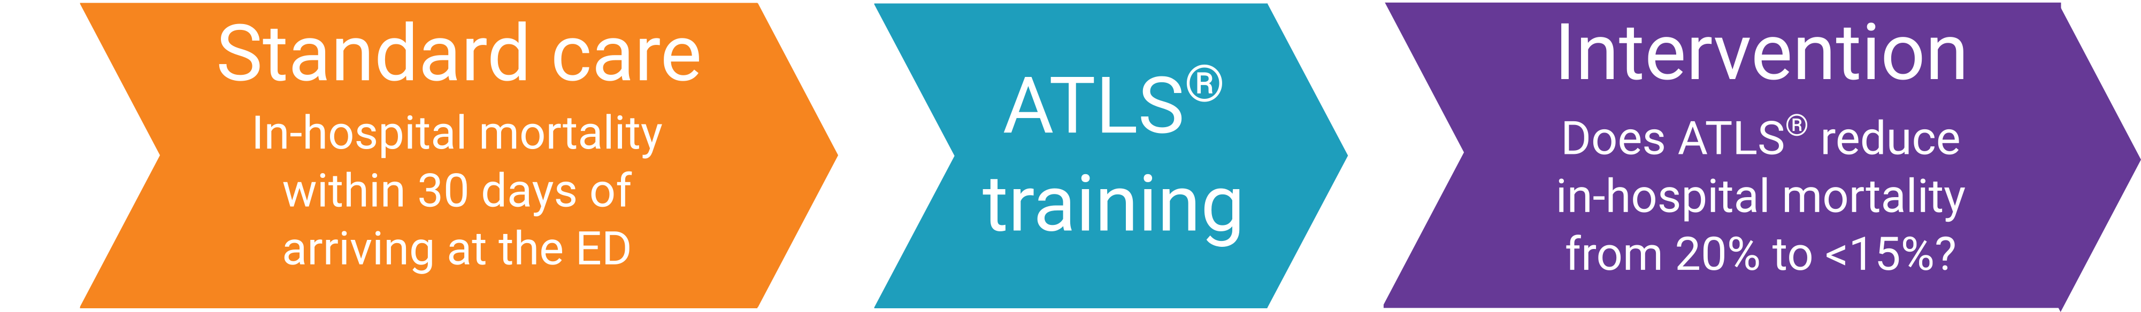
Primary outcome
30-day in-hospital mortality
Collected through medical records for patients admitted or discharged home
Collected through telephonic follow-up for patients transferred to another hospital
ADVANCE TRAUMA trial (NCT06321419)
18

Slide 19
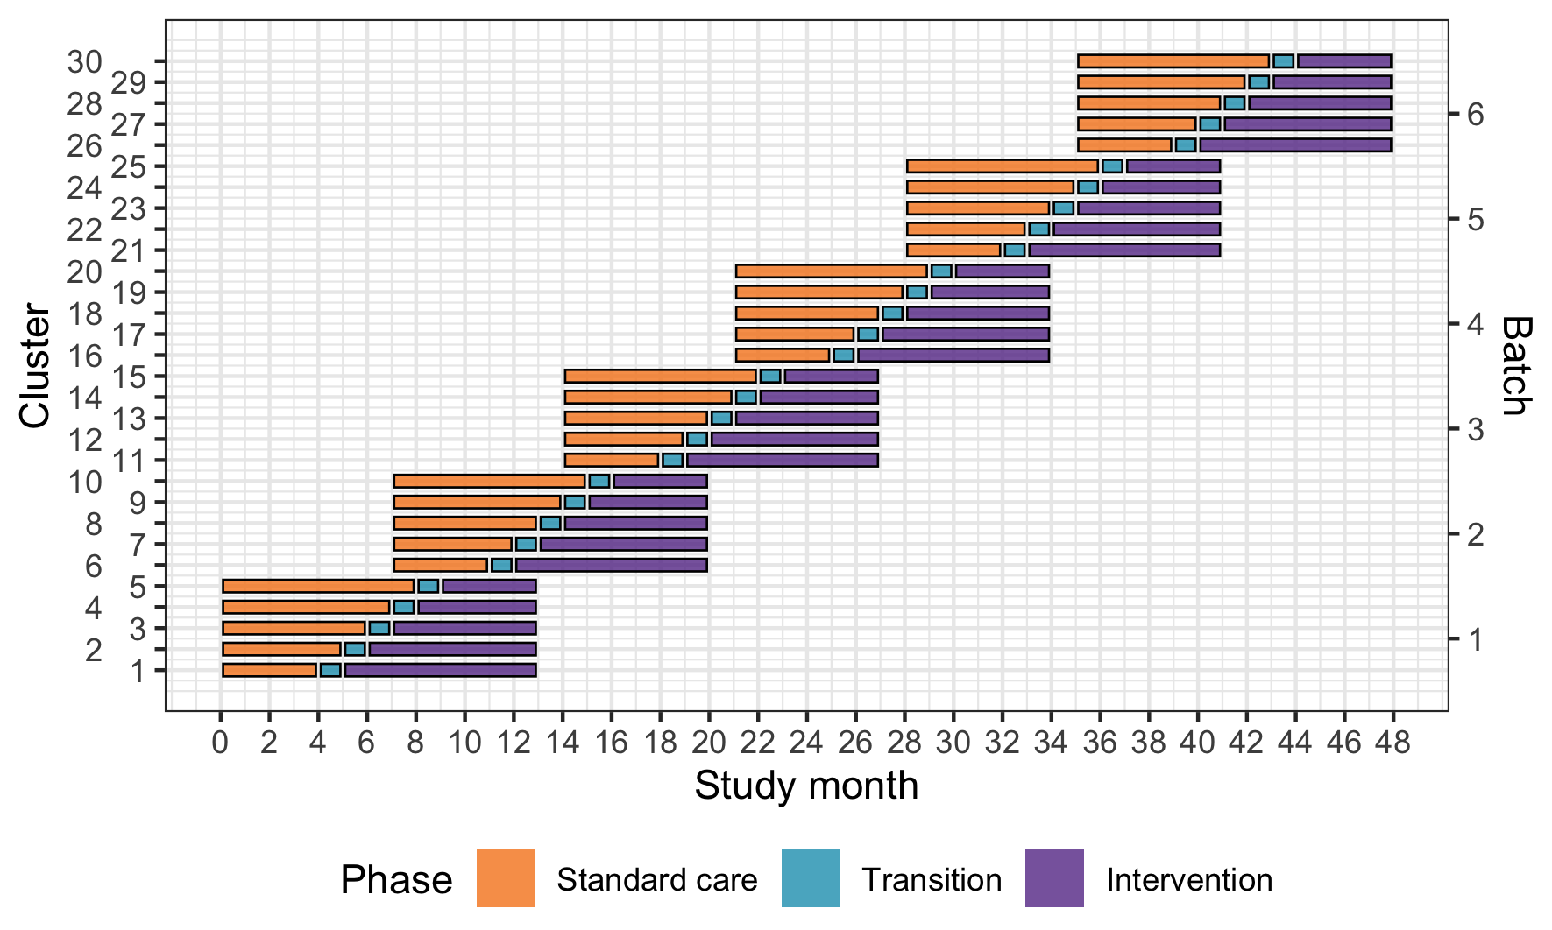
Main Design

Slide 20
Secondary outcomes
All patients using main stepped-wedge design:
All cause and in-hospital mortality at 24 hours, 30 days and 90 days
Length of stay, in the ED, ICU and hospital
Return to work, measured at 30 days and 90 days
Random subset of patients using nested staircase design
Adherence to ATLS principles, collected through observations
Quality of life, measured using EQ5D5L at 30 days and 90 days
Disability, measured using WHODAS 2.0 at 30 days and 90 days
ADVANCE TRAUMA trial (NCT06321419)
20

Slide 21
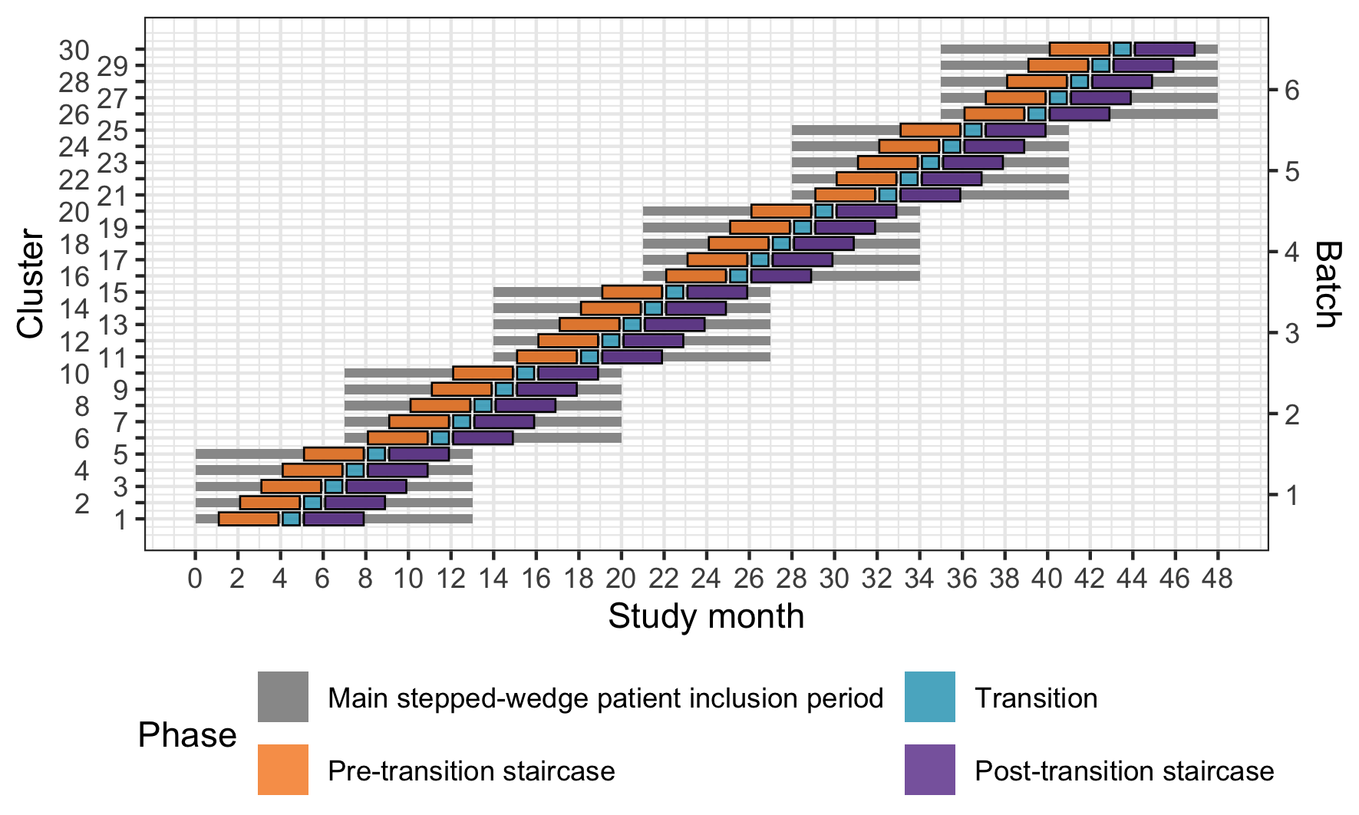
Nested staircase design

Slide 22
Eligibility criteria
Cluster
Hospitals that admit or refer/transfer for admission at least 400 patients with trauma per year
Around the clock emergency surgical and orthopaedic services
Patient
Adult trauma patients presenting to the emergency department of participating hospitals with a history of trauma
Admitted, dies before admission, transferred for admission
<48 hours since trauma
ADVANCE TRAUMA trial (NCT06321419)
22

Slide 23
Intervention and control
ATLS® and standard care
Control
Standard care varies across hospitals in India
Trauma patients are initially managed by 1st or 2nd year resident
No formal trauma life support training
Intervention
2.5 day ATLS® training course
Accredited ATLS® training facility in India
1-2 units per hospital
ADVANCE TRAUMA trial (NCT06321419)
23

Slide 24
Sample size
Effect size, clusters and patients
Detect a reduction in 30-day in-hospital mortality from 20 to 15% with 90% power
30 clusters
At least 4320 patients
Requires at 12 patients per cluster and period (month)
ADVANCE TRAUMA trial (NCT06321419)
24

Slide 25
Consent
Opt-out
Majority, including primary outcome
All variables considered routinely collected and adherence data
Opt-in
Less common
Variables that are not routinely collected, including follow-up
Waiver
For patients who are unconscious and are without a legally authorized representative
ADVANCE TRAUMA trial (NCT06321419)
25

Slide 26
Data collection
One Clinical Research Coordinator (CRC) per participating hospital
Enrols patients admitted under the participating unit(s)
Most data are extracted from medical records
Some outcomes will be collected through observation or telephone follow-up
ADVANCE TRAUMA trial (NCT06321419)
26

Slide 27
Data collection
Adherence to ATLS principles will be collected through observation
14 step checklist covering assessments and interventions that are part of the primary survey
Will require training of CRCs to recognize these assessments and interventions
  Observe ATLS course or training by the trial team
  Collection of adherence data from 10 patients under supervision of ATLS-trained senior clinician at each study site
ADVANCE TRAUMA trial (NCT06321419)
27

Slide 28
Safety reporting
We collect safety events indicative of pulmonary, renal, septic or bleeding complications:
Prolonged mechanical ventilation (> 7 days)
Initiation of renal replacement therapy
Prolonged (> 2 days) or renewed (restart after at least 2 days without) use of vasopressors
Any other event resulting in prolonged hospitalisation, death, or other meaningful harm as determined by the investigator
ADVANCE TRAUMA trial (NCT06321419)
28

Slide 29
Safety reporting
Safety events will be captured by Clinical Research Coordinators
Require review by investigator to assess if the event is potentially related to the intervention
This assessment is recorded in the CRF
Events assessed to be potentially related to the intervention are reported to the Trial Management Group
Decision by the Trial Steering and Data Monitoring Committee
ADVANCE TRAUMA trial (NCT06321419)
29

Slide 30
Current Status
Progress and funding
First batch ongoing since February 2025
~1200 included patients
Second batch started in December 2025
Third batch will start in May 2026
Expect to continue until December 2028, pending more funding
ADVANCE TRAUMA trial (NCT06321419)
30

Slide 31


Implications
If ATLS improves patient outcomes it should be further promoted
If it does not, then trauma life support training needs to change!
ADVANCE TRAUMA trial (NCT06321419)
31

Slide 32
References
Naghavi M et al. Global burden of 292 causes of death in 204 countries and territories and 660 subnational locations, 1990–2023: a systematic analysis for the Global Burden of Disease Study 2023. The Lancet. 2025 Oct 18;406(10513):1811–72.
Peterson C et al. Economic Cost of Injury — United States, 2019. MMWR Morbidity and Mortality Weekly Report. 2021 Dec;70(48):1655–9.
National Academies of Sciences, Engineering, and Medicine. Crossing the Global Quality Chasm: Improving Health Care Worldwide. Washington, D.C.: National Academies Press; 2018. Available from: https://www.nap.edu/catalog/25152
GBD 2019 Diseases and Injuries Collaborators. Global burden of 369 diseases and injuries in 204 countries and territories, 1990–2019: a systematic analysis for the Global Burden of Disease Study 2019. The Lancet. 2020 Oct;396(10258):1204–22.
American College of Surgeons. About Advanced Trauma Life Support. 2024 [cited 2024 Feb 18]. Available from: https://www.facs.org/quality-programs/trauma/education/advanced-trauma-life-support/about/
ADVANCE TRAUMA trial (NCT06321419)
32

Slide 33
References
Ali J, Cohen R, Reznick R. Demonstration of Acquisition of Trauma Management Skills by Senior Medical Students Completing the ATLS Program. The Journal of Trauma: Injury, Infection, and Critical Care. 1995 May;38(5):687–91.
Ali J, Cohen R, Adam R, Theophilus J. G, Pierre I, Bedaysie H, Ali E, West U, Winn J. Teaching Effectiveness of the Advanced Trauma Life Support Program as Demonstrated by an Objective Structured Clinical Examination for Practicing Physicians. World Journal of Surgery. 1996 Oct;20(8):1121–6.
Ali J, Adam RU, Josa D, Pierre I, Bedaysie H, West U, Winn J, Haynes B. Comparison of Performance of Interns Completing the Old (1993) and New Interactive (1997) Advanced Trauma Life Support Courses. The Journal of Trauma: Injury, Infection, and Critical Care. 1999 Jan;46(1):80–6.
Nakhid Z et al. Effect of trauma life support training on patient outcomes: a systematic review and meta-analysis. Scand J Trauma Resusc Emerg Med [Internet]. 2026 Jan 20 [cited 2026 Jan 26]; Available from: https://doi.org/10.1186/s13049-026-01549-w
Shilston J, Turner J. The cost of inadequate trauma training. Anaesthesia. 2022;77(5):617–8.
ADVANCE TRAUMA trial (NCT06321419)
33

Slide 34
References
Wiles MD. ATLS: Archaic Trauma Life Support? Anaesthesia. 2015;70(8):893–7.
TITCO Consortium. Towards Improved Trauma Care Outcomes in India. www.titco.org
David S, Gerdin Wärnberg M, Trauma life support training Effectiveness Research Network (TERN) Collaborators. Patient-reported outcomes relevant to post-discharge trauma patients in urban India. medRxiv; 2024. p. 2024.02.20.24302971. Available from: https://www.medrxiv.org/content/10.1101/2024.02.20.24302971v2
Gerdin Wärnberg M, Basak D, Berg J, Chatterjee S, Felländer-Tsai L, Ghag G, Juillard C, Khajanchi M, Khan T, Mishra A, Nandu VV, Roy N, Singh R, Soni KD, Strömmer L. Feasibility of a cluster randomised trial on the effect of trauma life support training: a pilot study in India. BMJ Open. 2025 Dec;15(12):e099020.
ADVANCE TRAUMA trial (NCT06321419)
34

Slide 35

www.advancetrauma.info

