Slide 1
Effects of Advanced Trauma Life Support® Training Compared to Standard Care on Adult Trauma Patient Outcomes
A Cluster Randomised Trial

Slide 2
Coordinating Institutions
Karolinska Institutet (KI), an international medical university in Stockholm, Sweden
The George Institute of Global Health (TGI), an international research organisation in New Delhi, India

Slide 3
Aim
To compare the effects of ATLS® training with standard care on outcomes in adult trauma patients

Slide 4
Primary Outcome
All-cause mortality within 30 days of arrival at the emergency department

Slide 5
Population
Adult trauma patients presenting to the emergency department of a participating hospital

Slide 6
Intervention
ATLS® training, a 2.5 day course teaching a standardised approach to trauma patient care
All hospitals will receive the intervention
~10 physicians per hospital will be trained in an accredited ATLS® training facility in India

Slide 7
Design
Batched stepped-­wedge cluster randomised controlled trial in 30 hospitals across India

Slide 8
Design
The time point when the training is implemented will be randomised
Minimum of 4 months standard care before the training is implemented
The training is implemented during a 1 month transition phase
Minimum of 4 months after training
Each hospital is in the trial for 13 months

Slide 9
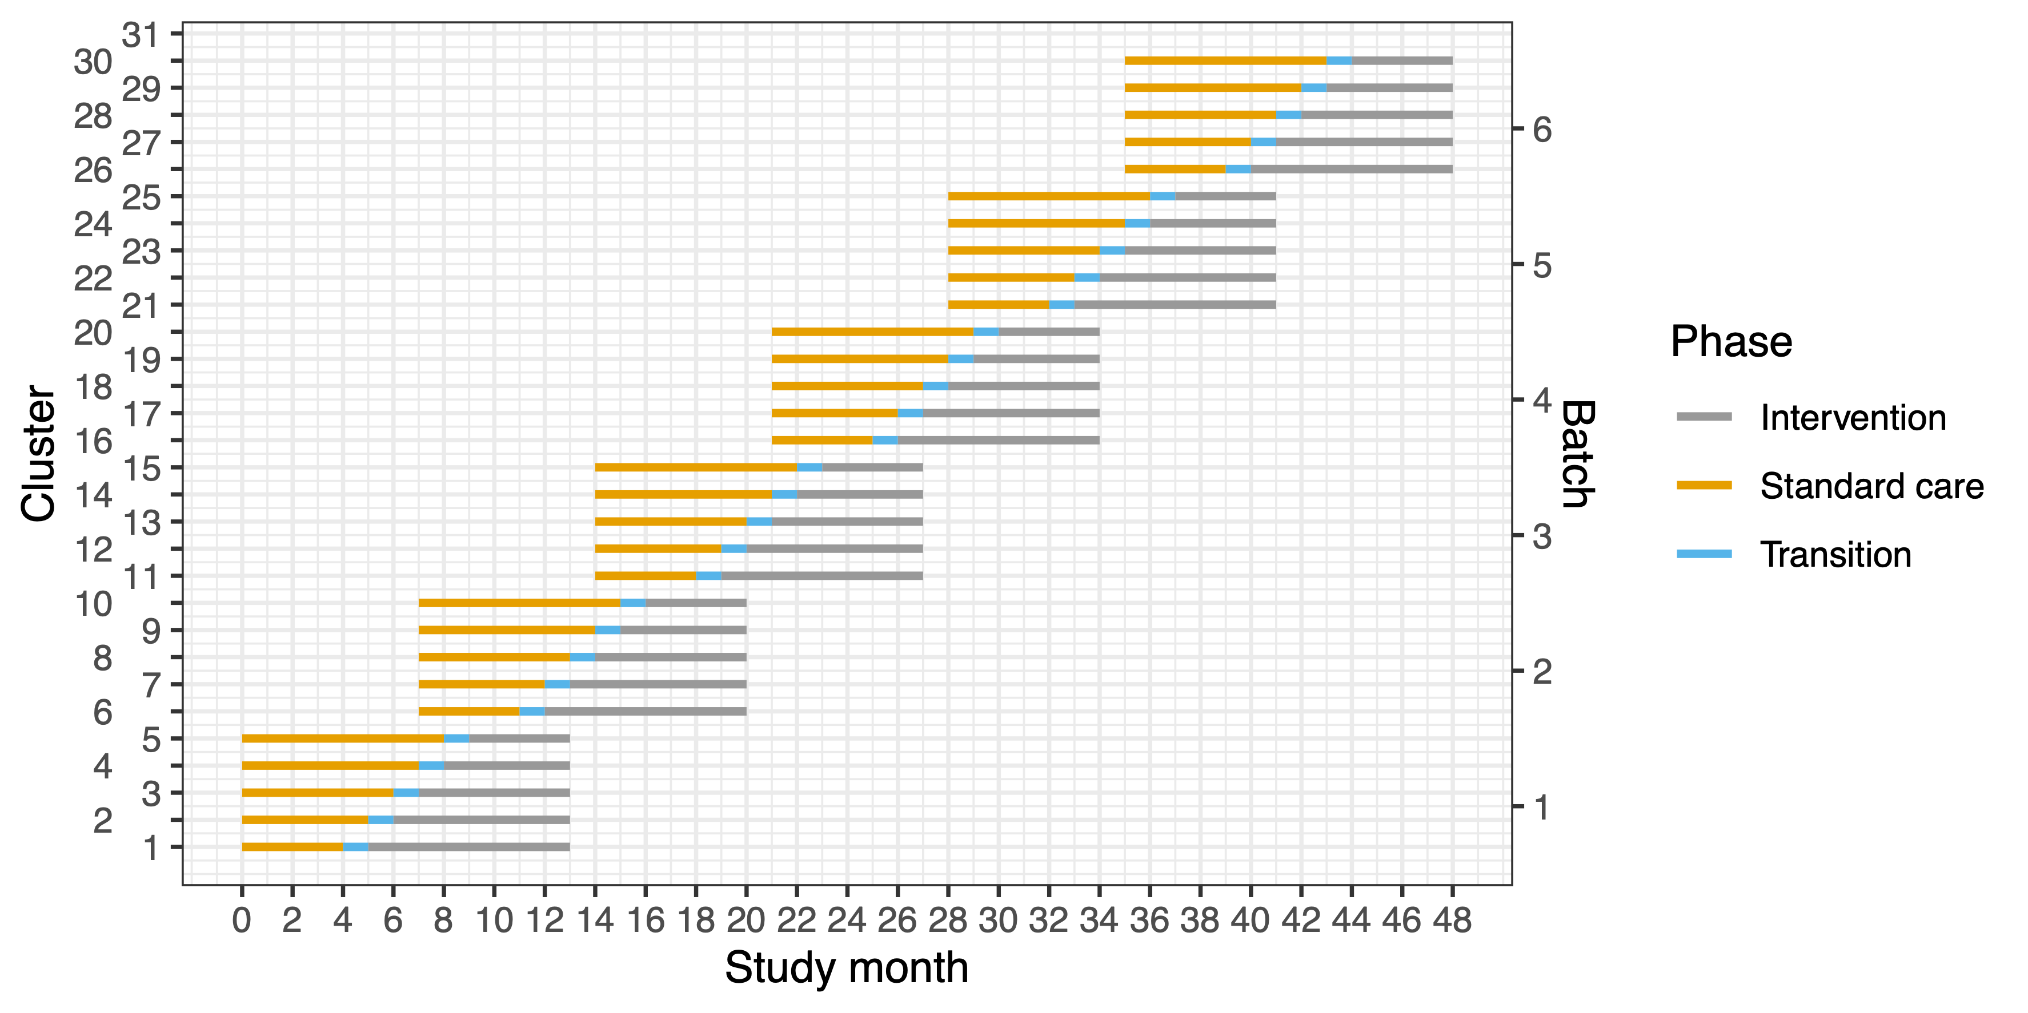

Slide 10
Power & Sample Size
30 clusters and a total sample size of 4320 patients
~90% power to detect a reduction in 30-day in-hospital mortality from 20% under standard care to 15% after ATLS® training.

Slide 11
Ethics & Clearances
We will apply for ethical approvals from:
Each participating hospital
TGI
We will apply for HMSC approval

Slide 12
Funding
Out current funding will cover 10 out of the 30 hospitals planned for
We are currently applying for additional funding
If we do not obtain additional funding the trial will be stopped early

Slide 13
Benefits
10 physicians at your hospital will be trained in ATLS at no cost to your institution
We will employ a full time clinical research coordinator stationed at your institution for the duration of the trial
Multiple opportunities for publications in international scientific journals

Slide 14
Amendments
If we obtain additional funding, we will add:
A cost-effectiveness analysis
An assessment of implementation outcomes
Suggestions for additional sub-studies are very welcome!

