Slide 1
ATLS® vs standard care trial
Trial Management Group meeting, 11th March 2024

Slide 2
Agenda
Decide to go ahead with the attached protocol for ethics submissions
Decide to use the attached Trial Management Charter
Decide to join Trial Steering Committee and Data Monitoring Committee into a Joint Trial Steering and Data Monitoring Committee
Identify external members for the joint committee
Present cluster screening progress
Present timeline

Slide 3
Protocol
Consent
Opt out consent for in-hospital data collection;
Opt in consent for follow-up data collection;
Opt in assent for follow-up data collection for participants who are minors; and
Waiver of informed consent for patients who are unconscious or otherwise unable to provide consent and do not have a legally authorized representative.

Slide 4
Trial Management Group
Members
Girish D Bakhshi
Debojit Basak
Abhinav Bassi
Johanna Berg
Shamita Chatterjee
Kapil Dev Soni
Martin Gerdin Wärnberg
Karla Hemming
Vivekanand Jha
Monty Khajanchi
Anurag Mishra
Samriddhi Ranjan
Nobhojit Roy
Rajdeep Singh
Lovisa Strömmer
Li Felländer-Tsai

Slide 5
Joint Trial Steering and Data Monitoring Committee
Rationale
Reduced complexity – meet once per year/every batch
No blinding – no closed meetings
Low safety risks
Composition
Chair with previous experience
Subject matter
Statistician
Patient/community representative

Slide 6
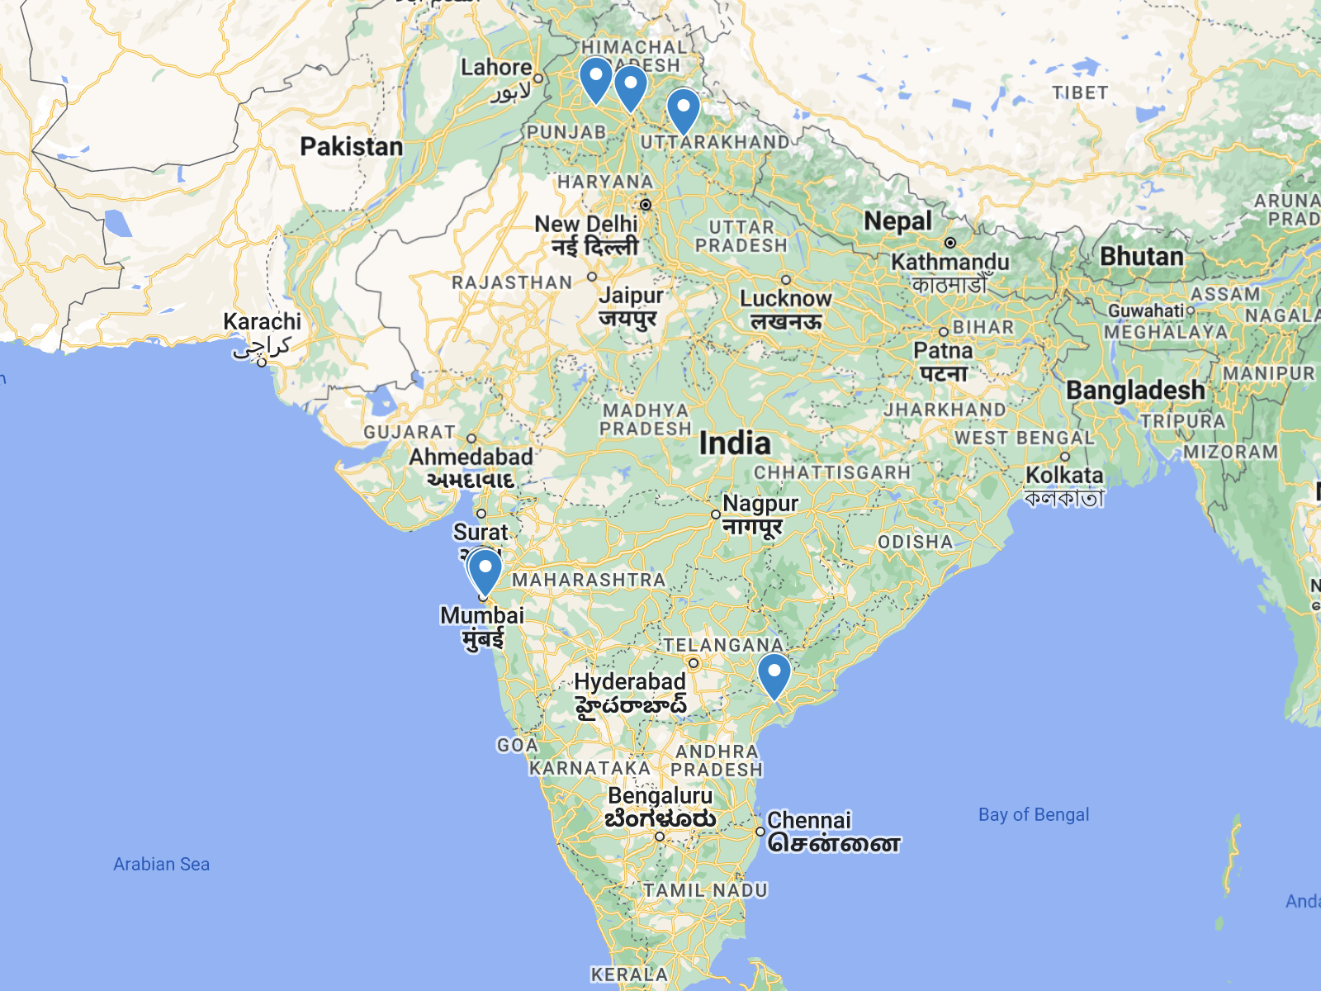
Cluster screening
In-depth interviews
H.B.T. Medical College & Dr. R.N. Cooper Municipal General Hospital, Mumbai
All India Institute of Medical Sciences, Mangalagiri
Christian Medical College and Hospital Ludhiana
Rajawadi Hospital, Mumbai
Government Medical College & Hospital, Chandigarh
Himalayan Institute of Medical Sciences, Uttarakhand

Slide 7
Timeline
Activity | Deadline
Trial registrations (CTRI and ClinicalTrials.gov) | March
Site ethics submission | April-June
HMSC submission | April-June
Start Batch 1 | October

Slide 8
Next steps
Screen additional sites
Identify committee members – send suggestions to Martin
Next meeting May 15

