Slide 1
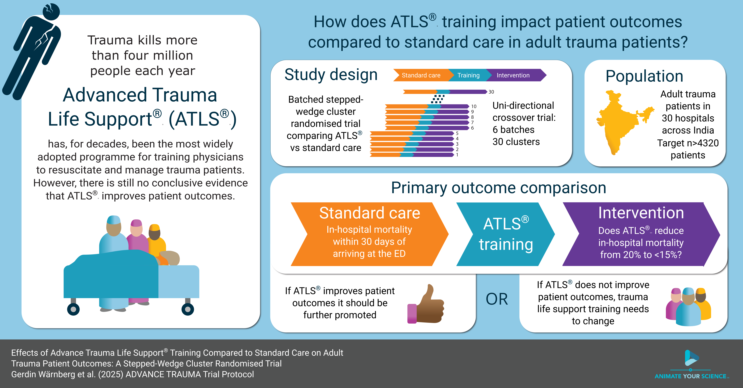

Slide 2

Batch 3 onboarding
Trial Meeting 2026・www.advancetrauma.info

Slide 3

Questions
www.menti.com/alwi12gy3iek

Slide 4
Aim To compare the effects of ATLS® training with standard care on outcomes in adult trauma patients
ADVANCE TRAUMA trial (NCT06321419)
4

Slide 5
Main Design
2026 |  |  |  |  |  |  |  | 2027
May | Jun | Jul | Aug | Sep | Oct | Nov | Dec | Jan | Feb | Mar | Apr | May
Observation | Train | Intervention
Observation | Train | Intervention
Observation | Train | Intervention
Observation | Train | Intervention
Observation | Train | Intervention
May | Jun | Jul | Aug | Sep | Oct | Nov | Dec | Jan | Feb | Mar | Apr | May
2026 |  |  |  |  |  |  |  | 2027

Slide 6
Main Design
2026 |  |  |  |  |  |  |  | 2027
May | Jun | Jul | Aug | Sep | Oct | Nov | Dec | Jan | Feb | Mar | Apr | May
Observation | Train | Intervention
Observation | Train | Intervention
Observation | Train | Intervention
Observation | Train | Intervention
Observation | Train | Intervention
May | Jun | Jul | Aug | Sep | Oct | Nov | Dec | Jan | Feb | Mar | Apr | May
2026 |  |  |  |  |  |  |  | 2027

Slide 7
Main Design Outcomes
Primary outcome: 30-day in-hospital mortality
Collected through medical records for patients admitted or discharged home
Collected through telephonic follow-up for patients transferred to another hospital
Secondary outcomes
All cause and in-hospital mortality at 24 hours, 30 days and 90 days
Return to work, measured at 30 days and 90 days
Length of stay, in the ED, ICU and hospital

Slide 8
Nested Staircase Design
2026 |  |  |  |  |  |  |  | 2027
May | Jun | Jul | Aug | Sep | Oct | Nov | Dec | Jan | Feb | Mar | Apr | May
 | Pre-training | Train | Post-training
 | Pre-training | Train | Post-training
 | Pre-training | Train | Post-training
 | Pre-training | Train | Post-training
 | Pre-training | Train | Post-training
May | Jun | Jul | Aug | Sep | Oct | Nov | Dec | Jan | Feb | Mar | Apr | May
2026 |  |  |  |  |  |  |  | 2027

Slide 9
Nested Staircase Outcomes
Secondary outcomes
Adherence to ATLS principles, collected through observations
Quality of life, measured using EQ5D5L at 30 days and 90 days
Disability, measured using WHODAS 2.0 at 30 days and 90 days
Rationale
These outcomes are more time consuming to collect and we expect larger effects, fewer participants needed

Slide 10
Intervention implementation
We can train an average of 10 physicians per hospital
Important
Train those who initially resuscitates trauma patients
Maximise the number of trained physicians in the emergency department on a given day
Train as many as possible in the same unit
The timing of the training will be randomised
The first hospital will undergo training four months after the trial starts
Hospitals will be informed about their sequence no later than one month in advance

Slide 11


Intervention implementation
 | Unit 1/Monday & Thursday | Unit 2/Tuesday & Friday | Unit 3/Wednesday & Saturday
Resident 1
Resident 2
Resident 3
Resident 4
 | Unit 1/Monday & Thursday | Unit 2/Tuesday & Friday | Unit 3/Wednesday & Saturday
Resident 1
Resident 2
Resident 3
Resident 4

Slide 12
Intervention implementation
 | Unit 1/Monday & Thursday | Unit 2/Tuesday & Friday | Unit 3/Wednesday & Saturday
Resident 1
Resident 2
Resident 3
Resident 4
 | Unit 1/Monday & Thursday | Unit 2/Tuesday & Friday | Unit 3/Wednesday & Saturday
Resident 1
Resident 2
Resident 3
Resident 4

Slide 13
Intervention implementation
 | Unit 1/Monday & Thursday | Unit 2/Tuesday & Friday | Unit 3/Wednesday & Saturday
Resident 1
Resident 2
Resident 3
Resident 4
 | Unit 1/Monday & Thursday | Unit 2/Tuesday & Friday | Unit 3/Wednesday & Saturday
Resident 1
Resident 2
Resident 3
Resident 4

Slide 14
Study timeline 2026
21/3
Trial meeting
27/4-1/5
Batch 3 CRC training including ATLS-adherence
4/5-15/5
Batch 3 pilot data collection
18/5
Batch 3 trial start
31/3
Batch 1 stops including participants

Slide 15
Study timeline 2026
July
Batch 2, 3rd site ATLS training
June
August
Batch 2, 4th site ATLS training
September
Batch 2, 5th site ATLS training
October
Batch 3, 1st site ATLS training
May
Batch 2, 1st site ATLS training
Batch 2 2nd site, ATLS training
Batch 1, end of follow up

Slide 16
Study timeline 2026-2027
January 2027
Batch 3, 4th site ATLS training
December 2026
February 2027
Batch 3, 5th site ATLS training
May 2027
Batch 3 stops including patients
August
Batch 3 end of follow up
November 2026
Batch 3, 2nd site ATLS training
Batch 2 stops including participants
Batch 3, 3rd site ATLS training
March 2027
Batch 2 end of follow up

Slide 17

www.advancetrauma.info

