Slide 1

Welcome!
Trial Meeting 2026・www.advancetrauma.info

Slide 2
Morning
 | Hall A
09.00 – 09.25 | Welcome & introductions
09.25 – 09.50 | Our past projects
09.50 – 10.40 | The ADVANCE TRAUMA trial
10.40 – 11.00 | Tea
 | Hall A |  | Hall B
 | Session | Participants | Session | Participants
11.00 – 11.30 | Batch 1 & 2 overview | Investigators | ATLS adherence | CRC
11.30 – 12.00 | Batch 3 onboarding | Investigators | Coding demonstration | CRC
12.00 – 12.30 | Publication policy | Investigators | REDCap demonstration | CRC
12.30 – 13.30 | Lunch

Slide 3
Afternoon
 | Hall A
13.30 – 14.20 | Batch 1 presentations
14.20 – 15.10 | Batch 2 presentations
15.10 – 15.30 | Tea
15.30 – 16.20 | Batch 3 presentations
16.20 – 16.40 | Group discussion
16.40 – 17.00 | Closing Remarks, Way Forward & Batch 1 CRC felicitation

Slide 4
Introductions

Slide 5
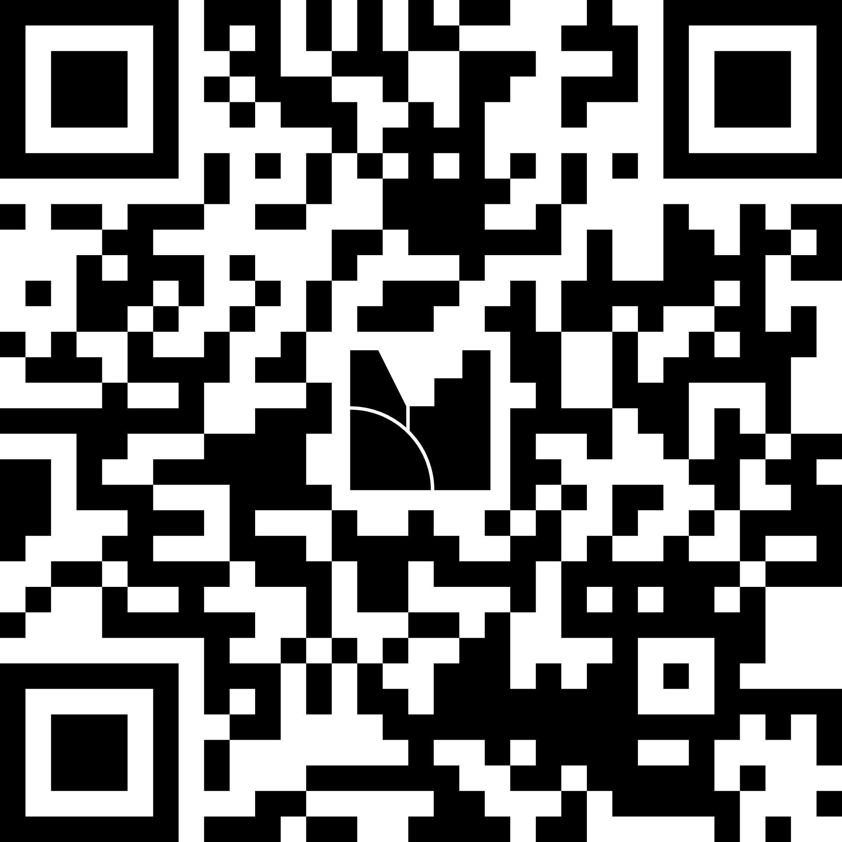
Questions
www.menti.com/alwi12gy3iek

