Slide 1




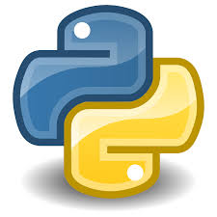





Microsoft Visual Studio
Pipeline
Python Libraries

