Slide 1

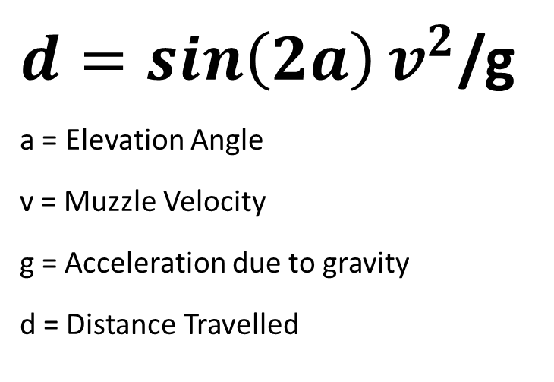
$d=\sin\left(2a\right)v^{2}$/g
a = Elevation Angle
v = Muzzle Velocity
g = Acceleration due to gravity
d = Distance Travelled
v
g
a
d

