Slide 1
Context:
MAJOR APP GOALS
- simple observability of pipeline and current progress toward goals based on the MEDDPICC sales framework
- provide suggested actions a rep can take based on the level of information needed in the MEDDPICC framework
- provide a button to see a popup with a check list of the required information for that op
- provide suggested actions based on your understanding of the MEDDPICC framework and how the data inter-relates, and a current review of 1) effective steps from other ops in the data base and 2) current review of end customer related information available on the web
- weight the opportunity likelihood of closing and closing on the indicated close date base on the MEDDPICC related information or lack of information, with visual indicators on the opportunity lists
- provide end customer and MEDDPICC process related insights on
- the information needed on each pullout
- the overall sales progression listed on a popup when requested from the selected opportunity on the dashboard
- provide quick summary of user related metrics and performance against on the dashboard

Slide 2
Context:
Thinking about the sales funnel information needed by various levels of people in the partner alliance sales hierarchy, you are going to create a multi user app with persistent data that allows users to input and update opportunity information using the MEDDPICC sales framework to intelligently capture and help guide users to drive and close deals.
From the dashboard the user should
-see a rollup of revenue potential by partner, by current quarter, by fiscal year with comparison to quarter and fiscal year goals
-provide a collapsible summary list of opportunities and initiatives
-buttons add edit delete partners opportunities and initiatives
-select a side pullout for each of the letters in MEDDPICC (listed vertically)
-suggest other useful items based on best practices
Do a deep search of the MEDDPICC sales methodology. On each of the MEDDPICC side pull outs develop a popup form and information layout that will capture the information needed for each element. For example, M = metrics. When opened for the first time for the selected opportunity the popup form should be displayed for the user to begin adding the required information to describe that metric.
Same for each pullout. Each entry should be editable and deletable. Each element listed should have a “Customer Validated” check the user will check when the user has received verifiable validation from the customer the information is correct.
Each entry on each tab should somehow weighted 1) for relevance to the customer and 2) relevance to the opportunity continuing to progress and 3) relevance to the opportunity closing on the estimated date

Slide 3
Context:
-each time a new partner or opportunity is created, you should do a current deep search of that companies financial, press data etc to extract information relevant to each of the MEDDPICC information requirements and add that summary information to the relevant pull out. For example developing as detailed an org chart as possible from financial filings and add the list and titles as additonal info on the decision, or financials results showing the prospect financial health summary in the economic buyer tab. And so on….
-the user should be able to select an opportunity or partner from the dashboard which should populate the MEDDPICC pull outs for the selection
-each pullout should have a refresh button which instructs you to refresh data from your review. If there is new relevant data it should be listed at the top with subsequent review data listed below in a scrollable list
Keeping future development phases into account to ensure extensibility
- this app will eventually be a multi-user (with hierarchy of users, for example VP of sales, regional sales directors and so on each with separate metrics such as quota and geography.
-this app will eventually also be multi-tenant
MAJOR APP GOALS
- simple observability of pipeline and current progress toward goals
- help to direct actions for the sales team to take based on the level of information needed in the MEDDPICC framework
- provide a button to see a popup with a check list of the required information for that op
- provide suggested actions based on your understanding of the MEDDPICC framework and how the data inter-relates, and a current review of 1) effective steps from other ops in the data base and 2) current review of end customer related information available on the web, which
- weight the opportunity likeli-hood of closing and closing on the indicated close date base on the MEDDPICC related information or lack of information with visual indicators on the opportunity lists

Slide 4
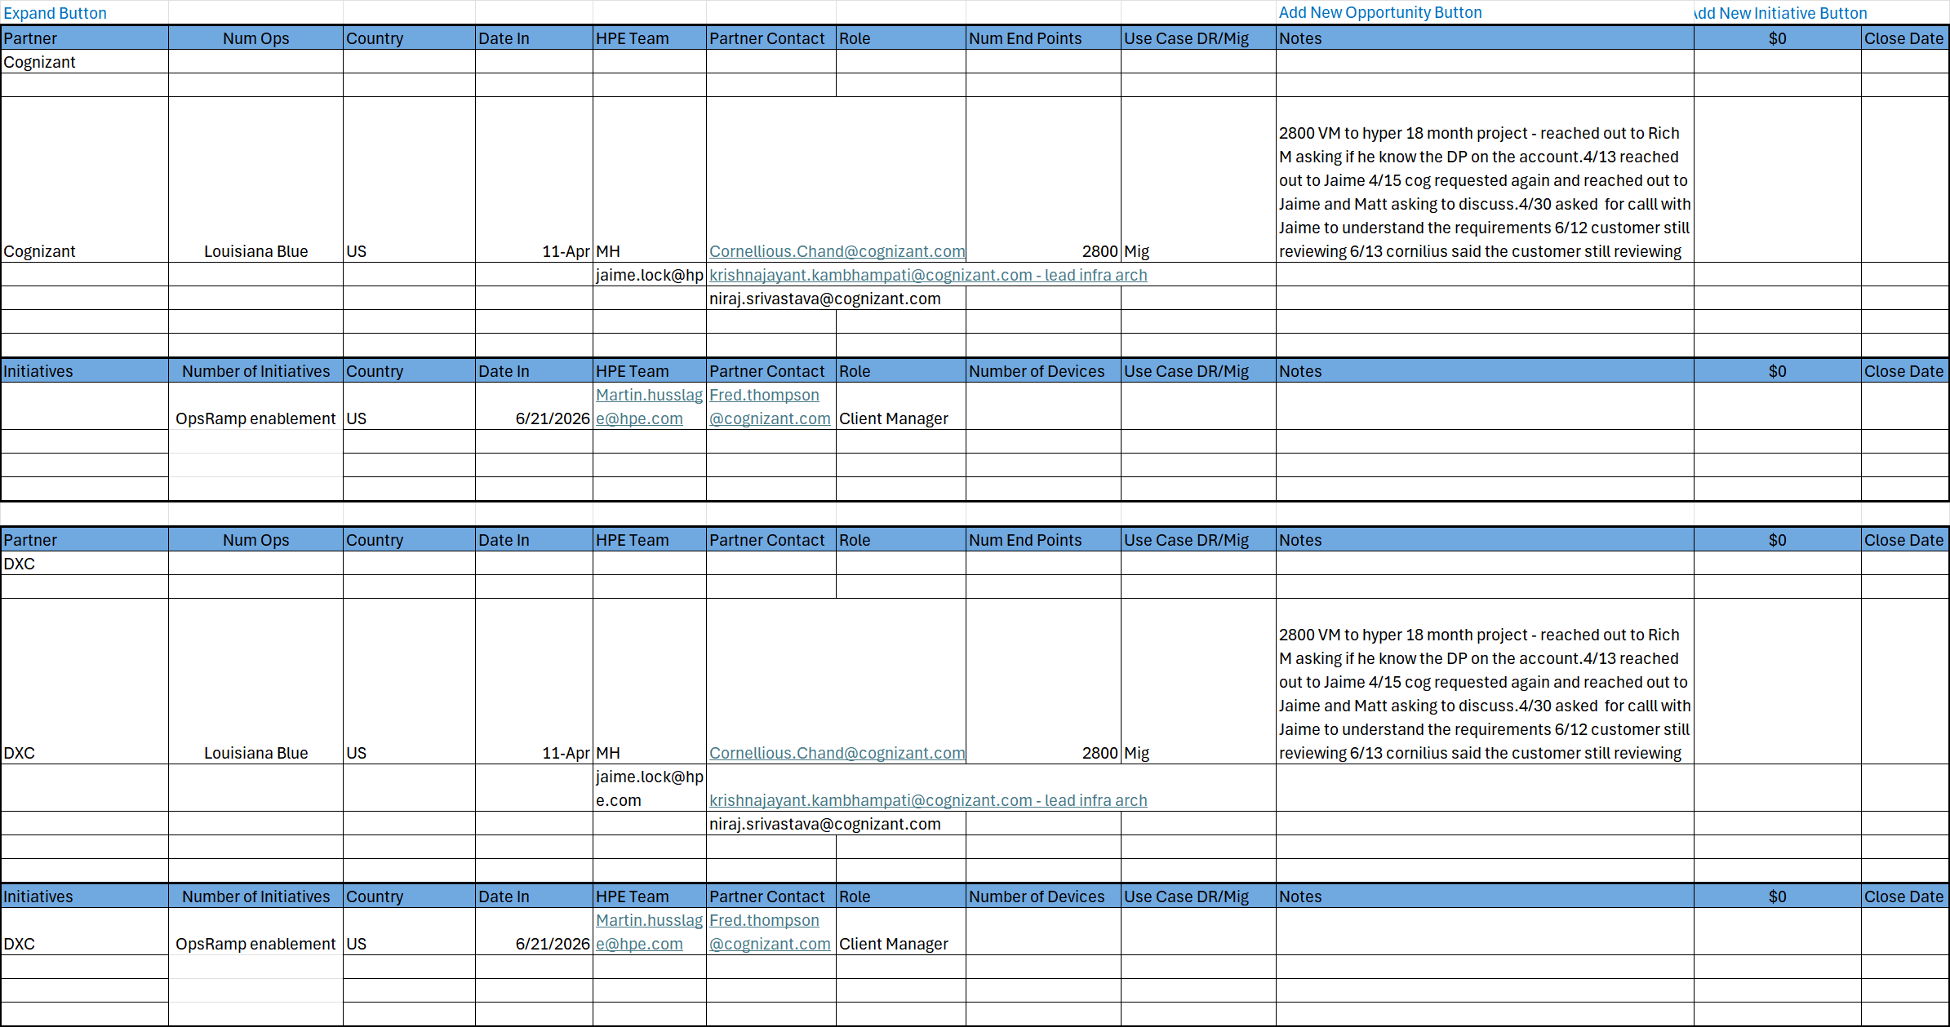
MEDDPICC

Slide 5
The MEDDPICC sales framework is an extended version of MEDDIC, adding further elements to improve opportunity qualification, risk management, and deal closure strategies. Each element helps sales teams thoroughly assess and manage complex sales opportunities.
### Elements of MEDDPICC:
1. **Metrics (M):**
Quantifiable measures that demonstrate the value or impact of your solution to the customer.
*Example:* Cost savings, increased revenue, efficiency gains.
2. **Economic Buyer (E):**
The individual with the authority and budget control to make the purchasing decision.
*Focus:* Identifying and engaging this person early.
3. **Decision Criteria (D):**
The specific standards, features, or requirements the customer uses to evaluate solutions.
*Purpose:* To ensure your solution aligns with these criteria.
4. **Decision Process (D):**
The steps, stages, and timeline involved in making the purchase decision.
*Goal:* To understand how and when the decision will be made and by whom.
5. **Paper Process (P):**
The administrative and contractual steps needed to finalize the deal, including approvals, legal review, and paperwork.
*Focus:* Managing and streamlining contract and procurement processes.
6. **Identify Pain (I):**
The specific problems or challenges the customer seeks to resolve.
*Purpose:* To position your solution as the remedy for their pain points.
7. **Champion (C):**
An internal advocate within the customer’s organization who supports and promotes your solution.
*Role:* To influence decision-makers and facilitate the sale.
8. **Competition (C):**
Other vendors or solutions competing for the customer’s business.
*Use:* To understand your competitive position and differentiate your offering.

