Slide 1
Engineering
Induction Training Program
(E-ITP)
Software Product Engineering
Part 2

Slide 2
Software Product Engineering Topics
Architecture and Design Phase
Architecture & Design Methodologies
Test Development Phase
Code & Unit Test Phase
Test Execution, Integration, and Release Phases
Process Tailoring

Slide 3
Architecture And Design Phase

Slide 4
Architecture and Design
Product Development
Requirements Development
ICD (optional)
PV
REQB
RTMX
SRS
PV
SDD
PV
Code
RTMX
SAD
Requirements Gathering
Requirements
Analysis
Architecture
& Design
Code &
Unit Testing
-Software
Ad
Ad
Integrated
Release
RV
Ad
PM
RV
PM
PV
System
PV
PV
-Release
PM
RV
Notes
Project
Integration
V&V Test
Release
Initiation
VVTC
Execution
PSCMP
SPMP
SQAP
VVTP
Ad
RRR
PV
VVTD
Ad
PM
RV
RV
RV
PCA
Project
Planning
V&V Test
Test
FCA
Development
Execution
RV
Ad
PM
PV
Ad
PM
RV
Test Development

Slide 5
Architecture Definition
“The software architecture of a program or computing system is the structure or structures of the system, which comprise software elements, the externally visible properties of those elements, and the relationships among them. ”.
[SEI]

Slide 6
Principles of Architecture
Software architecture represents the structure of the software.
  This includes the structural arrangements of software components, and various static and dynamic interrelationships between these components.
Software architecture is expressed using certain views, each of which serves a specific purpose. Each view is a specific abstraction of the architecture, for a specific purpose.
Software architecture includes the principles behind design and evolution of the software.

Slide 7
Architecture Activities
Develop detailed Solutions and Selection Criteria:
  Develop Selection Criteria.
  Generate and document at Initial Architecture Blueprint.
  Analyze alternative approaches and select relevant candidates.
  Evaluate relevant approaches.
  Select the solution alternative that best satisfies the established criteria.
  Decompose selected architecture in different views.
Evolve Operational Concepts and Scenarios:
  Allocate requirements to components resulting from architectural views.
  Identify requirements suitable to be covered by third party SW components documenting criteria for identification.
Conduct Quality Gate of Software Architecture and Interface Control Documents; documenting components, interfaces and relevant views
Notes:
The High Level Design activity logically decomposes the system requirements specified in the SRS into Software Modules. It defines their interfaces and the data and control flows between them. These modules are specified in the High Level Design Document (HDD).
The Detailed Design activity specifies the formats, inputs, outputs, and algorithms of the software modules in enough detail to support code development and unit testing. These details are specified in the Detailed Design Document (DDD).

Slide 8
Design Definition
“… the process of applying various techniques and principles for the purpose of defining a device, a process, or a system in sufficient detail to permit its physical realization”.

Slide 9
Design Activities
Design consists of two main activities:
  High Level Design (HDD)
    decomposes the system requirements in the SRS into Software Modules
    defines their interfaces and the data and control flows between them
  Detailed Design (DDD)
    specifies the formats, inputs, outputs, and algorithms of the software modules
    detailed to support code development and unit testing
Notes:
The High Level Design activity logically decomposes the system requirements specified in the SRS into Software Modules. It defines their interfaces and the data and control flows between them. These modules are specified in the High Level Design Document (HDD).
The Detailed Design activity specifies the formats, inputs, outputs, and algorithms of the software modules in enough detail to support code development and unit testing. These details are specified in the Detailed Design Document (DDD).

Slide 10
Architecture & Design Inputs
Mandatory inputs to this phase consist of:
  SPMP created
  Core Requirements identified (REQB, SRS, ICD as appropiate)
  Traceability Matrix initialized
  System Architecture Documents
  Standards applicable (e.g. ITUT, IEEE, etc.)
  Motorola Software Asset Inventory
  Risk Management Plan Document initialized
Optional Inputs
  Interface Control Document initialized

Slide 11
Architecture & Design Outputs
The outputs of this phase consist of:
  Initial Architecture Blueprint
  Software Architecture Document baselined
  Software Design Document baselined
  Interface Control Document updated
  Traceability Matrix updated
  Requirements documents updated
  Motorola Software Asset Inventory updated
  Preview and Postmortem minutes
  Risk Management Plan Document updated

Slide 12
Architecture & Design V&V
The following verification and validation activities are performed:
  Architecture Evaluation/Analysis.
  Reviews of the Software Architecture Document, and Software Design Document.
  Phase Audits (Optional).
  EOPC

Slide 13
Architecture and Design Methodologies

Slide 14
Architecture/Design Modeling
There are three primary types of modeling
  Process (or Transform) modeling,
  Data modeling and
  Architectural modeling
The Analysis/Design development of data, process and architecture models can be performed in either order, but are usually done concurrently.
Notes:
There are several types of Design Methodologies
One modeling approach focuses on data (and data objects)
The other focuses on processes (programs, code, routines)

Slide 15
Architecture/Design Modeling (2)
Functional
model
Information
model
Data Modeling
Behavioral
model
Design
Architectural
Modeling
Code
Other
requirements
Integrated
& validated
software
Procedural
Modeling
Program
modules
Test

Slide 16
General Design Guidelines
Exhibit a hierarchical organization that make intelligent use of control among components.
Logically partitioned into components that perform specific tasks and subtasks.
Distinct representation of data and procedure.
Lead to interfaces that reduce complexity.
Derived using a repeatable method driven by information gathered during requirements.

Slide 17
Data Modeling
“The primary activity during data design is to select logical representations of data objects identified during the requirements definition and specification phase. The selection process may involve algorithmic analysis of alternative structures in order to determine the most efficient design or may simply involve the use of a set of modules that provide the operations upon some representation of an object”.
[Wasserman]
Identify the program modules that operate upon the logical data structures.
Data design leads to better program structure, effective modularity and reduced complexity .

Slide 18
Architectural Modeling
The objective is to develop a modular program structure and represent the control relationships between modules.
Combines program and data structure by defining interfaces that allows data to flow throughout the program.
“Holistic view” of software.

Slide 19
Procedural Modeling
The objective is to specify procedural detail without ambiguity.

Slide 20
Design Fundamentals
Abstraction:
  Levels of detail/language used to describe a problem.
Refinement:
  Top-down strategy.
Modularity:
  Divide software into separate components that are integrated to solve problem requirements.
Software Architecture:
  The hierarchical structure of procedural components and the structure of data.

Slide 21
Design Fundamentals (2)
Control Hierarchy:
  Organization of modules that implies a hierarchy of control.
Data Structure:
  Logical representation of the relationship among individual data elements.
Software Procedure:
  Processing details of each module. Precise specification includes sequence of events, decision points, repetitive operations and data organization.
Information Hiding:
  Modules are designed so that information within a module is inaccessible to other modules with no need for the information.

Slide 22
Design Techniques
Structured design.
  Any disciplined approach to software design that adheres to specified rules based on principles such as modularity, top-down design, and stepwise refinement of data, system structures, and processing steps.
Object-Oriented design.
  A software development technique in which a system or component is expressed in terms of objects and connections between those objects.

Slide 23
Structured Modeling
There are several predominant notation schemes for Structured Data and Process modeling
  Data Modeling
    Authors: Martin, Bachman, Chen
    Notations: ERD, semantic object models
  Process or Transform Models
    Authors: Yourdon/Demarco, Gane/Sarson
    Notations: Context diagrams, DFD, Decomposition Diagrams
  Mixed Models
    Authors: Booch, Rumbaugh, Jacobson
    Notation: UML
Notes:
Let’s start by discussing Structured analysis and design techniques…we will consider primarily process and data modeling
Data Modeling is the design of databases
there are three primary notation schemes
(Martin, Bachman and Chen)
Process modeling is the design of programs, modules and subroutines
there are two primary notation schemes
(Yourdon and DeMarco, and Gane/Sarson)
The different between these two types of modeling methods is the different between NOUNS and VERBS
Nouns are things, data objects (files, records, fields, etc)
Verbs are programs that do things to these things

Slide 24
OO Modeling
There are also several notation methods for OO modeling
  Booch
  Rumbaugh
  Jacobson
  Schlaer- Mellor
  Wirfs-Brock
  UML
Notes:
On the other hand there are Object Oriented Methods (OO)
There are a number of different notation schemes
Booch
Rumbaugh
Jacobson
Schlaer-Mellor
Wirfs-Brock and
UML
Notice that Jacobson, Booch and Rumbaugh got together in 1996 and developed the notation scheme called UML
(which will be discussed later)

Slide 25
Model Summary
Data Models
  Entity-Relationship Diagrams
  Data Dictionary
Architecture Models
  Architecture Flow Diagrams
  Structure Charts
Object Oriented Models
  Object Models
  Dynamic Models
  Functional Models
Process or Transform Models
  DFD, Context charts, Decomposition charts
  Decision Trees
  State Charts/State Transition Diagram
Notes:
Here is a list of things that are often modeled using these techniques

Slide 26
SA/SD vs OO
OO is better suited when lower levels of domain expertise are present.
Structured approaches are better when the system is small or easily describable.
OO is better on large, complex systems that are difficult to describe.
If systems are recursive, chaotic or non-deterministic (like simulators), OO approaches excel.
SA/SD and OO are NOT mutually exclusive. OO may be used to define the system to one level and smaller subsystems or modules may be created using structured techniques.
Notes:
The choice between OO and SA/SD are thus dependent upon complexity, familiarity.

Slide 27
Architecture/Design Tools
Rational Rose (SWE CASE)
Visio (SWE Drawing tools)
(Others such as System Architect, Visual Analyst’s Workbench, SALSA, etc.)
Repositories; for reuse and design databases
  (Clearcase, ABT, Interleaf, etc.)
Notes:
Tools

Slide 28
Resources and References
DFD’s, Process Modeling
  Gane-Sarsen
  Tom DeMarco
  Ed Yourdon
ERD’s, Data Modeling
  James Martin
  Chen
  Bachman
OO, State Models
  Boosch
  Rumbaugh
  Wirfs-Brock
  Schlaer-Mellor
  OMG (Object Management Group)
UML - Clearcase, Rumbaugh, Boosch
Notes:
And other things that you might want to look up

Slide 29
V&V Test Development Phase

Slide 30
Test Development
Product Development
Requirements Development
ICD (optional)
PV
REQB
RTMX
SRS
PV
SDD
PV
Code
RTMX
SAD
Requirements Gathering
Requirements
Analysis
Architecture
& Design
Code &
Unit Testing
-Software
Ad
Ad
Integrated
Release
RV
Ad
PM
RV
PM
PV
System
PV
PV
-Release
PM
RV
Notes
Project
Integration
V&V Test
Release
Initiation
VVTC
Execution
PSCMP
SPMP
SQAP
VVTP
Ad
RRR
PV
VVTD
Ad
PM
RV
RV
RV
PCA
Project
Planning
V&V Test
Test
FCA
Development
Execution
RV
Ad
PM
PV
Ad
PM
RV
Test Development

Slide 31
Acceptance Criteria
Requirements
Development
Validation Testing
Develop V&V Test Suite
Verification Testing
Arch &
Design
Develop Sub-System Integration
Sub-System
Test Suite
Integration
Testing
High Level
Develop Module Integration
Module
Design
Test Suite
Integration
Testing
Detailed
Develop Unit Test Suite
Design
Phase
Test Development Lifecycle
Code
Unit Testing
Phase Transition
Test Software Entry/Exit
In-phase Activity boundary
Software Production Process applied with the V Model

Slide 32
Concurrent Test Suite Development
The SPP also has three activities that spawn the development of Test Suites concurrently with development of Product Software:
  Requirements Development
    System Test Suite
    Sub-System Integration Test Suite
  Architecture and Design
    Module Integration Test Suite
    Unit Test Suite (started)
  Code & Unit Test
    Unit Test Suite (completed)
Notes:
During the Requirements Analysis Phase, the System and Sub-System Integration Test Suites are developed
During Design, the Module Integration and Unit Test Suites are developed.
During the Code & Unit Test Phase, the Unit Test Suite is completed.
The development of Test Suites and Product are carried out in parallel.

Slide 33
Test Development Activities
The following Test Development Activities are discussed in the relative Validation and Verification ITP Modules
  V&V Test Planning
  V&V Test Design & Test Cases
  V&V Test Suites
  Test Principles

Slide 34
Code and Unit Test Phase

Slide 35
Code & Unit Test
Product Development
Requirements Development
ICD (optional)
Code
PV
REQB
RTMX
SRS
PV
SDD
PV
RTMX
SAD
Requirements Gathering
Requirements
Analysis
Architecture
& Design
Code &
Unit Testing
-Software
Ad
Ad
Integrated
Release
RV
Ad
PM
RV
PM
PV
System
PV
PV
-Release
PM
RV
Notes
Project
Integration
V&V Test
Release
Initiation
VVTC
Execution
PSCMP
SPMP
SQAP
VVTP
Ad
RRR
PV
VVTD
Ad
PM
RV
RV
RV
PCA
Project
Planning
V&V Test
Test
FCA
Development
Execution
RV
Ad
PM
PV
Ad
PM
RV
Test Development

Slide 36
Code & Unit Test Activities
Code and Unit Testing consists of two activities:
  Coding
    The Coding activity translates the Detailed Design Document into code.
  Unit Testing
    The Unit Testing activity verifies the functionality of each individual code module.
Notes:
When developing Product software, this activity supplies additional input to the Unit Test software development lifecycle.
Code developed is delivered to the Unit Test Suite development lifecycle to supplement the preliminary requirements (consisting of UTDs and UTCs) developed during the Design phase.
The Unit Test Suite implements the UTDs, UTCs and code-dependent tests
The Unit Test Suite is a deliverable from the Unit Test development lifecycle.

Slide 37
Coding
The activity which translates the representation of the design into a programming language
  design → source code → object/machine code
Coding is the means by which humans “communicate” with the computer
  human readable descriptions of the procedures and data we need to manipulate and use to solve the problem are turned into “directions” for the required computer platform
The computer language used can affect the way we will design

Slide 38
Features of Programming Languages
Strong typing
User-defined types
Encapsulation of data abstractions
Run-time checking
Program redundancy checking
Assertions
Macro capability
Libraries
Error-prone constructions

Slide 39
Selecting a Coding Language
Selection considers the language characteristics
  the psychology of programming (Weinburg, 1971)
  technical characteristics
Programming language characteristics
  Ease of translation
    design to code
  Portability
    processor to processor, compiler to compiler, etc.
    environment change (e.g., version of operating system)
    product package to product package (reuse)
  Efficiency (fast, tight executable code)
  Availability of tools (software development environment)
  Ease of maintainability (readability)

Slide 40
Coding Support Tools
Language analyzers
File utilities
Command scripts
Searches and edits
File comparison
make utility
Version control
Coding standards

Slide 41
Code Inspection Checklist
The code to review compared to previous version shows only the lines that the developer modified.
All requirements are reflected in the created/modified code according to SRS/SDD documents.
Code compiles without errors
Unit Test was performed
Deprecated code (classes, methods, functions) has not been used
Each new/modified method/class/etc is documented using the appropriate methodology.
Names for new objects (attributes, methods, classes) are meaningful and concise.
Exceptions are handled and error messages shown to the user are user friendly (error messages must be accurate and must show understandable information).
Modified code is correctly tabulated according to existing code (check it with ClearDiff tool)

Slide 42
Unit Test Execution
Unit Tests shall be conducted. All results (pass or fail) shall be recorded in the Unit Test Log.
If any of the Unit Tests exhibit a problem:
  If a test execution error, re-run the test.
  If not a test execution error, raise a Problem Report.
After all the Unit Tests have been run, a Unit Test Report shall be produced, summarizing the Unit Test results.

Slide 43
Code & Unit Test Inputs
Mandatory inputs consist of:
  Inputs obtained from the Project Baseline:
    Software Architecture baselined
    Software Design Documents baselined
    Traceability Matrix updated
    Motorola Software Asset Inventory
    SPMP baselined
    PSCMP baselined
  The Project Folder
Optional inputs:
  ICD baselined

Slide 44
Code & Unit Test Output
The outputs of this phase consist of :
  Baselined Source Code
  Final Header Files & Build Scripts
  Traceability Matrix updated
  Unit Test Cases
  Unit Test Logs (optional)
  Unit Test Reports
  Motorola Software Asset Inventory updated (when appropriate)

Slide 45
Code & Unit Test V&V
The following verification and validation activities are performed:
  Code and UT Reviews/Inspections
  Quality Audits for Coding and UT Phase
  Prototyping activities
  EOPC

Slide 46
Test Execution, Integration, and Release Phases

Slide 47
Test Execution, Integration,
& Release
Product Development
Requirements Development
ICD (optional)
PV
REQB
RTMX
SRS
PV
SDD
PV
Code
RTMX
SAD
Requirements Gathering
Requirements
Analysis
Architecture
& Design
Code &
Unit Testing
-Software
Ad
Ad
Integrated
Release
RV
Ad
PM
RV
PM
PV
System
PV
PV
-Release
PM
RV
Notes
Project
Integration
V&V Test
Release
Initiation
VVTC
Execution
PSCMP
SPMP
SQAP
VVTP
Ad
RRR
PV
VVTD
Ad
PM
RV
RV
RV
PCA
Project
Planning
V&V Test
Test
FCA
Development
Execution
RV
Ad
PM
PV
Ad
PM
RV
Test Development

Slide 48
Acceptance Criteria
Requirements
Validation Testing
Development
Develop V&V Test Suite
Verification Testing
Arch & Design
Develop Sub-System Integration
Sub-System
Test Suite
Integration
Testing
High Level
Develop Module Integration
Module
Design
Test Suite
Integration
Testing
Detailed
Develop Unit Test Suite
Design
Phase
Test Development Lifecycle
Code
Unit Testing
Phase Transition
Test Software Entry/Exit
In-phase Activity boundary
Software Production Process applied with the V Model
Notes:
Module Integration Test Suite development starts once there is a High Level Design and is run after Unit Test is completed
Sub-System Integration Test Suite development starts once requirements are analyzed and a SRS is available and is run after the Module Integration Test is completed
Even though there will be changes, it is wise to overlap Test Suite Development with the Design or SRS development

Slide 49
Test Execution Activities
The following Test Execution Activities are discussed in the relative Validation and Verification ITP Modules (V&V Test Management and V&V Testing Techniques)
  Verification, Validation, Integration, and Regression Testing
  Test Readiness Review
Release and Acceptance Activities are discussed in the Configuration Management portion of the ITP (Configuration Management part 1 and part 2)
  Release Readiness Review
  Physical Configuration Audit
  Functional Configuration Audit

Slide 50
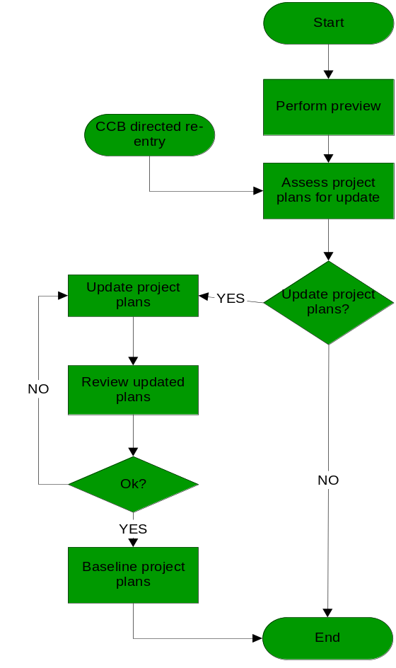
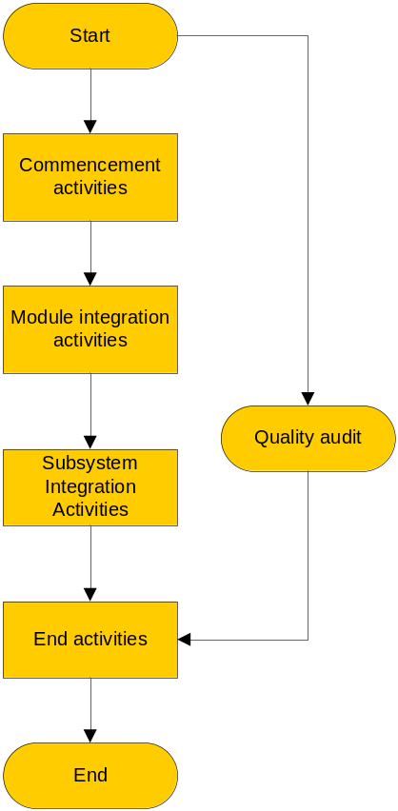
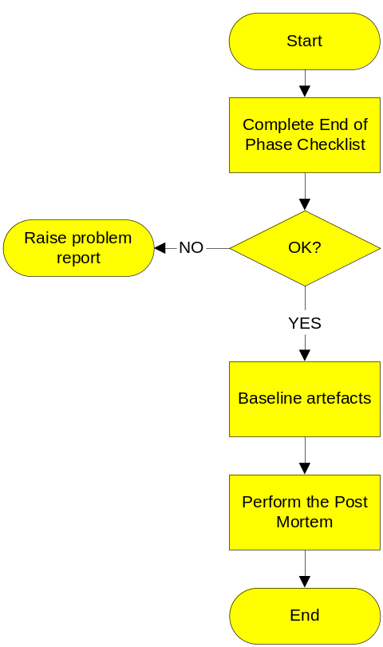
Integration Activity
Overview
Integration Commencement
Activities
Integration End Activities

Slide 51
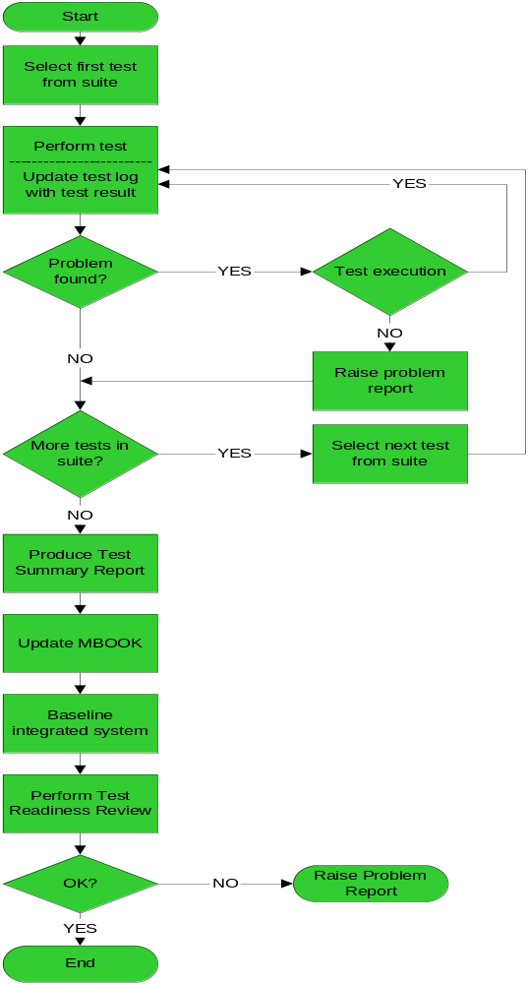
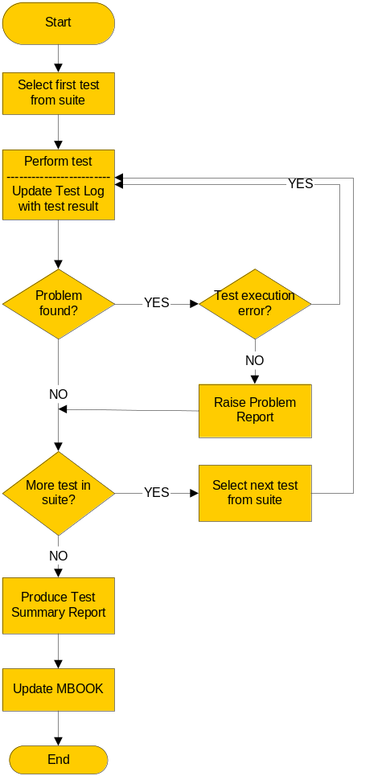
Sub-System Integration
Testing Activities
Module Integration Testing
Activities

Slide 52
Process Tailoring

Slide 53
Process Adherence
The processes, procedures, and standards described in the SPP are required to be followed on all software projects.
The project specific processes, procedures, and standards are selected and identified in the Software Project Management Plan.
If a project needs to deviate from the standard process the deviation shall be documented in the SPMP and approved by SQ&P department.

Slide 54
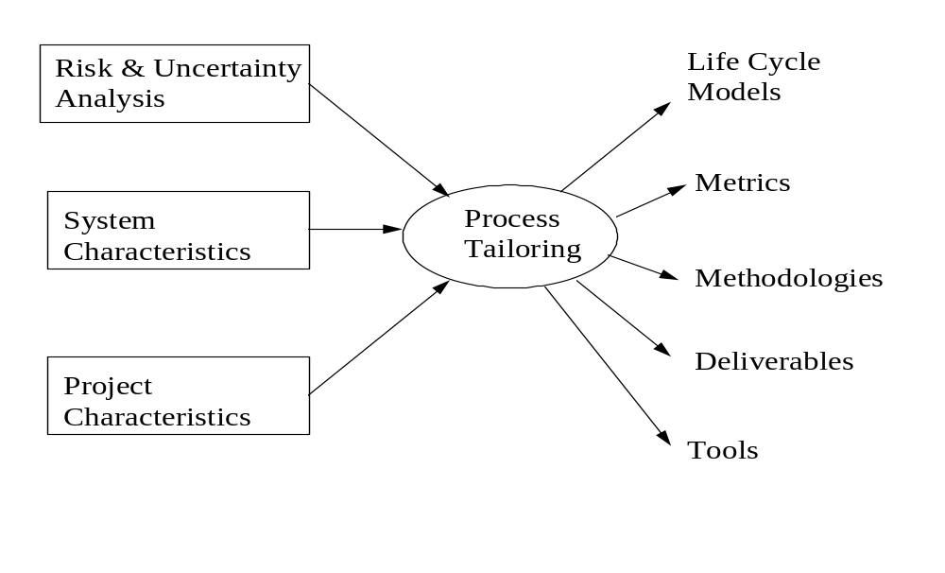
Process Tailoring
Notes:
Borrowed from the “SCMC PROCESS TAILORING GUIDELINE”, Document ID: SCMC_PROCESS_TAILOR_1.0.0 16 AUG 95, VERSION NO: 1.0.0
This document is a modification of <<MIEL Process Tailoring Guideline>>, it is changed based on the practical experiences of SCMC projects.
Process Tailoring is based on Risk & Uncertainty analysis, system characteristics and project characteristics.

Slide 55
Choice of Life Cycle Models
Choice of process life cycle models is predominantly based on the risk and uncertainties in the development of the system and our understanding of it.

Slide 56
Choice of Methodologies
Selection of development methods is based mainly on the understanding of the system characteristics.
Examples of development models include:
  Entity-Relationship(ER) Model
  Data Flow Diagram(DFD) Model
  Finite State Machine (FSM) Model
  Petri Net Model
  Object Oriented (OO) Model
  UML
Notes:
Every method assumes some form of computational model in terms of model data and/or control and model their static or dynamic aspects.
The methods chosen should best match the strengths of the methods to the key characteristics of the problem being solved.
In some cases inter-operability with the customer's development process may influence the choice of methodology.

Slide 57
Choosing Deliverables,
Formats and Scope
Identifying the deliverables and their formats should be based mainly on project characteristics.
The choice of deliverables in some cases, would also be influenced by customer preferences.
Notes:
Identifying the deliverables and their formats should be based mainly on project characteristics, i.e. whether the project is a delta development, GUI, protocol implementation, co-development or stand-alone, application domain and so on.
Another factor that should be considered here is the criticality of the system or the sub-systems to be developed in a project. Low criticality means that methods and deliverables with less formality can be used; high criticality means methods and deliverables with greater formality should be used.

Slide 58
Selecting and Identifying Phases (1)
This includes deciding on the start and end phases, criteria to eliminate a phase, combine two phases, add a phase and running parallel threads.
Eliminating a Phase
  Before deciding to eliminate a phase, one should:
    Make sure that all required deliverables from that phase are available, so that the exit criteria for that phase and the entry criteria for the subsequent phase are compiled with.
    Conduct an independent formal review of the deliverables so that it forms the baseline criteria.
Notes:
Different projects start and end at different phases based on the nature of the development contract and scope of the project. In some cases, the customer may have a requirements document or a functional specification to start with, and in some cases, the nature of projects are research development in advanced fields. Therefore, a set of uniform guidelines are required to help a project in identifying and controlling the start/end phase and also the intermediate phases. It is a result of combination of all possible factors (schedule, domain, requirements solidity, expertise, budget, technology, tools). This will help enforce standard entry and exit criteria in keeping with SPP and SEI requirements.
Eliminating a Phase
Before deciding to eliminate a phase, one should:
Make sure that all required deliverables from that phase are available. For example, if we have a software functional specification that describes the functional requirements then we need to produce a Traceability Matrix and a SSTP to ensure that test issues are identified upfront.
Conduct an independent formal review of the deliverables so that it forms the baseline criteria and ensure that downstream developers understand the requirements sufficiently well to carry out their tasks. This will also ensure that there are no major TBDs in the requirements before developments proceed full steam ahead.

Slide 59
Selecting and Identifying Phases (2)
Combining Phases
  Two common examples of combining two phases are:
    combine Requirements Analysis and Design and
    combining code, unit test and integration (CUIT)
      the system consists of only one process or task
      NOT for multi-process or multi-task systems
Adding a Phase
  In some cases a pre-development phase can be added in which benchmarking existing tools/technologies and reverse engineering work are involved.
Notes:
Combining Phases: Issues in combining two or more phases are: Sequencing and control of the activities during the phase. And Version control of deliverables if multiple developers are involved.
Except for the construction phase (code/unit test) downward, this combination arises due to the need to do some projecting. For example, feasibility of design may have to be considered during the Requirements Analysis phase, so phases need to be combined.
The CUIT phase should not be combined in the case of multi-task or multi-process systems. This would ensure that the integration phase focuses exclusively on testing the inter-task interfaces.
Since there is no “baseline” of deliverables within the phase, changes could become very frequent and uncontrolled. The project team must have a mechanism (e.g. check-pointing) to prevent unnecessary reworking due to different versions being used by different developers.
Adding a Phase: In some cases (e.g. R&D project, porting from purchased software package), a pre-development phase can be added in which benchmarking existing tools/technologies and reverse engineering work are involved. These can help the PM make a better decision and provide correct direction on transiting to the next phase.

Slide 60
Identifying Metrics (1)
This includes guidelines to identify what metrics are to be captured, analyzed and used in projects implementing process with tailoring.
  The purposes of metrics in the context of process tailoring are:
    To help manage and control the tailored process
    To help analyze the impact of process tailoring
    To guide the process tailoring decision
  Projects using process tailoring should review and finalize the metrics for the project at the beginning of the project and document it in the project SQAP.
Notes:
Requirements Management
Since the process model selection is based on the characteristics of the requirements, metrics in this area should be tracked throughout the project to help correct initial assessments of factors that resulted in the choice of the process model. The suggested metrics are:
Number of identified requirements
Number of uncertain requirements
Number of requirement changes with respect to time
Periodic evaluation of these metrics during the development of the project will help assess the applicability of the process model to the project during development.
Metrics During Development Process
Irrespective of the process model, all development phases will have the same metrics as defined in the Mbook.
Metrics on Reverse Engineering
When a project needs to do Reverse Engineering to a purchased or existing source code, the following metrics are suggested to collect:
Lines of the not commented source code (in which language)
Lines of the comments
Effort (in staff-weeks) for reversing the source code

Slide 61
Identifying Metrics (2)
  Depending on the Life Cycle chosen, additional metrics should be collected and analyzed. For example, for the Incremental Delivery Model additional metrics should include:
    Whether the partitioning of the features for the increments was optimal
    How extensible/flexible is the system and/or software architecture
  Irrespective of the process model, all development phases will have the same metrics as defined in the Mbook.
Notes:
Evolutionary Development Model
The purposes of metrics in this model are:
To analyze the architecture from a modifiability point of view
To analyze the effectiveness of product visualization
To analyze the extent of reuse of design, code and other deliverables and how it has impacted the time to market.
Apart from the Q-Data for each evolution(development), the number and cost of defects/changes associated with the previous evolution needs to be captured. Customer satisfaction measurements after each evolution should be made to assess if the product features have met the customer expectations.
Rapid Application Development (RAD)
As per the features of RAD, two aspects of this model that impact it heavily are user involvement and the use of automated tools. The following metrics are suggested to track these fields.
No. of staff in each phase
No. of customer involved in each phase
Cycle Time of each phase
Effort from own site & customer site in each phase
Size of deliverables
The effort distribution with respect to customer site & own site against different phases, and the cycle time with respect to the size of deliverables, are compared to the V-shaped model’s corresponding metrics.

Slide 62
Project Tailoring Steps
The typical steps in determining the tailoring of the process for a project are:
  Data Collection & Analysis - data is collected and analyzed to determine areas of tailoring.
  A draft of the tailored process is made with the guidelines and compared with the SPP process.
  Then in the SPMP, the deviations and tailoring are documented with adequate justification before the formal review of the SPMP.
Notes:
Types of data that could be collected and analyzed include:
risk and uncertainty factors,
system characteristics,
customer process/expectations,
time frames,
size,
priorities,
tool/methodologies available and
other project factors

Slide 63
Tailoring for Small Projects (1)
Project Planning
  There MUST be a consistently maintained project plan (SPMP), which MUST be maintained by a dedicated person
    BUT, the contents of the project plan can be effectively tailored to at least a minimum of schedule, responsibility, and staffing based on estimation techniques for size, effort, and feasibility
    the SPMP can be combined with the SQAP and the PSCMP
  The project MUST be assigned a Quality Engineer
    BUT, all other roles may be combined or overlap (PM, SE, TE, and CM)
Notes:
A documented project plan is still needed, however, content of such plan can be effectively tailored, for example, only includes the GANTT-chart for schedule, or additionally includes configuration and quality plan.
Mechanism used to control the progress of project includes regular meeting, report, tools, etc.
Estimation is critical to small project, which typically faces high schedule and resource pressure.
Definition of roles within small project varies, and may have much more overlapping than that of normally project. However, the project MUST have a project leader or manager, who is responsible for maintaining the plan, and is the final authority to solve project-related issues.
There is no constraint on how other roles are defined, for example, SSE, SSTE, SCM. Overlapping of roles and functionality are allowed, as long as project leader thinks it necessary.
Project team CAN combine the SPMP, SCMP, SQAP within one documents, the content of which MUST, in minimum, contains the schedule, responsibility and staffing. However, such plan MUST be made based on reasonable estimation of effort and technical feasibility.
SQA is still required to get involved into the activity of small-project, he or she SHOULD reach agreement with project team on the quality requirement of the project team, even if such agreement entails or leads to no QA-related activity in later progress of the project completely. However, QA SHOULD take audit responsibility, although time of such audit depends on project background. See SQA section for details.

Slide 64
Tailoring for Small Projects (2)
Requirements Management
  Requirements must be documented and updated based on changes but the format and style are not dictated.
  Changes must be documented and tracked but a formal configuration control board may not be necessary.
  Traceability between requirements, design, and test must still exist.
  Approval by QE of the project specific requirements management process is necessary.
Notes:
As with other normal project, a formal document is needed to document the customer requirement, which provide the foundation for commitment between SCMC and customer and version control.
However, the format and style of such requirement are not restricted..
Depending on the needs and for the convenience of project, it could be, for example, a spreadsheet.
The mechanism used for change control is not restricted, as long as such change is fully understood and tracked by affected group (PM a MUST).
As a result, for example, CCB may not be defined, it is recommended that one or more of the following activities are adopted for better control, Email, DDTS, informal meeting, etc.
Obviously requirement management of small project is looser than that of normal project, it’s clearly indicated by statement above that the bottom line for RM is a consistently maintained documents for requirement MUST be maintained. Emails, for example, are not permitted.
Whenever product design or test design exists, there MUST be tracability between them and requirement.
Whenever system testing exist, 100% coverage of the functionality defined in requirement is a MUST.

Slide 65
Tailoring for Small Projects (3)
Project Tracking
  Risk management largely determines the success of small project, it is important for the leader to define mechanisms to track and manage risks.
  Use of tools such as ClearQuest can be used to aid in tracking small project tasks.
Notes:
More rely on tools to support project tracking, instead of involvement of human resource.
Customize the Change Request System to provide more functionality for project tracking.
Risk management largely determines the success of small project, it is important for the leader to define mechanisms to track and manage risks. Good tools and regular group discussion will help.
Traditionally projects use various methods for project tracking, namely, weekly meeting, Email, Conference Call, Tools, etc.
Since human resource is the most precious in project, such tracking can mainly be based on tools, DDTS is an excellent choice. Such mechanism may or may not be defined in plan.
Evolution of plan CAN be controlled in a much looser manner compared to normal project, provided change of schedule and responsibility of project planning are understood by affected project team member in a real-time way, via, for example, Email, or informal channel, change control CAN be done exclusively by leader.
It’s RECOMMENDED that project team maintains a risk or issue list, which is tracked on a regular basis.

Slide 66
Tailoring for Small Projects (4)
Software Quality Assurance
  Tailoring of metrics in project level is significant. However, metrics like effort, staffing, schedule, etc. are critical to the project work.
  QA is an important role to reduce risk of small projects, which normally lack visibility compared to larger projects.
  Project manager and QE must define quality assurance activities for small projects.
  The project team should hold a project postmortem at least once during the life cycle. If there is only one, it’s recommended to be held at the end of the whole project.
Notes:
Small projects cannot afford and will not benefit from collection and analysis of most of the metrics.
Audit by quality engineers are to be reinforced, instead of degraded.
The project MUST be assigned QA engineer.
Such loss of visibility in favor of technical efficiency SHOULD be enhanced by QA audit. Such audit SHOULD cover, in minimum, verification of compliance with this document.
It is RECOMMENDED that project collect metrics like effort, staffing, schedule, etc. for tracking.
Although project team can omit definition of quality goal, or tracking of such goal, they SHOULD, in minimum, evaluate the requirement and risk of quality during planning.
Small projects are normally operated in a black-box manner, and hence assume high risks, since they may not have the reviews to enhance visibility to next high-level manager.

Slide 67
Tailoring for Small Projects (5)
Software Configuration Management
  the project deliverables, the storage area for these deliverables, the project specific change control procedures, and the CM responsibilities must be defined (in the combined SPMP and PSCMP)
  Audit of configuration by SQA is necessary
Software Product Engineering
  Waterfall more suitable than V-model for small-scale projects.
  System testing, in most cases, will cover functionality testing.
  For small units and modules, Unit testing and Integration testing may not be value-added phases. This is a tradeoff between quality and resources.
Notes:
Whenever multiple-version of deliverables needs to be maintained, responsibility and mechanism SHOULD be defined in the plan.
Whenever there is a possibility of configuration catastrophe due to, for example, looser configuration management definition, a backup mechanism SHOULD be defined, such backup SHOULD be done on a weekly basis, in minimum. However, backup can be done optionally by both SSD or project team itself. It is RECOMMENDED that, in this case, CI be tracked on a bi-weekly basis, in minimum.
All project members SHOULD consistently understand change control mechanism, even if it’s not explicitly defined in plan. Project can adopt a central control approach or distribute responsibility. However, in any case, project leader MUST know change and baseline before it happens.
In minimum, project team MUST work with QA to do PCA/FCA once. Project team MUST be ABLE to present configuration accounting from, whenever asked for during audit.

Slide 68
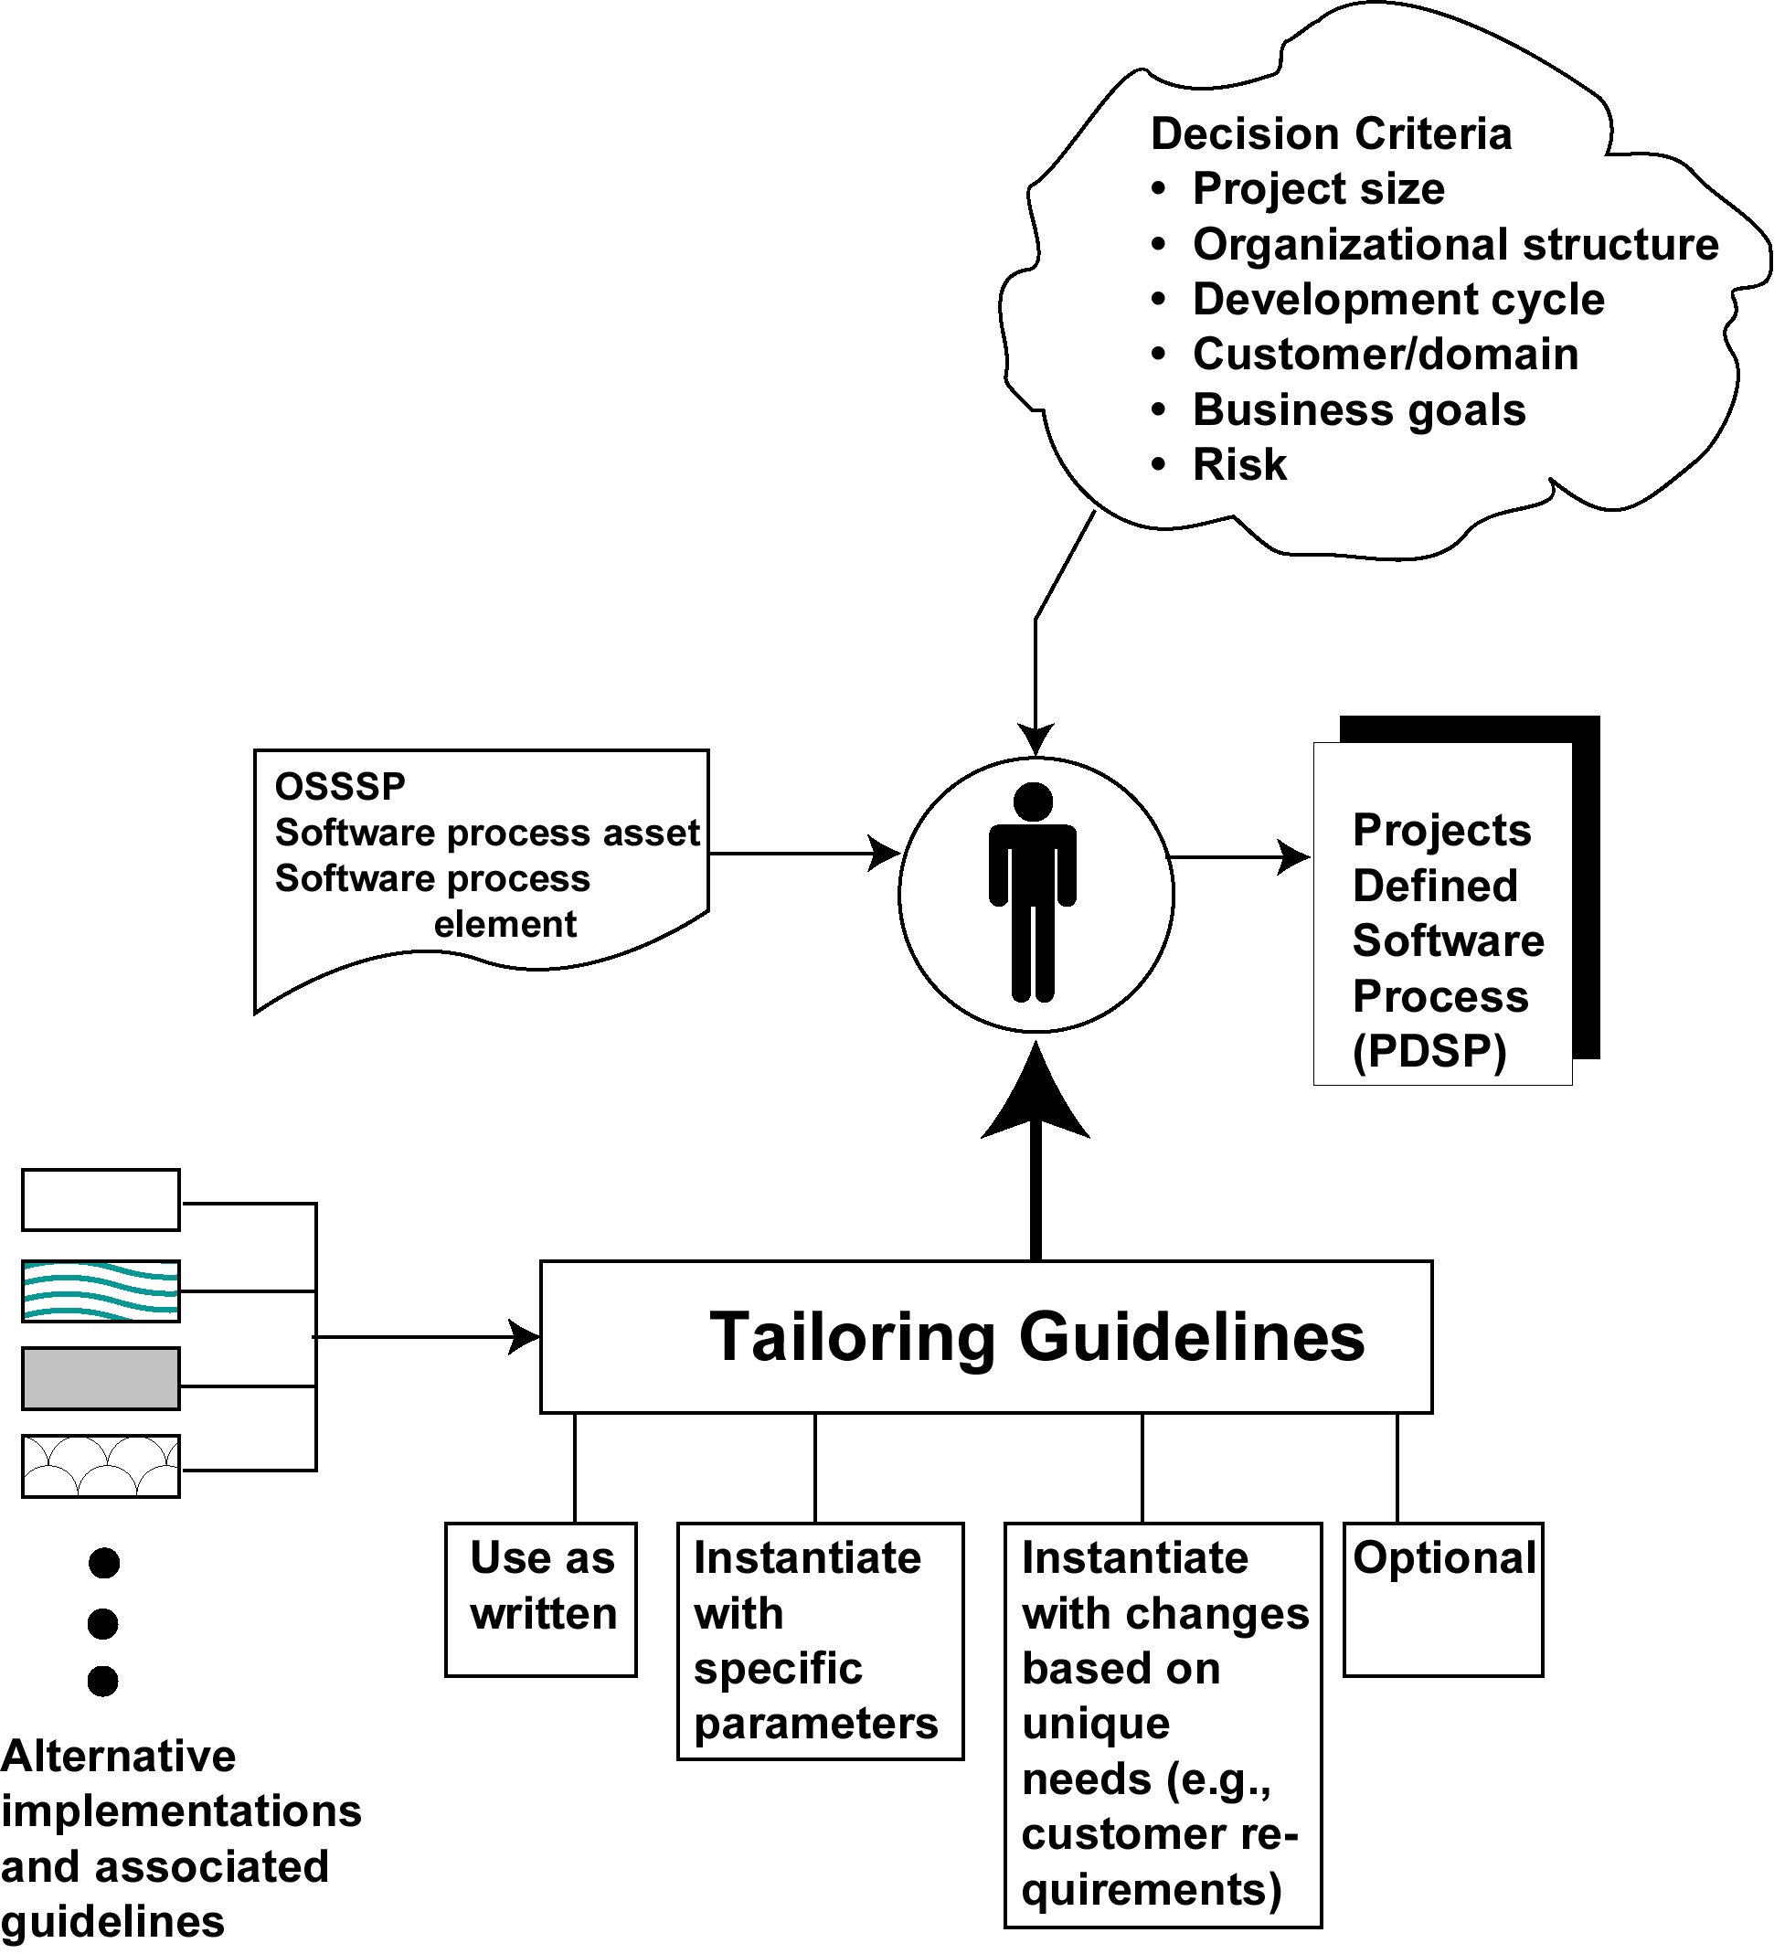
Tailoring Guidelines
Notes:
Should discuss the concept of projects tailoring the OSSP process framework to address their needs as a project. Tailoring guidelines are a way of deciding as an organization the limits of tailoring. In GSD, often tailoring is done at the domain level in each center.
One of the primary targets of tailoring is the selection of a Life Cycle Model to be used in a project (waterfall, spiral, V, etc.). The selection is made based on the risk patterns for the project.

Slide 69
Summary (1/2)
Quality Gate
Preview
Activity
Post mortem
SPP Framework
Measurement
Measurement
Measurement
Project Planning
Process Framework
Preview and Postmortems
Records and Metrics
Quality Control
Configuration Management
SPP Inviolates

Slide 70
Summary (2/2)
Product Development
Requirements Development
ICD (optional)
PV
REQB
RTMX
SRS
PV
SDD
PV
Code
RTMX
SAD
Requirements Gathering
Requirements
Analysis
Architecture
& Design
Code &
Unit Testing
-Software
Ad
Ad
Integrated
Release
RV
Ad
PM
RV
PM
PV
System
PV
PV
-Release
PM
RV
Notes
Project
Integration
V&V Test
Release
Initiation
VVTC
Execution
PSCMP
SPMP
SQAP
VVTP
Ad
RRR
PV
VVTD
Ad
PM
RV
RV
RV
PCA
Project
Planning
V&V Test
Test
FCA
Development
Execution
RV
Ad
PM
PV
Ad
PM
RV
Test Development

Slide 71
Version History
Version | Date | Comments | Author
A.1 | 27 Jul 2001 | New E-ITP SPE Week 1
A2 | 30 Aug 2001 | Reformatted and fixed typos, split into 2 presentations
A3 | 02 Nov 2001 | Fixed a few typos
A4 | 20 Dec 2001 | Minor changes based on Austin feedback
A5 | 16 Feb 2002 | Minor fixes for second MACS ITP
A6 | 02 Sep 2003 | Some slides were updated to adapt them to GSG Argentina SPP
A7 | 06 Sep 2003 | Minor changes in training approach
A8 | 21 Feb 2006 | Adapted Architecture & design Phase, and Code & UT Phase to new SPP
2.0.0_Draft_A | 07 Jun 2006 | Changes to the SPP Flow. Project Planning and Requirements Development Phases | Natalia Andriano
2.0.0_Draft_B | 05 Jul 2006 | Changes to the SPP flow. Test Development and Test Execution phases | Victoria Jaurena
2.0.0_Draft_C | 28 Aug 2006 | Changes after RAITAR18047 | Victoria Jaurena
2.0.0 | 28 Aug 2006 | Baseline | Victoria Jaurena
2.0.1 | 23 Nov 2006 | Summary slides were added | Natalia Andriano

