Slide 1





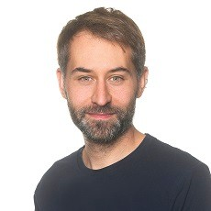
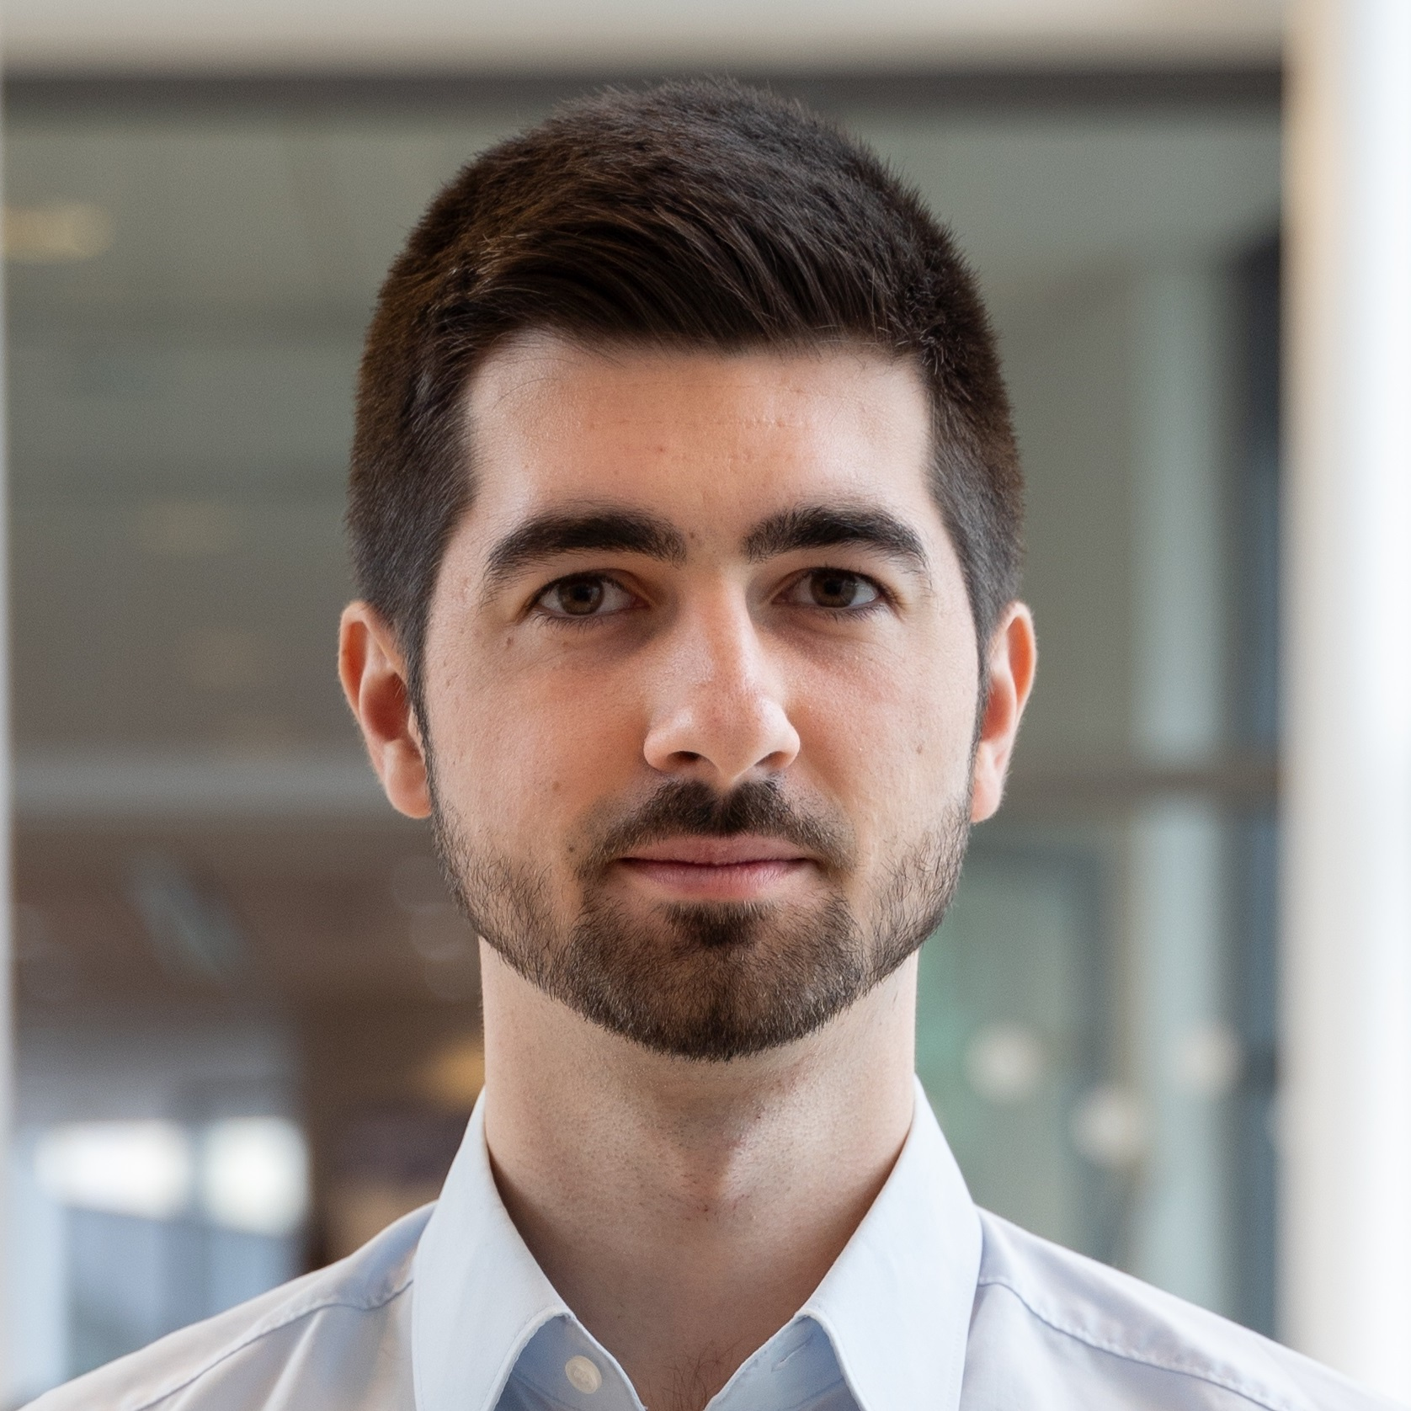
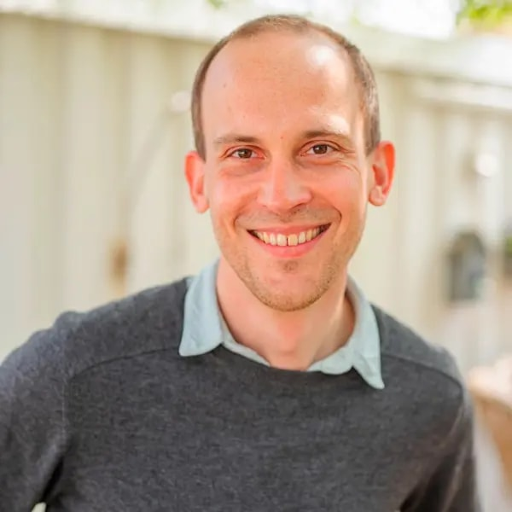
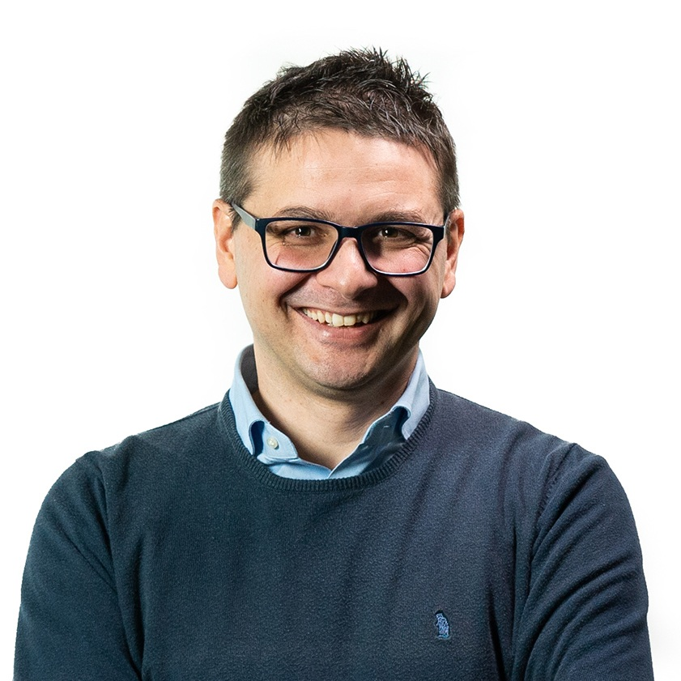
Introduction to Causal Inference for Software Engineering
Tutorial at the ACM International Conference on the Foundations of Software Engineering (FSE)
Sunday, July 5th, at 11:00 EST in room MB 2.430
Julien Siebert
Fraunhofer Institute for Experimental Software Engineering, Germany
https://www.iese.fraunhofer.de/blog/author/julien-siebert/
Julian Frattini
Chalmers University of Technology, Sweden
https://julianfrattini.github.io/
Hans-Martin Heyn
University of Gothenburg, Sweden
https://martinheyn.github.io/
Roberto Pietrantuono
University of Naples Federico II, Italy
http://wpage.unina.it/roberto.pietrantuono/

