Slide 1
Additional Slides

Slide 2
How about abundance of exons?
Modeling problems
exons are not independently transcribed; they always part of a transcript → there are no exons floating in the sample; exon counts will always be correlated
exons by themselves do not have a biological function
what to do with reads that span exon junctions?
do not count
count both
count proportionally

Slide 3
Gedankenexperiment: Read length dependency
Assume reads are very short, e.g. 1 base
no exon spanning reads, fine!
Assume reads are very long, e.g. as long as transcript
all reads span exon junctions, exon counting is obsolete
Reality: Read length is of the order of exon length
many reads span junctions
Issue: Even with perfect mappability exon counts depend on the read length → trimming reads will change exon counts but not transcript counts!
Issue: It is not possible to build a statistical model that would predict the number of reads that an exon of length l with abundance r would give
#reads expected does depend on whether there are neighboring exons
requires isoform abundance but if you have isoform abundance you have solved the problem!

Slide 4
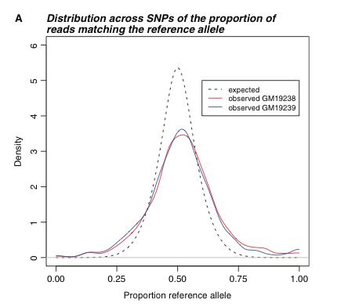
Biological Issue: SNPs
SNPs may lead to false positives in differential expression because fewer reads map to non-reference alleles
Note: Sequencing enables allele-specific expression values

Slide 5
Technical Issue: Gene-length bias
Differential expression of longer genes is more significant because long genes yield more reads → less counting noise
Ratio-based filtering yields more false positives for short genes
Bias has impact on downstream GO analysis
Gene-length bias persists even in RPKM data Potential causes:
Longer genes have higher expression
Technology favoring reads from long genes
Analysis using only 250 bases of each gene removes the length effect → Bias not caused by higher expression of longer genes but by technological artifact

Slide 6
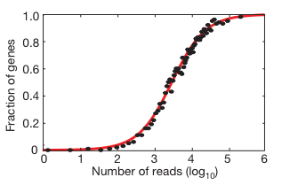
Biological issue: Isoform Expression
For most of the multi-exon genes different isoforms are expressed
Only detectable if there are sufficient counts per gene available
Differential isoform expression may be misinterpreted as differential gene expression.
Wang et al. 2008

Slide 7
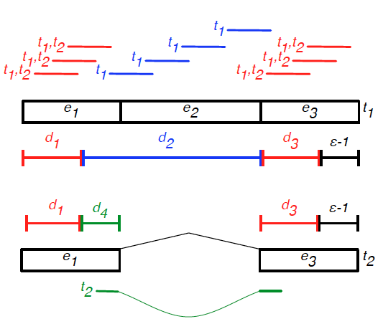
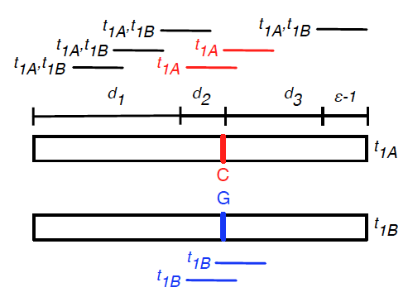
Extension to Haplo-Isoforms
Alternative Splicing
Haplotype switching

Slide 8
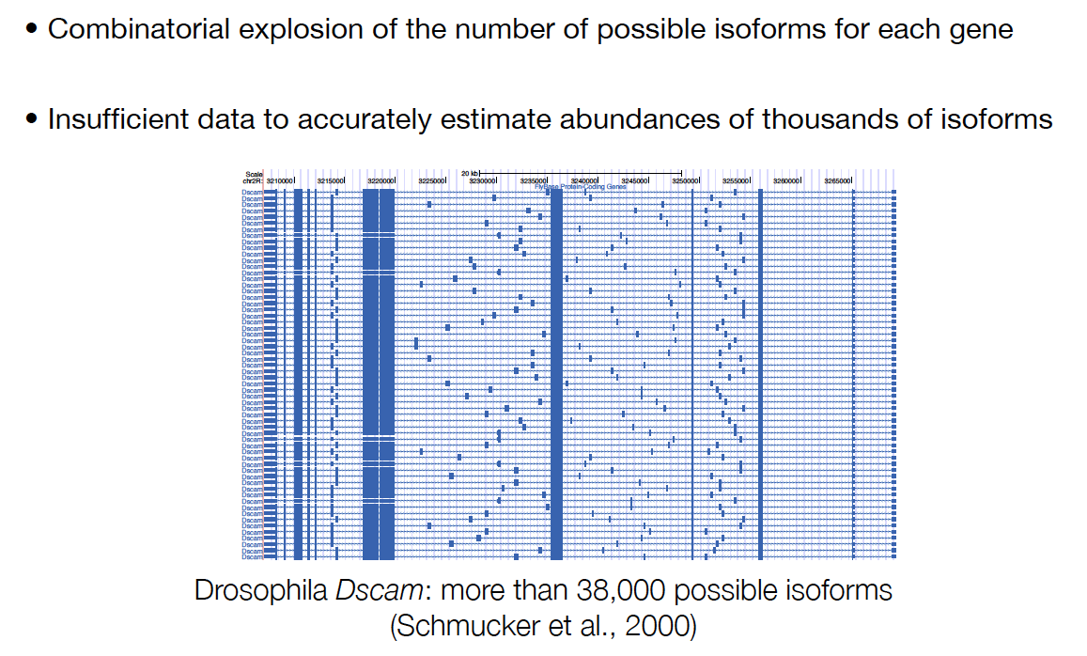
Genes with many Isoforms

Slide 9
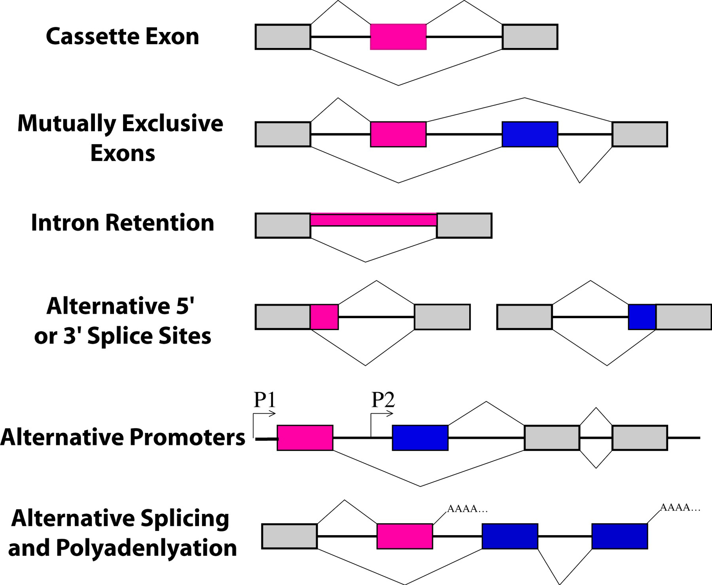
Alternative Splicing and Isoforms

Slide 10
Expression Estimation and Isoform Discovery
So far we assumed that all isoforms are known, however this knowledge is rather incomplete
Discovery approach:
use all possible exon combinations → too many
Methods:
use subset of exon combinations backed by junction spanning reads
introduce sparseness constraint

Slide 11
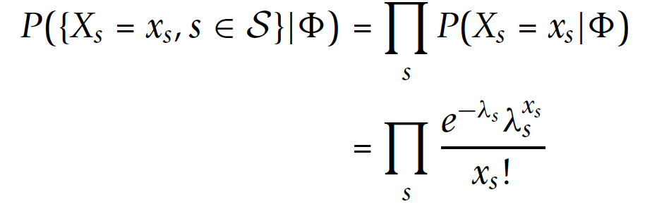
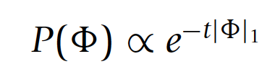
Expression Estimation and Isoform Discovery
Likelihood:
Sparseness constraint:
Xia 2011, BMC Bioinformatics

Slide 12
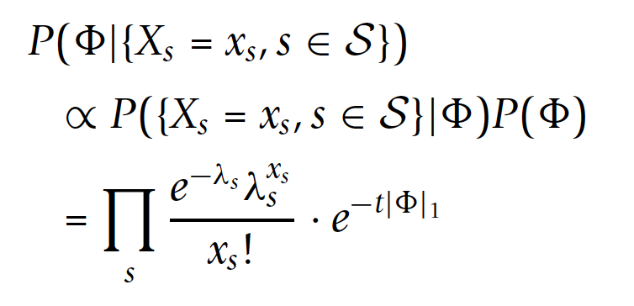
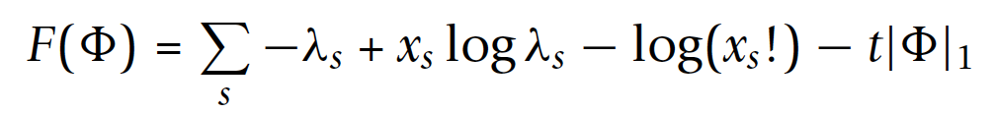
Posterior probability:
Maximum a posteriori:
logarithm of posterior probability
Optimization problem: Generalized LASSO approach

Slide 13
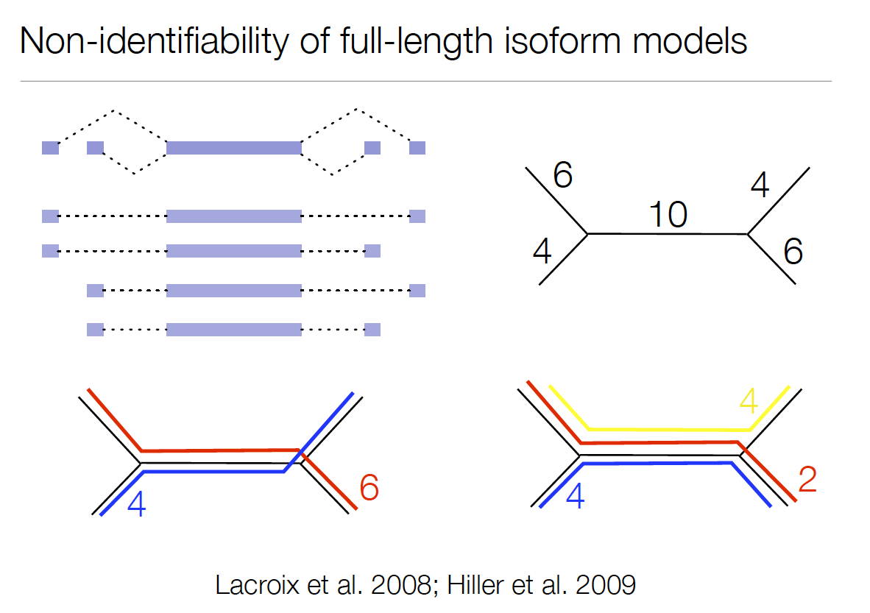

Slide 14
