Slide 1
RNA-seq Quantification

Slide 2
RNA-seq isoform quantification problem: How many transcripts?
GATCAGA CTTA AGAGGA TCAGA CTTAAGAG
Sequencing
GATCAGACTT AAGAGGATCAGA CTTAAGAG
GATCAG ACTTAAGAGGATCAGA CTTAAGAG
GATCAGACTTAA GAGGATCAGACTTAAGAG
Mapping
Transcription

Slide 3
RNA-seq comes with absolute counts but relative abundances
Gene | Sample 1 [Mio transcripts] | Sample 1 [Mio sequenced reads] | Sample 2 [Mio transcripts] | Sample 2 [Mio sequenced reads]
gene a | 10 | 0.5 | 10 | 0.2
gene b | 10 | 0.5 | 10 | 0.2
gene c | 10 | 0.5 | 10 | 0.2
gene d | 10 | 0.5 | 10 | 0.2
gene e | 160 | 8.0 | 460 | 9.2
total | 200 | 10 | 500 | 10
With RNA-seq different amounts of starting material will give the identical numbers of reads!
The read count for a gene is always relative to the counts for the other genes.

Slide 4
Abundance estimates
Abundance of what???
Biologically relevant:
gene level:
# molecules transcribed from one gene locus
isoform level:
# molecules of a specific isoform transcribed from one gene
Feasible with RNA-seq:
relative fractions
Really easy to get but not that useful:
# reads that uniquely map to a gene locus → biased by length, discards information in multi-mappers
#reads that map to gene locus (including multi-mappers) → disambiguation is not possible if you do not have abundance estimates of the isoforms

Slide 5
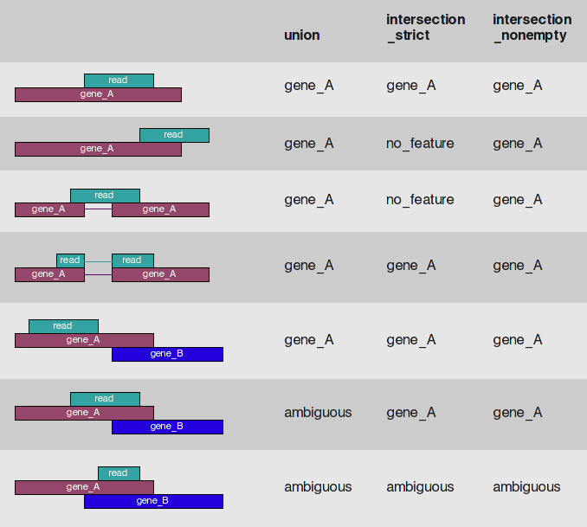
Model-free Counting of Overlapping reads – Count Modes

Slide 6
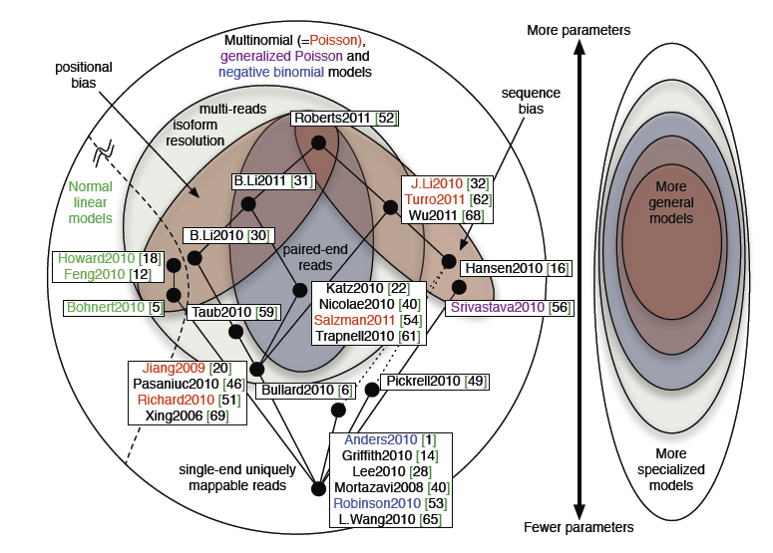
Model Hierarchy
Pachter 2011

Slide 7
RNA-seq model
The normalization factor is the weighted mean length of the transcripts.

Slide 8
RNA-seq model
Estimation of the probability that a read is from a specific transcript:
Abundance estimates:

Slide 9
Definition of expression levels
Reads Per Kilobase per Million of mapped reads
Transcripts Per Million Transcripts
Preferable is TPM because it is independent of the transcriptome

Slide 10
Maximum Likelihood Estimation
The estimated abundances represent unique MLE estimates

Slide 11
Effective Transcript Length
Since fragments have a non-zero length the read probabilities depend actually on an effective length:
For simplicity we continue to use the symbol without tilde but will always assume it is the effective length
The effective length represents the stretch of the transcript from which I can get a fragment that I can then map back to the transcript
→ The effective length must also consider mappability!
→ Mappability does depend on mapping algorithm, mutations, …

Slide 12
Multi-reads
Reads that cannot be uniquely assigned to one transcript were ignored so far
Multi-reads can occur
if a read aligns more than once in the genome
if a at an alignment position there is more than one transcript defined
Multi-reads do occur due to homology not due to pure chance

Slide 13
Considering Multi-reads
Define a compatibility matrix
The likelihood is now:
but now abundances have to be estimated iteratively

Slide 14
Iterative Estimation
Three step algorithm
Estimate abundances based on uniquely mapping reads only
For each multi-read, divide it between the transcripts to which it maps, proportionally to their abundances estimated in the first step
Recompute abundances based on updated counts for each transcript
Continue with Step 2

Slide 15
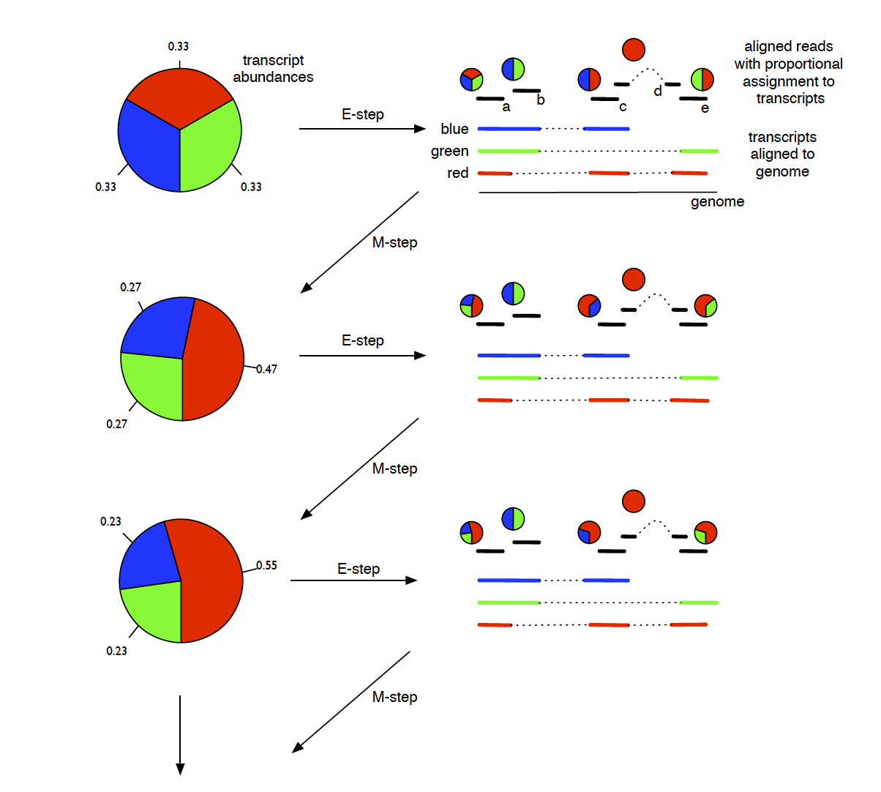
Expectation-Maximization Estimation

Slide 16
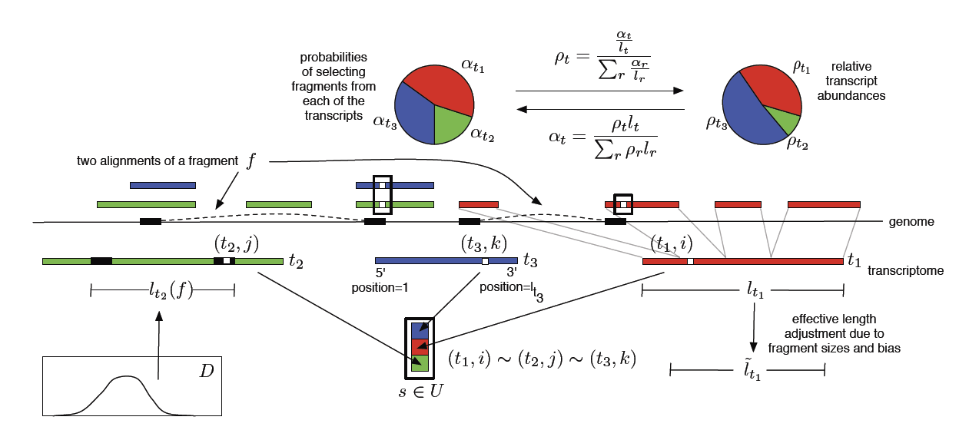

Slide 17
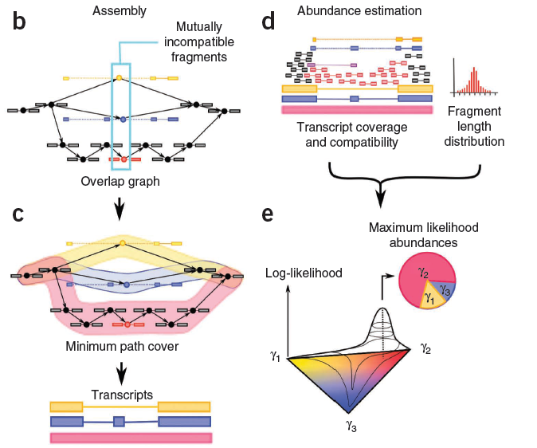
Transcript abundance estimation with Cufflinks
Trapnell 2010, Nature Biotechnology

Slide 18
General Formulation of Abundance Estimation
A full model for the abundance estimation should consider:
position bias
fragment-length distribution
sequencing errors
site-specific bias
…

Slide 19
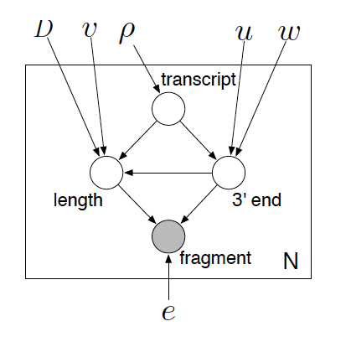
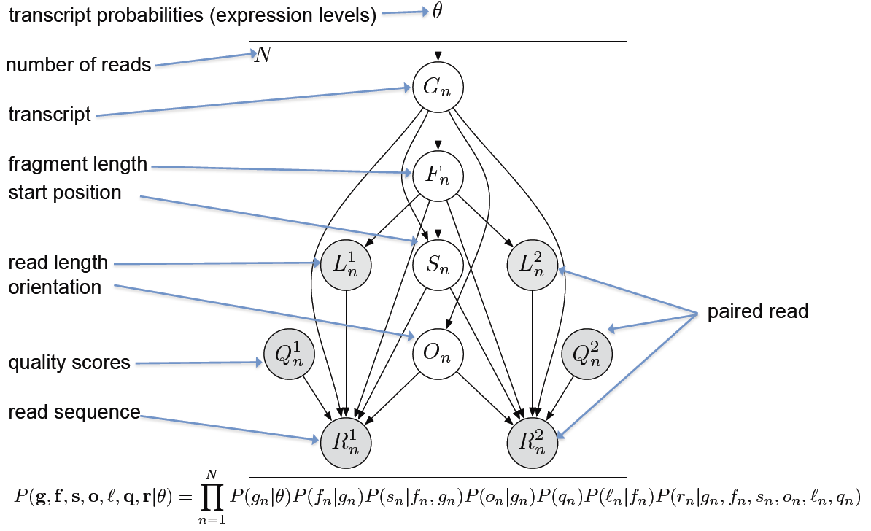
Example Implementations
Pachter: Cufflinks
Dewey: RSEM

Slide 20
Implementations of Generative Models
RSEM
Cufflinks
NSMAP
IsoEM
MISO
MMSEQ

Slide 21
Fast approaches to get the Read-Transcript Compatibility Matrix
Sailfish: lightweight alignment
Salmon:
kallisto: pseudo-alignments

Slide 22
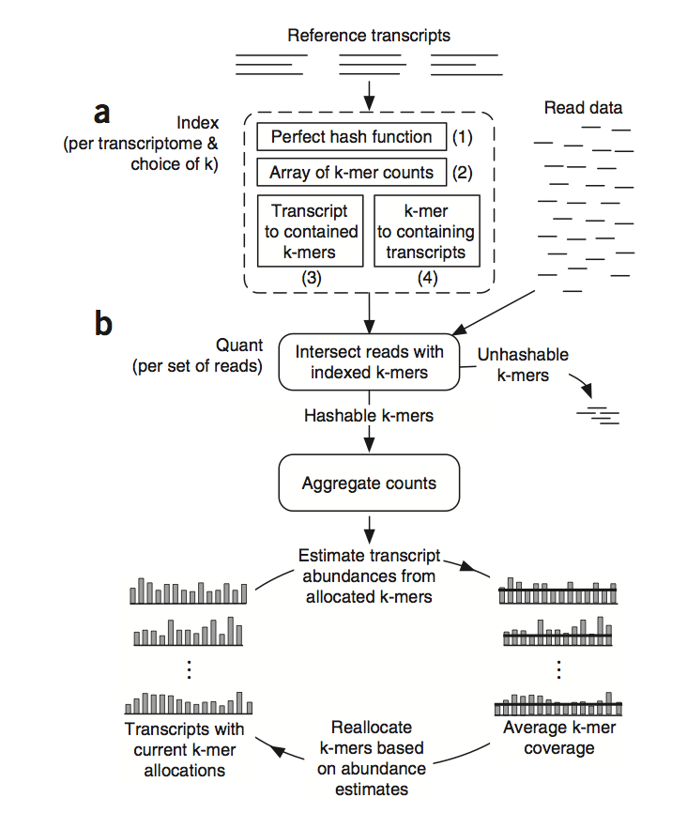
Sailfish
No read alignment only k-mer lookup (very fast)
Iterative resolution of ambiguous k-mers
Patro et al. Sailfish …. Nature Biotechnology, 2014

Slide 23

http://www.bluespheremedia.com/2012/03/isla-mujeres-sailfish-2012/

Slide 24
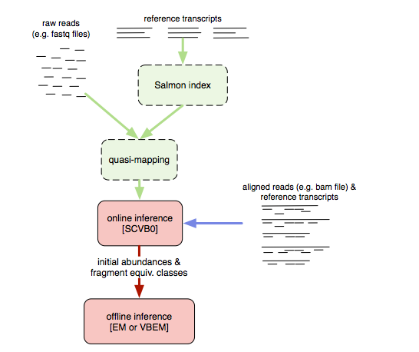
Salmon

Slide 25
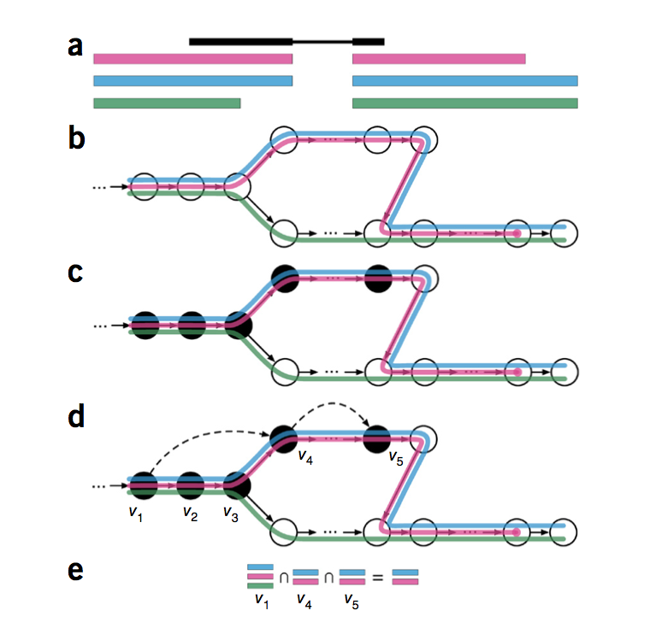
Quantification with pseudo-alignments

Slide 26
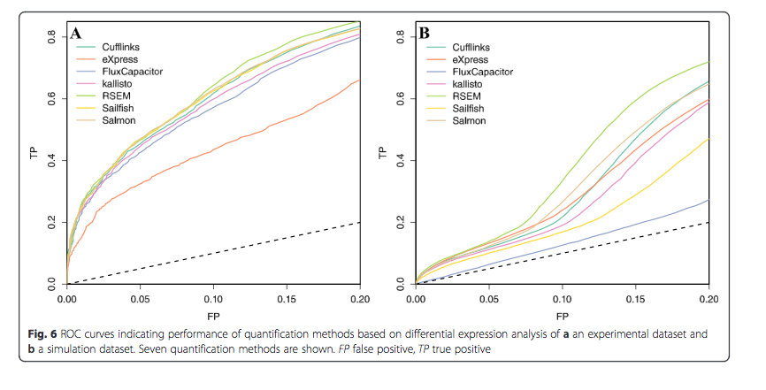
Performance comparison
Teng et al. Genome Biology, 2016

Slide 27
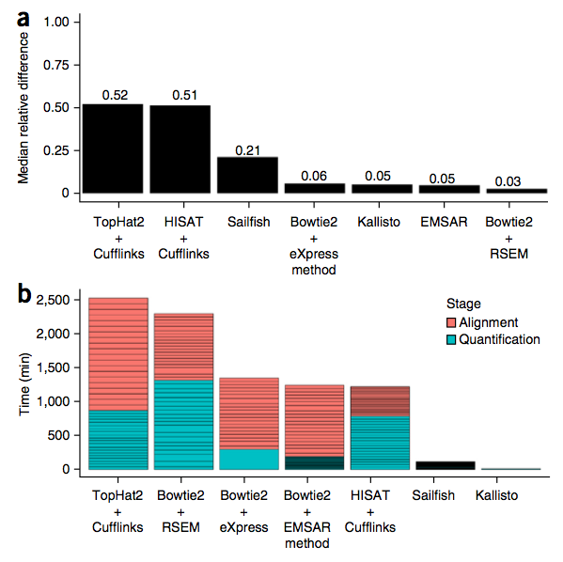
Performance Comparison
Bray et al. Nature Biotechnology, 2016

Slide 28
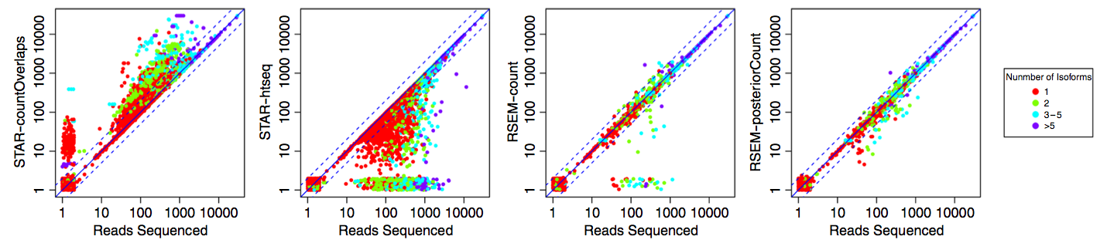
Read Counting Accuracy

Slide 29
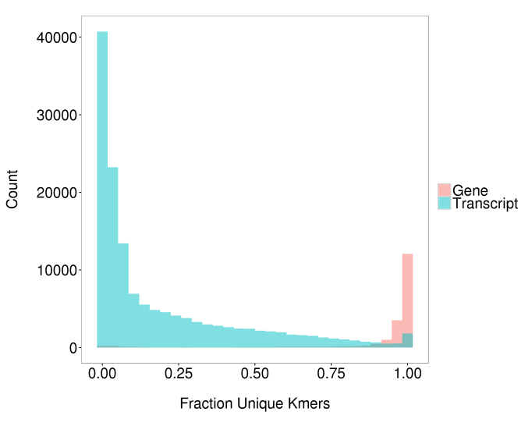
Uniqueness: Isoform-level vs gene-level

Slide 30
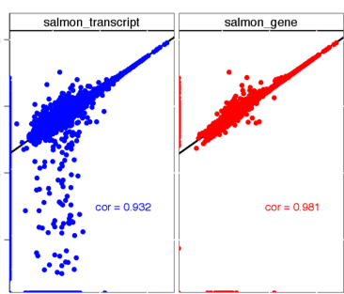
Accuracy: Isoform-level vs gene-level
Soneson et al. F1000, 2015

Slide 31
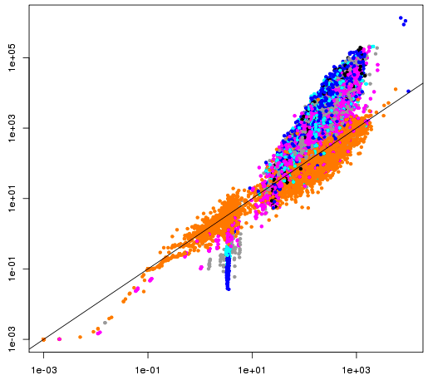
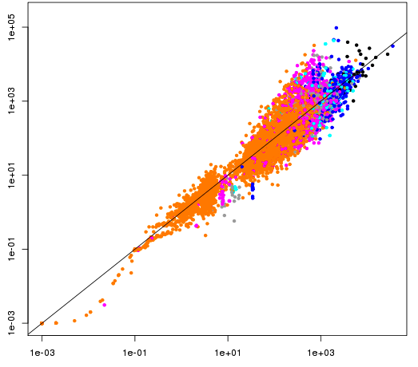
Isoform level has higher variability
isoform level
gene level
variance
mean
mean

Slide 32
Cufflinks and Related
Pachter, L. Models for transcript quantification from RNA-Seq. arXiv preprint arXiv:1104.3889 (2011).
Trapnell C, Williams BA, Pertea G, Mortazavi AM, Kwan G, van Baren MJ, Salzberg SL, Wold B, Pachter L. Transcript assembly and quantification by RNA-Seq reveals unannotated transcripts and isoform switching during cell differentiation Nature Biotechnology doi:10.1038/nbt.1621
Roberts A, Trapnell C, Donaghey J, Rinn JL, Pachter L. Improving RNA-Seq expression estimates by correcting for fragment bias Genome Biology doi:10.1186/gb-2011-12-3-r22
Roberts A, Pimentel H, Trapnell C, Pachter L. Identification of novel transcripts in annotated genomes using RNA-Seq Bioinformatics doi:10.1093/bioinformatics/btr355

Slide 33
RSEM: Li, B. & Dewey, C. N. RSEM: accurate transcript quantification from RNA-Seq data with or without a reference genome. BMC Bioinformatics 12, 323 (2011).
MISO: Katz, Y., Wang, E. T., Airoldi, E. M. & Burge, C. B. Analysis and design of RNA sequencing experiments for identifying isoform regulation. Nat Methods 7, 1009–1015 (2010)
MMSEQ: Turro, E. et al. Haplotype and isoform specific expression estimation using multi-mapping RNA-seq reads. Genome Biol 12, R13 (2011).
NSMAP: Xia, Z., Wen, J., Chang, C.-C. & Zhou, X. NSMAP: a method for spliced isoforms identification and quantification from RNA-Seq. BMC Bioinformatics 12, 162 (2011).

