Slide 1

Bodybuilding.com
Spring Data & MongoDB

Slide 2
Agenda
Spring Data overview
Repositories – convenient data access objects
JPA repositories
Spring Data – MongoDB
FAQs
Q&A

Slide 3
Overview
Originated from a hacking session of Rod Johnson (Spring Source) and Emil Eifrem (Neo Technologies) at JavaOne 2010.
Traditional data access support in Spring has targeted relational databases, but, the with new version of Neo4J module for Spring Data, a new SpringSource project aimed at supporting the growing interest in NoSQL data stores.
Additionally to the NoSQL support, improvements for tradional relational stores has been added.

Slide 4
NoSQL for Spring/Java Developers
All the stores have very different characteristics and use cases.
Trying to abstract away their differences would actually remove the benefits each NoSQL data store offers.
Spring Data provides a consistent programming model across different store implementations.
Mission Statement Spring Data provides a familiar and consistent Spring-based programming model for NoSQL and relational stores while retaining store-specific features and capabilities.

Slide 5
Spring Data projects
JPA
JDBC Extensions
Apache Hadoop
GemFire
REST
Redis
MongoDB
Neo4J
HBase
Commons
Grails Mapping

Slide 6
Repositories: convenient DAOs
The goal of the repository abstraction of Spring Data is to reduce the effort to implement data access layers for various persistence stores significantly.
Using generic (repository) interfaces, Spring will introspect our classes and then create Spring beans to handle with persistence-specific operations.
Repository interfaces provided by Spring Data:
  Repository
  CrudRepository
  PagingAndSortingRepository

Slide 7
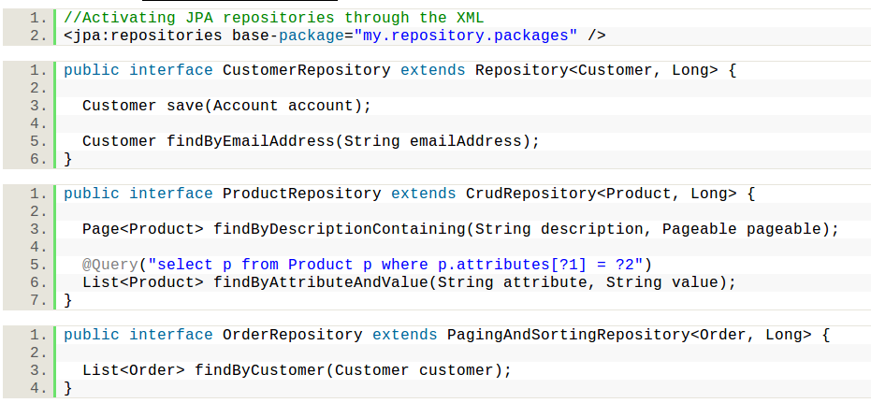
JPA Repositories

Slide 8
Query derivation

Slide 9
Spring Data – MongoDB features
MongoTemplate helper
Annotation based mapping metadata
Rich Object Mapping
Low-level mapping using MongoReader/MongoWriter
Automatic implementation of Repository interfaces
Java based Query, Criteria and Update DSLs
GeoSpacial integration

Slide 10
Spring Data – MongoDB
Add Spring config to enable mongoDB support

Slide 11
MongoDB Java Driver
Add quick description

Slide 12
Spring Data

Slide 13
FAQs
Custom repositories
Custom conversion?
Type-Safe queries – QueryDSL
Can I store binary files?
Accesing a MongoDB cluster - ReplicaSet

Slide 14
References

