Slide 1

BOSNA
EUROCUP - GAME #5

Slide 2
OFFENSIVE
Picture
TRANSITION GAME: early 3’s and early post up
Handler dangerous on P&R or 1on1 situations
Top P&R especially with 4 to create shots or play vs mismatch
Defensive
Picture
P&R with #5: Drop + no tag, no last. Only stunts. Moslty 2on2 D
With some players (scorers) they try to be more aggressive (Flat/Show)
P&R with #4: On the sides short show + over. On top P&R hard show + plug.

Slide 3
WIN
Keys to
Limit their D Transition. Early match up with the 3pt shooter. Under from Pressure on Drag.
Spend your Body vs their Scorers: Ball Pressure+Screen line on Single- Stunt on Double
Switch on PF P&R + Front vs LP ISO (Potential ICE)
Set the Tone and build open shots using Paint touches + Kick out
Punish Tessitori using Deep Rolls/P&Pop
Target Wiltjer: P&Pop/Ghost…Speed GAP if Switch

Slide 4
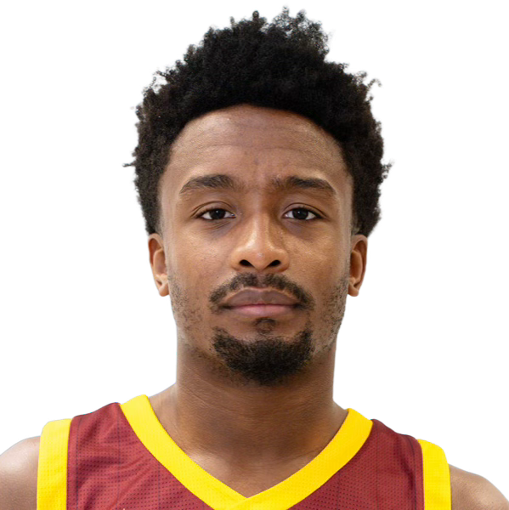

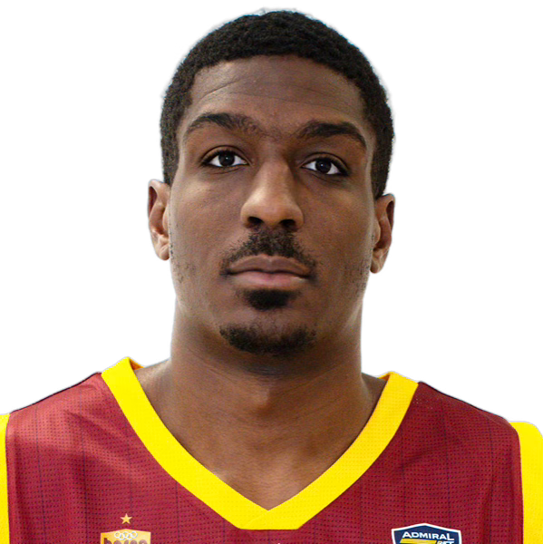
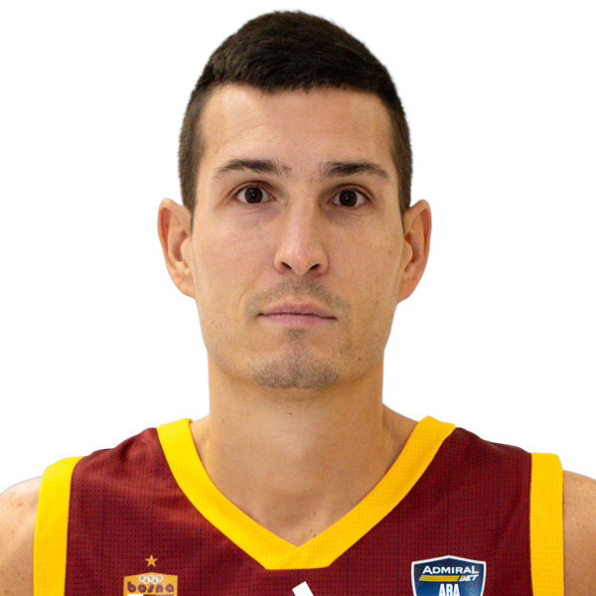
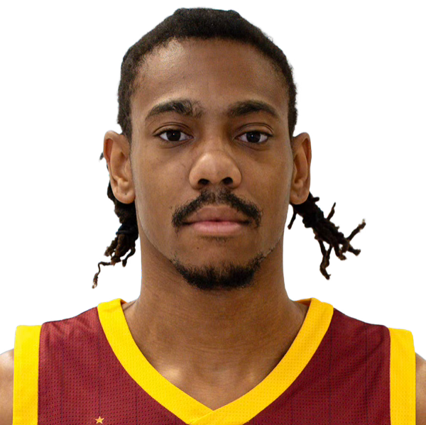
BOSNA
Roster
PG |  | SG |  | SF |  | PF |  | C
^{#19} | TALIC | ^{#2} | PIPES JR | ^{#4} | GHOLSTON | ^{#44} | HAWKINS | ^{#11} | PERRY
^{#14} | BROWNE | ^{#5} | ATIC | ^{#3} | DOMASK | ^{#7} | VRABAC | ^{#1} | BANKS
 |  |  |  |  |  | ^{#21} | POPOVIC ❌ | ^{#33} | islamovic

Slide 5
BOSNA
Stats
# | PLAYER | MIN. | PTS | FGM-A | FG% | 3PM-A | 3PT% | FTM-A | FT% | ORB | DRB | REB | AST | TO | STL | BLK
1 | Banks | 11.6’ | 3.7 | 1.7-2.7 | 0.63 | 0.0-0.0 | - | 0.3-1.3 | 0.25 | 1.7 | 1.7 | 3.3 | 0.3 | 1.0 | 0.0 | 0.7
2 | Pipes Jr | 23.1’ | 13.6 | 3.6-7.9 | 0.46 | 1.4-4.0 | 0.34 | 5.0-5.6 | 0.89 | 0.4 | 1.1 | 1.5 | 2.0 | 1.2 | 1.0 | 0.0
3 | Domask | 13.6’ | 6.8 | 2.5-4.4 | 0.57 | 0.5-1.1 | 0.44 | 1.2-1.5 | 0.83 | 0.6 | 1.5 | 2.1 | 1.0 | 0.6 | 0.4 | 0.0
4 | Gholston | 25.3’ | 13.4 | 4.6-9.0 | 0.51 | 1.2-3.8 | 0.33 | 2.9-3.5 | 0.82 | 0.5 | 2.0 | 2.5 | 0.9 | 1.9 | 1.0 | 0.0
5 | Atic | 19.7’ | 5.6 | 2.2-5.9 | 0.38 | 0.4-2.8 | 0.13 | 0.8-1.6 | 0.46 | 1.4 | 2.8 | 4.1 | 3.4 | 1.5 | 0.5 | 0.5
7 | Vrabac | 21.9’ | 4.5 | 1.4-3.0 | 0.46 | 0.6-1.8 | 0.36 | 1.1-1.8 | 0.64 | 0.2 | 2.1 | 2.4 | 1.2 | 0.6 | 0.5 | 0.4
11 | Perry | 25.7’ | 17.5 | 6.9-13.5 | 0.51 | 0.5-2.5 | 0.2 | 3.2-4.8 | 0.68 | 2.5 | 5.9 | 8.4 | 1.1 | 2.4 | 0.6 | 0.4
14 | Browne | 13.3’ | 4.9 | 1.8-3.4 | 0.52 | 0.6-1.2 | 0.5 | 0.8-0.9 | 0.86 | 0.1 | 1.0 | 1.1 | 1.2 | 2.2 | 0.1 | 0.0
19 | Talić | 25.1’ | 8.5 | 3.0-5.9 | 0.51 | 1.0-2.5 | 0.4 | 1.5-1.9 | 0.8 | 0.5 | 2.4 | 2.9 | 4.5 | 1.8 | 0.6 | 0.0
21 | Popovic | 17.2’ | 8.3 | 4.0-7.7 | 0.52 | 0.0-0.7 | 0 | 0.3-0.7 | 0.5 | 1.7 | 2.0 | 3.7 | 1.7 | 1.3 | 0.0 | 0.0
33 | Islamovic | 7.7’ | 3.0 | 1.0-1.5 | 0.67 | 0.0-0.0 | - | 1.0-1.0 | 1 | 0.5 | 0.0 | 0.5 | 0.5 | 0.5 | 0.5 | 0.0
44 | Hawkins | 17.6’ | 5.0 | 1.9-3.8 | 0.5 | 0.8-2.4 | 0.32 | 0.5-0.9 | 0.57 | 0.6 | 2.8 | 3.4 | 0.6 | 0.6 | 0.6 | 0.0

Slide 6
{{name}} {{surname}}
#{{number}}
{{height}}
{{role}}
{{hand}}
{{minutes}}
{{points}}
{{stat_1}}
{{stat_2}}
BULLETS | TO DO
{{bullet_1}} | {{to_do1}}
{{bullet_2}} | {{to_do2}}
{{bullet_3}} | {{to_do3}}
{{photo}}
CLOSE OUT
ISO
{{iso}}
🔑
🚀

Slide 7



REFEREES
Bosna
(2)
(1)
(3)
{{ref2_first}}
{{ref2_last}}
{{ref1_first}}
{{ref1_last}}
{{ref3_first}}
{{ref3_last}}

