Slide 1
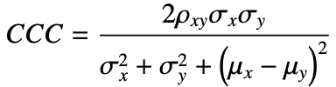
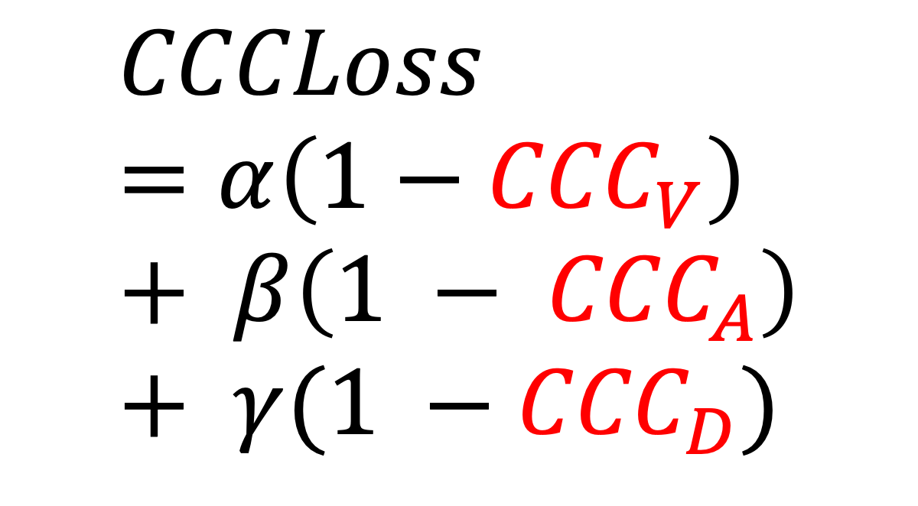
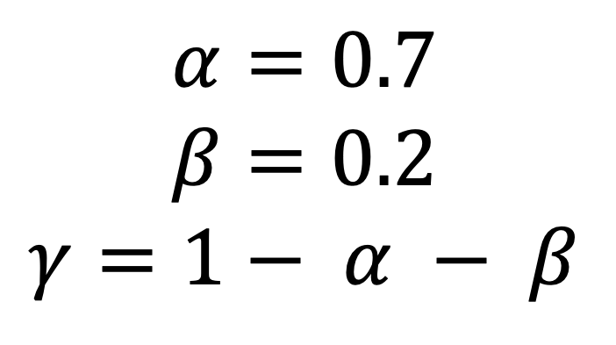
Acoustic Features (68)
Text Features (300)
LSTM (256)
LSTM (256)
A
C
O
U
S
T
I
C
LSTM (256)
LSTM (256)
T
E
X
T
$$CCCLoss=α\left(1−{CCC}_{V}\right)+ β\left(1 − {CCC}_{A}\right)+ γ(1 −{CCC}_{D})$$
$$α=0.7$$
$$β=0.2$$
$$γ=1− α − β$$
LSTM (256)
LSTM (256)
full_seq
last_seq
Flatten
Dense (64)
CONCATENATE(320)
Drop (0.3)
Multi-Task Learning
Regression Model
Dense (64)
DENSE
CCC
Loss
Drop (0.4)
Dense (32)
Drop (0.4)
Dense (1)
Dense (1)
Dense (1)
Valence
Arousal
Dominance

Slide 2




Sequential System
pyAudioAnalysis HSF
Step 1
Step 2
Multi-task Learning
Regression
Model
Support Vector Machine Classifier
Valence
Feature
Extraction
Arousal
Discrete
Emotion
Dominance
Continuous Representation
GloVe Embeddings
Parallel System
pyAudioAnalysis HSF
Step 1
Multi-task Learning
Regression &
Classification
Model
Valence
Continuous Representation
Arousal
Feature
Extraction
Dominance
Discrete
Emotion
GloVe Embeddings

Slide 3
Multi-Task
Learning
Regression &
Classification
Model
Acoustic Features
Text Features
LSTM (256)
LSTM (256)
LSTM (256)
LSTM (256)
LSTM (256)
LSTM (256)
Flatten()
Dense (64)
Cross-entropy
Loss
CCC
Loss
CONCATENATE
Dense (64)
Dense (64)
Dense (32)
Dense (32)
Regression
Classification
Dense (1)
Dense (1)
Dense (1)
…
V
A
D
Happy
Angry
Sad
Neutral
Fear

Slide 4
Sequential vs Parallel Systems
CCC
ZRC (Baseline)
0.8120
0.3008
0.8378
+ 3 %
Accuracy
0.6970
0.7659
+ 5 %

Slide 5
Multi-Task Learning Regression Model
Thesis Model
0.6311
CCC
Cambridge Result (Baseline)
0.5080
+ 13 %

