Slide 1
Personalized Search on WikiQuote Database
Martin Iglesias Goyanes

Slide 2
Data - Guidelines
What do we want?
Simulate real life application
What we need?
Searchable data that pushes our algorithm to be resilient
Constraints?
Personal machines with 16gb RAM and 500GB of disk space + time limitation

Slide 3
Data - Alternatives
Stack Overflow
Lots of data
Constraint to a subset of topics
English Wikipedia
Ideal: Lots of data + endless topics to search for
Infeasible: ~100s of GBs
Wikipedia subset
Subsets are split by topics, again same problem
~10s of GBs
English WikiQuote data
Lots of documents
No constraint on topics
~1GBs
CHOSEN!!

Slide 4
Data - Indexing 1
English WikiQuote Data
“the goal of the project is to produce collaboratively a vast reference of quotations from prominent people, books, films, proverbs, etc. and to be as proper as possible in regard to the details of the quotations and also providing the appropriate human reference of the quotation”
Some of them are around 300-500 words.
Perfect to validate our algorithm -> it is like a wikipedia of short documents
Database System: Elasticsearch
NoSQL database: we store quotes as documents with their text and other metadata directly
Easy interaction: RESTful service
Fast and scalable (considered using one of the bigger database and host an ES cluster in GCP/AWS)
Efficient: Allows us to store only concrete features of our data points (quotes) with the use of mappings

Slide 5
Data - Indexing 2
Index 1: Quotes (Searchable Data)
Text
Category
Title
(we don't care about author, image links, timestamps, …)
Index 2: Search Logs
Searched Text
Username
Timestamp
Index 3: Users’ Info
Username
Category counts
Used by search algorithm

Slide 6
Technology used
Frontend
Web page
Invoke queries & display results
Ease debugging & developing
Backend
Web server (Django)
Authentication
Record search history & click event
Apply algorithm to the original query
Elasticsearch
Search engine
Store search history & user profile
Frontend
User query
Search results
Backend
Extended query with algorithm
Search results
Elasticsearch

Slide 7
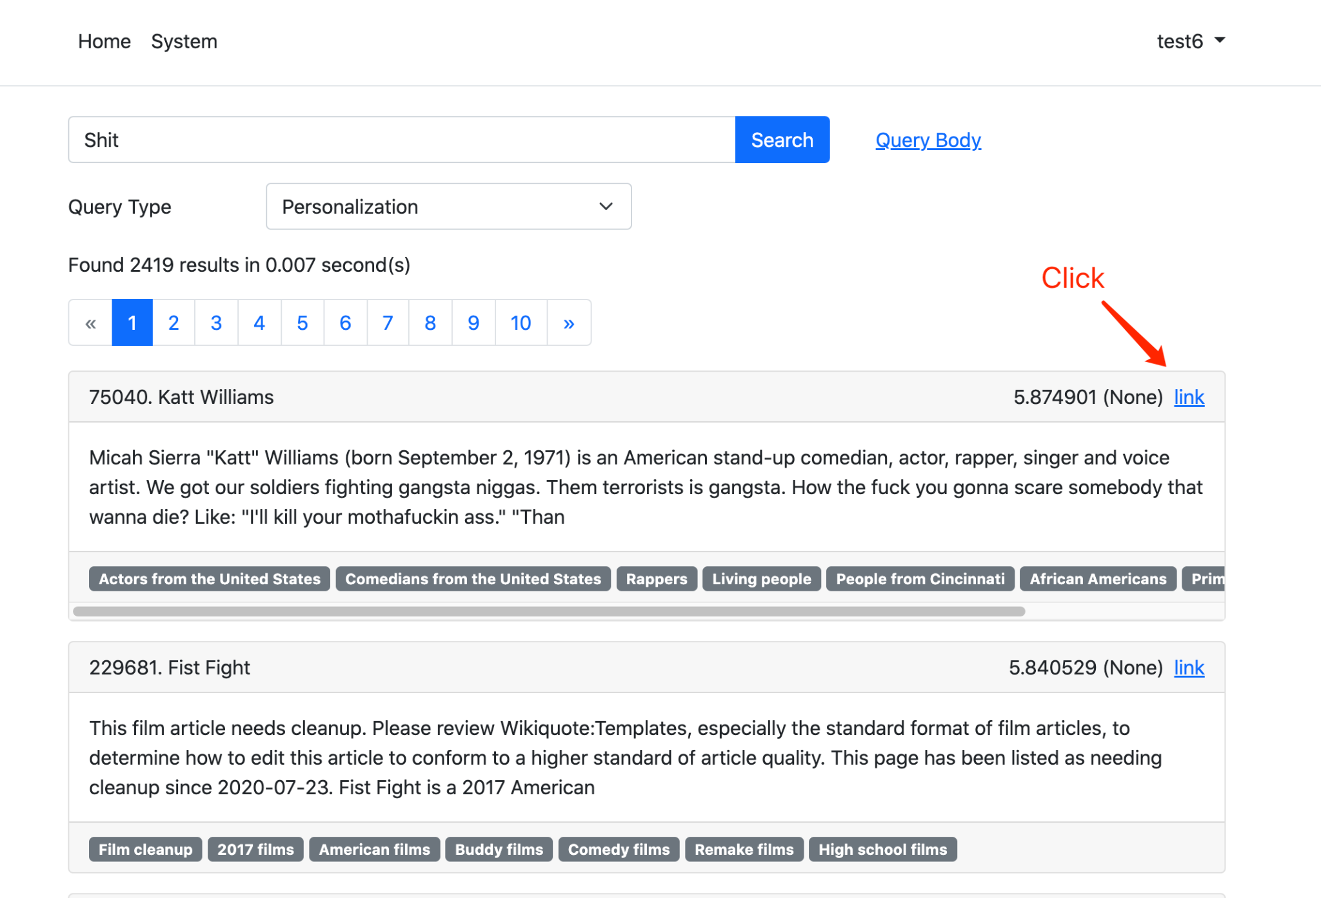
Implementation- History & Profile
A search history will be created and saved to Elasticsearch when a user invoked a search from the index page.
When a user clicks a document, the clicking count of categories of that document will be incremented by 1.

Slide 8
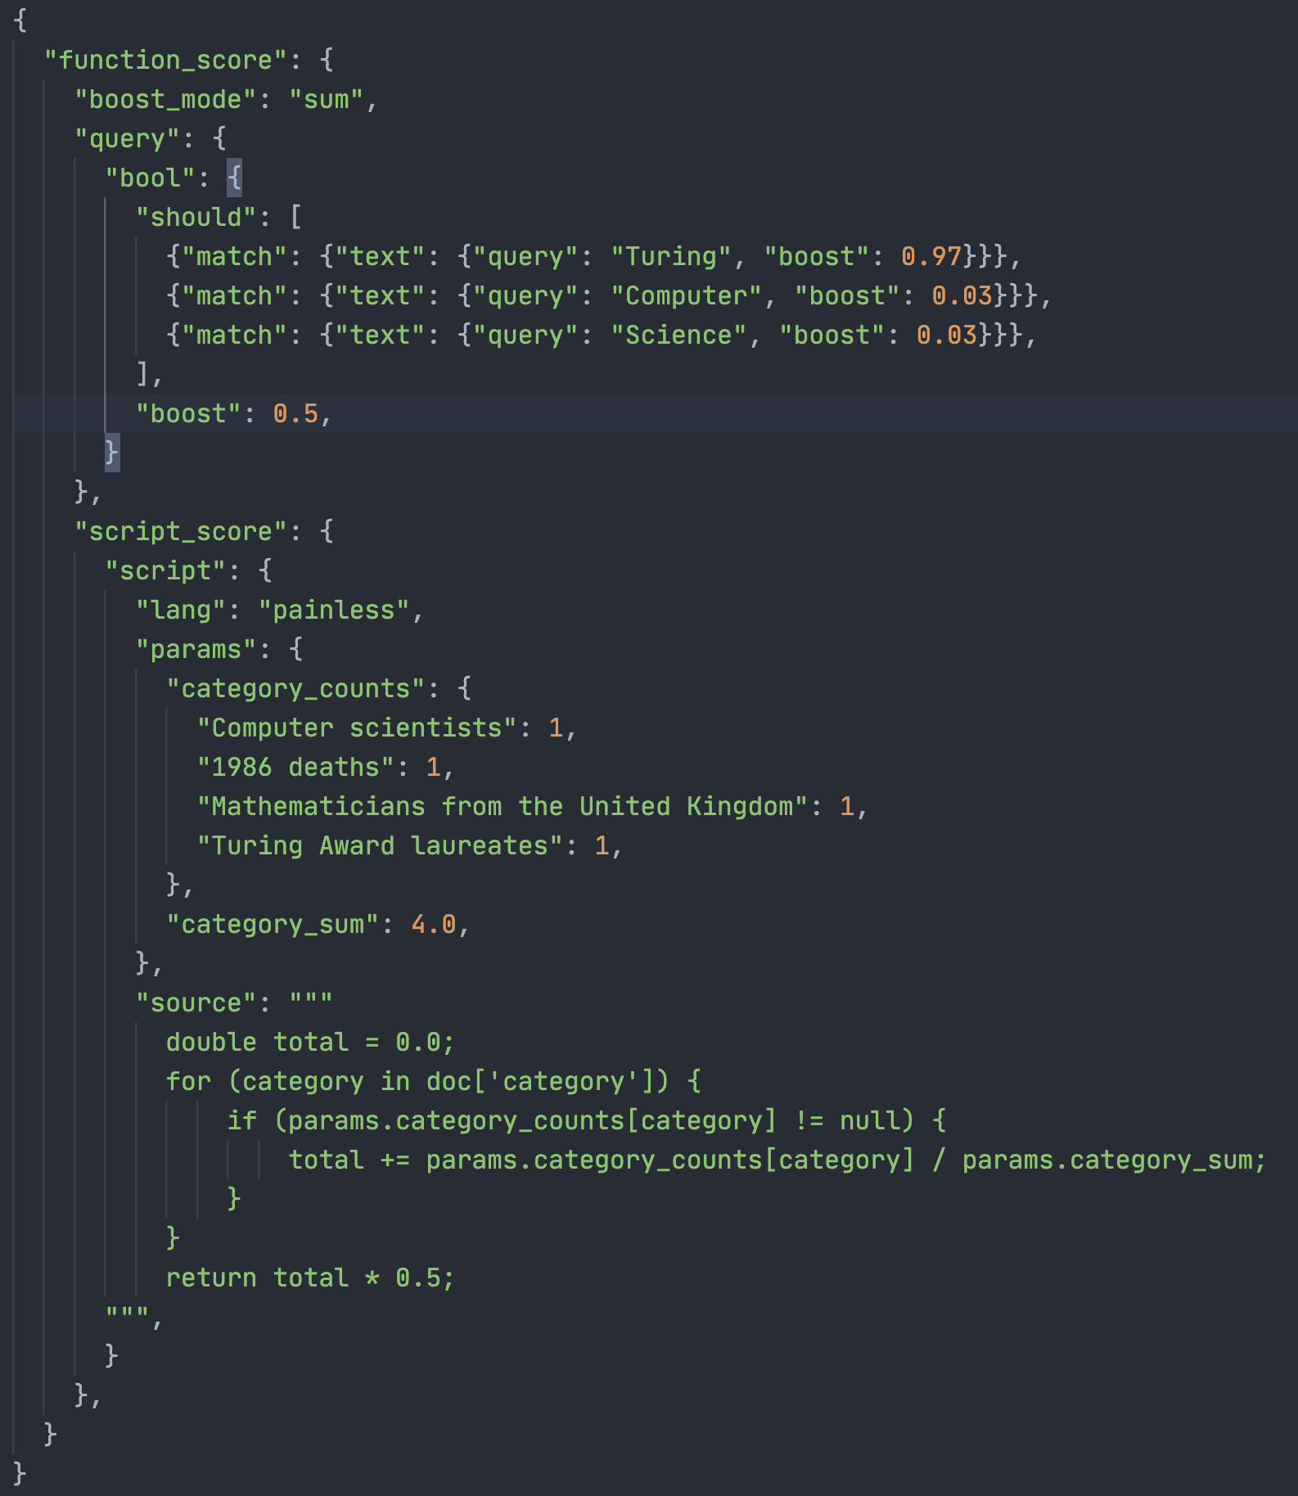
Implementation- Query Generation
Suppose we searched for “Computer Science”, and clicked on the document “James H. Wilkinson”. We then search for “Turing”.
The backend will first fetch query histories to expand the query. It will then fetch all categories the user has clicked, and pass them as a parameter to Elasticsearch function.

Slide 9
Search Algorithm - Overview
2 parts:
Expansion of the search query by using search log of a user
Re-ranking of results by using interests (category weights) of user

Slide 10
Search Algorithm - Expanding the query
Search log:
“skyscrapers”
“high buildings”
“architecture”
“United states”
“New York”
Search query:

Slide 11
Search Algorithm - Expanding the query
Search log:
“skyscrapers” +
“high buildings” +
“architecture” +
“United states” +
“New York” =
Search query:
Actual query:
“New York skyscrapers high buildings architecture United states”
0.97 0.03 0.03 0.03 0.03
(0.88) (0.027) (0.027) (0.027) (0.027)

Slide 12
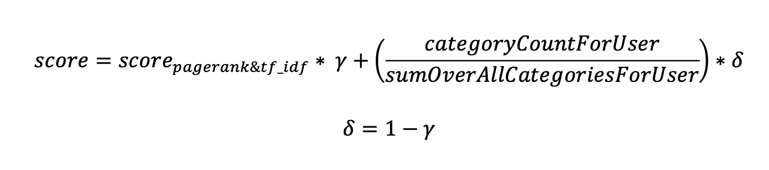
Search Algorithm - Ranking of results
γ and δ are used to balance initial score and category weights
γ = δ = 0.5

Slide 13
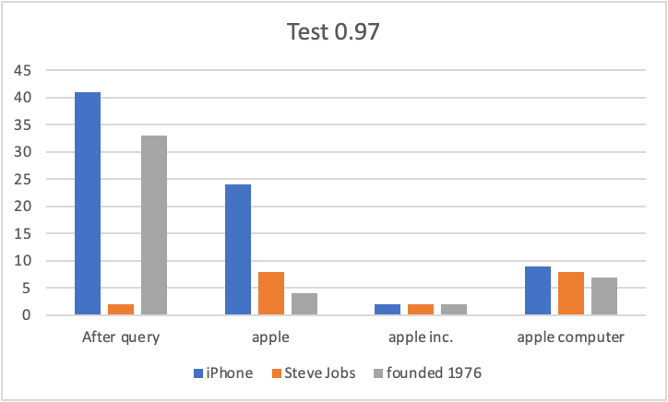
Search Algorithm - Evaluation
Passed general evaluation
Category weights influence the ranking in the result list
Search history influences the result list
Experiment 3 (Bias and “Debias”)
Bias search engine “apple”, “peach”, “tree”, “growing”, “plants”
“De-bias” “iPhone”, “Steve Jobs”, “founded 1976”

