Slide 1
CPE 301 Publish Compass
Martin Jaime
Email: jaimem5@unlv.nevada.edu

Slide 2
AIM & ACCOMPLISHMENT
AIM:
Read HMC5883L with Atmega328P over I²C.
Communicate with another the ESP8266 over UART.
Publish data to ThingSpeak.com with ESP8266.
ACCOMPLISHMENT
IoT device that publishes data to the cloud.
IMPLEMENTATION
Robotics
Mobile devices

Slide 3
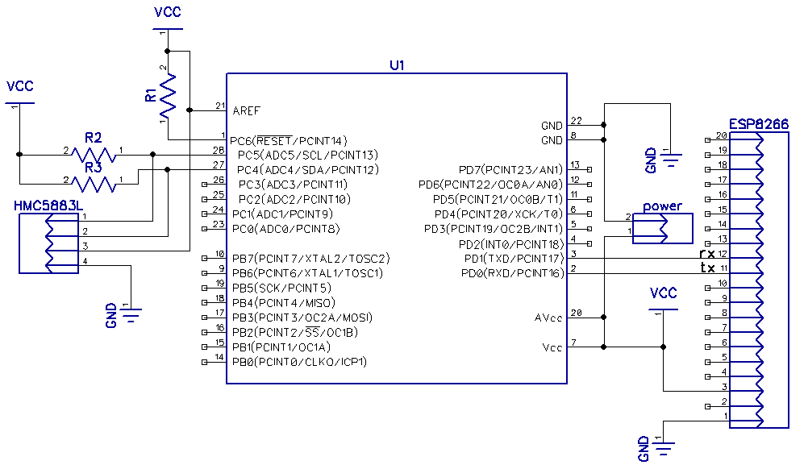
SCHEMATICS

Slide 4
DESIGN STAGES
Main Components
AVR ATMEGA328p
HMC5883L
ESP8266
Interfaces
Atmega328p – HMC5883L using I²C – Address (0x3C)
Atmega328p – ESP8266 using USART
IoT : Thingspeak.com server

Slide 5
CODE DEVELOPMENT
Initialization
Amega328P initializes its UART and I²C ports
Initialize HMC5882L for continuous acquisition at 15Hz
Initialize ESP8266 with initialization script init.lua
Data Collection
Collect magnetic field magnitudes in gauss units on three axis of the sensor.
Calculate angle of sum of vectors parallel to breadboard.
ESP8266 publishes prepared data.

Slide 6
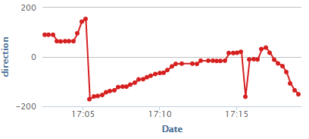
OIT/Visualization

Slide 7

DEMO SNAPSHOT/VIDEO

