Slide 1


Java EE 7 news and highlights
Martin Mareš

Slide 2
The following is intended to outline our general product direction. It is intended for information purposes only, and may not be incorporated into any contract. It is not a commitment to deliver any material, code, or functionality, and should not be relied upon in making purchasing decisions. The development, release, and timing of any features or functionality described for Oracle’s products remains at the sole discretion of Oracle.

Slide 3


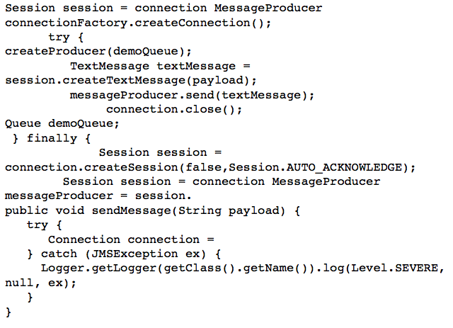
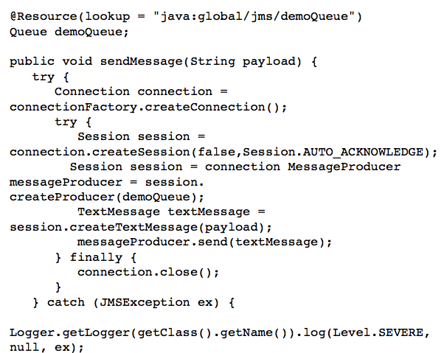
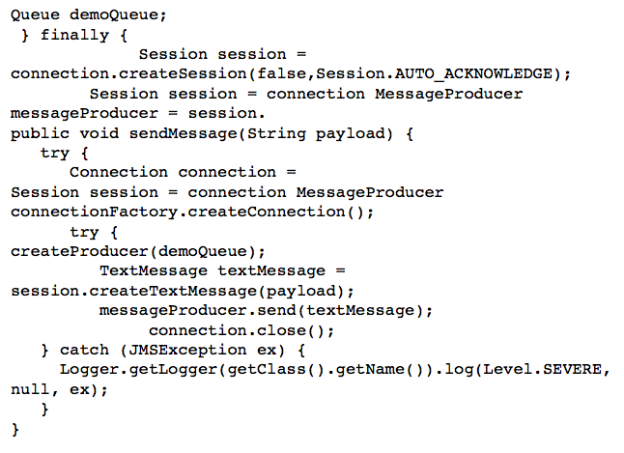


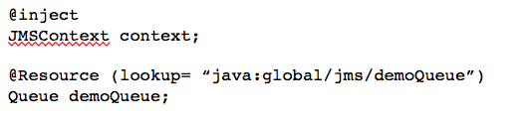
Java EE 7 - Themes
ENTERPRISE EDITION
DEVELOPER
PRODUCTIVITY
MEETING ENTERPRISE DEMANDS
Java EE 7
More annotated POJOs
Less boilerplate code
Cohesive integrated platform
Batch
Concurrency
Simplified JMS
WebSockets
JSON
Servlet 3.1 NIO
REST

Slide 4

Claude Shannon

Slide 5
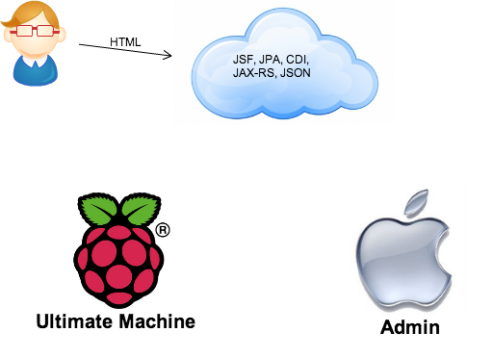

Slide 6

http://tinyurl.com/czjug

Slide 7
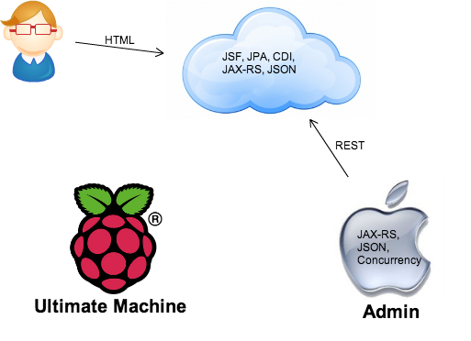

Slide 8


Slide 9

http://tinyurl.com/czjugsrc

Slide 10
Díky za pozornost

