Slide 2


Jersey and Tyrus
JAX-RS
Java API for WebSockets
Martin Mareš
Petr Janouch
Copyright © 2015, Oracle and/or its affiliates. All rights reserved. |

Slide 4
What you can see and enjoy today
What we are doing and why we like it so much!
JAX-RS and WebSockets 101
What is coming next
Play! Play! Play! – Hopefully with your cooperation
“What is the difference between me and 10 years old boy? - 25 years.!”

Slide 5
GO TO the code

Slide 6



Wi-Fi: clear-guest
guest / 7tcJK6yX
#OracleStudentsDay
REST
HTTP

Slide 7

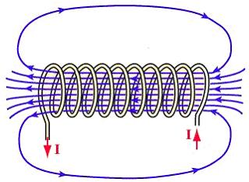
GPIO
REST
REST
HTTP

Slide 8

GPIO
REST
REST
HTTP
SSE

Slide 9
Java API for WebSockets

Slide 10
Motivation for WebSocket
Client
Server
Client
Server
Polling request
Handshake Request (HTTP)
Response (server -> client channel)
Handshake Response (HTTP)
HTTP requests (client -> server channel)
Messages (WebSocket)
Session Close (WebSocket)
Long polling
WebSocket

Slide 11
WebSocket protocol
RFC 6455 (December 2011)
Two-way communication, replacement for Long-polling
Better resource utilisation
WebSocket handshake uses HTTP, connection is then UPGRADEd to “websocket” protocol
No HTTP from this point, only WebSocket frames are allowed to be sent or received
Connection can be closed using Close frame or just closing underlying TCP connection
Extensions, SubProtocol
Notes:
Handshake
- extensions
- subprotocol

Slide 12
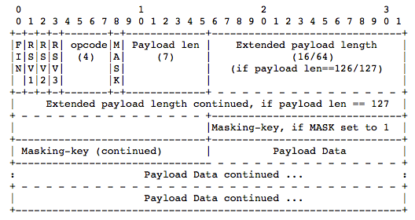
WebSocket protocol - Frame
Notes:
Handshake
- extensions
- subprotocol

Slide 13
WebSocket in browsers
Supported in all modern browsers
Part of HTML 5
W3C standardised javascript API:
var webSocket = new WebSocket(“ws://myhost:8080/myapp/myendpoint”);
webSocket.onmessage(function(msg) {
console.log(msg.data)
});
webSocket.onerror(function(error) {
console.log(error)
});
webSocket.onopen( . . .);
webSocket.onclose( . . .);
Notes:
Handshake
- extensions
- subprotocol

Slide 14
Java API for WebSocket
JSR 356 – Part of Java EE 7
1.0 (May 2013)
1.1 (August 2014)
Project Tyrus
Reference Implementation for JSR 356
In Oracle WebLogic Server and GlassFish
Works outside application servers, too
https://tyrus.java.net

Slide 15
Java API for WebSocket - Server Endpoint
@ServerEndpoint(“/echo”)
public class EchoEndpoint {
@OnOpen
public void onOpen(Session session) throws IOException {
session.getBasicRemote().sendText(“onOpen”);
}
@OnMessage
public void echo(Session session, String message) throws IOException{
session.getBasicRemote().sendText(message + “ (from your server)”)
}
@OnError
public void onError(Throwable t) {
t.printStackTrace()
}
}
Notes:
This is a sample Title and Code Layout slide, ideal for displaying codes.
To take advantage of the pre-formatted paragraph style: Start typing the code, using the tab key (not space key) to increase and Shift+tab keys to decrease indention levels for each paragraphs. Ignore the bullets at this point.
If copy and paste the text from other sources, make sure the text is reset to the defaulted size and formatting by clicking Reset, within the Slides Group. (Or select Reset Layout to Default Settings, located at the bottom of the Layout gallery, for Mac.) Delete extra spaces.
Once finish typing, select all text in the body copy block and click the Bullets button, within the Paragraph group to turn off bullets.

Slide 16
Java API for WebSocket - Client side
Session session = new SessionBuilder()
.uri(“ws://myhost:8080/myapp/myendpoint”)
.messageHandler(message -> {
// do something useful
})
.onOpen((wsSession, endpointConfig) -> . . . ))
.onError((wsSession, throwable) -> . . . )
.onClose((wsSession, closeReason) -> . . . )
.connect();
session.getBasicRemote().sendText("My awesome message");
Notes:
This is a sample Title and Code Layout slide, ideal for displaying codes.
To take advantage of the pre-formatted paragraph style: Start typing the code, using the tab key (not space key) to increase and Shift+tab keys to decrease indention levels for each paragraphs. Ignore the bullets at this point.
If copy and paste the text from other sources, make sure the text is reset to the defaulted size and formatting by clicking Reset, within the Slides Group. (Or select Reset Layout to Default Settings, located at the bottom of the Layout gallery, for Mac.) Delete extra spaces.
Once finish typing, select all text in the body copy block and click the Bullets button, within the Paragraph group to turn off bullets.

Slide 17
WebSocket use cases
Chat-like applications
Various implementations options
XMPP (Jabber) over WebSocket
Trading and transactions
Fast feedback/execution
Real-time monitoring
Depends on the data source
Interaction with monitored object
(SSE?)
Remote control
Input with “real-time” feedback
From industry application to fun apps
Games
HTML5 “native” transport
Supported by improvements in browsers 2D/3D canvas support
General collaboration
Customer service, Social apps, …
Notes:
Social: shared piano keyboard

Slide 18

WebSocket demo
http://tinyurl.com/oraday15
Notes:
Handshake
- extensions
- subprotocol

Slide 19

GPIO
REST
REST
HTTP
SSE
HTTP + WebSockets

Slide 20


GPIO
REST
REST
HTTP
SSE
HTTP + WebSocket
Bluetooth
WebSocket

Slide 21



URLs and so
Carpe diem!
Martin Mareš
martin.mares@oracle.com
@MartinJMares
https://github.com/martinjmares
Petr Janouch
petr.janouch@oracle.com
https://github.com/PetrJanouch
JAX-RS 2.0 (JSR 339): https://jcp.org/en/jsr/detail?id=339
JAX-RS 2.1 (JSR 370): https://jcp.org/en/jsr/detail?id=370
Java API for WebSocket (JSR 356): https://jcp.org/en/jsr/detail?id=356
Notes:
I am excited!

Slide 22










Keep Learning with Oracle University
Classroom Training
Learning Subscription
Live Virtual Class
Training On Demand
Cloud
Technology
Applications
Industries
education.oracle.com

