Slide 1
An intro to Singularity
These slides and examples
https://github.com/martinjvickers/install_scripts
Official docs for our version
http://singularity.lbl.gov/archive/docs/v2-4/
CiS documentation
https://docs.cis.nbi.ac.uk/display/CIS/Installing+software+on+the+cluster+using+Singularity
Presented by Martin and Sreya

Slide 2
Not exactly an interactive tutorial
However if you want to try the examples;
  Best to have two terminals on SLURM
    ssh software7
      To create singularity containers
    interactive
      To interact with them correctly
  On software7
    source git-1.8.1.2
    git clone https://github.com/martinjvickers/install_scripts
    cd install_scripts/singularity_intro

Slide 3
Contents
A little background
Working with Singularity
  Creating a basic recipe
  Building an image from a recipe
  CentOS and Ubuntu package manager example
  Sandbox
  Environment variable
  Singularity Hub pre-built example

Slide 4
Why Singularity?
Singularity aims:
  Make applications and pipelines portable
  Cross platform
  Software reproducibility
  Support legacy OS and apps
  Reduce burden of installing software on SysAdmins and allow users more flexibility

Slide 5
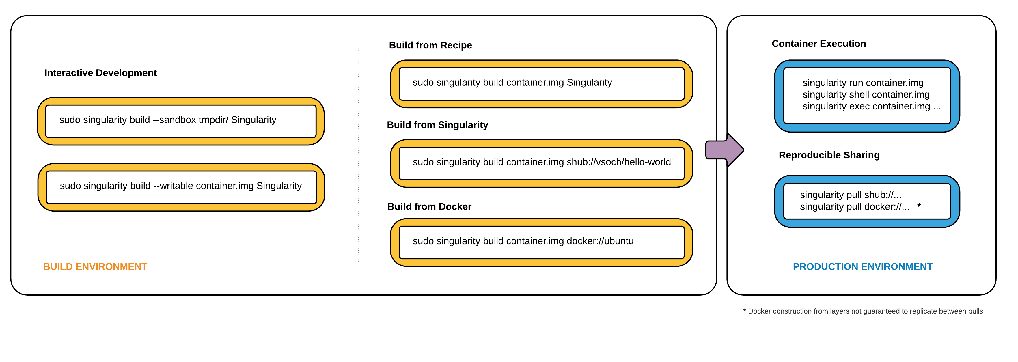

Slide 6
Create a recipe file
Defines the container you're creating
  e.g. OS and version
Install software and dependencies
Provide a record of how the software was installed
  can be version controlled e.g. using git
Can be shared/published

Slide 7
Samtools example
Installing samtools
A CentOS and a Ubuntu example
Both built using a recipe file
Both installed using the OS package manager

Slide 8
Quick note on directory structure
./x86_64
./x86_64/samtools-0.1.19centos.img
./x86_64/README.md
./x86_64/bin
./x86_64/bin/samtools
./x86_64/bin/singularity.exec
./src
./src/samtools-0.1.19-centos.def

Slide 9
Create a recipe
BootStrap: yum
OSVersion: 7
MirrorURL: http://yum-repos.hpccluster/centos/7/os/$basearch/
Include: yum
UpdateURL: http://yum-repos.hpccluster/centos/7/updates/$basearch/
%post
mkdir /jic && mkdir /nbi
mkdir /tgac && mkdir /tsl

Slide 10
Installing software in the recipe
%post
mkdir /jic
mkdir /nbi
mkdir /tgac
mkdir /tsl
yum -y install https://dl.fedoraproject.org/pub/epel/epel-release-latest-7.noarch.rpm
yum update && yum -y install samtools

Slide 11
Build a writeable image
Build the container from the recipe which installs the OS and anything you're specified in %post
sudo singularity build -w container.img recipe.def
This creates an image which is writeable.
Without the -w flag, a read only image is created which is perfect for deploying and sharing

Slide 12
Running samtools using exec
singularity exec container.img <command>
[mvickers@ ~]$ ls
bin README.md samtools-0.1.19centos.img
[mvickers@ ~]$ samtools
-bash: samtools: command not found
[mvickers@ ~]$ singularity exec samtools-0.1.19centos.img samtools
Program: samtools (Tools for alignments in the SAM format)
Version: 0.1.19-44428cd
Usage: samtools <command> [options]

Slide 13
Same example using Ubuntu
BootStrap: debootstrap
OSVersion: trusty
MirrorURL: http://us.archive.ubuntu.com/ubuntu/
%post
mkdir /jic && mkdir /nbi && mkdir /tgac && mkdir /tsl
apt-get install --force-yes -y software-properties-common
add-apt-repository "deb http://archive.ubuntu.com/ubuntu $(lsb_release -sc) universe"
apt-get update --force-yes -y
apt-get install --force-yes -y samtools

Slide 14
Same build process as before
[mvickers@NBI-HPC ~]$ sudo singularity build -w samtools-0.1.19ubuntu.img ../src/samtools-0.1.19-ubuntu.def
[mvickers@NBI-HPC ~]$ singularity exec samtools-0.1.19ubuntu.img samtools
Program: samtools (Tools for alignments in the SAM format)
Version: 0.1.19-96b5f2294a

Slide 15
Why a read only image?
What is the purpose of a read only image
  Simply: compressed and easier to share
129M May 10 08:45 samtools-0.1.19ubuntu_readonly.img
404M May 10 08:41 samtools-0.1.19ubuntu.img

Slide 16
Expanding a image
When building a writeable image, you get around ~20% more than the space required to build it.
Can you expand an image? Short answer: Not easily
[mvickers@ ~]$ sudo singularity shell -w samtools-0.1.19ubuntu.img
Singularity: Invoking an interactive shell within container...
Singularity samtools-0.1.19ubuntu.img:/> df -h
Filesystem Size Used Avail Use% Mounted on
singularity 383M 310M 53M 86% /

Slide 17
The answer, use a sandbox
Creates a directory structure of the container so that you can develop interactively
[mvickers@NBI-HPC sandbox]$ sudo singularity build --sandbox centos_sandbox centos_sandbox.def
[mvickers@NBI-HPC sandbox]$ ls centos_sandbox
bin environment jic media opt run srv tmp var
boot etc lib mnt proc sbin sys tsl
dev home lib64 nbi root singularity tgac usr

Slide 18
Interacting with the sandbox
Same as usual.
Must use -w to write to shell otherwise changes will not persist
[mvickers@NBI-HPC sandbox]$ sudo singularity shell -w centos_sandbox
Singularity: Invoking an interactive shell within container...
Singularity centos_sandbox:~>

Slide 19
Making an image from a sandbox
Once you've installed your software, you can make an image the same way as before
sudo singularity build production_app.img centos_sandbox
Just in case you wondered why bother:
[mvickers@NBI-HPC sandbox]$ du -h --max-depth=1
2.0G ./centos_sandbox
[mvickers@NBI-HPC sandbox]$ ls -lath production.img
-rwxrwx--x 1 root root 263M May 10 00:20 production.img

Slide 20
Environment variables
RNAstructure example (courtesy of Hugh)
Setting variable in the recipe
%environment
DATAPATH=/opt/software/RNAstructure/data_tables
Setting a variable at runtime
  using SINGULARITYENV_*
SINGULARITYENV_DATAPATH=/opt/software/RNAstructure/data_tables singularity exec <command>

Slide 21
Perfect, a more complex example
Installing RNA-seq tools in bioconda
  CentOS
  Install OS dependencies
  Install miniconda
  Install bioinformatics channels
  Install some standard bioinformatics tools
  Append miniconda binaries to the PATH

Slide 22
%post
mkdir /jic && mkdir /nbi
mkdir /tgac && mkdir /tsl
yum -y update
yum -y install yum-utils which wget
yum -y groupinstall development
wget https://repo.continuum.io/miniconda/Miniconda3-latest-Linux-x86_64.sh -O miniconda.sh
bash miniconda.sh -b -p /usr/local/miniconda
#### Required here as %environment is added after build
export PATH=$PATH:/usr/local/miniconda/bin
conda config --add channels conda-forge
conda config --add channels bioconda
conda install -y trimmomatic tophat cufflinks transdecoder trinity
%environment
export PATH=$PATH:/usr/local/miniconda/bin

Slide 23
Build as usual
We can see in the environment variables that the PATH is set correctly, and we can run a command
[mvickers@NBI-HPC ~]$ singularity exec bioconda_centos.img env | grep miniconda
PATH=/bin:/sbin:/usr/bin:/usr/sbin:/usr/local/bin:/usr/local/sbin:/usr/local/miniconda/bin
[mvickers@NBI-HPC ~]$ singularity exec bioconda_centos.img bowtie2
No index, query, or output file specified!
Bowtie 2 version 2.3.4.1 by Ben Langmead (langmea@cs.jhu.edu, www.cs.jhu.edu/~langmea)

Slide 24
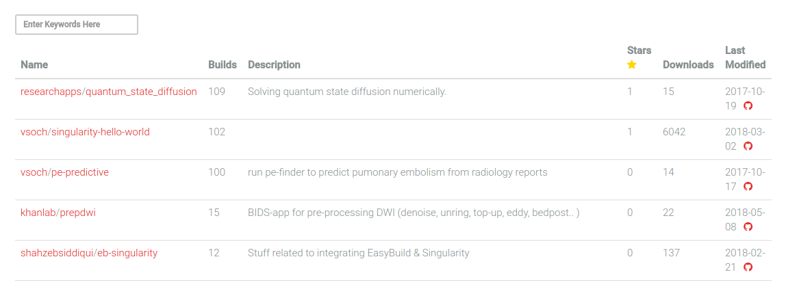
Singularity Hub (shub://)
https://singularity-hub.org.

Slide 25
Downloading prebuild shub images using pull
[mvickers@NBI-HPC ~]$ singularity pull shub://vsoch/hello-world
Progress |===================================| 100.0%
Done. Container is at: vsoch-hello-world-master-latest.simg
[mvickers@NBI-HPC ~]$ ls
vsoch-hello-world-master-latest.simg
[mvickers@NBI-HPC ~]$ singularity exec vsoch-hello-world-master-latest.simg ls
bin environment lib mnt rawr.sh sbin sys var
boot etc lib64 opt root singularity tmp
dev home media proc run srv usr

Slide 26
Extra points
singularity image.expand image.img does not work. It only works on empty image, before an OS has been installed
When running singularity exec on the software node, you can't access your file system correctly
WARNING: Could not chdir to home: /usr/users/JIC_c1/mvickers
open: No such file or directory
[main_samview] fail to open "70SC_1_val_1.bam" for reading.

Slide 27
Extra points
If publishing only a recipe that installs from github, use specific releases e.g.
git clone <repository> --branch v0.1.19
  Rather than simply git clone <repository>
  As the software in the repository develops, so do the dependencies
Probably best to use centOS recipes where possible (at least at the moment) for NBI specific things

Slide 28
Development of Singularity
It's moving very fast
  We are using 2.4.2 as of yesterday, latest is 2.5.1
    Prior to that was 2.2 which is quite different
  Significant changes and compatibility
The move from 2.2 to 2.4.2 yesterday on the software node changed a lot of things
  including all of these slides and examples

Slide 29
What we've not manage to cover
Docker
  singularity pull docker://ubuntu
  Quite like a little buggy at times as still in active development
How to install on the /nbi/testing and sourcing the file
  Getting the right directory structure
  Following the CiS instructions
  https://docs.cis.nbi.ac.uk/display/CIS/Installing+software+on+the+cluster+using+Singularity
Publishing to Singularity Hub
Converting images (e.g. image->sandbox->image)

Slide 30
Thank you
Tjelvar Olsson
Matthew Hartley
Hugh Wollfenden
Michael Burrell
Sam Gallop
CiS Team

