Slide 1
Multiple Linear Regression

Slide 2
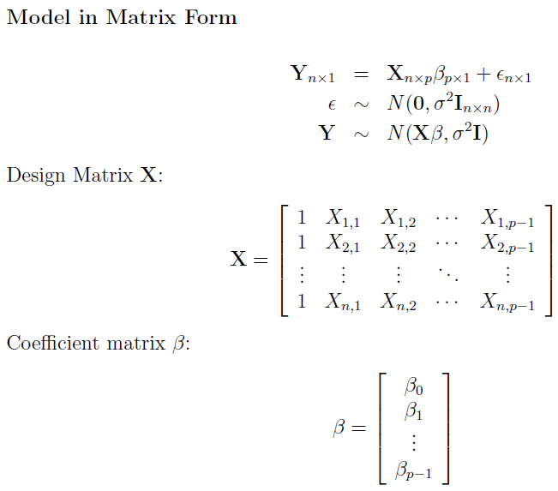

Slide 3
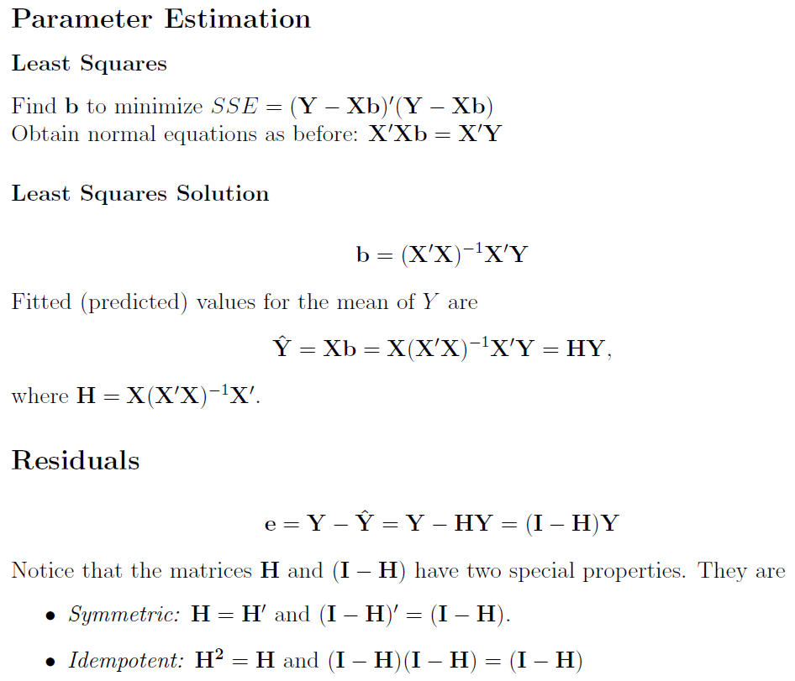

Slide 4
