Slide 1
Building an MCP Server
Tools, Resources, and Prompts
Notes:
This is the hands-on lecture. We move from the architecture we mapped in Lecture 1 to actually building a server. By the end you will have scaffolded a working server, exposed one tool, one resource, and one prompt, and debugged it with the MCP Inspector. We lean on the official Python and TypeScript SDKs and the official build-a-server tutorial.

Slide 2
What a Server Is
A program that exposes capabilities to AI apps via a standard protocol
Examples: file system, database, GitHub, Slack, and calendar servers
One server = one domain of functionality (e.g. weather, files)
Official SDKs in many languages; Python and TypeScript are Tier 1
The same SDK builds servers and clients across stdio and HTTP
Sources: Understanding MCP servers (server concepts), Official MCP SDKs
Notes:
An MCP server is just a program. It wraps some capability — a database, a REST API, the file system — and exposes it over the MCP protocol so any host can use it. The official docs list file system, database, GitHub, Slack, and calendar servers as common examples. You don't write protocol code by hand: the official SDKs (Python and TypeScript are Tier 1, alongside C# and Go) handle the wire format, and the same SDK lets you build both servers and clients.
Understanding MCP servers (server concepts)
Official MCP SDKs

Slide 3
The Three Building Blocks
Tools (model-controlled)
Functions the LLM actively calls based on context
Can write to databases, call APIs, or modify files
Schema-defined; each performs one clearly typed operation
Discovered via tools/list, executed via tools/call
May require user consent before running
Resources & Prompts
Resources (app-controlled): read-only context data
Each has a URI and a MIME type
Fixed URIs, or parameterized resource templates
Prompts (user-controlled): pre-built instruction templates
Guide the model to use specific tools and resources
Sources: Understanding MCP servers (server concepts)
Notes:
Servers expose capabilities through exactly three building blocks, and it matters who controls each. Tools are model-controlled: the LLM decides when to call them, and they can do real, sometimes destructive work — writing to a database, sending a message, modifying a file — so MCP supports user consent before a tool runs. Resources are application-controlled: read-only, passive data such as file contents, schemas, or API docs, each identified by a URI and a MIME type; you can have fixed direct resources or parameterized templates like travel://activities/{city}/{category}. Prompts are user-controlled: pre-built instruction templates that nudge the model to use particular tools and resources together. On the wire, tools use tools/list and tools/call; resources use resources/list, resources/templates/list, resources/read, and resources/subscribe.
Understanding MCP servers (server concepts)

Slide 4
You write plain Python with type hints and docstrings. The SDK generates the schema, validation, and protocol handling.
Sources: MCP Python SDK docs (v2)
Notes:
MCP Python SDK docs (v2)

Slide 5
A Complete Server in Ten Lines
from mcp.server import MCPServer
mcp = MCPServer("Demo")
@mcp.tool()
def add(a: int, b: int) -> int:
"""Add two numbers."""
return a + b
@mcp.resource("greeting://{name}")
def greeting(name: str) -> str:
"""Greet someone by name."""
return f"Hello, {name}!"
Sources: MCP Python SDK docs (v2)
Notes:
This is a complete, working MCP server: one tool (add) and one templated resource (greeting://{name}). There is no JSON Schema anywhere — a: int, b: int is the schema, and the docstrings become the descriptions. The SDK generates tool definitions, validates arguments, and handles the JSON-RPC. Run it with uv run mcp dev server.py, which starts the server and opens the MCP Inspector; call add with a=1, b=2 to get 3, and read greeting://World to get 'Hello, World!' The same pattern works in TypeScript and the other official SDKs. (The official build-a-server tutorial uses the equivalent FastMCP class for its weather server.)
MCP Python SDK docs (v2)

Slide 6
Running & Wiring the Server
Run it over stdio: mcp.run(transport="stdio")
The host launches it and speaks JSON-RPC over the pipe
STDIO servers: never log to stdout — it corrupts JSON-RPC
Log to stderr or a file instead (a logging library)
HTTP servers: ordinary stdout logging is fine
Wire it into a host, e.g. a Claude for Desktop config
Sources: Build an MCP server (official tutorial), MCP Python SDK docs (v2)
Notes:
The quickstart weather server runs over stdio: mcp.run(transport='stdio'). The host — Claude for Desktop in the tutorial — launches the server as a child process and talks JSON-RPC over stdin/stdout. That is why the logging rule matters: for stdio servers, anything written to stdout is interpreted as a protocol message, so a stray print() corrupts the JSON-RPC stream and breaks the server. Use file=sys.stderr or a logging library that writes to stderr or a file. For HTTP-based (Streamable HTTP) servers, stdout is fine because it does not carry the protocol. To connect the server you edit the host config — for Claude for Desktop that is claude_desktop_config.json under the mcpServers key — with the command (uv) and args that launch your server, using an absolute path. The official tutorial builds a weather server exposing get_alerts and get_forecast as its two tools.
Build an MCP server (official tutorial)
MCP Python SDK docs (v2)

Slide 7
Debugging with the Inspector
The MCP Inspector: the reference tool for testing servers
One package, three clients: Web, CLI, and TUI
Web: npx @modelcontextprotocol/inspector opens a browser UI
CLI: --cli is scriptable for CI (tools/list, tools/call)
TUI: --tui gives an interactive terminal client
uv run mcp dev server.py opens the Inspector for you
Sources: MCP Inspector (developer tool), MCP Python SDK docs (v2)
Notes:
The MCP Inspector is the reference developer tool for testing and debugging MCP servers. It ships as one package, @modelcontextprotocol/inspector, with three clients behind one binary, all built on the same core so a connection behaves identically. The Web client (npx @modelcontextprotocol/inspector) is the richest — a full graphical inspector in the browser where you list tools, fill in the generated argument forms, and watch the JSON-RPC exchange. The CLI client (add --cli) is scriptable and machine-readable, ideal for CI, shell pipelines, and coding agents: for example --method tools/list to enumerate tools, or --method tools/call --tool-name get_weather --tool-arg city=Boston --format json piped into jq. The TUI client (add --tui) is an interactive terminal UI for when a browser is not available. It needs Node 22.19 or newer and runs straight through npx. In the Python SDK, uv run mcp dev server.py starts your server and opens the Inspector automatically.
MCP Inspector (developer tool)
MCP Python SDK docs (v2)

Slide 8
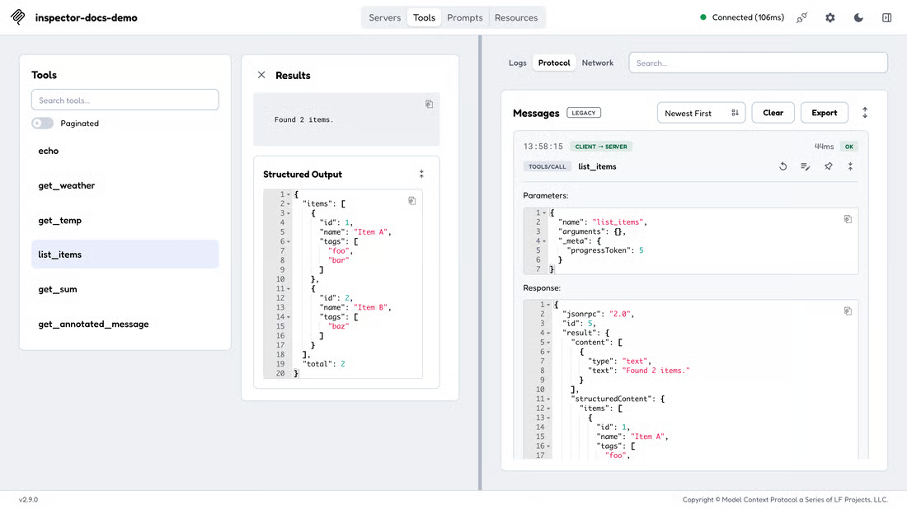
The Inspector in Action
Inspector web client: the tool list, a tools/call result with structured output, and the raw JSON-RPC exchange in the monitoring panel.
Sources: MCP Inspector web client screenshot (official docs), MCP Inspector (developer tool)
Notes:
This is the official Inspector web client. On the left is the list of tools the server exposes — here: echo, get_weather, get_temp, list_items, get_sum, get_annotated_message. The middle panel shows the result of a tools/call on list_items: the text result plus the structuredContent the server returned. The right panel is the monitor: the raw JSON-RPC 2.0 exchange, with the client-to-server tools/call request (name, arguments, _meta.progressToken) and the response (jsonrpc, id, result.content text 'Found 2 items', and structuredContent carrying the items array). This is the view you want during the lab: confirm your tool is listed with the schema you expect, that arguments arrive with the right shapes, and that the result looks like what the model will see. Use the Logs / Protocol / Network tabs to change perspective, and Clear or Export the message log when you want a clean capture for a bug report.
MCP Inspector web client screenshot (official docs)
MCP Inspector (developer tool)

Slide 9
Key Takeaways & Lab
A server is a program exposing tools, resources, and prompts. With an official SDK, a few type-annotated functions become a working server: run it over stdio, wire it into a host, and debug it with the Inspector. Lab: scaffold a Python or TypeScript server, expose one tool, one resource, and one prompt, and verify each in the Inspector.
Sources: MCP Python SDK docs (v2), Understanding MCP servers (server concepts)
Notes:
Recap: an MCP server is a program exposing three building blocks — tools (model-controlled), resources (application-controlled), and prompts (user-controlled). The official SDKs do the heavy lifting: type hints become JSON Schema, docstrings become descriptions, and the SDK handles validation and the JSON-RPC wire. You run the server over stdio, wire it into a host via its config, and remember the stdout logging rule for stdio servers. You debug everything with the MCP Inspector's web, CLI, and TUI clients. For the lab, scaffold a server in Python or TypeScript, expose at least one tool, one resource, and one prompt with correct schemas, then verify each in the Inspector. Next, Lecture 3 turns to the security risks of the servers you now know how to build.
MCP Python SDK docs (v2)
Understanding MCP servers (server concepts)

