Slide 1
Why MCP Exists
The fragmentation problem and the client/host/server architecture
Sources: What is MCP? — MCP is an open-source standard for connecting AI applications to external systems
Notes:
Welcome. You already know HTTP and JSON; MCP is built directly on both: JSON-RPC 2.0 messages carried over stdio or HTTP. Today: (1) the integration problem MCP solves, (2) the host/client/server architecture, (3) the two protocol layers, (4) lifecycle and capability negotiation, and (5) what a real message looks like on the wire. By the end you should be able to trace a request from a host through a client to a server, and explain why the architecture draws these security boundaries.
What is MCP? — MCP is an open-source standard for connecting AI applications to external systems

Slide 2
The Integration Problem
Before MCP, every AI app hand-rolled integrations for each tool and data source
N apps x M tools meant N x M one-off connectors, each with its own schema
Tool-calling formats were provider-specific, fragmenting the ecosystem across vendors
Context stayed locked in one app; switching providers meant rebuilding integrations
No shared standard existed for how models discover and invoke external capabilities
Sources: Specification 2025-11-25 — MCP as an open protocol for LLM applications and external data sources and tools, What is MCP? — a standardized way to connect AI applications to external systems
Notes:
Walk through the N-by-M matrix: before MCP, every new AI application had to re-implement every integration by hand. The specification frames MCP's motivation directly: it takes inspiration from the Language Server Protocol, which standardized adding language support across a whole tool ecosystem; MCP does the same for context and tools across the ecosystem of AI applications. Emphasize that pre-MCP 'tool calling' was a per-provider API feature, not an interoperable protocol, which is why integrations could not move between apps or vendors.
Specification 2025-11-25 — MCP as an open protocol for LLM applications and external data sources and tools
What is MCP? — a standardized way to connect AI applications to external systems

Slide 3
MCP is the USB-C port of AI: one open standard that connects applications to tools, data, and workflows.
Sources: What is MCP? — the USB-C analogy for standardized connectivity
Notes:
Verbatim from the docs: "Think of MCP like a USB-C port for AI applications. Just as USB-C provides a standardized way to connect electronic devices, MCP provides a standardized way to connect AI applications to external systems." (MCP documentation, "What is MCP?", 2026-07-28.) The slide states the analogy directly because the quote box is too small for the full sentence. The USB-C analogy does the heavy lifting: one connector standard, many peripherals, and anything built against it works everywhere. MCP standardizes the protocol for context exchange between applications and external systems. Point out the scope boundary from the architecture docs: MCP focuses solely on the protocol for context exchange; it does not dictate how AI applications use LLMs or manage the context they receive.
What is MCP? — the USB-C analogy for standardized connectivity

Slide 4
What MCP Provides
An open protocol anyone can implement, free of vendor lock-in
A growing set of pre-built integrations that plug straight into your LLM app
Flexibility to switch between apps and providers, taking your context with you
A standard way to build custom integrations for any AI application
Broad ecosystem support: Claude, ChatGPT, VS Code, Cursor and many more
Sources: What is MCP? — benefits for developers, applications, and end users; broad ecosystem support
Notes:
Frame benefits by stakeholder, as the docs do: developers save development time and complexity when building or integrating AI applications; AI applications gain access to an ecosystem of data sources, tools, and apps; end users get more capable agents that can access their data and act on their behalf. The ecosystem point is what makes it a standard rather than a library: Claude, ChatGPT, VS Code, Cursor, and many others all support MCP, so build once and integrate everywhere.
What is MCP? — benefits for developers, applications, and end users; broad ecosystem support

Slide 5
Host, Client, Server
Inside the host
Host: the AI application, e.g. Claude Desktop or VS Code
Coordinates and manages one or more MCP clients
Client: one per server, a dedicated 1:1 connection
Each client maintains a stateful session with its server
The server
Server: a program that provides context and capabilities
Local over stdio, or remote over Streamable HTTP
Local servers typically serve a single client
Remote servers typically serve many clients
Sources: Architecture overview — host, client, and server participants; VS Code example; local vs remote servers
Notes:
Use the documentation's running example: Visual Studio Code is the host. When it connects to the Sentry server, the VS Code runtime instantiates a client object for Sentry; when it also connects to a local filesystem server, it instantiates a second client. So one host, many clients, one client per server, and each client holds a dedicated stateful connection. 'Local' versus 'remote' describes where the server process runs and which transport it uses (stdio versus Streamable HTTP), not a different architecture: a server is simply the program that provides context to clients. Local stdio servers typically serve one client; remote Streamable HTTP servers typically serve many.
Architecture overview — host, client, and server participants; VS Code example; local vs remote servers

Slide 6
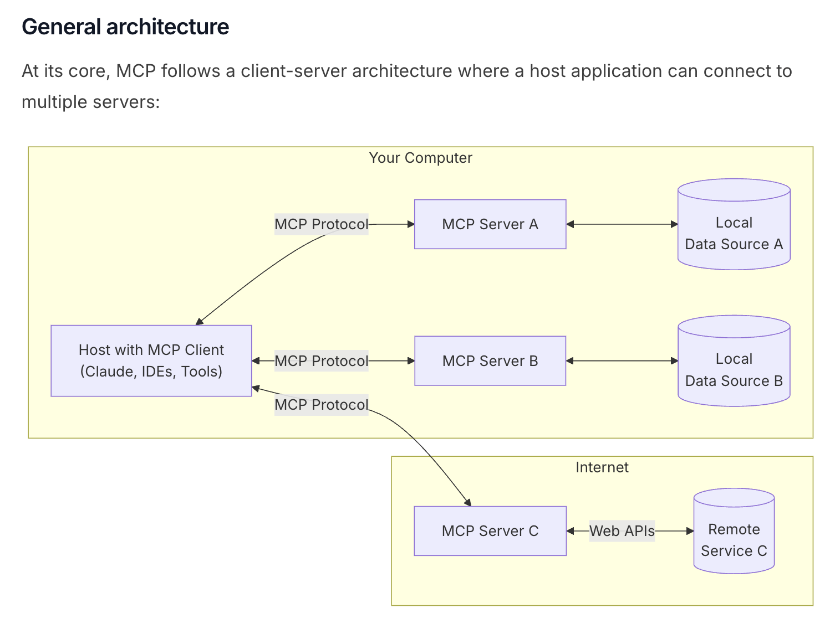
The Architecture Diagram
General MCP architecture: one host, one client per server; local servers (A, B) and a remote server (C). Source: MCP documentation, general architecture diagram.
Sources: Official MCP general architecture diagram (modelcontextprotocol docs), Architecture overview — participants and local vs remote servers
Notes:
Walk the diagram left to right. The host (Claude, IDEs, tools) sits on the user's machine and speaks the MCP protocol to each server. Servers A and B run locally and read local data sources (files, databases); server C runs on the Internet and reaches remote services through web APIs. Two teaching points: first, every server connection is its own dedicated client, so one host scales to many servers; second, 'local' versus 'remote' is a deployment and transport difference (stdio versus Streamable HTTP), not a protocol difference — the same JSON-RPC messages flow in all three links.
Official MCP general architecture diagram (modelcontextprotocol docs)
Architecture overview — participants and local vs remote servers

Slide 7
Two Layers of the Protocol
Data layer (inner)
JSON-RPC 2.0: requests, responses, notifications
Lifecycle: initialization, capability negotiation, termination
Server primitives: tools, resources, prompts
Client primitives: sampling, elicitation, logging
Utilities: notifications and progress tracking
Transport layer (outer)
Stdio: process streams for local servers, no network overhead
Streamable HTTP: POST plus optional Server-Sent Events
Standard HTTP auth; OAuth recommended for tokens
Same JSON-RPC message format across all transports
Sources: Architecture overview — data layer and transport layer; stdio and Streamable HTTP transports, Specification 2025-11-25 — JSON-RPC 2.0 message types and the HTTP authorization framework
Notes:
The key design point is that the transport layer abstracts communication details from the protocol layer, so the identical JSON-RPC 2.0 message format works over every transport. Stdio uses standard input/output streams for direct process communication on the same machine: optimal performance, no network overhead. Streamable HTTP uses HTTP POST for client-to-server messages with optional Server-Sent Events for streaming; it enables remote servers and supports standard HTTP authentication (bearer tokens, API keys, custom headers), with OAuth recommended for obtaining tokens. The data layer carries lifecycle management, the server primitives (tools for actions, resources for context data, prompts for interaction templates), the client primitives (sampling, elicitation, logging), and utilities like notifications and progress tracking.
Architecture overview — data layer and transport layer; stdio and Streamable HTTP transports
Specification 2025-11-25 — JSON-RPC 2.0 message types and the HTTP authorization framework

Slide 8
Lifecycle & Capability Negotiation
MCP is stateful: every session starts with an initialize handshake
The handshake negotiates protocol version, capabilities, and identity
Servers declare tools, resources, prompts, and list-changed support
Clients declare what they support, e.g. elicitation
If no compatible protocol version is found, the connection terminates
After init, the client sends notifications/initialized
Sources: Architecture overview — lifecycle management and the initialization exchange example, Specification 2025-11-25 — lifecycle management: connection initialization, capability negotiation, and session control
Notes:
Use the documentation's worked example. The client sends initialize with protocolVersion 2025-11-25, its capabilities (e.g. elicitation), and clientInfo. The server replies with its own capabilities: in the example, tools with listChanged true (it can send tools/list_changed notifications), and resources. The handshake serves three purposes: protocol version negotiation (terminate if no compatible version), capability discovery (each side declares which primitives and features it handles), and identity exchange (clientInfo and serverInfo for debugging). After successful initialization the client sends notifications/initialized, a one-way notification with no response. All implementations MUST support the base protocol and lifecycle management; capabilities decide what is available for the rest of the session.
Architecture overview — lifecycle management and the initialization exchange example
Specification 2025-11-25 — lifecycle management: connection initialization, capability negotiation, and session control

Slide 9
A Request on the Wire
{
"jsonrpc": "2.0",
"id": 2,
"method": "tools/list"
}
{
"jsonrpc": "2.0",
"id": 2,
"result": { "tools": [ ... ] }
}
Sources: Specification 2025-11-25 — request, response, and notification message rules, Architecture overview — the tools/list discovery example and tool metadata
Notes:
This is the entire wire format. The request carries a unique, non-null id that must not be reused within the session; the result response echoes the same id and may carry any JSON object as result. Notifications, like notifications/initialized, omit the id entirely and the receiver MUST NOT respond. On failure the response carries an error object with an integer code and a message. In the docs' example, tools/list returns a tools array where each entry has name, title, description, and a JSON Schema inputSchema; the host aggregates tools from all connected servers into one registry the LLM can call. Discovery first (tools/list), execution second (tools/call) — that pattern holds for resources and prompts too.
Specification 2025-11-25 — request, response, and notification message rules
Architecture overview — the tools/list discovery example and tool metadata

Slide 10
Key Takeaways
MCP is an open, JSON-RPC-based standard. A host runs isolated clients, each holding a 1:1 stateful session to a server that exposes tools, resources, and prompts over stdio or Streamable HTTP. Next lecture: build a server that exposes all three.
Sources: Architecture overview — core concepts recap, What is MCP? — start building: servers, clients, and MCP Apps
Notes:
Recap in one breath: the problem (N-by-M integration fragmentation), the fix (one open, JSON-RPC-based standard), the participants (host coordinates isolated clients, one stateful 1:1 session per server), the layers (data layer for what, transport layer for how), and the lifecycle (initialize, negotiate capabilities, then work). Preview Lecture 2: we scaffold a real MCP server with an official SDK, expose one tool, one resource, and one prompt with proper JSON Schemas, and test it end to end with the MCP Inspector.
Architecture overview — core concepts recap
What is MCP? — start building: servers, clients, and MCP Apps

