Slide 1
Fast Thinking in Decisions
Lecture 1: intuition, heuristics, and the dual-process view
Sources: Evans & Stanovich 2013, Dual-process theories of higher cognition, Kahneman & Klein 2009, Conditions for intuitive expertise
Notes:
Frame the lecture around one question: when is fast judgment good enough, and when does it need checking? Preview the three parts: why decisions are fast, how System 1 and System 2 divide the work, and when intuition is reliable.
Evans & Stanovich 2013, Dual-process theories of higher cognition | lines 13–13
Kahneman & Klein 2009, Conditions for intuitive expertise

Slide 2
Why Decisions Are Made Fast
Decision makers face limits on time, information, and mental effort.
Dual-process accounts treat rapid autonomous processes as the default response.
Less information and less computation can sometimes improve accuracy.
Sources: Evans & Stanovich 2013, Dual-process theories of higher cognition, Gigerenzer & Brighton 2009, Homo heuristicus
Notes:
Stress that fast judgment is the normal mode, not a failure. Evans and Stanovich describe rapid autonomous (Type 1) processes as yielding default responses unless higher-order reasoning intervenes. Gigerenzer and Brighton argue that less information, computation, and time can sometimes improve accuracy.
Evans & Stanovich 2013, Dual-process theories of higher cognition
Gigerenzer & Brighton 2009, Homo heuristicus

Slide 3
Dual-Process Theory
System 1: fast, automatic, effortless, associative, often emotionally charged.
System 2: slower, serial, effortful, consciously monitored and controlled.
Type 2 processing supports hypothetical thinking and loads heavily on working memory.
Sources: Kahneman 2003, A perspective on judgment and choice, Evans & Stanovich 2013, Dual-process theories of higher cognition
Notes:
Use Stanovich and West's labels as Kahneman summarizes them. System 1 is the intuitive mode; System 2 is the deliberate mode. Evans and Stanovich define the difference by hypothetical thinking and working-memory load.
Kahneman 2003, A perspective on judgment and choice | lines 246–250
Evans & Stanovich 2013, Dual-process theories of higher cognition

Slide 4
Characteristics of System 1
Operations are implicit, not available to introspection, and often emotionally charged.
Governed by habit, so they are difficult to control or modify.
Concurrent-task test: effortful processes interfere with each other; effortless ones do not.
Sources: Kahneman 2003, A perspective on judgment and choice
Notes:
The concurrent-task test is the practical way to classify a process: if adding a second task disrupts it, the process draws on the limited effort capacity that System 2 uses.
Kahneman 2003, A perspective on judgment and choice | lines 246–268

Slide 5
Heuristics as Adaptive Shortcuts
Heuristics are efficient processes that ignore part of the available information.
Less information, computation, and time can sometimes improve accuracy.
Ecological rationality asks in which environments a given strategy succeeds or fails.
Sources: Gigerenzer & Brighton 2009, Homo heuristicus
Notes:
Gigerenzer and Brighton describe the mind as an adaptive toolbox. The key question is not whether a heuristic is biased, but whether it fits the environment. Their abstract argues a biased mind can handle uncertainty more efficiently and robustly than an unbiased, resource-intensive one.
Gigerenzer & Brighton 2009, Homo heuristicus

Slide 6
A Judgment That Is Usually Right
The bias research is compatible with intuition as generally skilled and successful.
Ecological rationality: a heuristic succeeds when its structure fits the environment.
Test in class: when does a fast judgment beat a slower, more thorough one?
Sources: Kahneman 2003, A perspective on judgment and choice, Gigerenzer & Brighton 2009, Homo heuristicus
Notes:
Kahneman's abstract states that the study of biases is compatible with a view of intuitive thinking as generally skilled and successful. Gigerenzer and Brighton's less-is-more results give the mechanism. No worked numerical example is in the admitted Sources yet; add one from the Course Author's material or from a Source before teaching this slide.
Kahneman 2003, A perspective on judgment and choice
Gigerenzer & Brighton 2009, Homo heuristicus

Slide 7
When Intuition Works
Intuition is trustworthy when the environment is predictable.
The judge must have had a real chance to learn its regularities.
Subjective confidence is not a reliable indicator of judgment accuracy.
Sources: Kahneman & Klein 2009, Conditions for intuitive expertise
Notes:
Kahneman and Klein reconcile the heuristics-and-biases and naturalistic decision-making traditions. The quality of an intuition depends on two conditions: predictability of the environment and opportunity to learn it.
Kahneman & Klein 2009, Conditions for intuitive expertise

Slide 8
Expert vs. Novice Intuition
Intuition is not always poor: skilled performance is rapid and effortless after prolonged practice.
Chess masters recognize patterns quickly, which is skill, not guessing.
Practice and feedback separate expert intuition from novice impressions.
Sources: Kahneman 2003, A perspective on judgment and choice, Kahneman & Klein 2009, Conditions for intuitive expertise
Notes:
Kahneman's Nobel lecture gives the chess master example: the skill is acquired by prolonged practice, and its performance is rapid and effortless. Kahneman and Klein add that expertise develops in predictable environments where the judge can learn the regularities. Ask students which of their own intuitions come from that kind of practice.
Kahneman 2003, A perspective on judgment and choice | lines 401–413
Kahneman & Klein 2009, Conditions for intuitive expertise

Slide 9
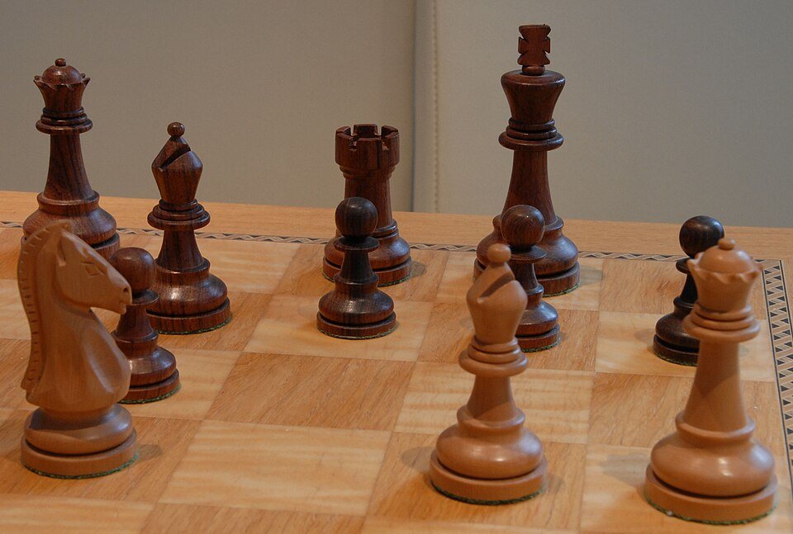
Expert Intuition
Chess position, Kramnik vs. Lautier, Monaco 1999 (Wikimedia Commons, CC BY-SA 2.5). Photo by Thomas Kretschmer.
Sources: Kretschmer 2006, Schachfiguren (Kramnik-Lautier, Monaco 1999), CC BY-SA 2.5, Wikimedia Commons, Kahneman 2003, A perspective on judgment and choice
Notes:
The photo shows the board from an angle, so students can't reliably reconstruct the full position or find a move. Use it for the general point instead: a chess master's quick sense of a position comes from prolonged practice (Kahneman 2003). Ask students what kinds of experience would let them read a situation this way, and whether their own domain gives that kind of practice. Kahneman and Klein add that this skill depends on a predictable environment and a chance to learn its regularities.
Kretschmer 2006, Schachfiguren (Kramnik-Lautier, Monaco 1999), CC BY-SA 2.5, Wikimedia Commons | https://commons.wikimedia.org/wiki/File:Schachfiguren.jpg
Kahneman 2003, A perspective on judgment and choice | lines 401–413

Slide 10
System 1 Proposes, System 2 Tests
System 2 monitors the tentative judgments and intentions System 1 produces.
Most intuitive errors involve both systems: System 1 generates the error, System 2 fails to catch it.
Hypothetical thinking is the deliberate check that can test a fast hypothesis.
Sources: Kahneman 2003, A perspective on judgment and choice, Evans & Stanovich 2013, Dual-process theories of higher cognition
Notes:
Kahneman's account assumes System 2 continuously monitors System 1's tentative judgments. Errors therefore involve two failures: generation by System 1 and non-detection by System 2. In a decision model, the fast output is the hypothesis, and the model or analyst is the test.
Kahneman 2003, A perspective on judgment and choice | lines 2571–2586
Evans & Stanovich 2013, Dual-process theories of higher cognition

Slide 11
Measuring System 1 in Practice
Concurrent-task interference is the most useful test of whether a process is System 1 or System 2.
Reaction time has long been used as a general-purpose measure of response strength.
Subjective confidence is not a reliable indicator of accuracy.
Sources: Kahneman 2003, A perspective on judgment and choice, Kahneman & Klein 2009, Conditions for intuitive expertise
Notes:
Kahneman identifies the concurrent-task effect as the most useful indication of System 1 versus System 2, and notes that reaction time has been used as a general measure of response strength. Treat response time as an observable signal, not proof of process type. Kahneman and Klein warn that confidence is not a reliable guide to accuracy, which matters when reading a dashboard or a model's output.
Kahneman 2003, A perspective on judgment and choice | lines 246–268
Kahneman & Klein 2009, Conditions for intuitive expertise

Slide 12
Data Science Example: Reading a Dashboard
Quick reads of a dashboard are System 1 judgments: fast, automatic, and effortless.
A glance surfaces the most salient number and can miss base rates and trends.
Ask: what would a slower, deliberate check need to show before acting?
Sources: Kahneman 2003, A perspective on judgment and choice, Link & Raab 2021, Experts use base rates in real-world sequential decisions
Notes:
No admitted Source contains a dashboard case, so this is an instructor-built illustration of the System 1 characteristics from Kahneman 2003. Link and Raab show that base rates matter in real sequential decisions, which is the kind of information a glance can omit. Consider adding a dashboard example from the Course Author's own material.
Kahneman 2003, A perspective on judgment and choice
Link & Raab 2021, Experts use base rates in real-world sequential decisions

Slide 13
Lecture 1 Summary
Dual-process view: fast System 1 proposes; slower System 2 can test.
Intuition is reliable in predictable environments with real opportunity to learn.
Heuristics ignore information but can be ecologically rational.
Next lecture: how the same fast processes produce systematic errors.
Sources: Evans & Stanovich 2013, Dual-process theories of higher cognition, Kahneman & Klein 2009, Conditions for intuitive expertise, Gigerenzer & Brighton 2009, Homo heuristicus
Notes:
Discussion questions: Where in your own work is a fast judgment reliable, and what would tell you it is not? When would a glance at a dashboard be enough, and when does it need a deliberate check?
Evans & Stanovich 2013, Dual-process theories of higher cognition
Kahneman & Klein 2009, Conditions for intuitive expertise
Gigerenzer & Brighton 2009, Homo heuristicus

Slide 14
Preview: Heuristics and Systematic Biases
Fast judgments are useful but can produce systematic errors.
Lecture 2 covers representativeness, availability, anchoring, and base-rate neglect.
Key question: when does a heuristic's shortcut mislead?
Sources: Kahneman 2003, A perspective on judgment and choice, Tversky & Kahneman 1974, Judgment under uncertainty: Heuristics and biases
Notes:
Bridge to Lecture 2. Kahneman describes the attribute-substitution model of heuristic judgment and the biases that follow from it. Tversky and Kahneman 1974 is the primary source for the heuristics covered next.
Kahneman 2003, A perspective on judgment and choice
Tversky & Kahneman 1974, Judgment under uncertainty: Heuristics and biases

