Slide 1


DEV490
.NET Framework:
CLR – Under The Hood
Jeffrey Richter
Author / Consultant / Trainer
Wintellect

Slide 2
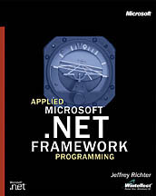

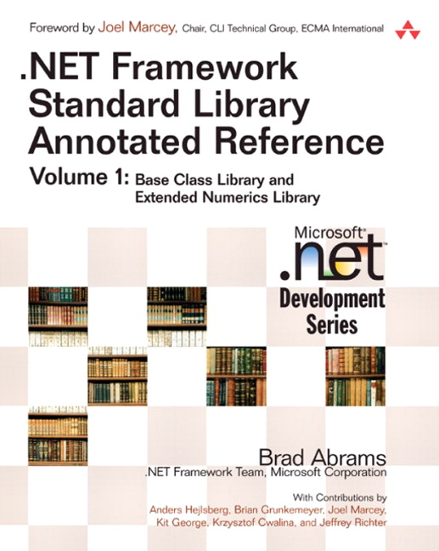

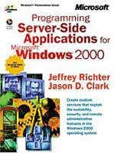

Jeffrey Richter
Author of several .NET Framework/Win32 Books
Cofounder of Wintellect: a company dedicated to helping clients ship better software faster
  Services: Consulting, Debugging, Security Reviews, Training
Consultant on Microsoft’s .NET Framework team since
October 1999
MSDN Magazine Contributing Editor/.NET Columnist
Notes:
<footer>© 2004 Microsoft Corporation. All rights reserved.
This presentation is for informational purposes only. Microsoft makes no warranties, express or implied, in this summary.

Slide 3
Topics
Execution Model
  Intermediate Language (IL), verification, JIT compilation, metadata, and assembly loading
How Things Relate at Runtime
  Code, Types, Objects, a thread’s stack, and the heap
Garbage Collection
  How a reference-tracking GC works
Notes:
<footer>© 2004 Microsoft Corporation. All rights reserved.
This presentation is for informational purposes only. Microsoft makes no warranties, express or implied, in this summary.

Slide 4
Topics
Execution Model
  Intermediate Language (IL), verification, JIT compilation, metadata, and assembly loading
How Things Relate at Runtime
  Code, Types, Objects, a thread’s stack, and the heap
Garbage Collection
  How a reference-tracking GC works
Notes:
<footer>© 2004 Microsoft Corporation. All rights reserved.
This presentation is for informational purposes only. Microsoft makes no warranties, express or implied, in this summary.

Slide 5
Compiling Source Code
Into Assemblies
C#
Source Code
File(s)
Basic
Source Code
File(s)
C++
Source Code
File(s)
Fortran
Source Code
File(s)
C#
Compiler
Basic
Compiler
C++
Compiler
Fortran
Compiler
Managed Assembly
(IL and Metadata)
Managed Assembly
(IL and Metadata)
Managed Assembly
(IL and Metadata)
Managed Assembly
(IL and Metadata)

Slide 6
An Assembly
An Assembly is the managed equivalent of an EXE/DLL
Implements and optionally exports a collection of types
It is the unit of versioning, security, and deployment
Parts of an Assembly file
  Windows PE header
  CLR header (Information interpreted by the CLR and utilities)
  Metadata (Type definition and reference tables)
  Intermediate Language (code emitted by compiler)

Slide 7
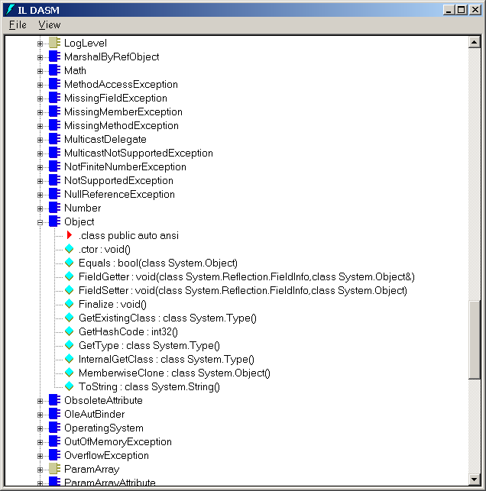
ILDasm.exe

Slide 8
Intermediate Language
All .NET compilers produce IL code
IL is CPU-independent machine language
  Created by Microsoft with input from external commercial and academic language/compiler writers
IL is higher-level than most CPU machine languages
Some sample IL instructions
  Create and initialize objects (including arrays)
  Call virtual methods
  Throw and catch exceptions
  Store/load values to/from fields, parameters, and local variables
Developers can write in IL assembler (ILAsm.exe)
  Many compilers produce IL source code and compile it by spawning ILAsm.exe

Slide 9
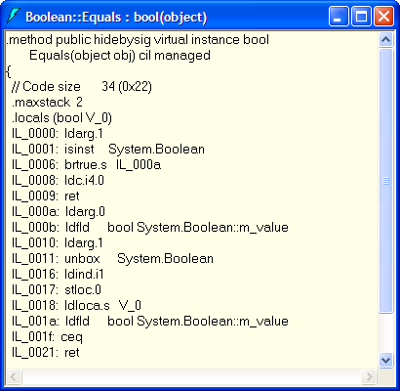
ILDasm.exe

Slide 10
Benefits Of IL
IL is not tied to any specific CPU
Managed modules can run on any CPU (x86, Itanium, Opteron, etc), as long as the OS on that CPU supports the CLR
Many believe that “write once, run everywhere” is the biggest benefit
  I disagree, security and verification of code is the really BIG win!

Slide 11
Real Benefit Of IL:
Security And Verification
When processing IL, CLR verifies it to ensure that everything it does is “safe”
  Every method is called with correct number and type of parameters
  Every method’s return value is used properly
  Every method has a return statement
Metadata includes all the type/method info used for verification

Slide 12
Benefits Of “Safe” Code
Multiple managed applications can run in 1 Windows’ process
  Applications can’t corrupt each other (or themselves)
Reduces OS resource usage, improves performance
Administrators can trust apps
  ISPs forbidding ISAPI DLLs
  SQL Server running IL for stored procedures
  Internet downloaded code (with Code Access Security)
Note: Administrator can turn off verification

Slide 13
Executing Managed IL Code
When loaded, the runtime creates method stubs
When a method is called, the stub jumps to runtime
Runtime loads IL and compiles it
  IL is compiled into native CPU code
  Just like compiler back-end
Method stub is removed and points to compiled code
Compiled code is executed
In future, when method is called, it just runs

Slide 14
Managed EXE
Console
static void Main() {
Console.WriteLine(“Hello”);
Console.WriteLine(“Goodbye”);
}
static void WriteLine()
JITCompiler
static void WriteLine(String)
JITCompiler
NativeMethod
Native CPU Instructions
(remaining members)
…
MSCorEE.dll
JITCompiler function {
1. In the assembly that implements the type (Console),
look up the method (WriteLine) being called in the metadata.
2. From the metadata, get the IL for this method and verify it.
3. Allocate a block of memory.
4. Compile the IL into native CPU instructions; the native code is saved
in the memory allocated in step #3.
5. Modify the method’s entry in the Type’s table so that it now
points to the memory block allocated in step #3.
6. Jump to the native code contained inside the memory block.
}

Slide 15
All Types/Modules Are
Self-Describing
public class App {
public static void Main() {
System.Console.WriteLine("Hi");
}
}
1 TypeDef entry for “App”
  Entry refers to MethodDef entry for “Main”
2 TypeRef entries for “System.Object” and “System.Console”
  Both entries refer to AssemblyRef entry for MSCorLib
Notes:
<footer>© 2004 Microsoft Corporation. All rights reserved.
This presentation is for informational purposes only. Microsoft makes no warranties, express or implied, in this summary.

Slide 16
Metadata Definition Tables
(Partial List)
TypeDef: 1 entry for each type defined
  Type’s name, base type, flags (i.e. public, private, etc.) and index into MethodDef & FieldDef tables
MethodDef: 1 entry for each method defined
  Method’s name, flags (private, public, virtual, static, etc), IL offset, and index to ParamDef table
FieldDef: 1 entry for each field defined
  Name, flags (i.e. private, public, etc.), and type
ParamDef: 1 entry for each parameter def’d
  Name, and flags (in, out, retval, etc.)

Slide 17
Metadata Reference Tables
(Partial List)
AssemblyRef: 1 entry for each assembly ref’d
  Name, version, culture, public key token
TypeRef: 1 entry for each type ref’d
  Type’s name, and index into AssemblyRef table
MemberRef: 1 entry for each member ref’d
  Name, signature, and index into TypeRef table

Slide 18

ILDasm.exe
Metadata And IL
Notes:
<footer>© 2004 Microsoft Corporation. All rights reserved.
This presentation is for informational purposes only. Microsoft makes no warranties, express or implied, in this summary.

Slide 19
Code Attempts To
Access A Type/Method
.method /*06000001*/ public hidebysig static
void Main(class System.String[] args) il managed
{
.entrypoint
// Code size 11 (0xb)
.maxstack 8
IL_0000: ldstr "Hi“
IL_0005: call void ['mscorlib'/* 23000001 */]
System.Console/* 01000003 */::WriteLine(class System.String)
IL_000a: ret
} // end of method 'App::Main'
23000001: AssemblyRef entry for MSCorLib
01000003: TypeRef entry to System.Console
06000001: MethodDef for Main (FYI)

Slide 20
How The CLR Resolves An Assembly Reference
IL Call with
Metadata token
MemberRef
MemberRef → TypeRef
TypeRef → AssemblyRef
Load
Assembly
MethodDef
MethodDef → TypeDef
Create internal
type structure
Look-up
TypeDef
Emit Native Call

Slide 21
Topics
Execution Model
  Intermediate Language (IL), verification, JIT compilation, metadata, and assembly loading
How Things Relate at Runtime
  Code, Types, Objects, a thread’s stack, and the heap
Garbage Collection
  How a reference-tracking GC works
Notes:
<footer>© 2004 Microsoft Corporation. All rights reserved.
This presentation is for informational purposes only. Microsoft makes no warranties, express or implied, in this summary.

Slide 22
A Thread’s Stack
Windows’ Process
void M1() {
String name = “Joe”;
M2(name);
...
return;
}
.
.
.
name (String)
M1 Locals
s (String)
M2 Params
[return address]
length (Int32)
void M2(String s) {
Int32 length = s.Length;
Int32 tally;
...
return;
}
M2 Locals
tally (Int32)
CLR (Thread Pool & Managed Heap)

Slide 23
Simple Class Hierarchy
class Employee {
public Int32 GetYearsEmployed() { ... }
public virtual String GenProgressReport() { ... }
public static Employee Lookup(String name) { ... }
}
class Manager : Employee {
public override String GenProgressReport() { ... }
}

Slide 24
Instance Method Mapping Using this
public Int32 GetYearsEmployed();
public (static) Int32 GetYearsEmployed(Employee this);
public virtual String GenProgressReport();
public (static) String GenProgressReport(Employee this);
public static Employee Lookup(String name);
public static Employee Lookup(String name);
Employee e = new Employee();
e.GetYearsEmployed();
e.GenProgressReport();
Employee e = new Employee();
Employee.GetYearsEmployed(e);
Employee.GenProgressReport(e);
this is what makes instance data available to instance methods

Slide 25
IL Instructions To
Call A Method
Call
  Is usable for static, instance, and virtual instance methods
  No null check for the this pointer (for instance methods)
  Used to call virtual methods non-polymorphically
    base.OnPaint();
Callvirt
  Usable for instance and virtual methods only
  Slower perf
  Null check for all instance methods
  Polymorphs for virtual methods
    No polymorphic behavior for non-virtual methods
  C# and VB use callvirt to perform a null check when calling instance methods

Slide 26
class App {
static void Main() {
Object o = new Object();
o.GetHashCode(); // Virtual
o.GetType(); // Non-virtual instance
Console.WriteLine(1); // Static
}
}
.method private hidebysig static void Main() cil managed {
.entrypoint
// Code size 27 (0x1b)
.maxstack 1
.locals init (object V_0)
IL_0000: newobj instance void System.Object::.ctor()
IL_0005: stloc.0
IL_0006: ldloc.0
IL_0007: callvirt instance int32 System.Object::GetHashCode()
IL_000c: pop
IL_000d: ldloc.0
IL_000e: callvirt instance class System.Type System.Object::GetType()
IL_0013: pop
IL_0014: ldc.i4.1
IL_0015: call void System.Console::WriteLine(int32)
IL_001a: ret
} // end of method App::Main

Slide 27
Memory: Code, Types, Objects
Windows’ Process
Stack
.
.
.
Heap
e (Employee)
Manager Object
.
.
.
null
Manager Type
Mthd Tbl Ptr
Sync Blk Indx
Instance Fields
Method Table Ptr
Sync Block Index
Static Fields
GenProgressReport
Jitted
Code
year (Int32)
= 5
= 0
Manager Object
Mthd Tbl Ptr
Sync Blk Indx
Instance Fields
Jitted
Code
Employee Type
void M3() {
Employee e;
Int32 year;
e = new Manager();
e = Employee.Lookup(“Joe”);
year = e.GetYearsEmployed();
e.GenProgressReport();
}
Method Table Ptr
Sync Block Index
Static Fields
GetYearsEmployed
GenProgressReport
Lookup
Jitted
Code
Jitted
Code
CLR (Thread Pool & Managed Heap)

Slide 28
Topics
Execution Model
  Intermediate Language (IL), verification, JIT compilation, metadata, and assembly loading
How Things Relate at Runtime
  Code, Types, Objects, a thread’s stack, and the heap
Garbage Collection
  How a reference-tracking GC works
Notes:
<footer>© 2004 Microsoft Corporation. All rights reserved.
This presentation is for informational purposes only. Microsoft makes no warranties, express or implied, in this summary.

Slide 29
The Managed Heap
All reference types are allocated on the managed heap
  Your code never frees an object
  The GC frees objects when they are no longer reachable
Each process gets its own managed heap
  Virtual address space region, sparsely allocated
The new operator always allocates objects at the end
If heap is full, a GC occurs
  Reality: GC occurs when generation 0 is full
A
B
C
NextObjPtr

Slide 30
Roots And GC Preparation
Every application has a set of Roots
A Root is a memory location that can refer to an object
  Or, the memory location can contain null
Roots can be any of the following
  Global & static fields, local parameters, local variables, CPU registers
When a method is JIT compiled, the JIT compiler creates a table indicating the method’s roots
  The GC uses this table
  The table looks something like this...
Start Offset End Offset Roots________________
0x00000000 0x00000020 this, arg1, arg2, ECX, EDX
0x00000021 0x00000122 this, arg2, fs, EBX
0x00000123 0x00000145 fs

Slide 31
When A GC Starts...
All objects in heap are considered garbage
  The GC assumes that no roots refer to objects
GC examines roots and marks each reachable object
  If a GC starts and the CPU’s IP is at 0x00000100, the objects pointed to by the this parameter, arg2 parameter, fs local variable, and the EBX register are roots; these objects are marked as “in use”
    As reachable objects are found, GC uses metadata to checks each object’s fields for references to other objects
      These objects are marked “in use” too, and so on
  GC walks up the thread’s call stack determining roots for the calling methods by accessing each method’s table
    For objects already “in use”, fields aren’t checked
      Improves performance
      Prevents infinite loops due to circular references
The GC uses other means to obtain the set of roots stored in global and static variables

Slide 32
Before A Collection
Managed Heap
A
B
C
D
E
F
G
H
I
J
ROOTS
(strong references)
Globals
Statics
Locals
CPU Registers
NextObjPtr

Slide 33
Compacting The Heap
After all roots have been checked and all objects have been marked “in use”...
  The GC walks linearly through heap for free gaps and shifts reachable objects down (simple memory copy)
  As objects are shifted down in memory, roots are updated to point to the object’s new memory address
After all objects have been shifted...
  The NextObjPtr pointer is positioned after last object
  The ‘new’ operation that caused the GC is retried
    This time, there should be available memory in the heap and the object construction should succeed
      If not, an OutOfMemoryException is thrown

Slide 34
After A Collection
Managed Heap
A
C
D
F
H
ROOTS
(strong references)
Globals
Statics
Locals
CPU Registers
NextObjPtr

Slide 35
Root Example
class App {
public static void Main() {
// ArrayList object created in heap, a is now a root
ArrayList a = new ArrayList();
// Create 10000 objects in the heap
for (int x = 0; x < 10000; x++) {
a.Add(new Object());
}
// Local a is a root that refers to 10000 objects
Console.WriteLine(a.Length);
// After line above, a is not a root and all 10001
// objects may be collected.
// NOTE: Method doesn’t have to return
Console.WriteLine(“End of method”);
}
}

Slide 36
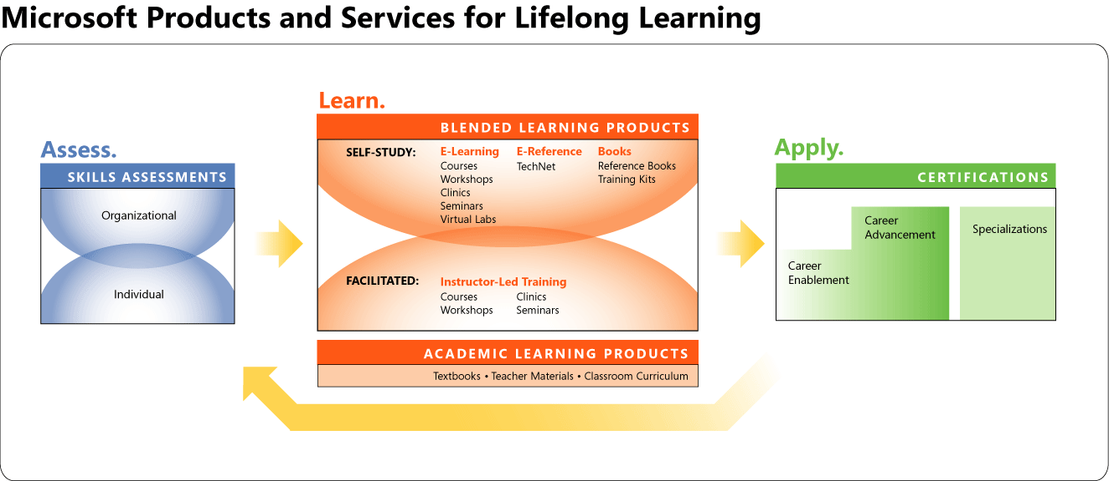
Microsoft Products And Services For Lifelong Learning www.microsoft.com/learning
Microsoft Products and Services for Lifelong Learning
Assessments | http://www.microsoft.com/assessment/
Courses | 2415: Programming with the Microsoft .NET Framework (Microsoft Visual Basic .NET) 2349: Programming with the Microsoft .NET Framework (Microsoft Visual C# .NET)
Books | The Microsoft Platform Ahead, ISBN: 0-7356-2064-4 Network Programming for the Microsoft .NET Framework, ISBN: 0-7356-1959-X Programming Microsoft .NET, ISBN: 0-7356-1376-1 Applied Microsoft Windows .NET Framework Programming, ISBN: 0-7356-1422-9 Applied Microsoft Windows .NET Framework Programming in Microsoft Visual Basic .NET, ISBN: 0-7356-1787-2 Microsoft Windows .NET Framework 1.1 Class Library References Performance Testing Microsoft .NET Web Applications, ISBN: 0-7356-1538-1

