Slide 1


Song lyrics sentiment analysis
Martin L.
David A.
David S.

Slide 2
goal
Determine the correlation between the lyrics sentiment, artists and billboard ranking

Slide 3
The method
Sentimental analysis to popular music
Rank every song in the data set on a sentimental scale
Sad happy
0 4

Slide 4
The Data set
We used a csv file containing ~5000 Songs
Every record of the file contains: billboard ranking, artist name, name of the song, lyrics and year

Slide 5
The algorithm
We processed the data set using language analysis tools which can take raw English language text input (Stanford nlp java libraries)
For each artist and for each record we did a statistical analysis based on our scale
Over this analysis we calculated for each artist the average sentiment and his success on billboard ranking
Main problem – this is a computationally heavy algorithm, for a big dataset it takes a lot of time to process!
Solution – split the dataset to small chunks and reduce.

Slide 6
How it works?
The algorithm uses Deep Learning for Sentiment Analysis
The model builds up a representation of whole sentences based on the sentence structure. It computes the sentiment based on how words compose the meaning of longer phrases. This way, the model is not as easily fooled as previous models (based on word isolation)
The underlying technology of this model is based on a new type of Recursive Neural Network that builds on top of grammatical structures.
A paper can be found here: Recursive Deep Models for Semantic Compositionality Over a Sentiment Treebank

Slide 7
Running the algorithm on sentence less text
In the beginning we ran the algorithm on the lyrics contained in our dataset
Later, we notice that the lyrics were sentence less (with no delimiters)
Our algorithm is based on sentence structure
We tried to see if this fact influences the result and causes errors
In order do evaluate this alleged error we calculated the difference between the result of a sentence less song and the same song with delimiters.
We took a small sample and did this evaluation
We got a very small error (close to 0)
Suggestion why we got this result: The algorithm is based on syntactic structure and works well on long phrases. Example : noun, verb, objective.

Slide 8
Sentiment generator – java API
Record (class) – represents a single record of the csv file.
Contains: rank, song, artist, year, source, lyrics, sentiment
SentimentActions (class) – contains the following Functionality:
void findSentiment () – calculates the sentiment for each record on the file
void parseCsv() – parses a single csv file into a Record ArrayList

Slide 9
Showing the results
Finally, we show the correlation between the sentiment of the lyrics and the ranking of the songs
Our results will be shown on a web page using graphic objects

Slide 14
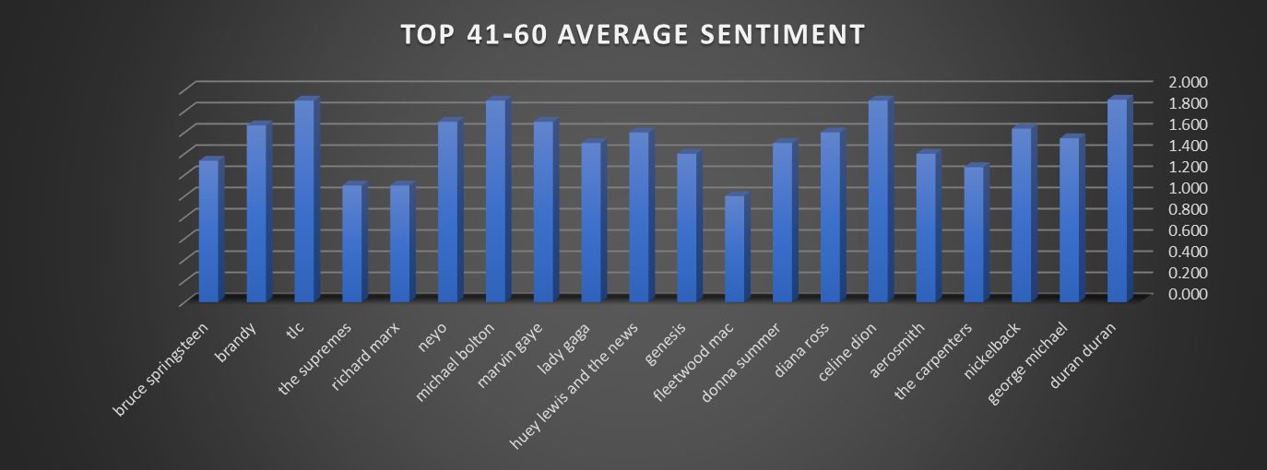
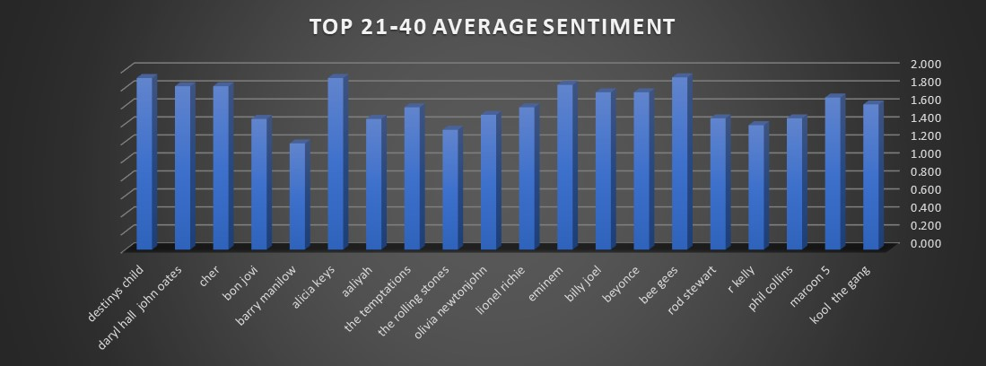

Slide 15
demo
Page URL

Slide 16
Thank you!

